Slide 1
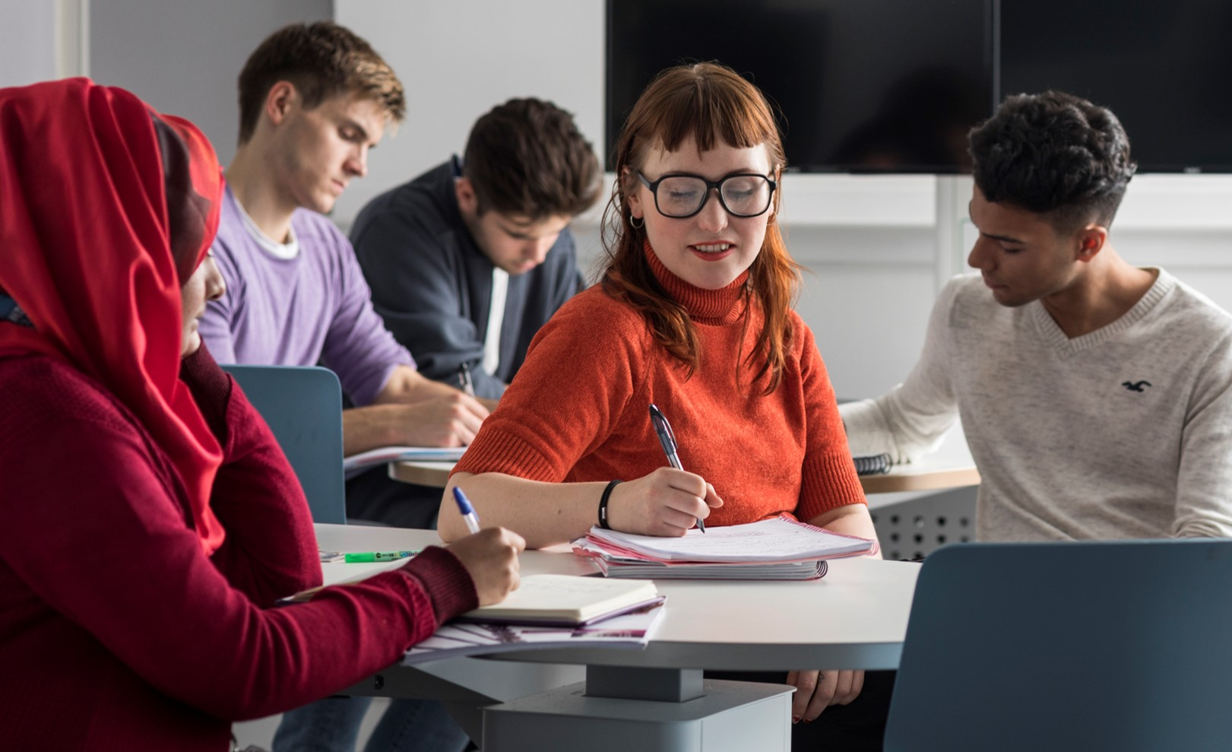

Innovation in Partnerships:
Rethinking the Learning Space
Monica Callaghan and Craig Whittet
Monica.Callaghan@glasgow.ac.uk

Slide 2
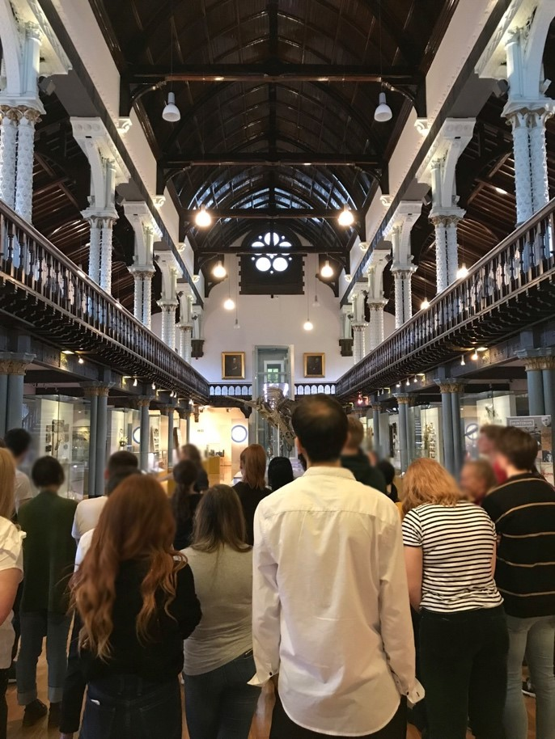
Product Design Engineering and the non-Traditional Classroom
Hunter Gatherer:
Experiential learning beyond the classroom

Slide 3
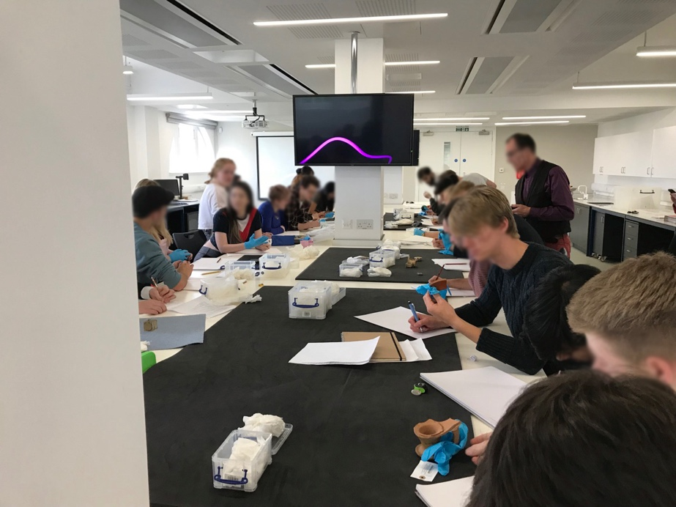
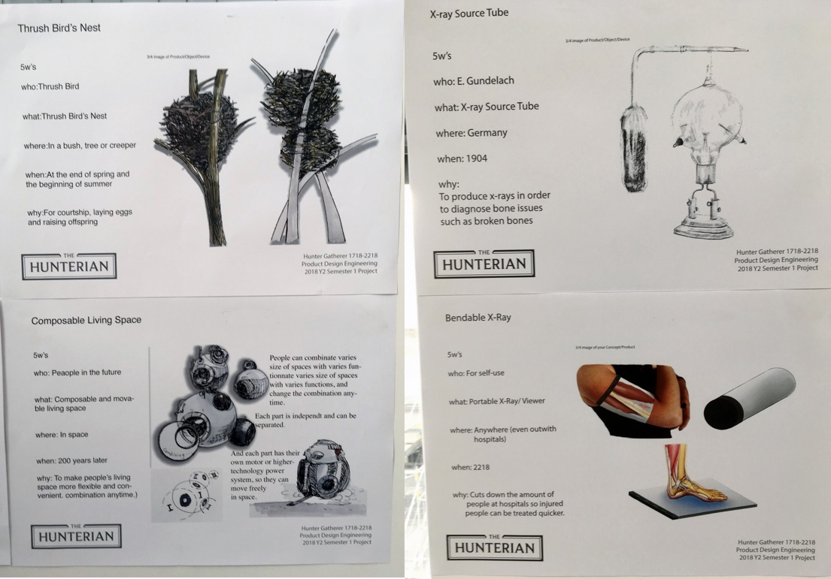
Impact of the Project
Value of the process:
Key transferable learning and the wider benefits

Slide 4
12th Annual University of Glasgow Learning & Teaching Conference
Firstname.Surname@glasgow.ac.uk

