Slide 1


Collaborative problem based learning – in or out of the classroom?
Dr Katherine Price
Dr Michelle Welsh
Katherine.Price@glasgow.ac.uk

Slide 2


PBL:
Outside or Inside the classroom?
A style of active learning, PBL refers to learning opportunities that use real-world issues or problems to increase knowledge and understanding
Student-centred approach to learning subject specific material whilst developing transferable skills.
Traditional PBL involves learning outside the classroom
Interest in “single-shot” PBL in a classroom setting due to timetabling constraints, staff availability
L3 Human Biology students 1 hour workshop, 12 days to set & investigate learning objectives and report their findings back to the class.
L3 Anatomy and Physiology students 2 hour classroom-based workshop
Evaluated student opinions on the learning experience.

Slide 3
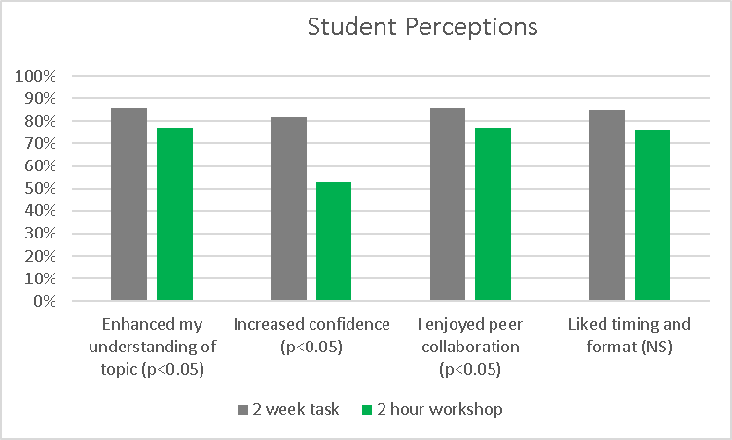
Results
Two week task:
Greater self-reported understanding, confidence % enjoyment.
Benefits to collaborative learning outside the classroom
Statistical analysis: Mann-Whitney U-test
I truly believe my group working and presentation skills are improving
I really enjoyed this session and the time constraints
we had "finished" in an hour
[PBL] has improved my knowledge on many different aspects of Human Biology I may not have considered before
2 hours was too short to prepare and present the information.
Human Biology
Anat / Phys

Slide 4
12th Annual University of Glasgow Learning & Teaching Conference
Katherine.Price@glasgow.ac.uk

