Slide 1
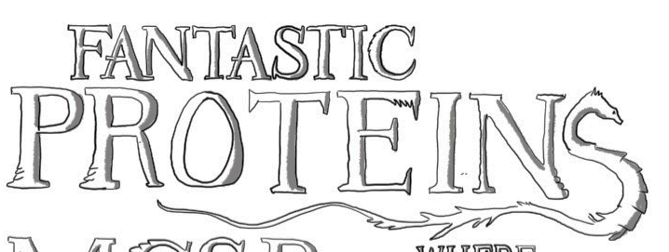
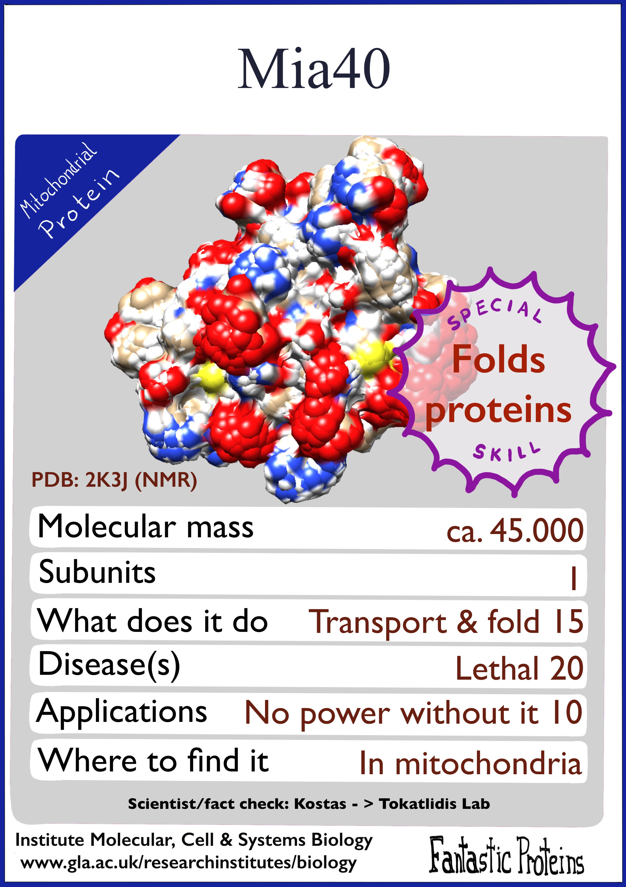
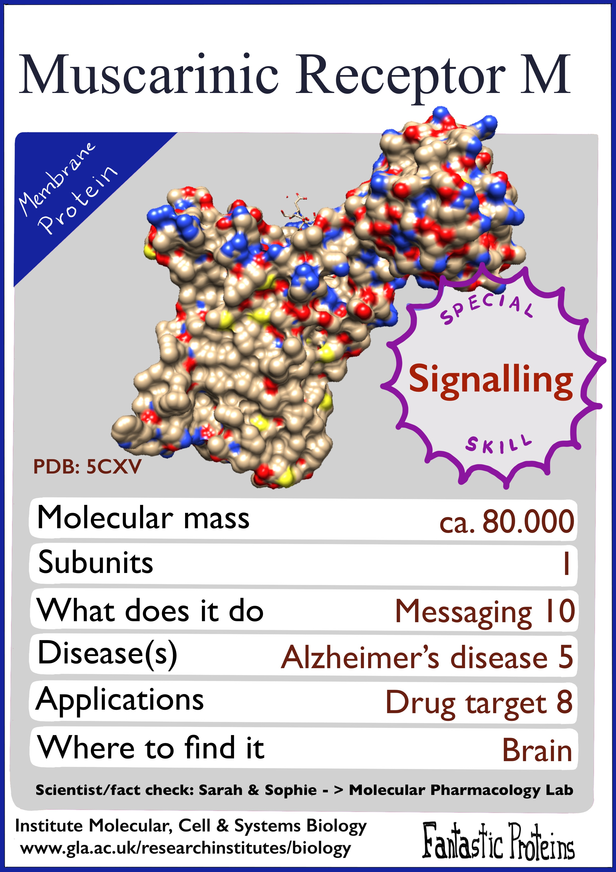
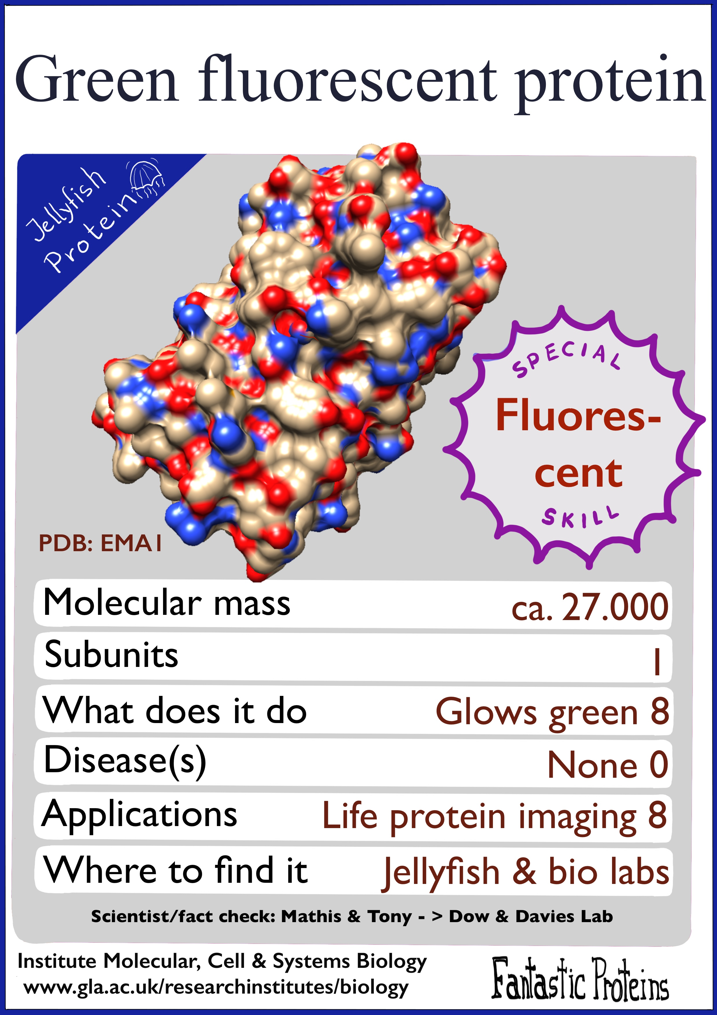
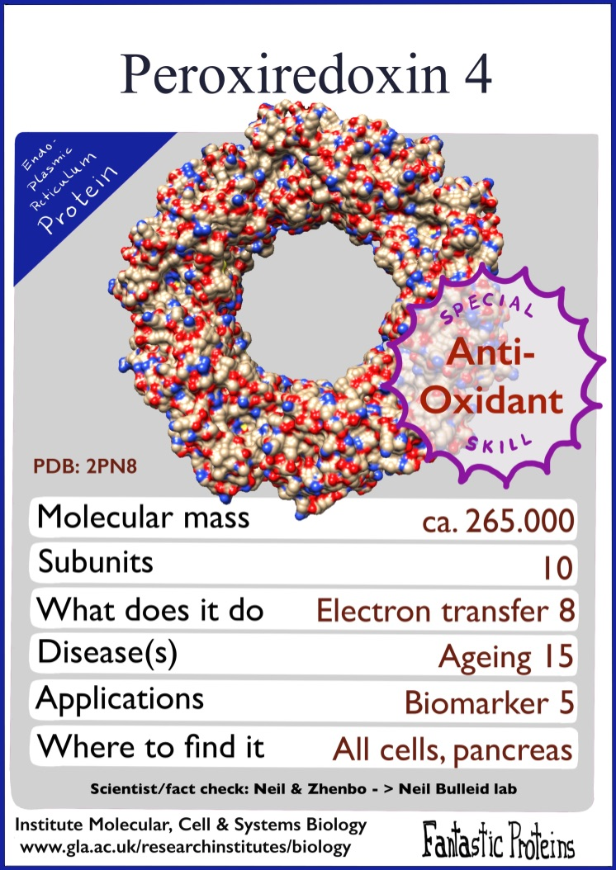
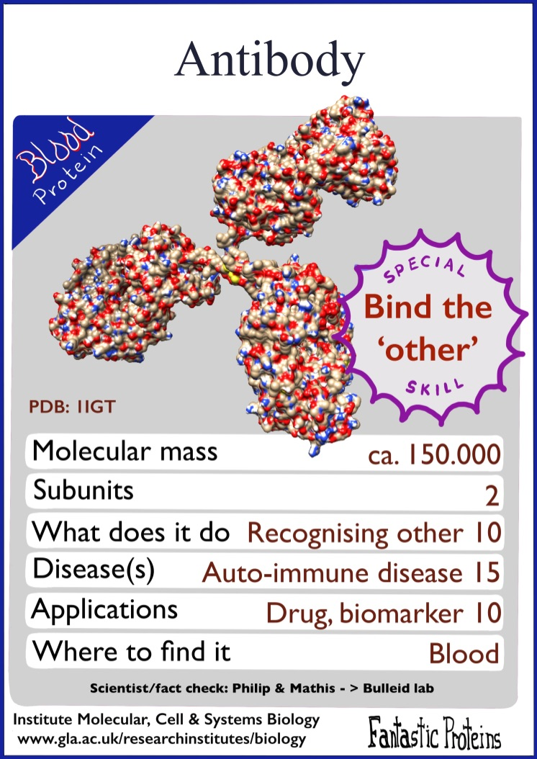
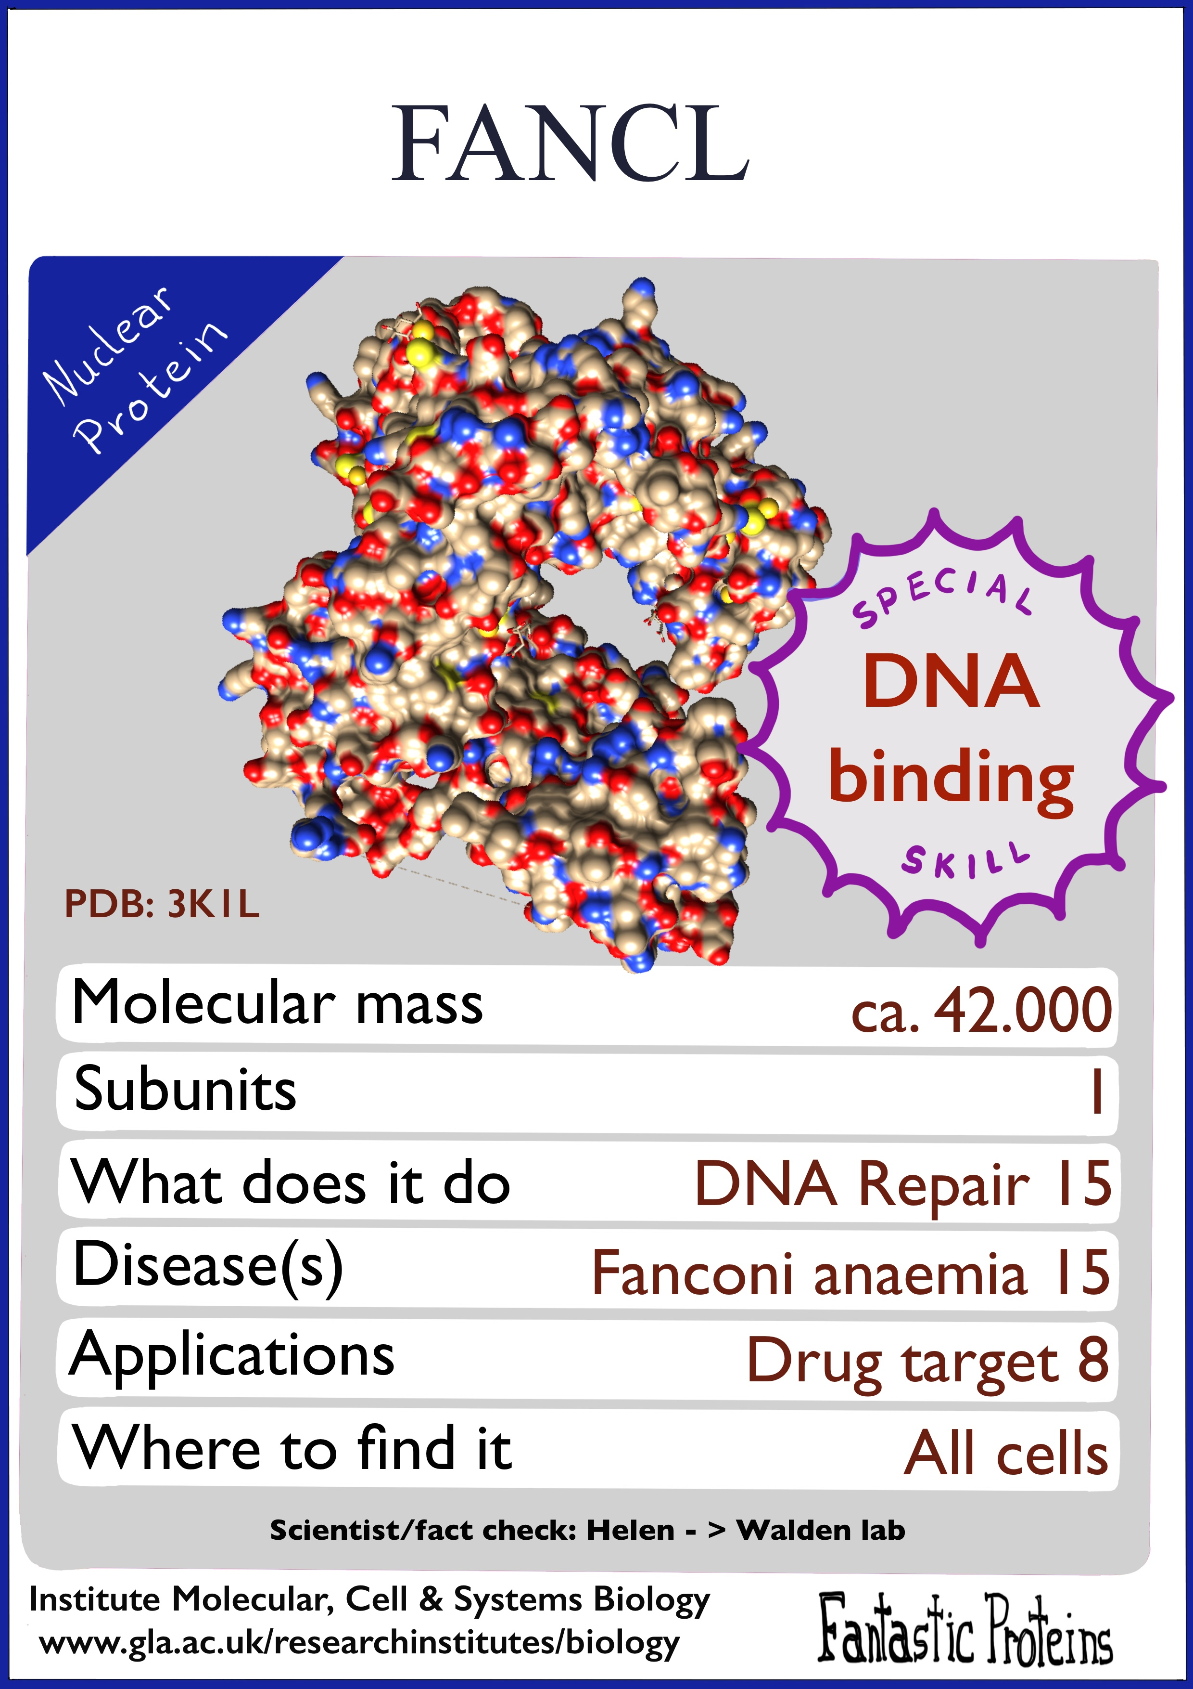
Proteins are molecules found in all organisms, big or small – from viruses to whales.
Proteins are made up of smaller units, amino acids, that are joined together like beads on a string.
Proteins come in different shapes and sizes and have many different functions.
Proteins help to form our organs; they make up our body and allow us to move, see, hear, breathe, digest and make memories.
They are the
molecules of life
that we study
Institute of Molecular Cell & Systems Biology

Slide 2

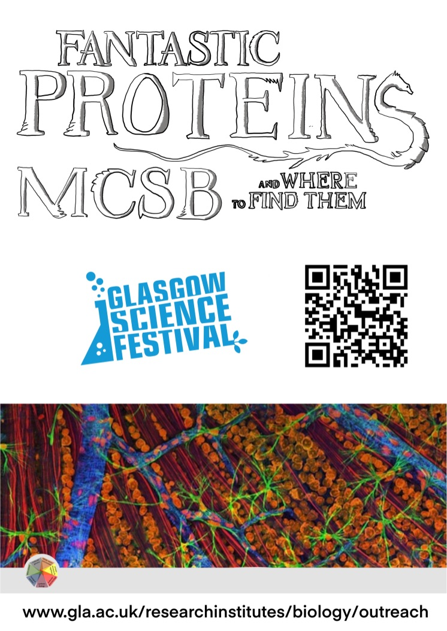
☞
Since proteins are so important and fantastic they are studied by many of our researchers here at the Institute of Molecular, Cell and Systems Biology.
The scientists in our laboratories are trying to find out what many of these fantastic proteins look like and work out what they do!
As they find out more about proteins they are able to study ways to help prevent and fight diseases to keep humans, animals and plants healthy.
Find out more about our scientists and the work they do at our website

Slide 3
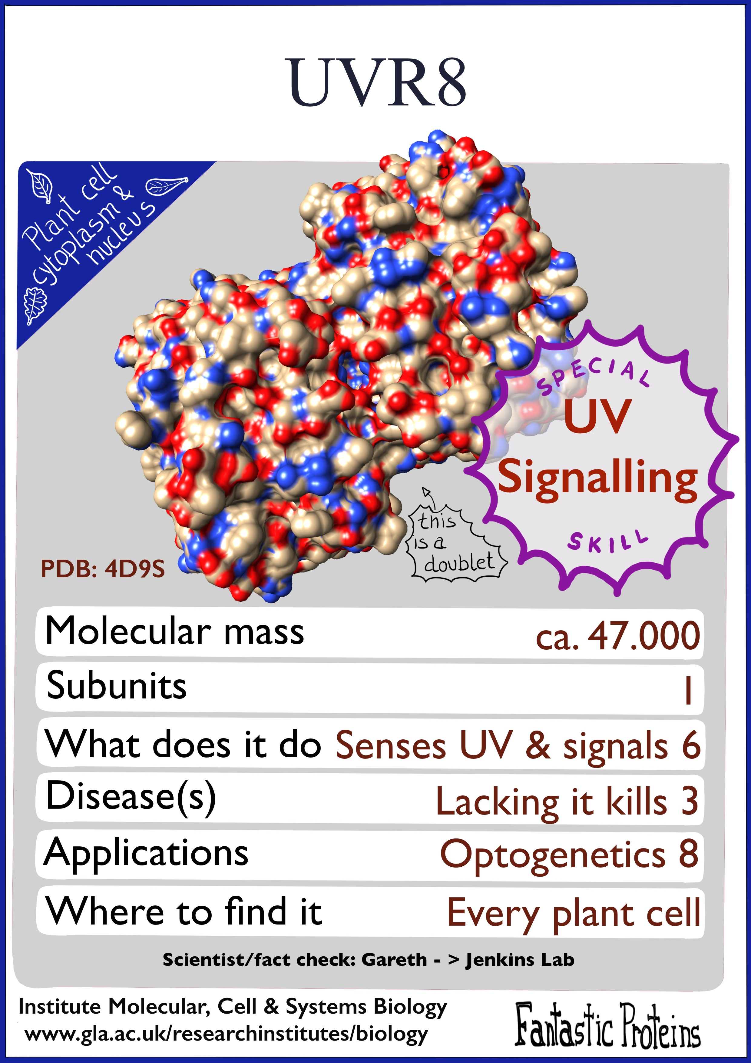
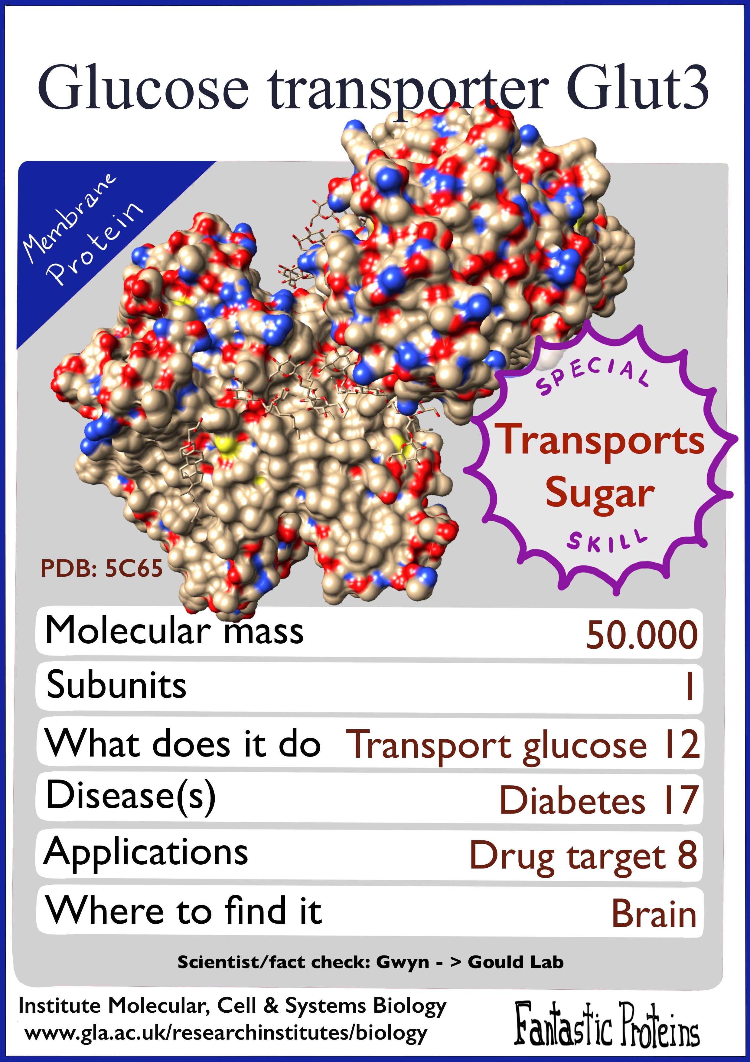
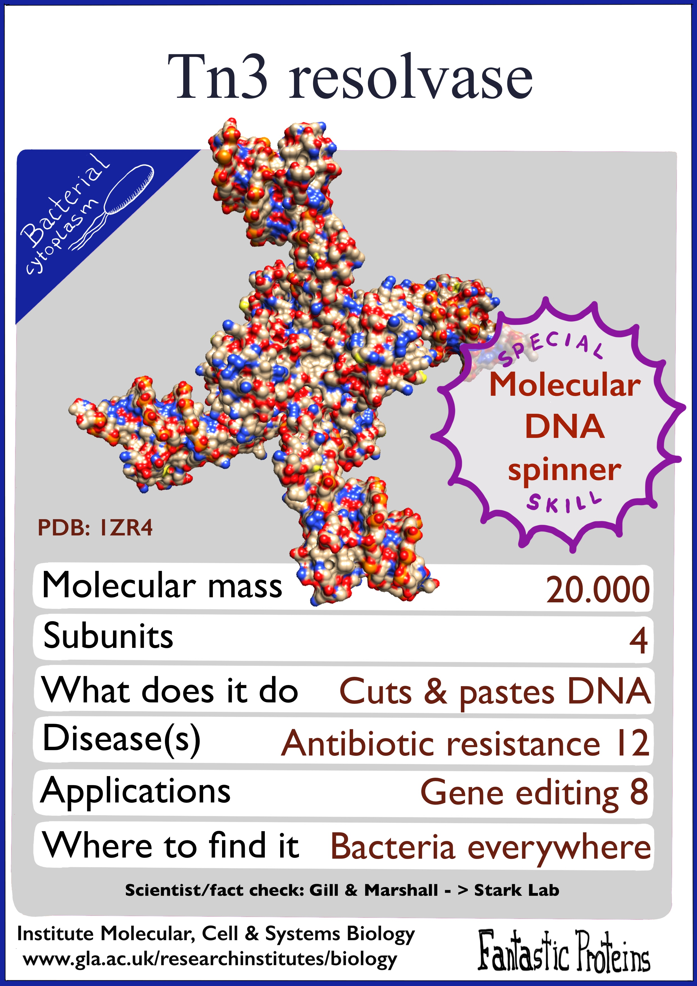
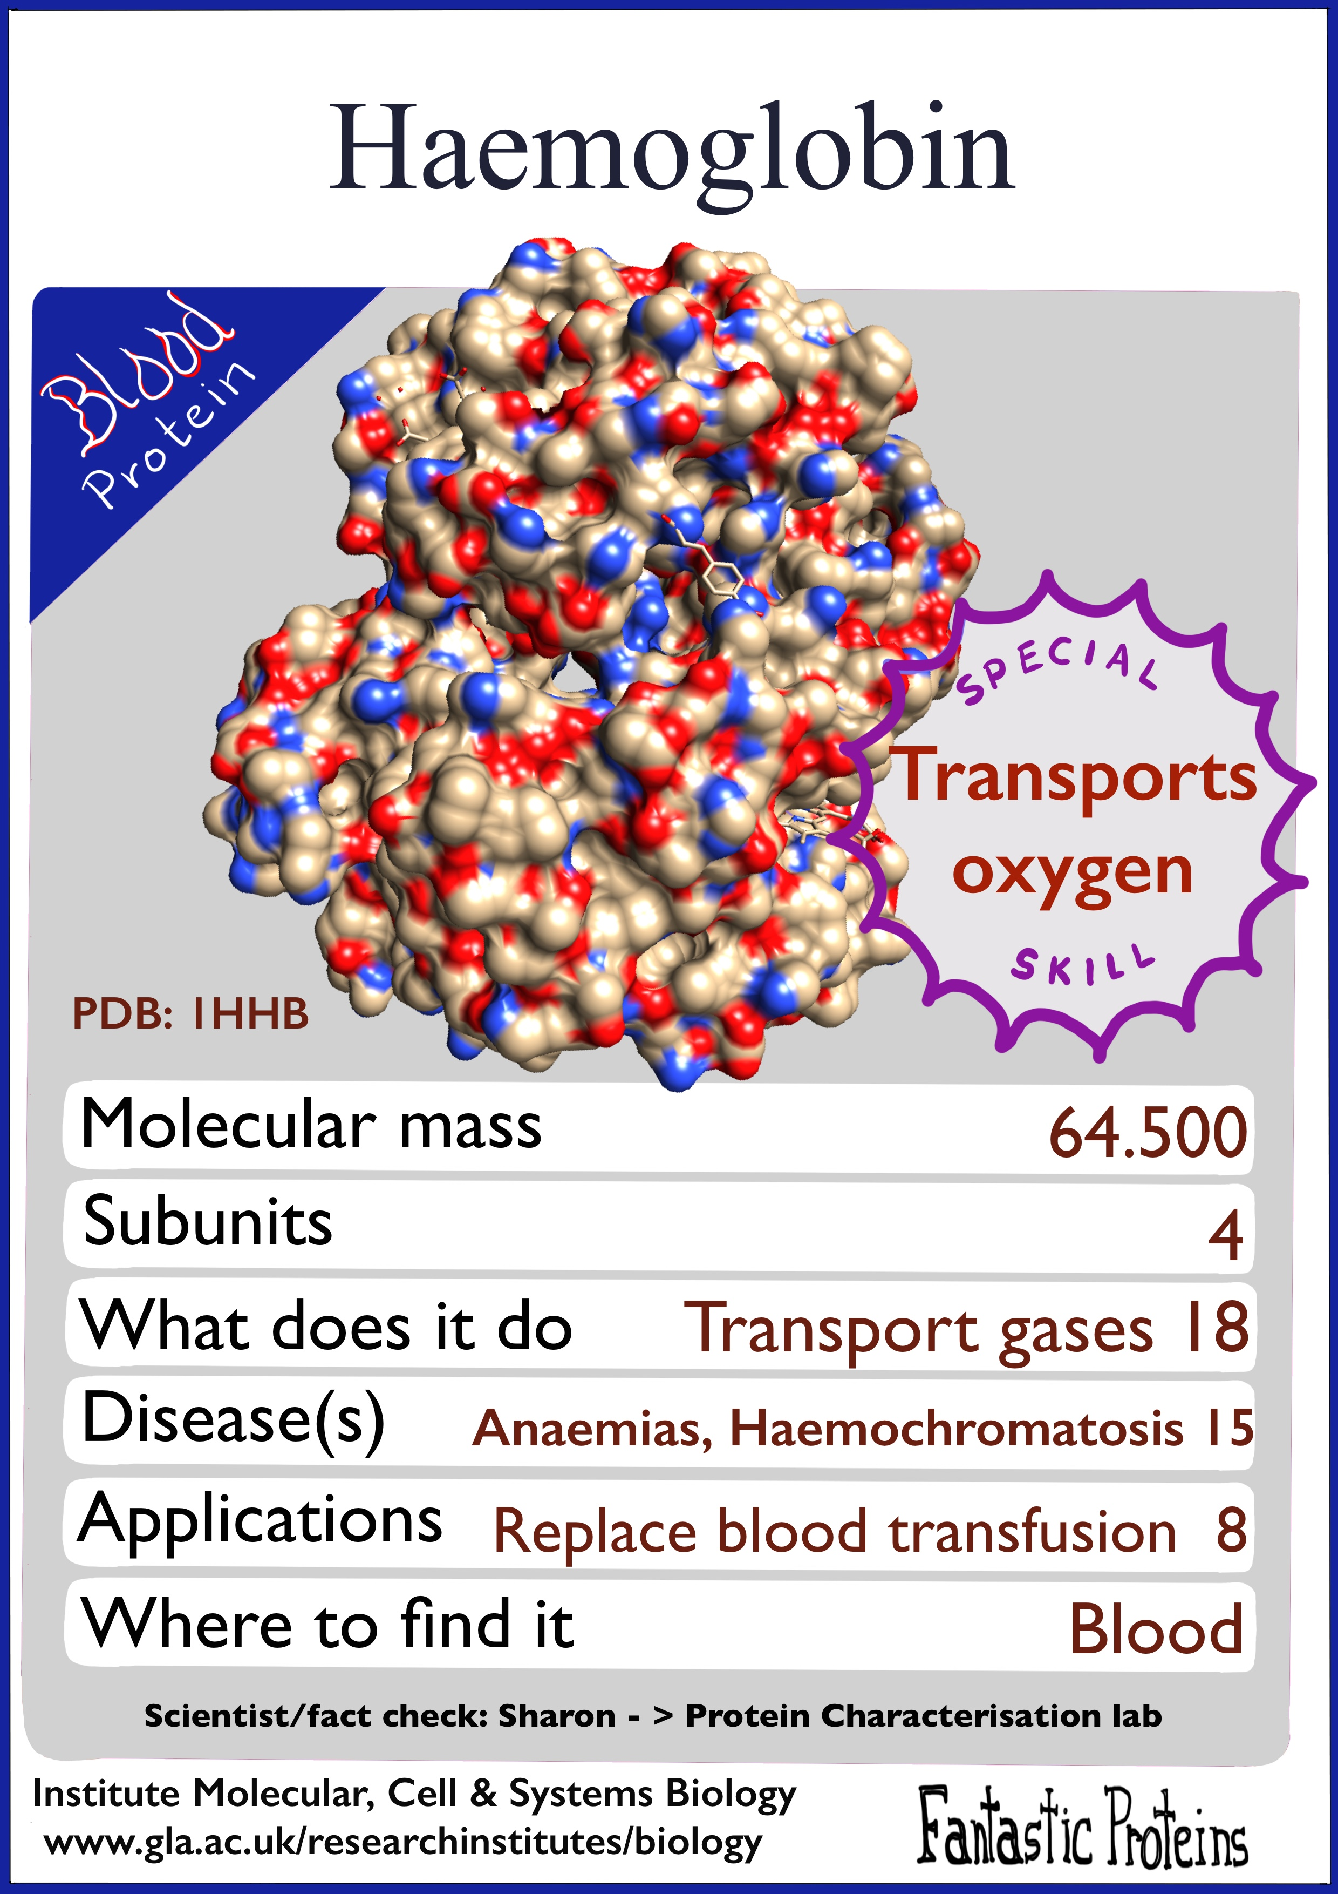
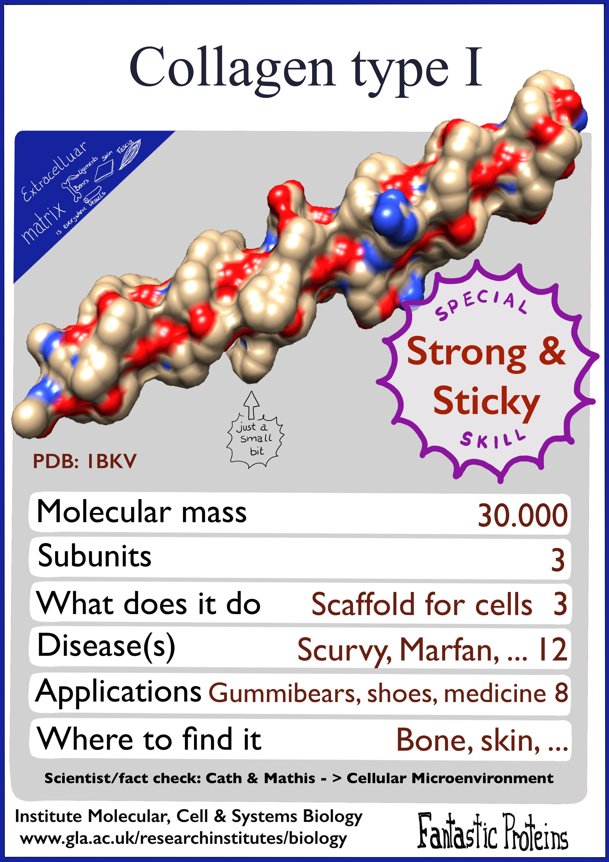
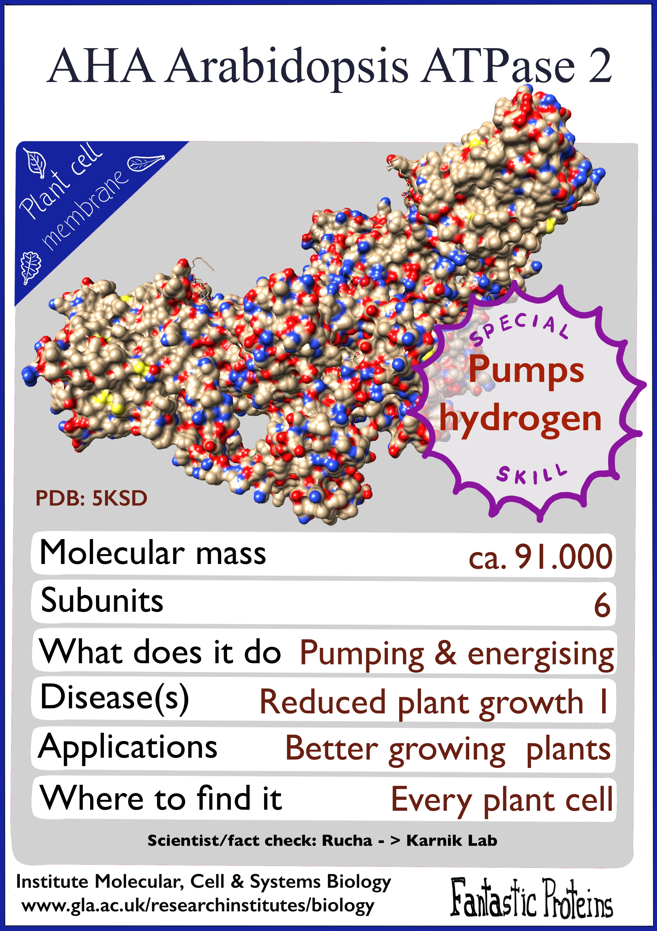
Proteins are molecules found in all organisms, big or small – from viruses to whales.
Proteins are made up of smaller units, amino acids, that are joined together like beads on a string.
Proteins come in different shapes and sizes and have many different functions.
Proteins help to form our organs; they make up our body and allow us to move, see, hear, breathe, digest and make memories.
They are the
molecules of life
that we study…
Institute of Molecular Cell & Systems Biology

Slide 4
☞
Since proteins are so important and fantastic they are studied by many of our researchers here at the Institute of Molecular, Cell and Systems Biology.
The scientists in our laboratories are trying to find out what many of these fantastic proteins look like and work out what they do!
As they find out more about proteins they are able to study ways to help prevent and fight diseases to keep humans, animals and plants healthy.
Find out more about our scientists and the work they do at our website

