Slide 1
Learning & Teaching Seminar Team Based Learning
Iyke Ikegwuonu,
Areti Chavale,
Aiden Gilani,
Sarah Honeychurch

Slide 2
Learning Outcomes
By the end of this session you will be able to:
Describe what Team-Based Learning (TBL) is,
Explain how and why Team-based Learning works,
Discuss the benefits and challenges of team-based learning at programme level,
Describe solutions for overcoming these challenges

Slide 3
Programme
Why TBL?
What is TBL?
Team Formation
Readiness Assurance Process
Application Exercise
Discussion and Q&A

Slide 4

What is TBL?
A special form of active and collaborative learning
Learner-centred flipped strategy, designed to engage students through a process of preparation, assessment and application of knowledge
Shifts the focus of classroom time from conveying course concepts by the instructor to the application of course concepts by student learning teams

Slide 5
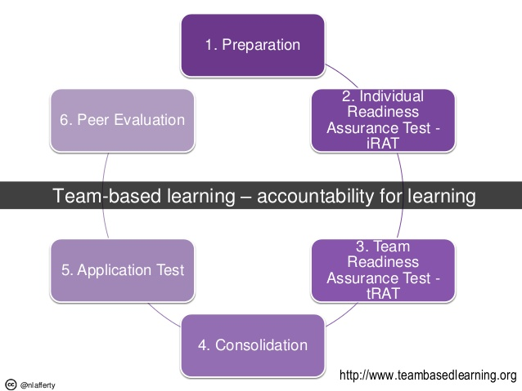
The TBL Cycle

Slide 6
Four Key TBL Design Principles
Teams must be properly formed and managed
  Diverse resources
  Permanent teams formed transparently
Students must be motivated to come to class prepared
Students must learn to use course concepts to solve problems
Students must be truly accountable

Slide 7
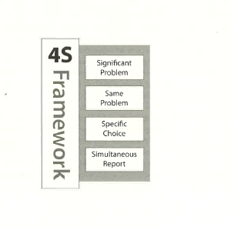
Four Key TBL Design Principles

Slide 8
Readiness Assurance Process
(iRAT and tRAT)
Individual Readiness Assurance Test (iRAT): students answer questions as individuals
Answers are NOT revealed
Team Readiness Assurance Test (tRAT): students answer same questions, but as a group
Then answers are given

Slide 9
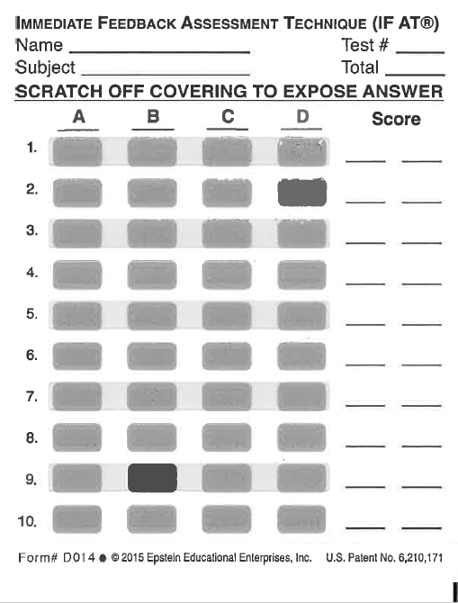
Readiness Assurance Process
(iRAT and tRAT)

Slide 10
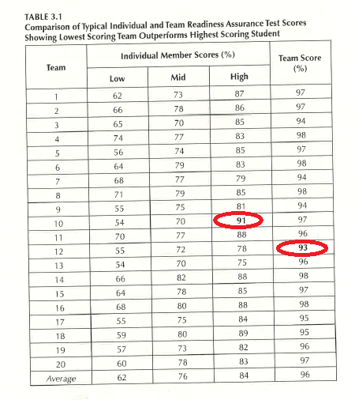

Slide 11
iRAT Question 1
In 2011, Chobani was the number one yogurt brand in the United States. However, by the end of 2012, the company was steadily losing its share of the US yogurt market. What one factor did NOT contribute to Chobani’s momentary down fall?
    Rising competition in the US yogurt market
    Falling demand
    Product quality issues
    Chobani contained only strained Yogurt
    Excess capacity due to large plant

Slide 12
iRAT Question 2
What was the most important strategy used by Ulukaya to make Chobani a successful brand?
  Packaging
  Capacity expansion
  Market segmentation and customer education
  Innovation
  Internationalisation

Slide 13
iRAT Question 3
What does ‘phigital approach to innovation’ imply?
    Consumers sharing experiences of use of Chobani yogurt over social media
    Integrating consumers' physical experiences with their digital or social media use
    Tracking fans pictures on pinterest and Instagram and different uses of yogurt
    Minute noting and observations of fans social media use of yogurt
    Describing customer experience over social media

Slide 14
iRAT Question 4
Looking at Chobani turnaround, what did Ulukaya do differently?
  Customer engagement
  Chobani advertised during the 2014 Super Bowl in the United States
  Marketing and promotion
  Value Innovation
  Chobani significantly expanded its portfolio

Slide 15
iRAT Question 5
What traits of a successful entrepreneur did Ulukaja implement?
  Ulukaya implemented innovation more quickly
  Ulukaya identified a gap in the market
  Ulukaya not only focused on consumers but also on the entire gamut of stakeholders
  A + C only
  All of the above

Slide 16
tRAT Question 1
In 2011, Chobani was the number one yogurt brand in the United States. However, by the end of 2012, the company was steadily losing its share of the US yogurt market. What one factor did NOT contribute to Chobani’s momentary down fall?
    Rising competition in the US yogurt market
    Falling demand
    Product quality issues
    Chobani contained only strained Yogurt
    Excess capacity due to large plant

Slide 17
tRAT Question 2
What was the most important strategy used by Ulukaya to make Chobani a successful brand?
  Packaging
  Capacity expansion
  Market segmentation and customer education
  Innovation
  Internationalisation

Slide 18
tRAT Question 3
What does ‘phigital approach to innovation’ imply?
    Consumers sharing experiences of use of Chobani yogurt over social media
    Integrating consumers' physical experiences with their digital or social media use
    Tracking fans pictures on pinterest and Instagram and different uses of yogurt
    Minute noting and observations of fans social media use of yogurt
    Describing customer experience over social media

Slide 19
tRAT Question 4
Looking at Chobani turnaround, what did Ulukaya do differently?
  Customer engagement
  Chobani advertised during the 2014 Super Bowl in the United States
  Marketing and promotion
  Value Innovation
  Chobani significantly expanded its portfolio

Slide 20
tRAT Question 5
What traits of a successful entrepreneur did Ulukaja implement?
  Ulukaya implemented innovation more quickly
  Ulukaya identified a gap in the market
  Ulukaya not only focused on consumers but also on the entire gamut of stakeholders
  A + C only
  All of the above

Slide 21
Application Exercise
In this section students will work in teams to solve problems and provide collective answers from a specific set of answers.
The Ansoff Matrix (AM) explains the four alternative options available to a firm for growth based on a combination of product or market expansion. As a group of marketing consultants:
Arrange in order of priority A-D: how, in your view, Chobani should adopt the AM options?
Agree in your group, which strategic option should come first.
Explain why your preferred option is the best alternative.
Use the flipchart provided to present your work.
Declare your priority

Slide 22
Declare and Feedback
Which option did you choose and why?

Slide 23
Discussion and Q&A
How did you find the elements of TBL?
How might you adopt it for use in your class?
What tools might you need?
What support might you need?

Slide 24
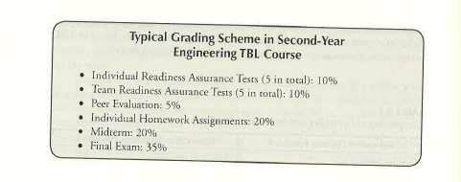
Peer evaluation

