Slide 1

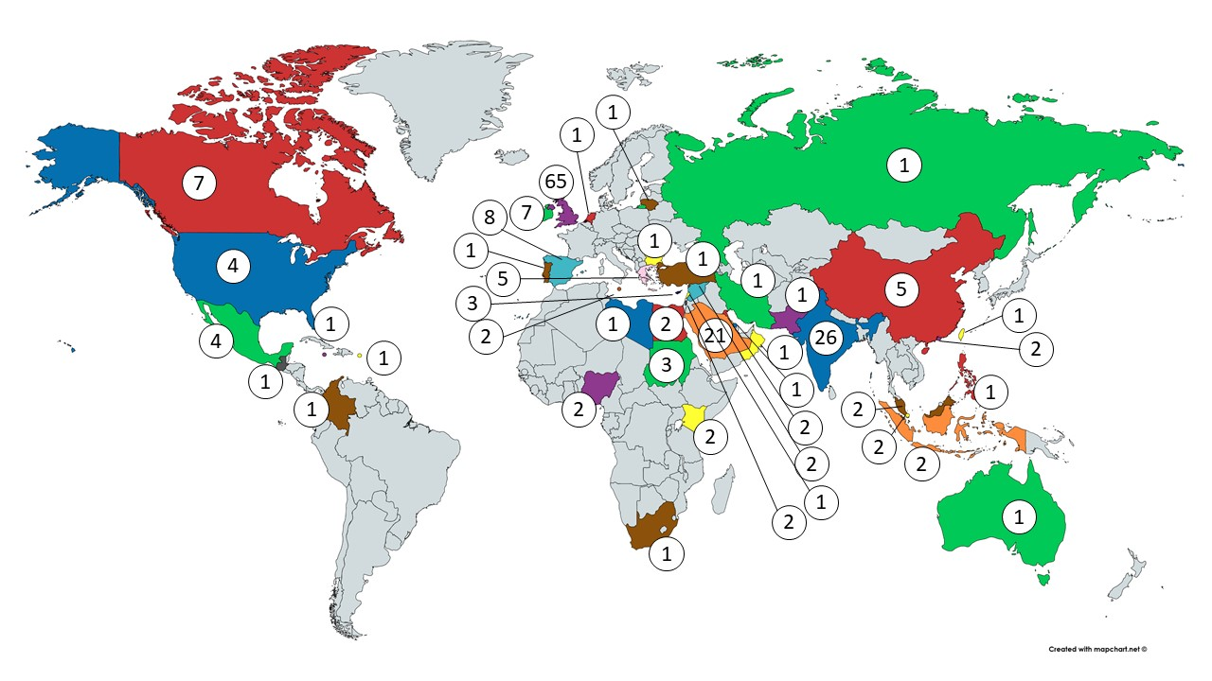
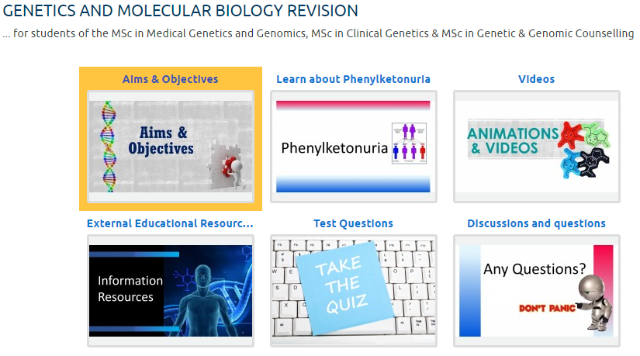
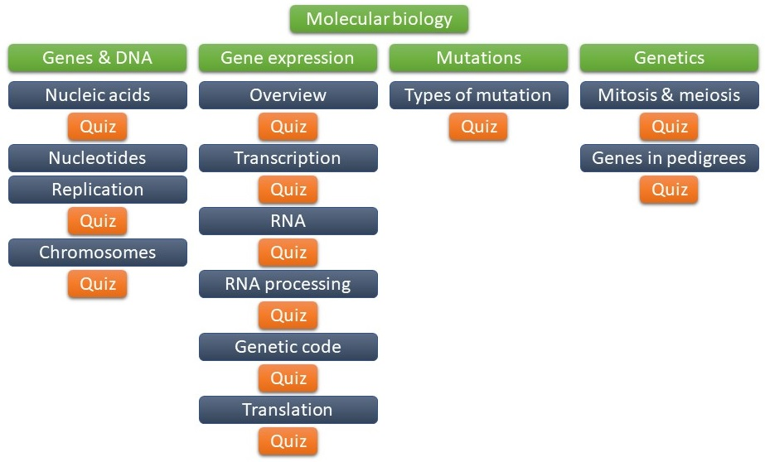
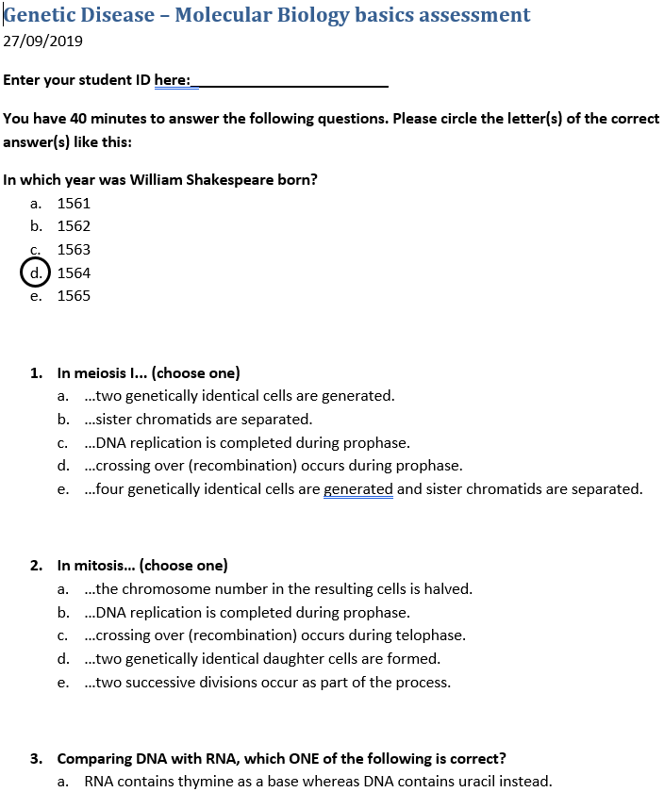
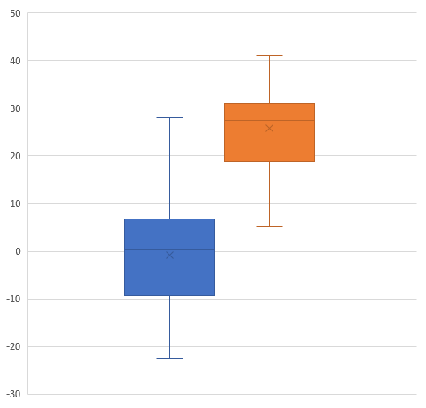
‘Levelling up’ – a pre-master’s revision course
Gerhard H.W. May, School of Medicine, Dentistry and Nursing
Countries of origin
… of MSc Medical Genetics and Genomics students since 2015
Background
Our solution
The MSc in Medical Genetics and Genomics and sister programmes attract a diverse cohort of students including not only home and EU, but also a significant number of international students. These students arrive in Glasgow with variable, often unpredictable, background knowledge in basic molecular biology. Consequently, in previous years some of our students struggled with more advanced molecular concepts. This frequently only became clear after the first assignments of the class were graded. However, at that point it was often too late to intervene. Therefore, we believe that some students didn’t reach the potential they could have with a better foundation.
A revision Moodle course consisting of one Moodle lesson, videos and quizzes
A basic molecular biology test
Additional tutorials as required
Timeline
4 weeks before semester starts
Week 1
Week 2
Week 3
Week 4
Revision Moodle is made available to all registered students
Students are informed about the process
Results of test are published
Selected students are invited to additional tutorials
Test of basic molecular biology knowledge
Students in orange were invited to additional tutorials
Moodle content
Test example
Student results
Does attending tutorials help?
Questionnaire – results
Students’ views
Students were given a questionnaire after the last optional tutorial. Of those responding, 100 % had accessed the revision Moodle.
Of those:
Tutorials, in my opinion, could be longer.
Very informative and useful. Definitely needed it.
It was good at helping refresh ideas from my degree and remind me of the basics.
Difference between test score and final MSc result [%]
Worked through the whole lesson | 78%
Liked the lesson | 74%
Thought lesson was at the right level | 65%
Heard it all before | 9%
Learned something new | 52%
Lesson was a reminder | 74%
Good mix of different media involving text, images and videos. Sets out a baseline as with regards what kind of knowledge the student is expected to know. Allows for self-assessment by quizzes.
I like that the tutorials have a smaller number of student attending which helps me interact more and ask more questions.
Helps brush up the basic concepts in an engaging way.
Did not attend additional tutorials (n = 49)
Attended additional tutorials (n = 13)
It was good for me to revise things I learned in undergrad before I start my postgrad.
I found it just fine. Not much to improve there.
Students who attended revision tutorials at the beginning of the programme appear to have improved more, when comparing their initial test result with their final MSc result.

