Slide 1
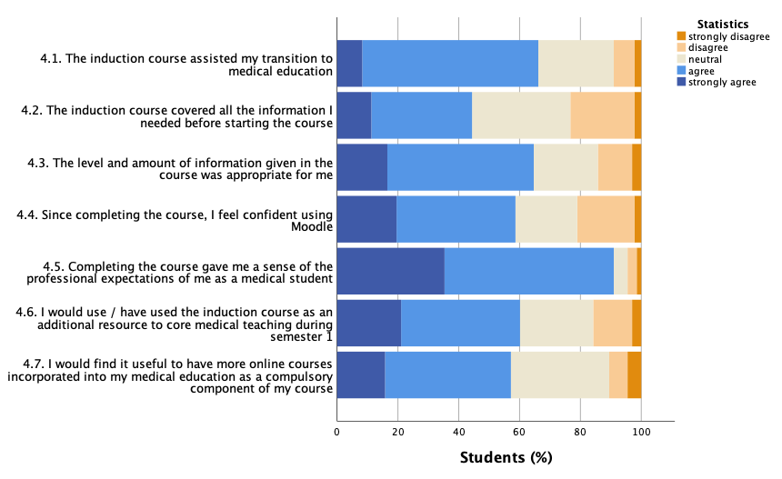
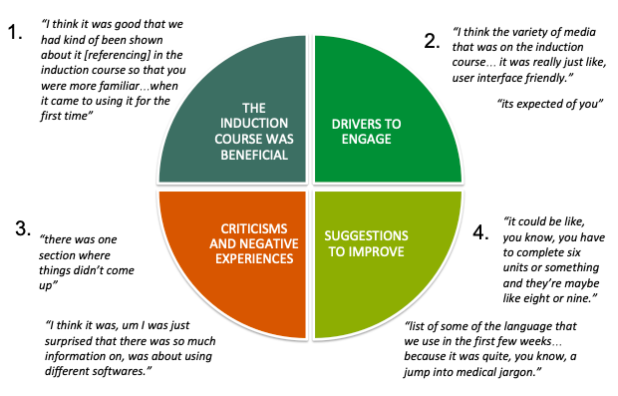
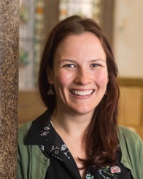
Bridging the gap: implementation of an online induction course for first year medical students
Background
Student transition into medical school is traditionally supported by dry, didactic lectures. This year content was delivered instead via an online induction course. The course was available to all incoming MBChB medical students prior to their arrival at Glasgow and included units on digital skills as well as medicine-specific topics such as professionalism.
1. Online questionnaire
Student responses to the online induction course were overwhelmingly positive. Students most valued content related to professional values and behaviours (GMC, 2020).
2. Focus group
Student perceptions of the online induction course were explored in-depth by focus group with two year 1 MBChB students. Key themes were identified by inductive thematic analysis (Braun & Clark, 2006).
Take home messages
The online induction course helped students understand institutional expectations and their digital skills needs.
Online formats will be the primary format by which we induct our students for the upcoming academic year in response to the COVID-19 pandemic (Nordman et al., 2020).
Dr Kirsty McIntyre Lecturer School of Medicine kirsty.mcintyre@glasgow.ac.uk twitter: @_kirstymcintyre

