Slide 1


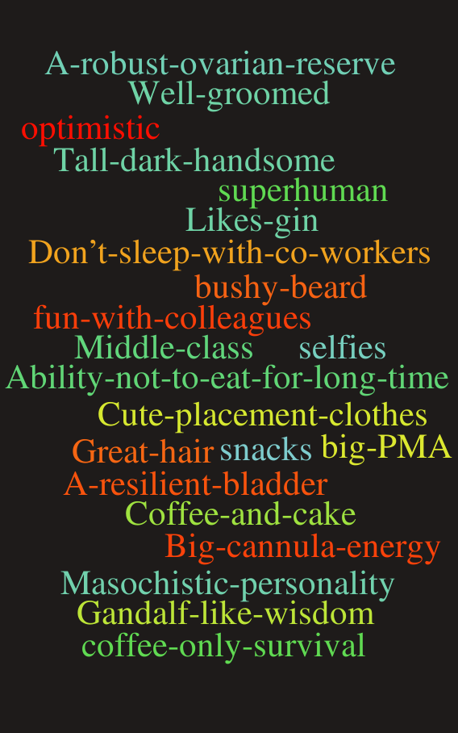
Truth told in Jest?
Truth Told in Jest?
Professional Value Confessions at the end of a Medical Curriculum confessions at the end of a
Dr Iain Grom, Dr Lynsay Crawford and Professor Lindsey Pope, School of Medicine, University of Glasgow, UK
“What makes a good doctor ?”
Working in small groups, 1st year medical students are asked this question, prompting them to generate a list of attributes to be used in future teaching sessions.
In 2019, we posed the same question to our final year students enabling comparison with the cohort’s collated responses 5 years earlier.
Our final year students described some unexpected “professional” values.
Dr Iain Grom, School of Medicine, University of Glasgow, UK
Dr Iain Grom, School of Medicine, Uni, UK
What was done
A list of student-generated beliefs was retrieved from students in their 1st year
A list was compiled from the same cohort in their final year of study (5th year)
The lists were compared and responses mapped against attributes in key professionalism documents (1,2)
Changes in patterns of beliefs, as well as comparison with the guidance, were noted Project).
Discussion
A more comprehensive list of professional values was expected from final year students as a reflection of their learning and experience
The study revealed a number of surprising attributes not found in key professionalism documents.
These findings may reflect an element of stress experienced by the students in their transition to the workplace (3).
The anonymous nature of the survey may have allowed expression of feelings, and attitudes, not normally disclosed.
Was this a one-off finding or is it an expression of underlying stresses?
Conclusions
.
.
.
Though Final Year medical students identified a wide range of professional values, they also expressed some ‘unconventional’ values.
The expression of these values may represent underlying stresses they feel during their transition to junior doctors or reflect the impact of the ‘informal’ or hidden curriculum
Further study of these findings is merited.
.
.
Outcomes
565566 (5-26/community) needs were identified
63 (9-33/community) strategies were proposed
Concordance with 31 of the original professional values
17 values did not survive to final year
The study revealed a number of surprising new attributes (see Figure 1)
References
1 GMC Good-medical-practice[Accessed Feb28 2019]
2 RCP London 2018 https://www.rcplondon.ac.uk/projects/outputs/advancing-medical-professionalism [Accessed Feb28 2019]
3 MockzoTR, Bugai TJ, Herzog W, Nikendei C Perceived stress at transition to workplace: a qualitative interview study exploring final-year medical students’ needs. Advancing Medical Education and Practice 2016:7 15-27
Figure 1: Final Year Unexpected Professional Values
Contact detail: iain.grom@glasgow.ac.uk
Wordclouds- WorditOut
Notes:
1

