Slide 1
Ice Age: A geomorphic scavenger hunt
Dr Hannah mathers – lecturer in geography & earth Science, university of glasgow

Slide 2
Structure of the session
Intro - Hello from me!
Brief review of the workshop – answers and what they mean.
My start in Geoscience & If I could have my uni. time again….
Q&A – ask anything, anytime (Chat or Slido functions)

Slide 3
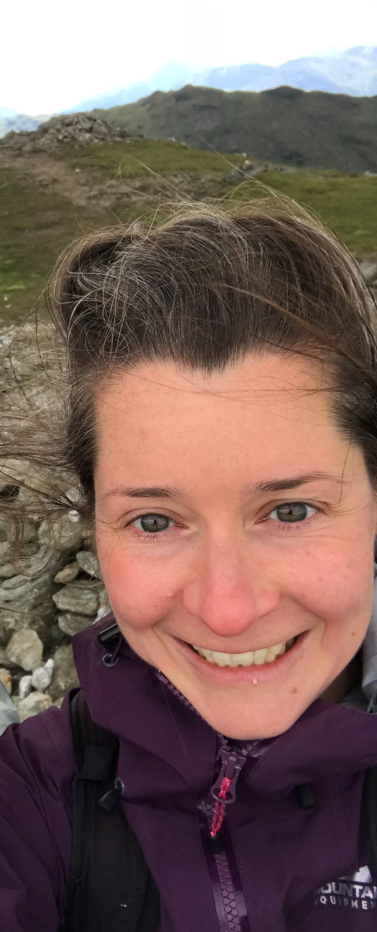
me in geoscience: DR Hannah mathers (she/her)
Job Title: Lecturer in Geography & Earth Science.
Employer: University of Glasgow.
My students: Earth Science & Geography 1st year to 4th year.
Work interests: Glacial geomorphology, inclusive learning.
What I like about my job:
Working with learners – doing something meaningful;
Being creative;
Time in the natural environment;
Flexibility;
Variety and diversity in people and tasks.

Slide 4
outside geoscience: Hannah mathers (she/her)
Live: Glasgow
Outside work: Being a mum
Hobbies:
Cooking & Eating
Walking
Birdwatching
Yoga
Cinema & arts
Geocaching

Slide 5
The scavenger hunt workshop
Part 1: Landscape reading – spotting and analyzing landform patterns.
Part 3: Scavenger Hunt - independent work to investigate three geoscience problems.
Part 2: Tools & Resources – video tutorials to introduce you to the geoscience interfaces.
You can now find the ‘answers’ as a document on the ivent site.
There is a separate data sheet to complete with this workshop.
You can find extra resources, including a photo glossary at the end of the presentation.

Slide 6
tools & resources – any questions or comments?
Data Interfaces:
Digimap
BRITICE Glacial Map 2
Google Earth (Web version)
Geology of Britain viewer
Visible Geology

Slide 7
Part 3: scavenger hunt: exercise 1: graveyards questions or comments?
Why are most of the graveyards on the west coast of Scotland, right by the beach?
You investigated how humans interact with geology using the example of graveyards in the West of Scotland.
Most graveyards are situated on blown sand or glacial sediments (glaciofluvial, till, morainic materials).
For these communities they were often the only soft locations to dig!
Scourie Cemetery
Photo: Chris Wimbush

Slide 8
Part 3: scavenger hunt: Exercise 2: Allt nan Uamh: The disappearing river.
What’s weird here? Rivers that disappear and reappear.
You are going to investigate why the Allt nan Uamh disappears.
Stream sink, Malham, Yorkshire.
Photo: Steve Warren.

Slide 9
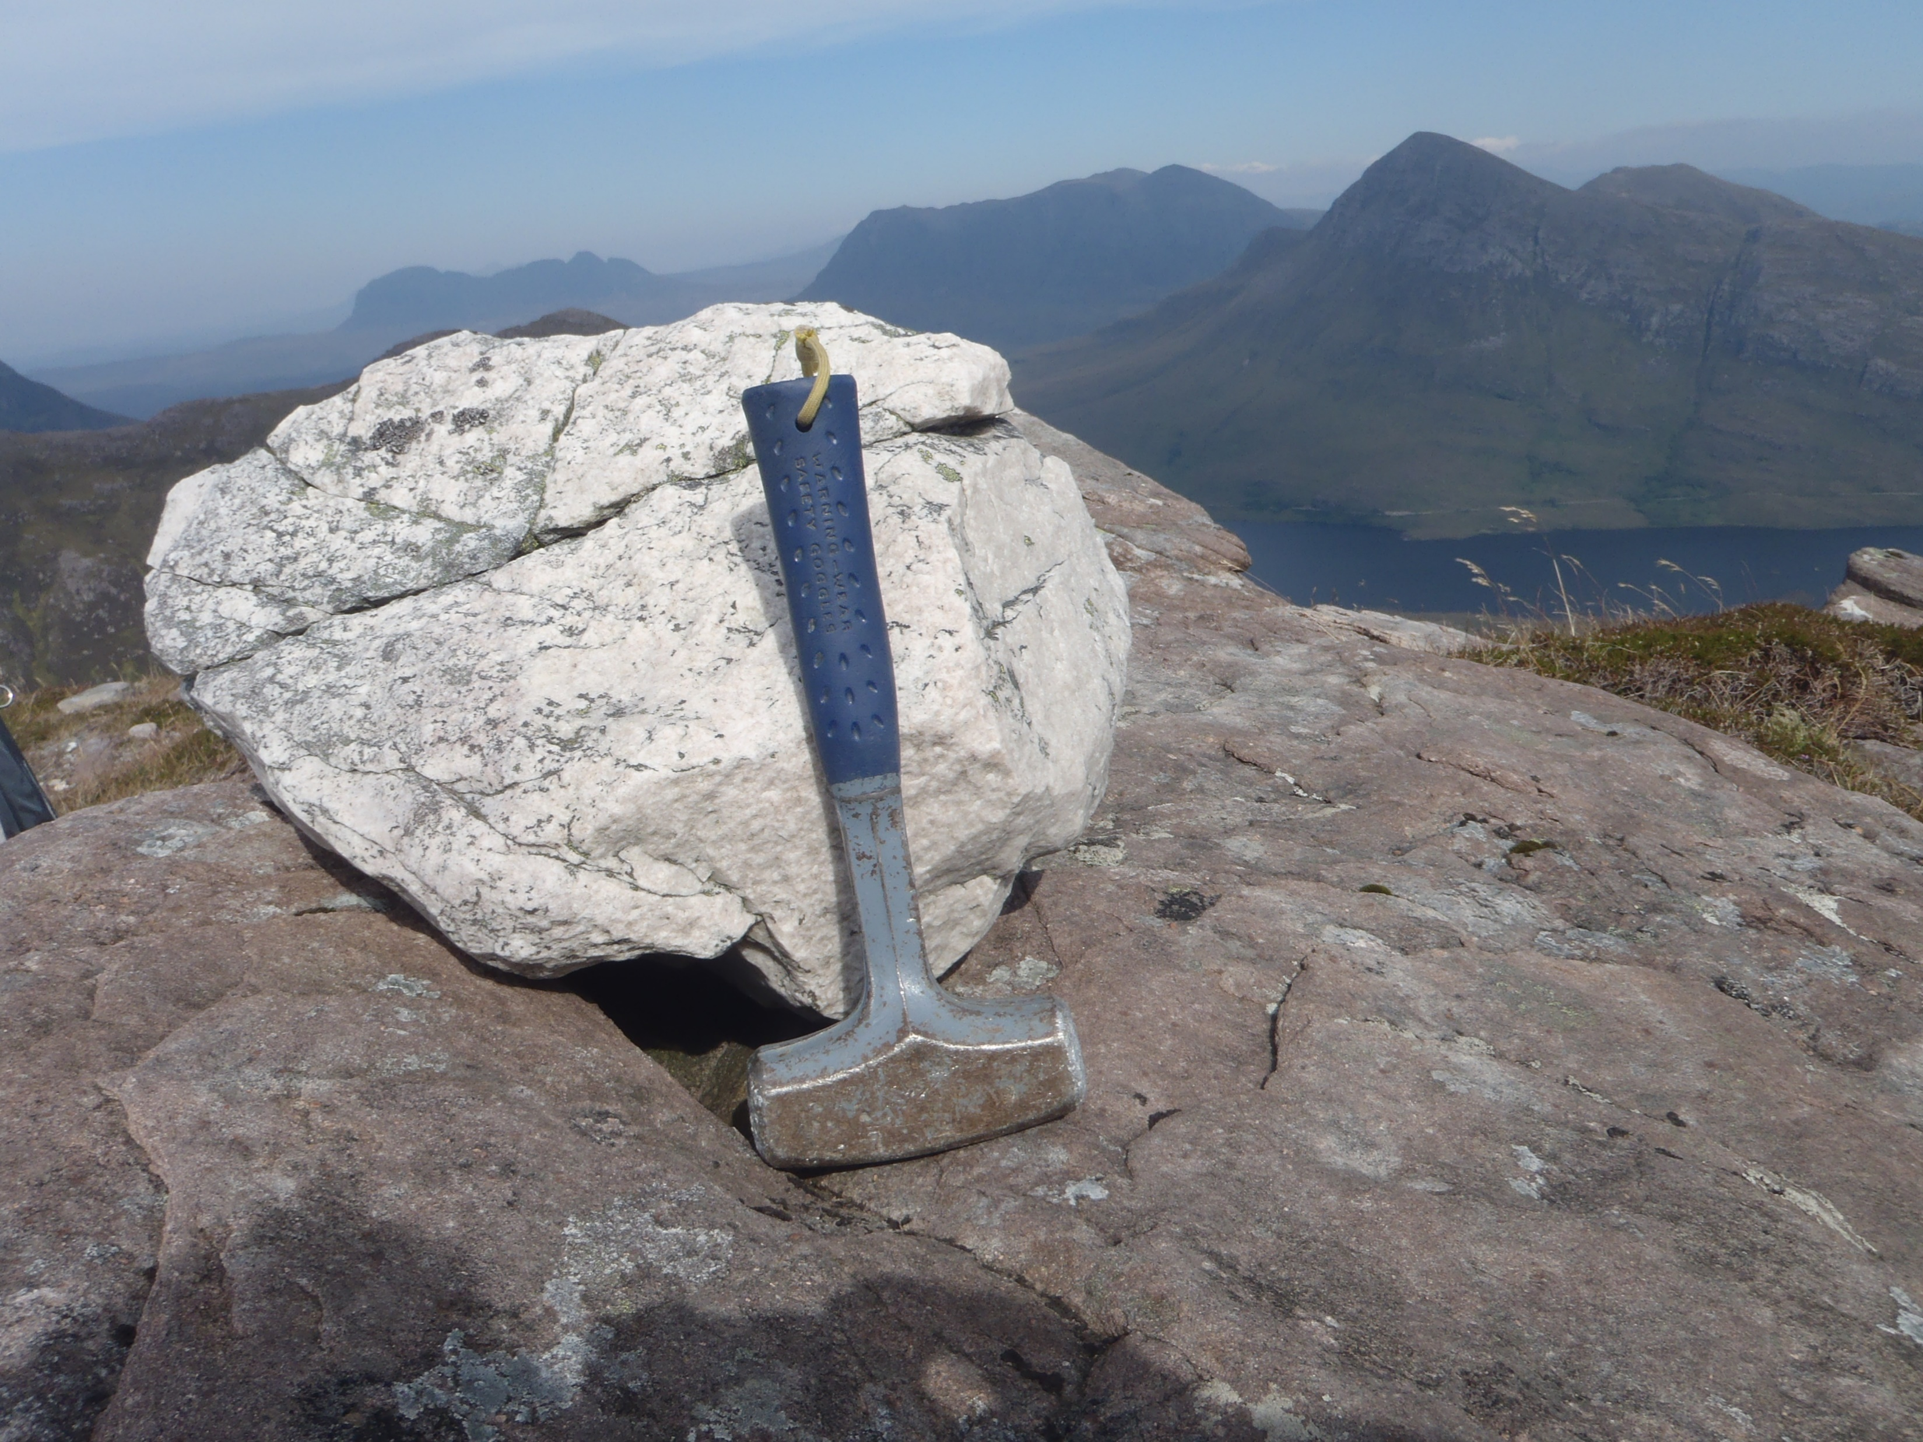
Part 3: scavenger hunt Exercise 3: erratics
What’s weird here? Rocks that are out of place – erratic boulders moved by ice flow.
Your job is to identify erratic lithologies, their bedrock pairs and to identify the ice flow direction they inform on.
Glacially transported erratic boulder perched on bedrock – where did it come and therefore which way did the ice flow?

Slide 10
erratics
Ice thickness
Ice flow
Ice streams
Ice processes

Slide 11
My start in geoscience
School: Northumberland, NE England
A levels: Geography, Biology, English Literature
Gap year: Bookshop, National Park, USA trip
Degree: Geology & Physical Geography
Postgraduate degree: MSc Quaternary Science
Gap year: Worked in pub, did lots of running, volunteered on footpath work for National Trust
Research: PhD on glacial history of NW Scotland

Slide 12
My degree: geology & physical geography @ Edinburgh (2000-2004)
Cons
Traditional way of teaching didn’t work with how I learn.
Course structure wasn’t very flexible.
Big chunks of the course were things I wasn’t interested in.
Didn’t get enough time/content on things I was interested in e.g. glaciers.
Lack of cohort responsibility/identity from staff.
Pros
Lots of field classes in Scotland and Europe (I like fieldwork).
Good range of subjects – grounding across geology and physical geography.
In Scotland – good walking, quiet, different from home.
Close but not too close to home.
I met lifelong friends.

Slide 13
if I could have my universitytime again…
Try to overcome my shyness and anxieties by:
Being braver about my choice of location – think about your interests and what you want to experience inside and outside of your degree.
Joining lots of societies and clubs – it’s a cheap and friendly way of finding a community and support to do the things you are interested in.
Applying for a year abroad – such an amazing opportunity – I see the great benefits in confidence and enthusiasm that it generates in my students.

Slide 14
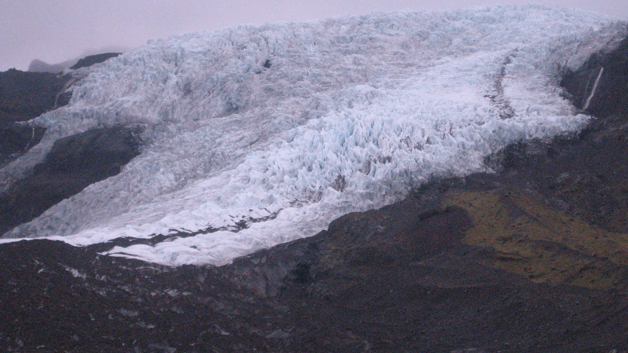
Great to see you!
Thanks for getting involved!
Get in touch: Hannah.Mathers@glasgow.ac.uk
KEEP ENGAGING!
STAY CURIOUS ☺

