Slide 1

Driving & Releasing Change
Template: Root cause analysis

Slide 2

Root cause analysis
What is it?
A tool to help understand what causes a problem
Who and when can you use it?
Anyone for anything – as long as there is a clear scope
How do you use it?
Develop a shared understanding of the problem

Slide 3
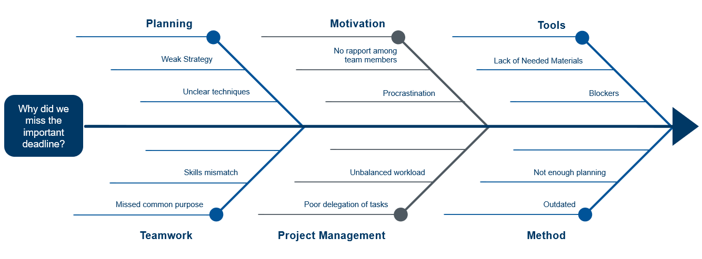
Next step: using the template
Identify all the causes/reasons for the problem
Identify the root cause/s e.g. using ‘5 whys’
Identify as many ideas/solutions as possible e.g. using ‘why not?’
For example:

Slide 4
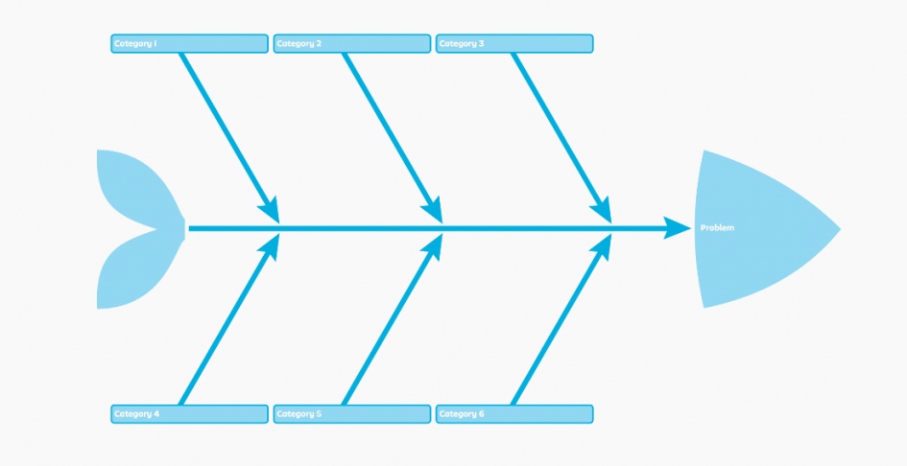

Template design
Questions or comments about this resource?
Contact us

