Slide 1
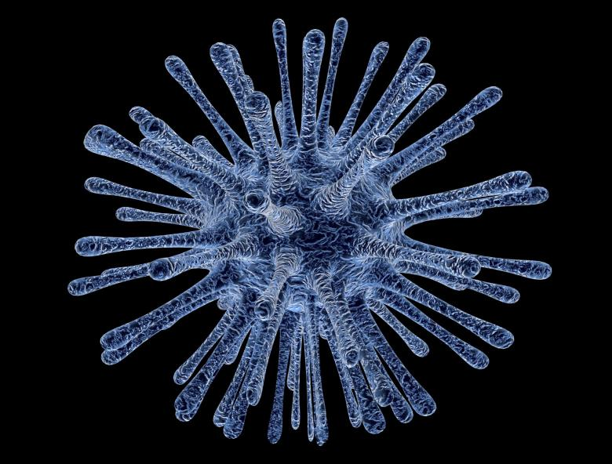
Co-IMMUNnicate 2020

Slide 2
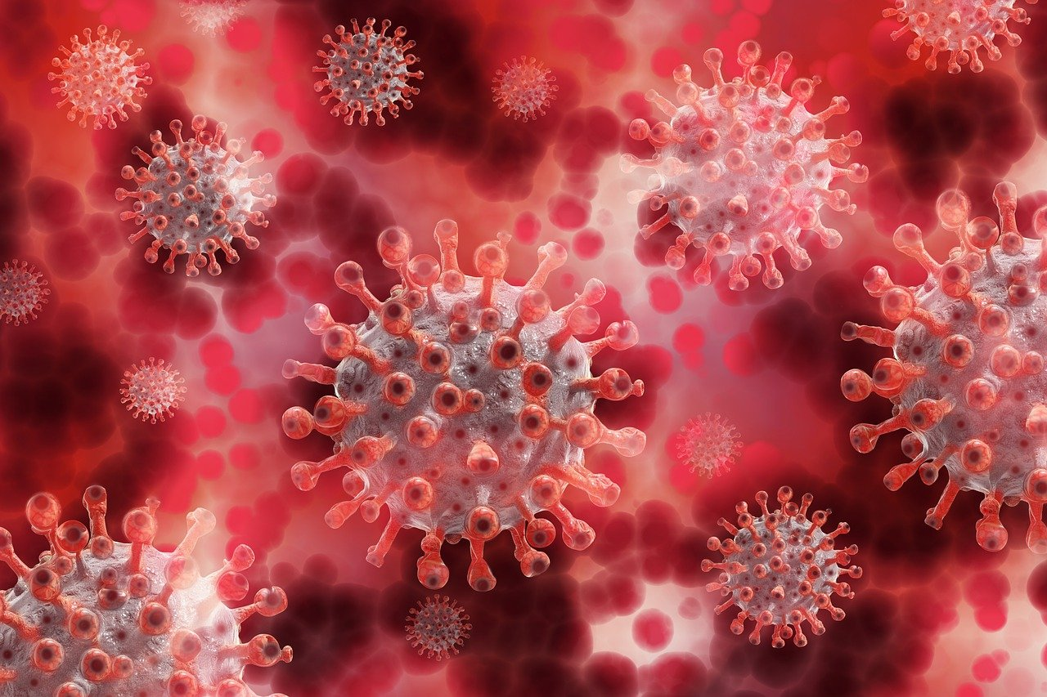
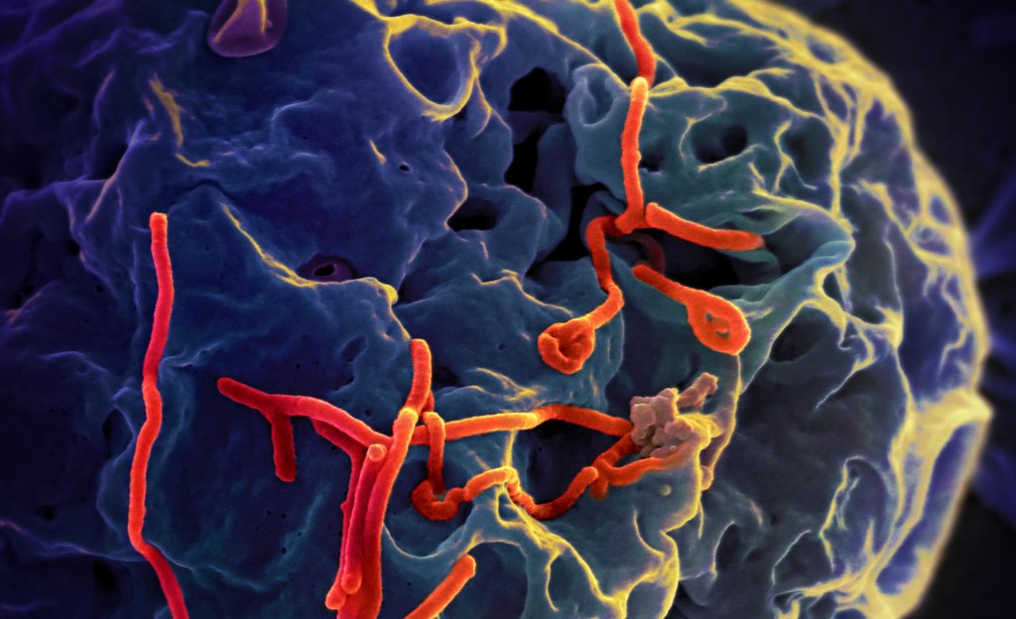
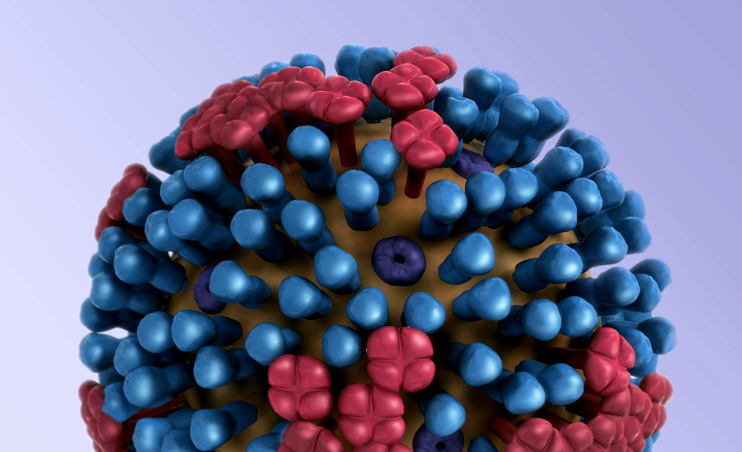
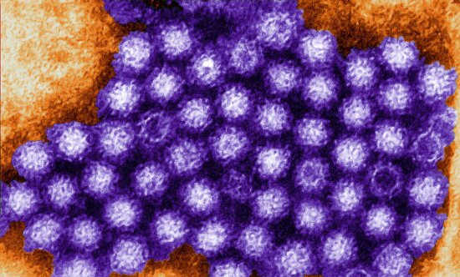
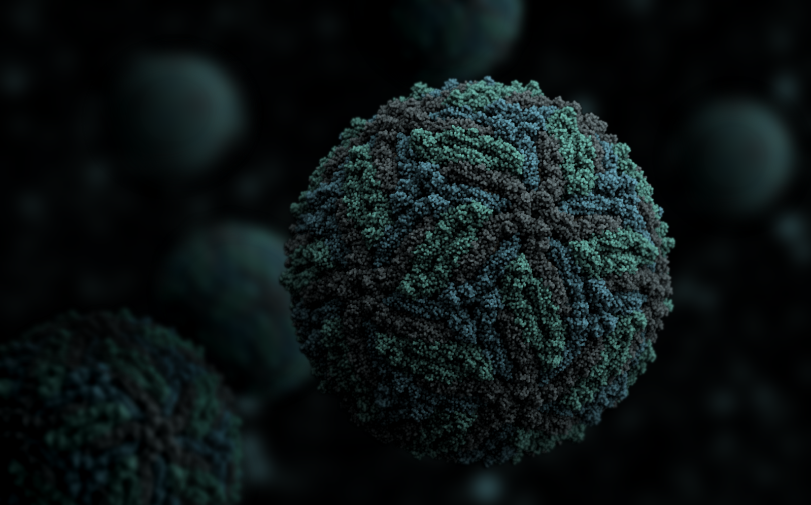
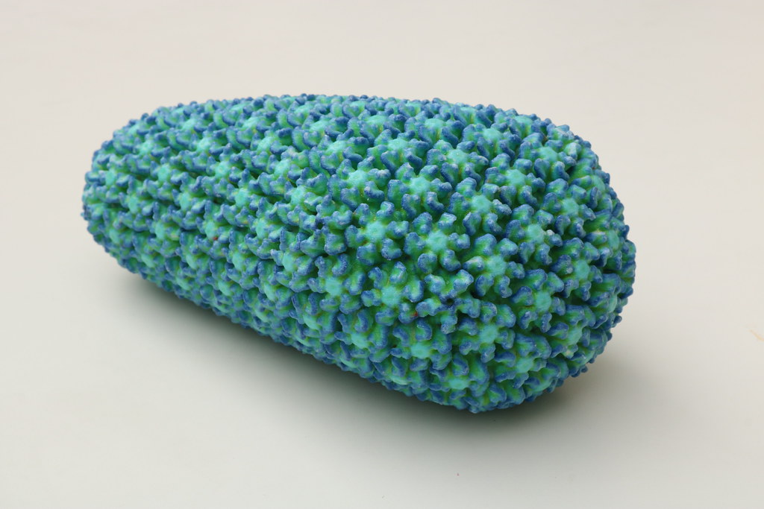
Many different types of viruses exist that can make you ill
Coronavirus
Ebola
Influenza
Norovirus
Zika Virus
HIV
Today, we are going to talk more influenza…also known as the Flu!

Slide 3
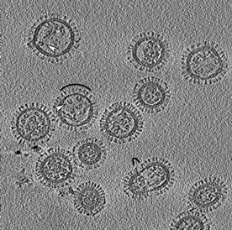
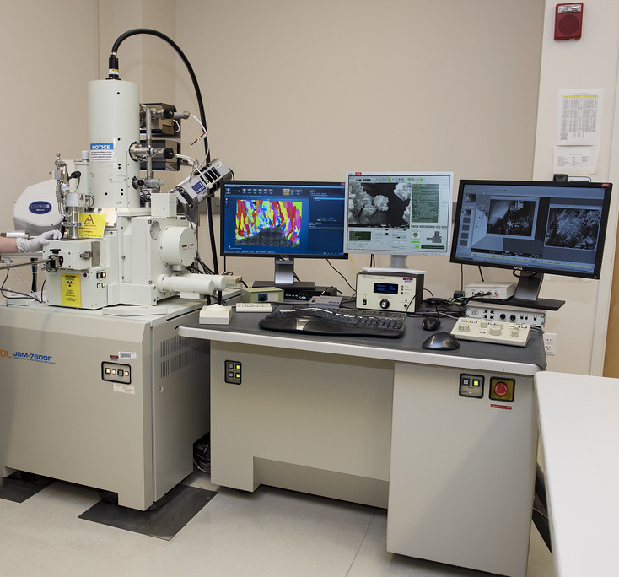
Viruses are so tiny that you need a special microscope to see them!
Electron microscope
Virus

Slide 4
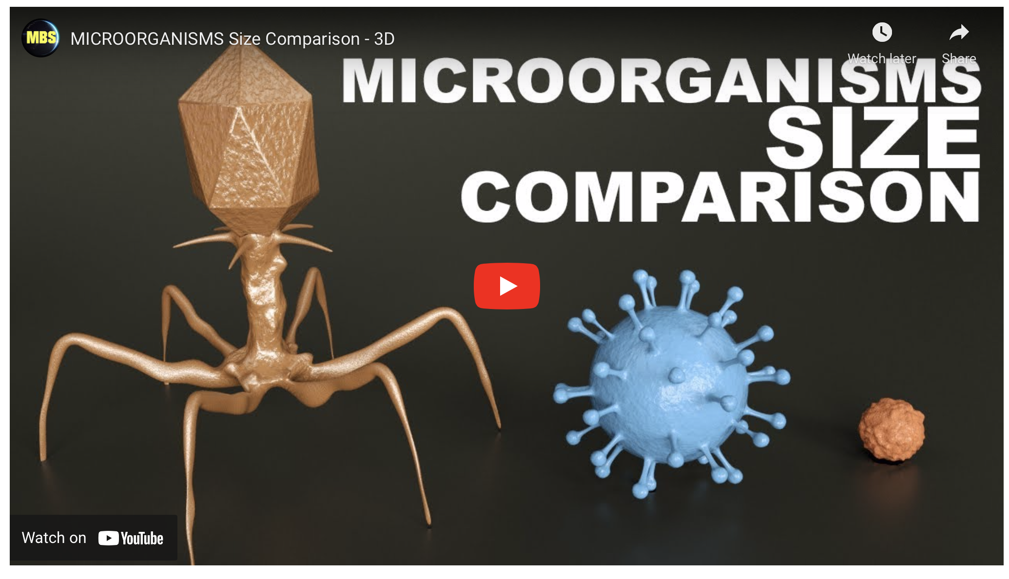
Follow this link to see how small viruses really are…
]
https://youtu.be/h0xTKxbIElU

Slide 5
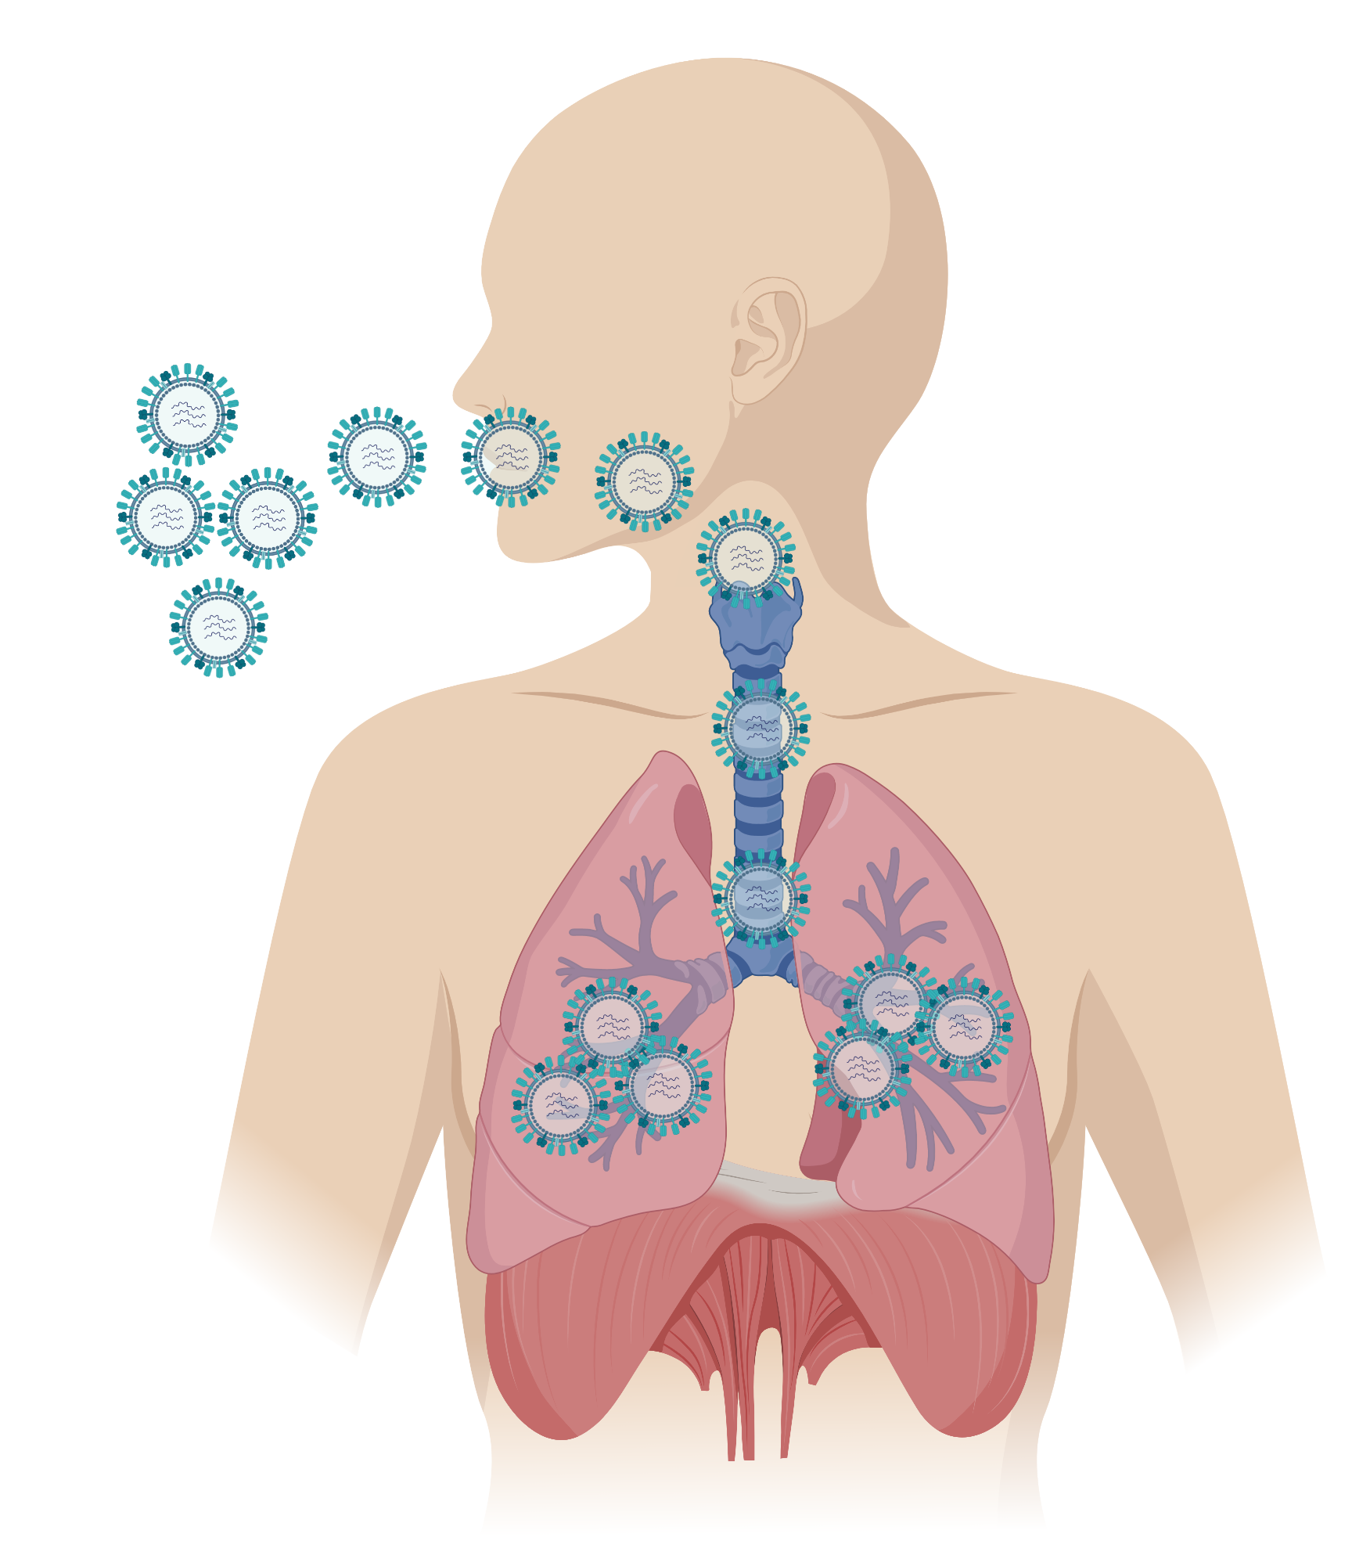
Influenza viruses enter your body through your mouth or nose before spreading to your lungs
Biorender

Slide 6
Coughing
Sore throat
Sneezing
Symptoms of the Flu
Body Aches
Sore head
Fever/ chills

Slide 7
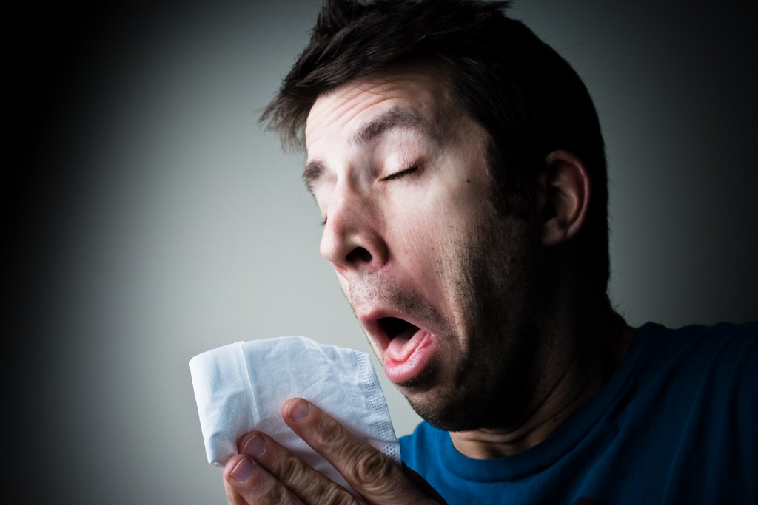
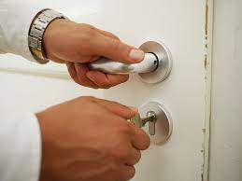
Viruses can spread easily from one person to the next
Some common examples include:
Infected person coughing or sneezing on you
Touching a door handle that an ill person has touched
FUN FACT: Did you know the droplets from a sneeze can travel up to 1m

Slide 8
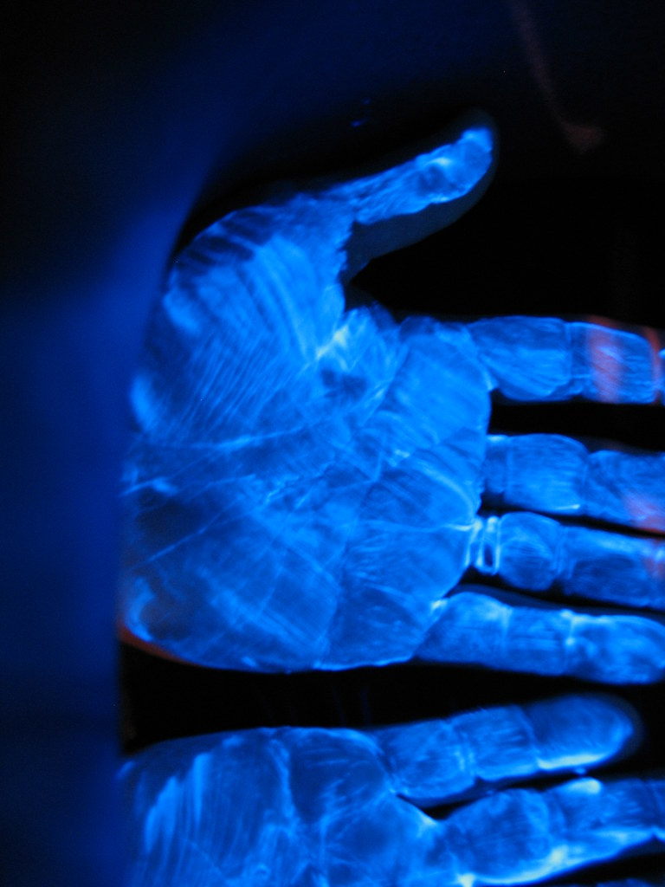
Activity
Wash your hands!

Slide 9
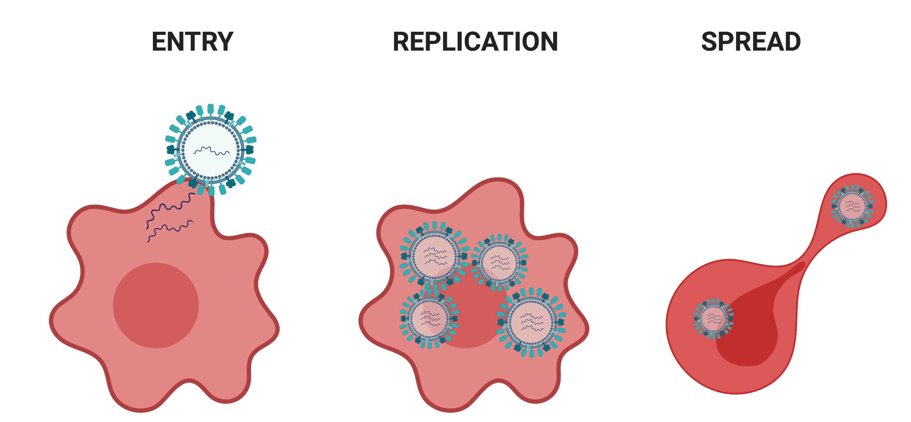
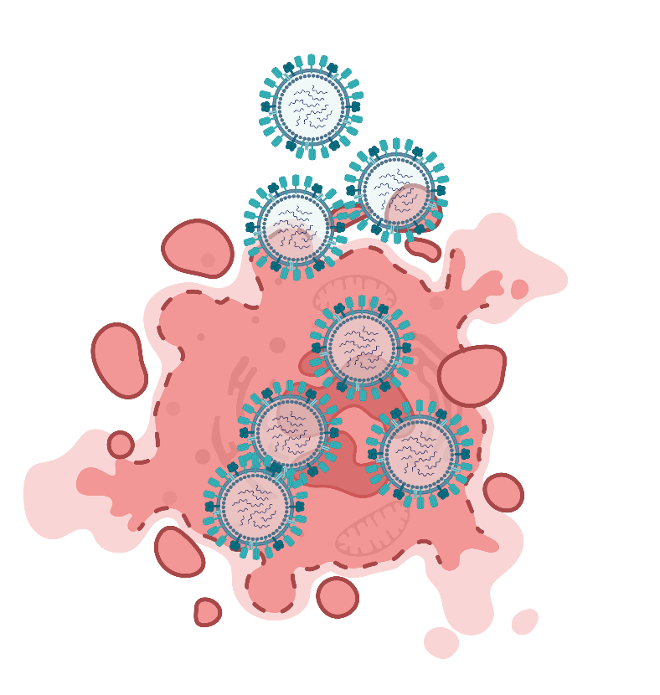
Viruses replicate once inside host cells
1. The Virus binds to the outside of the cell and injects material into the cell that acts as an instruction manual .
2. The virus will use this instruction manual, the cell’s own food supply and equipment to replicate and make more viruses
3. When the cell can no longer hold anymore virus, the cell bursts and dies. The viruses are released ready to infect another cell.
Biorender

Slide 10
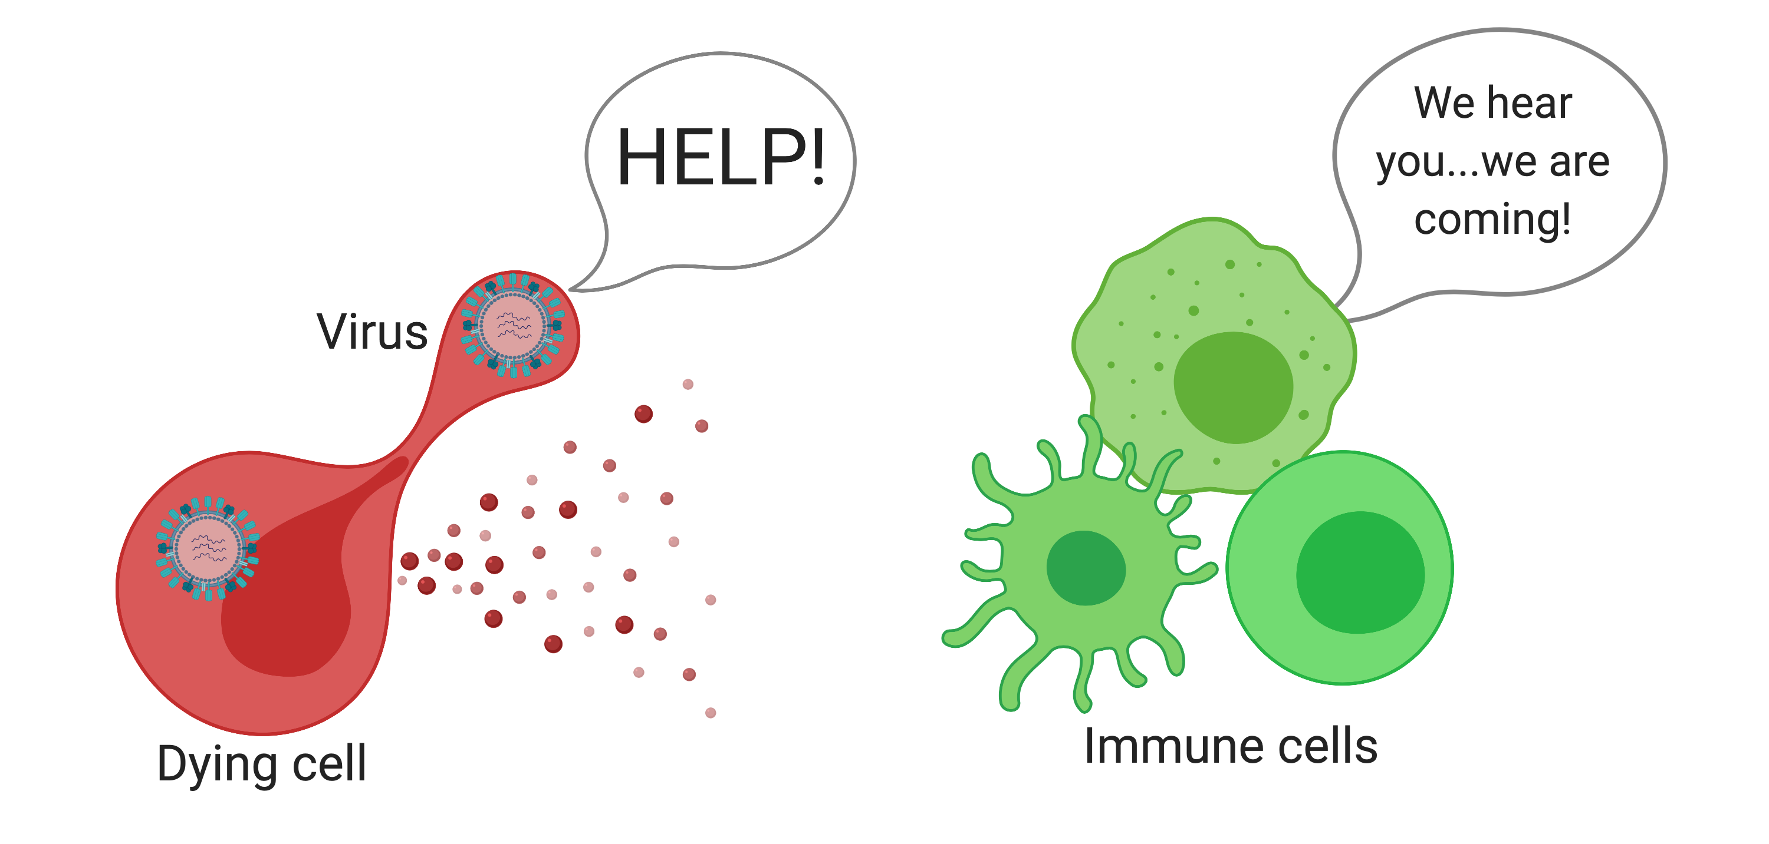
Infected cells needs help from immune cells to fight off infection
1. Dying cell makes signals that warn the immune system about the virus.
2. Immune cells rush to the scene of infection to recognise and respond to the threat.
Biorender

Slide 11
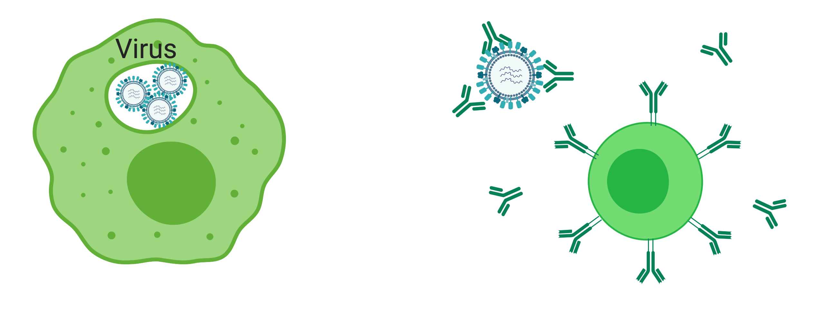
Immune cells can eliminate viruses in several different ways
Oh no! I am now entirely coated in these immune molecules and have no free legs to bind to a cell
1. Once at the site of infection, immune cells called macrophages engulf and destroy viruses.
2. Immune molecules completely coat the outside of the virus meaning it is trapped and cannot bind to other cells to continue infecting.
Biorender

Slide 12
Healthy
Beginning
of illness
Immune system working hard
Blood in mucus
Image from UPMC Healthbeat webpage

Slide 13

Activity
Snot: what is it good for?
Image and original recipe from British Society of Immunology

Slide 14
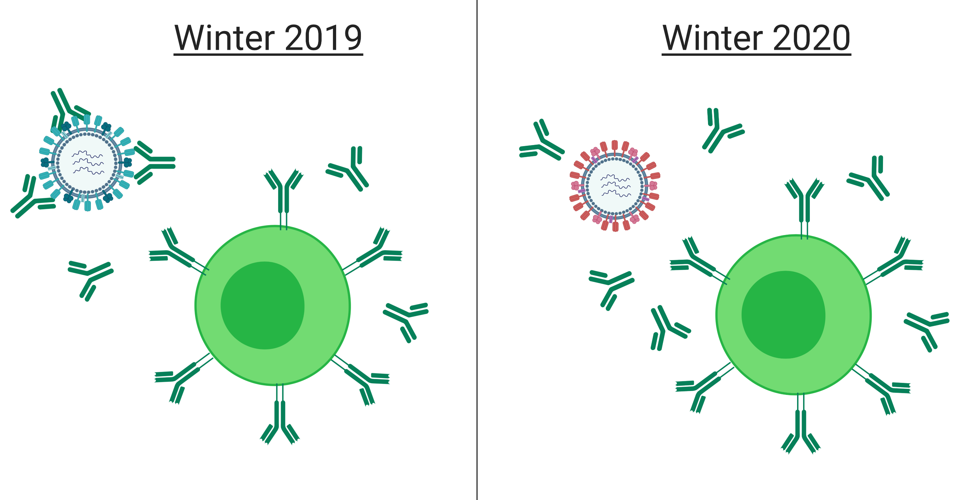
Viruses are sneaky and can change their surface coat to avoid being recognised by immune cells and destroyed
1. Immune molecules bind to virus to stop it getting inside cells
2. Every year, the virus can change its coat so that it cannot be recognised. This means it can now get inside cells again!
Biorender

Slide 15
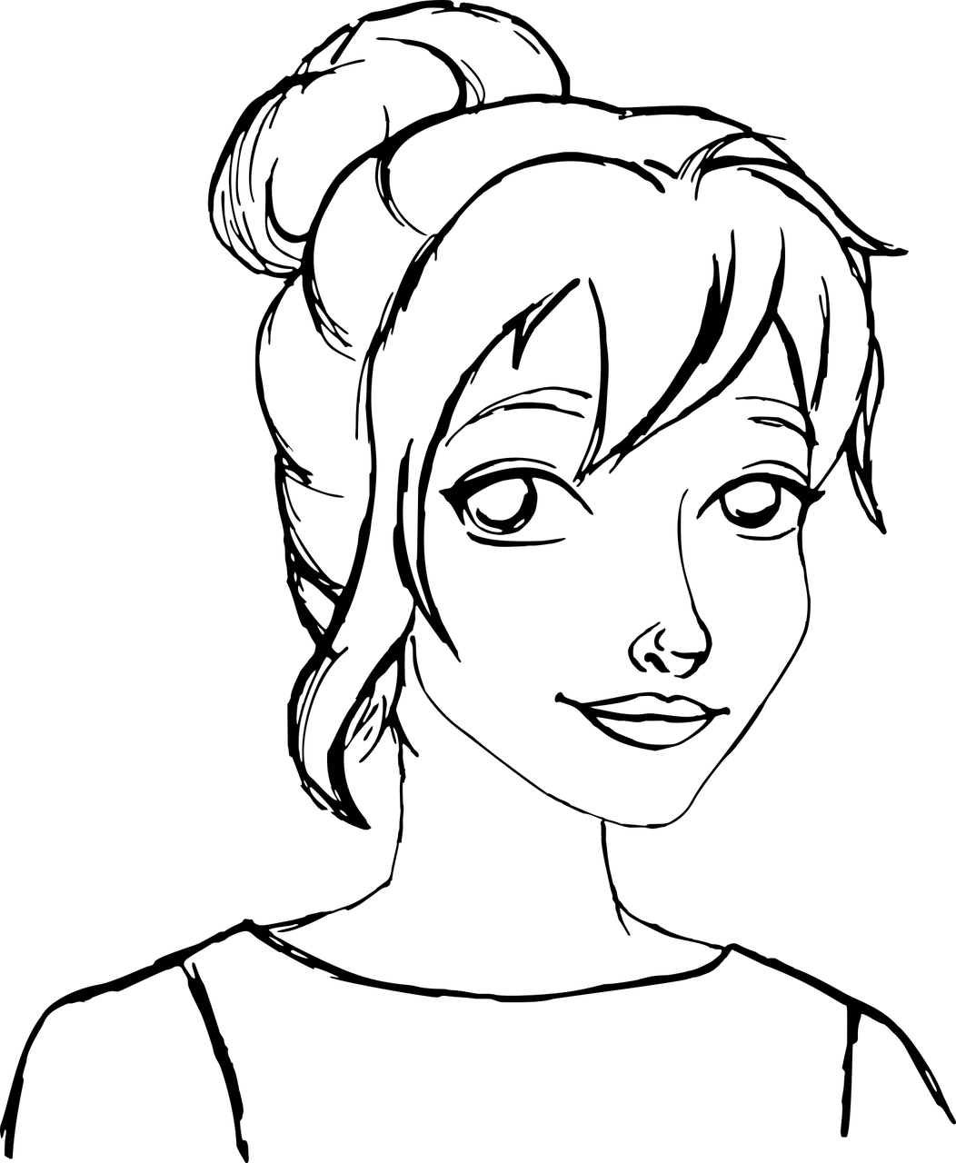


























Disguise!

Slide 16

Activity
Flu Whispers

Slide 17
Now you get to be the expert!
We need you to design fun, interactive activities that will help junior pupils, family members and the wider community to understand:-
  What is a virus?
  How are they transmitted?
  How can they be prevented?

Slide 18
How it will work?
Tomorrow morning you will be spilt into groups to brainstorm activity ideas
You will then spend every Thursday afternoon for 6 -8 weeks with your team bringing that idea to life
All activities will be shown to junior pupils of Anderston primary school at a showcase event

Slide 19
And there are prizes…
The best team will get gift vouchers!
The best activity will attend the Science festival at the University of Glasgow to showcase their activity to family members and the general public

