Slide 1
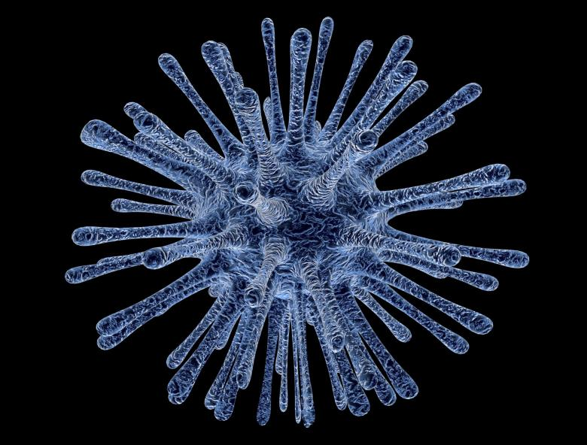
Co-IMMUNnicate 2021
Day 1
How do cells communicate?

Slide 2
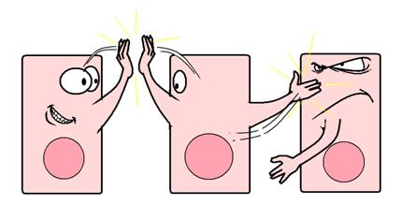
The aim of this week of activities is to think about these question:
Do cells “talk” with each other?
Why would cells want with “speak” to each other?
How do they “communicate” with each other…surely, they don’t speak English!
http://7bigspoons.com/wp-content/uploads/2011/03/cells-communicating.png

Slide 3
Let’s first think about how you communicate?
Write down a list of ways people communicate with each other

Slide 4
With one colour pen/pencil, underline the types of communication that need people to be close together
With a different colour pen underline those that work even if people are far way from each other

Slide 5
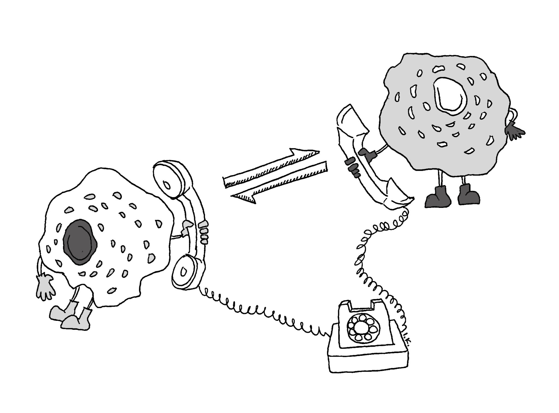
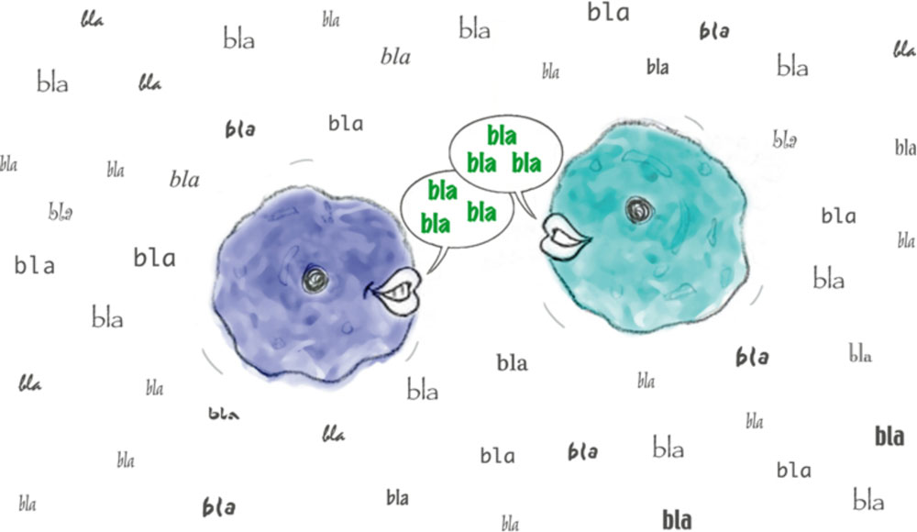
Hands Up
Do you think cells can communicate in similar ways?
Credit: irene.kim@yale.edu
Credit: EMBL/P. Riedinger
Notes:
Hand up: do you think cells can talk to each other if they are close together?
Hands up: do you think cells can talk to each other of they are far away from each other?

Slide 6

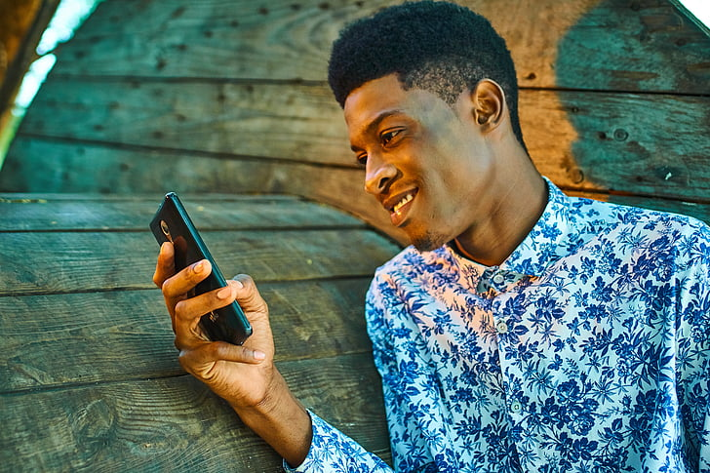

Being able to communicate is essential in everyday life but can help us deal with dangers!
Notes:
Hand up: do you think cells can talk to each other if they are close together?
Hands up: do you think cells can talk to each other of they are far away from each other?

Slide 7
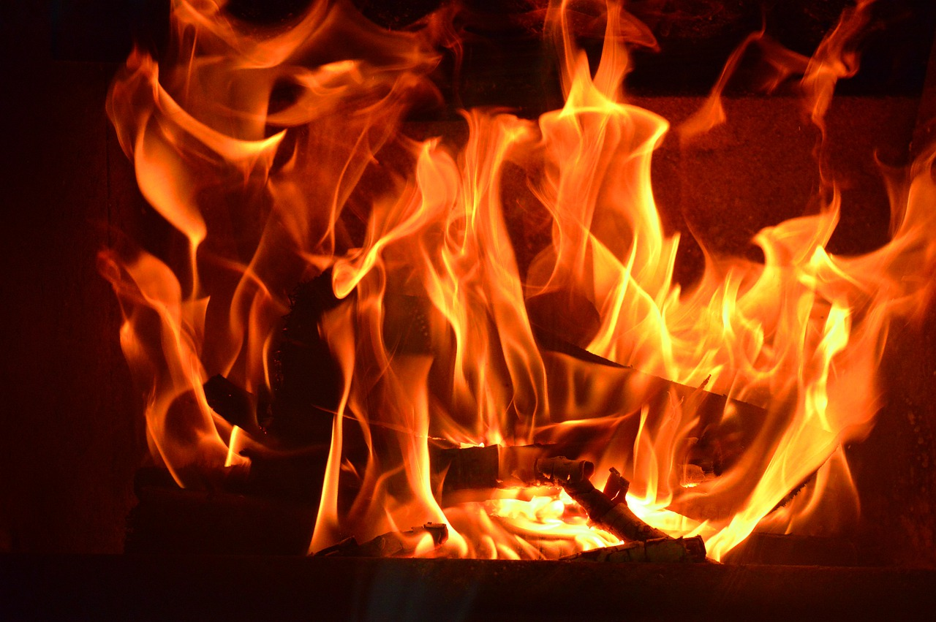
What would you do if you found a raging fire?
(A) Walk away
(B) Try and extinguish it yourself
(C) Tell someone and raise the fire alarm

Slide 8


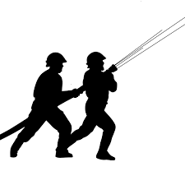



Slide 9
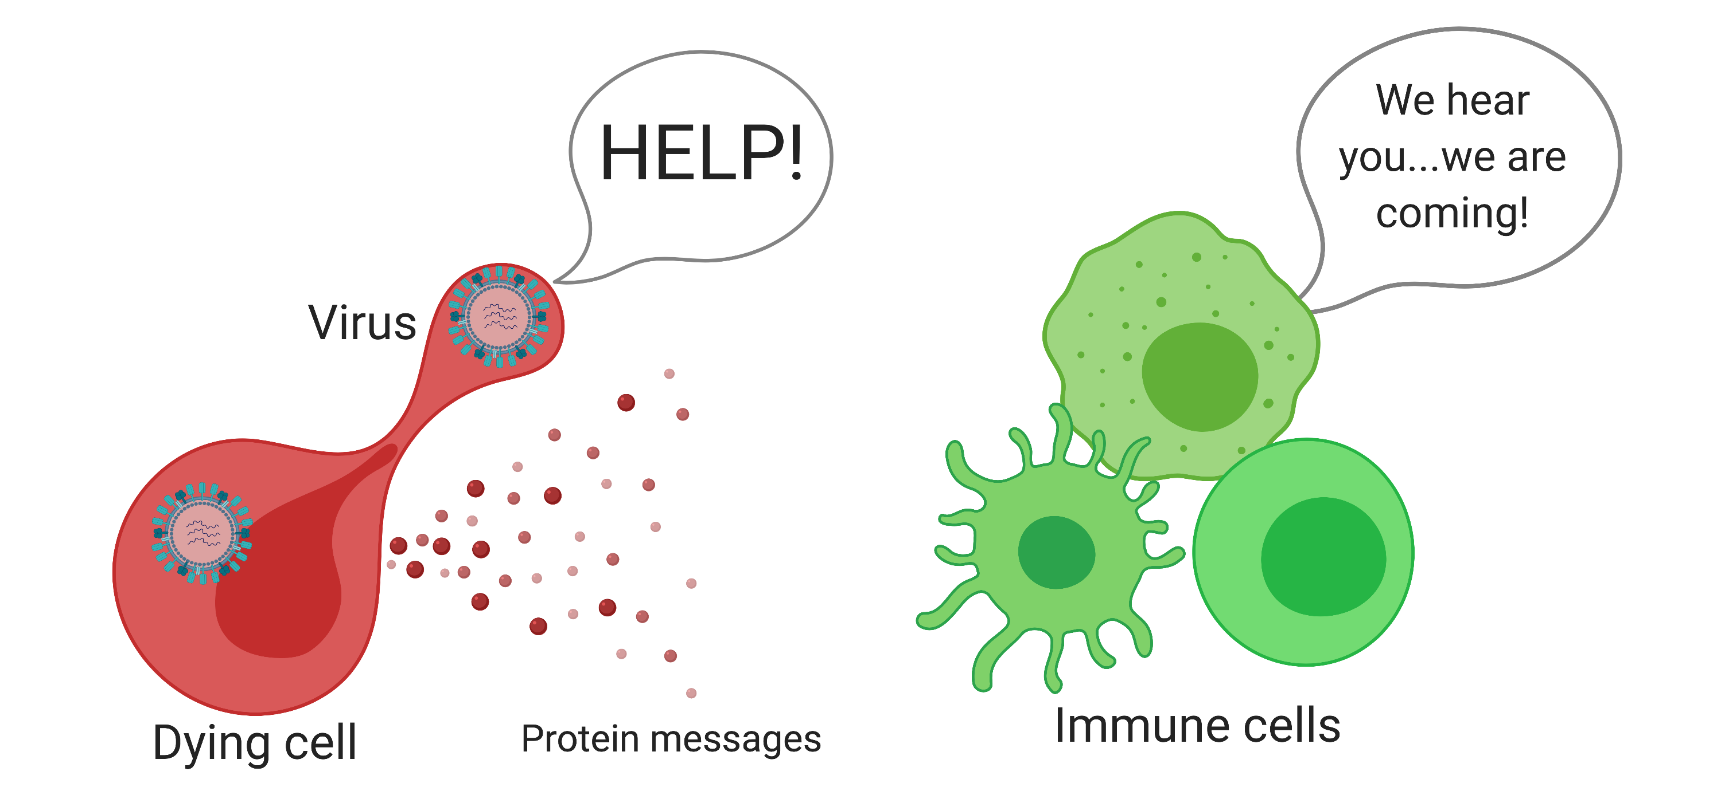
Cells communicate with each other by making warning signals
Infected cell
Immune cells
1. Infected lung cells make signals that warn the immune system about the virus
2. Immune cells rush to the scene to recognise and respond to the threat!
Bio render image

Slide 10
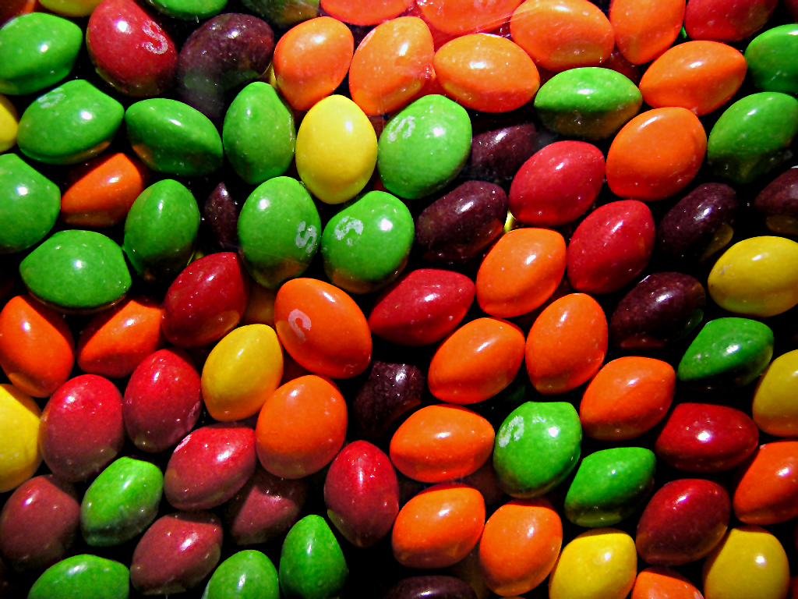
How do cells send messages?
Warning signals given off by cell

Slide 11
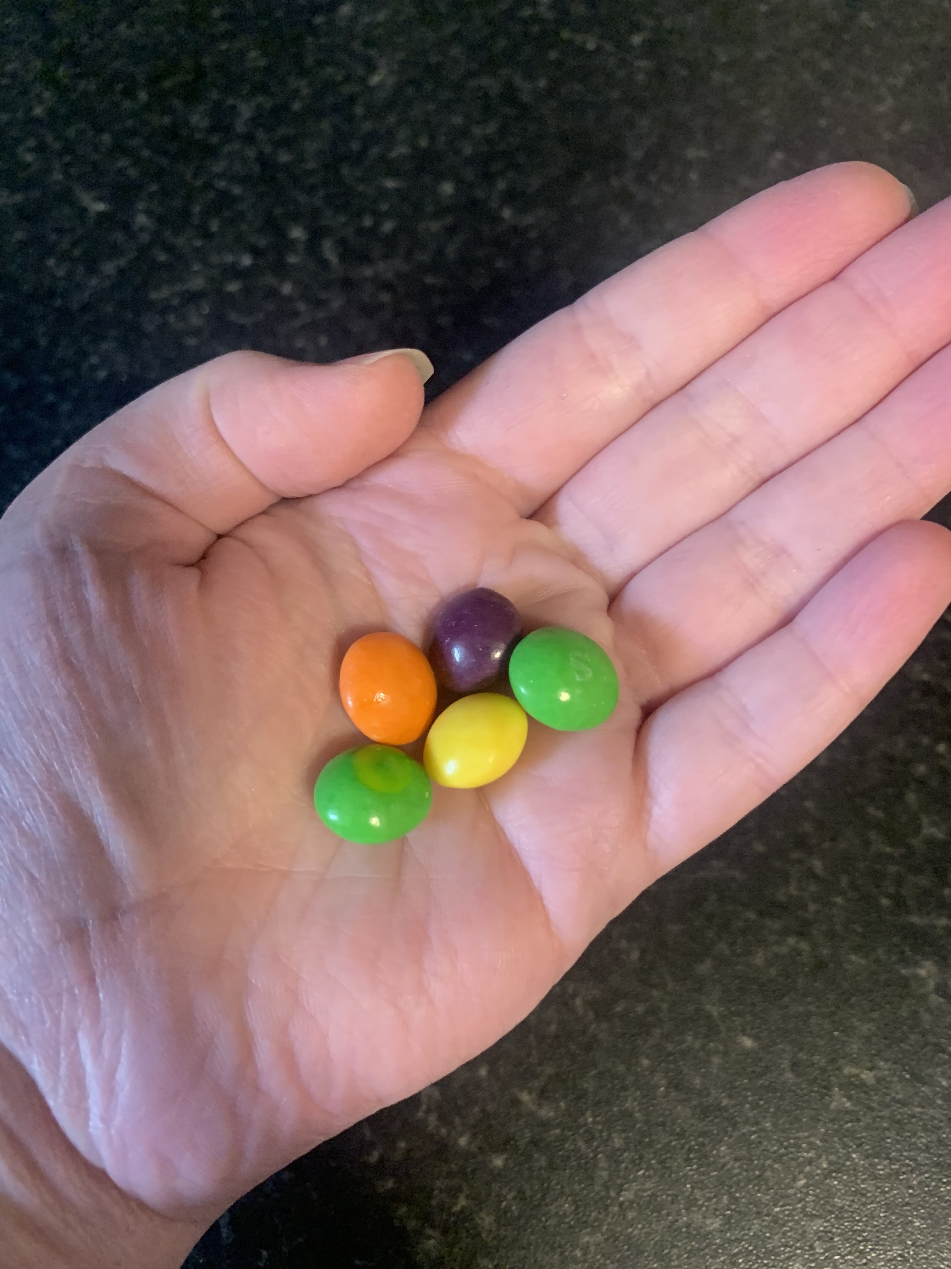
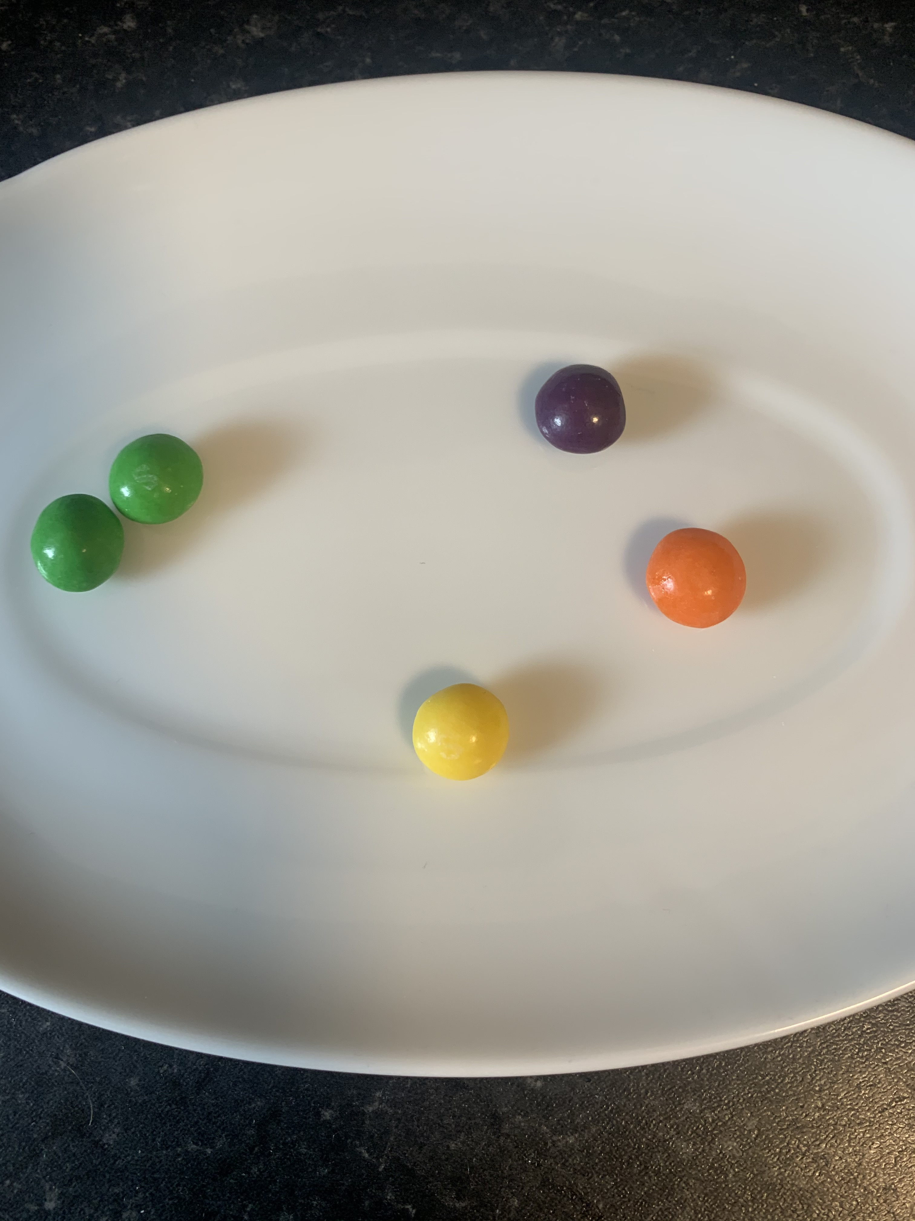
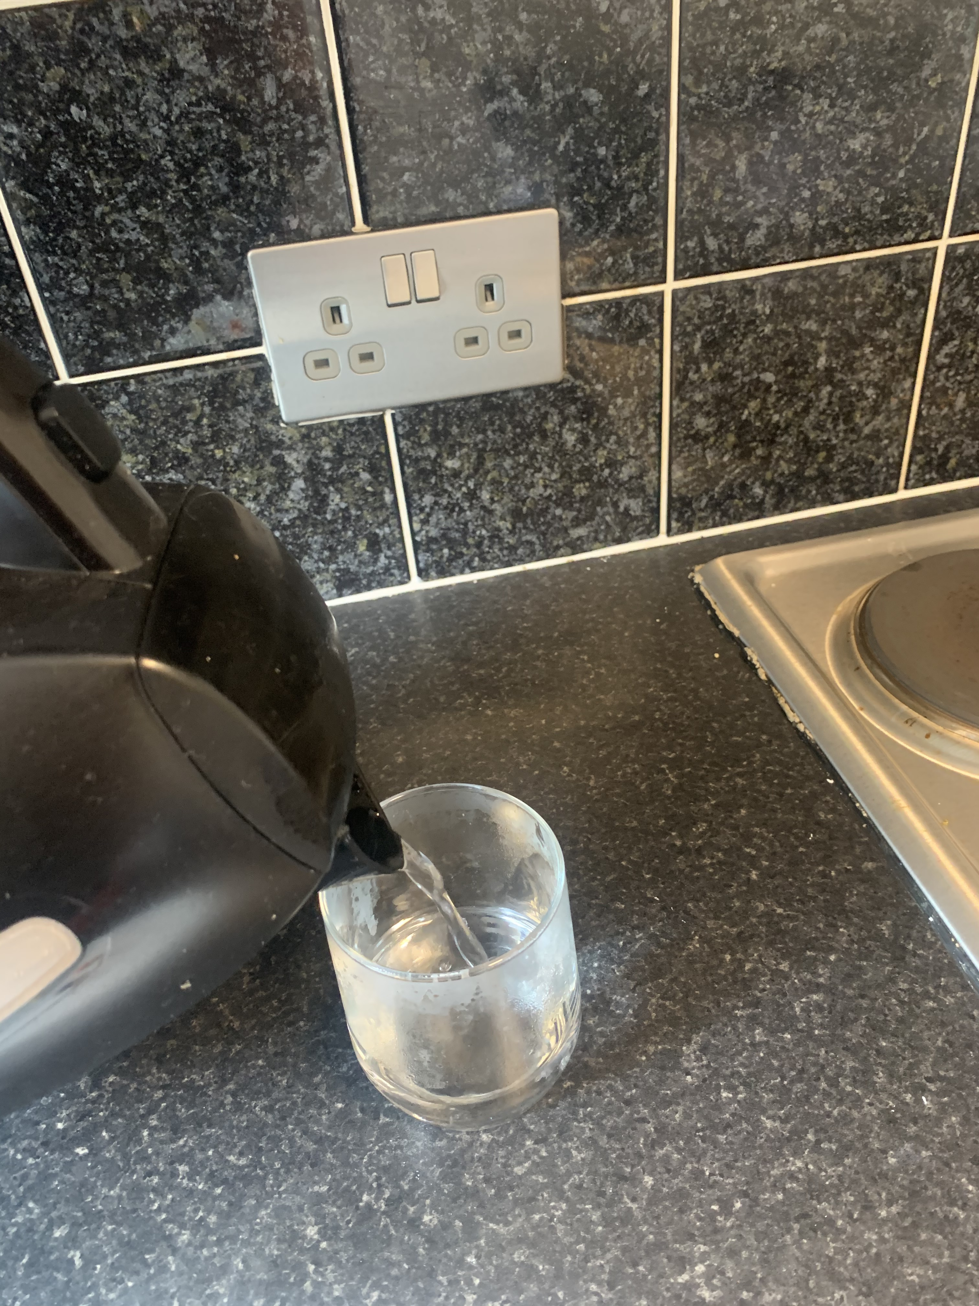
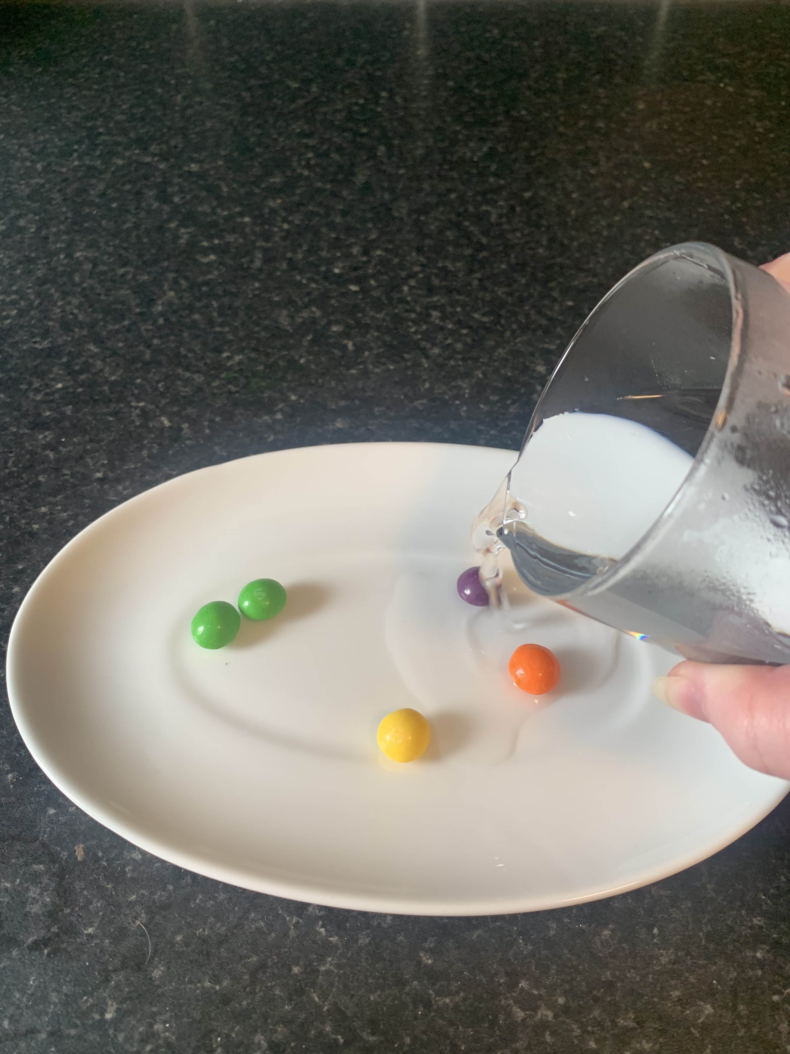
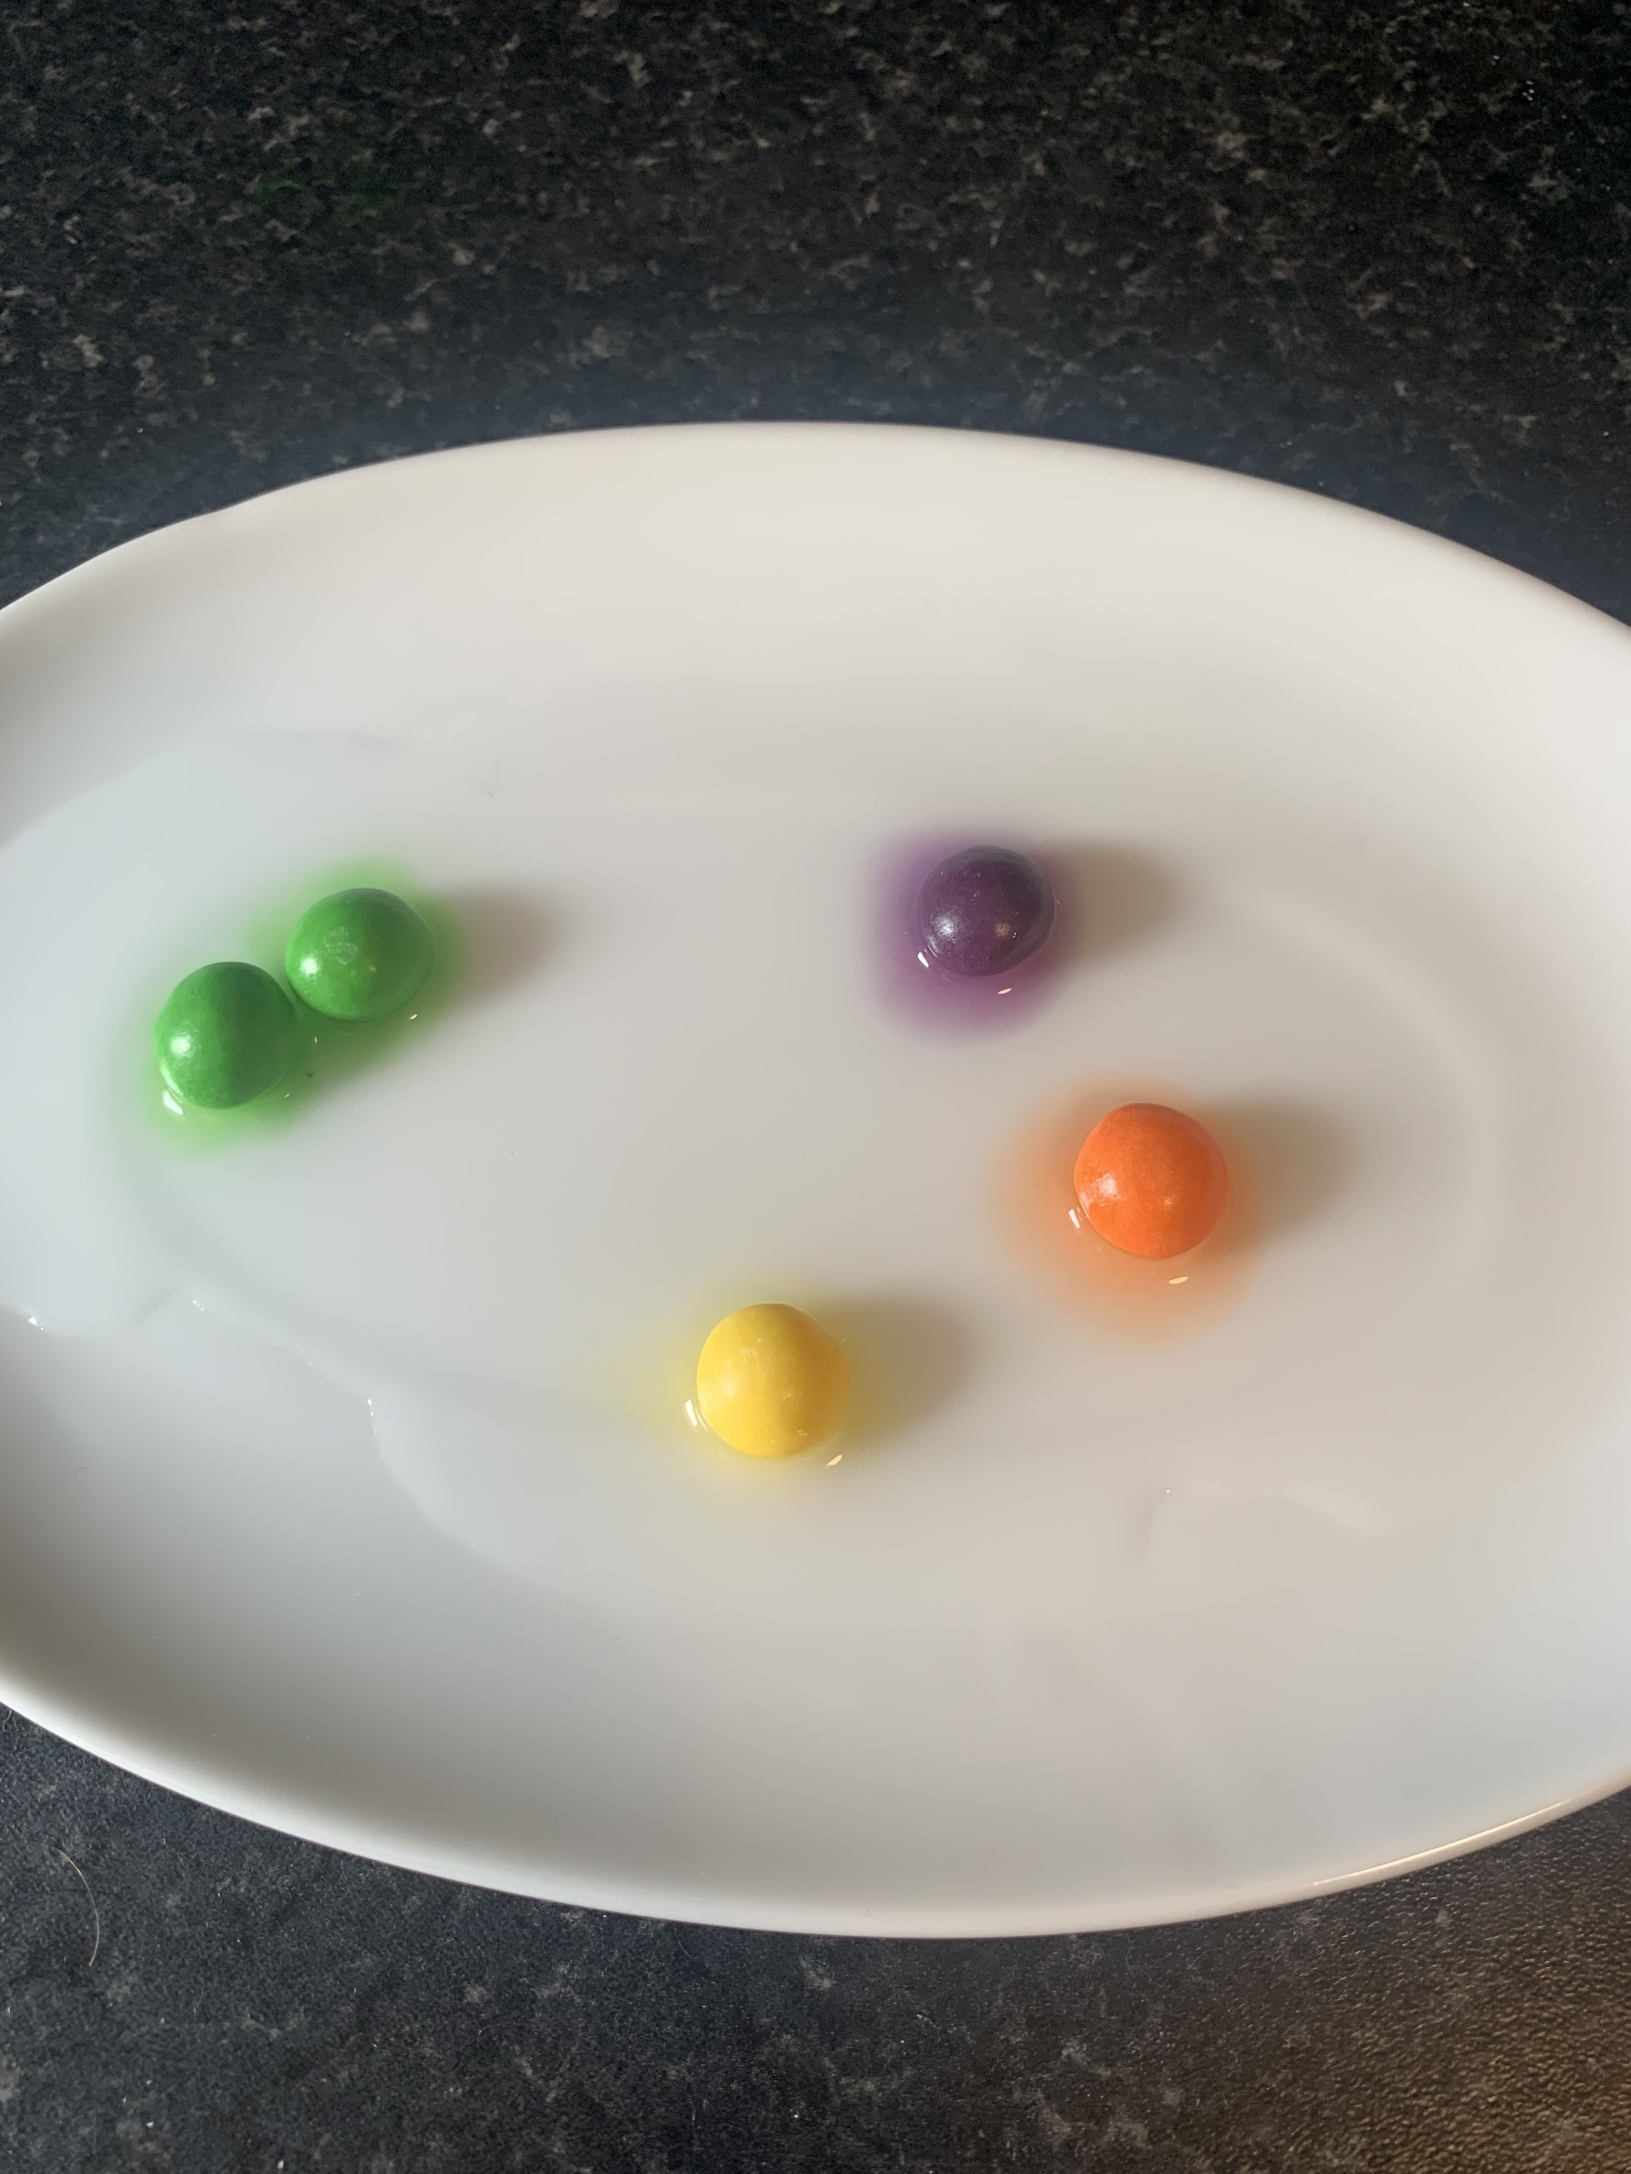
1.
2.
3.
Select 5 skittles of different colours.
Arrange your skittles on plate in a design
Pour some lukewarm water into a glass
4.
5.
Add water to plate
Watch what happens…

Slide 12
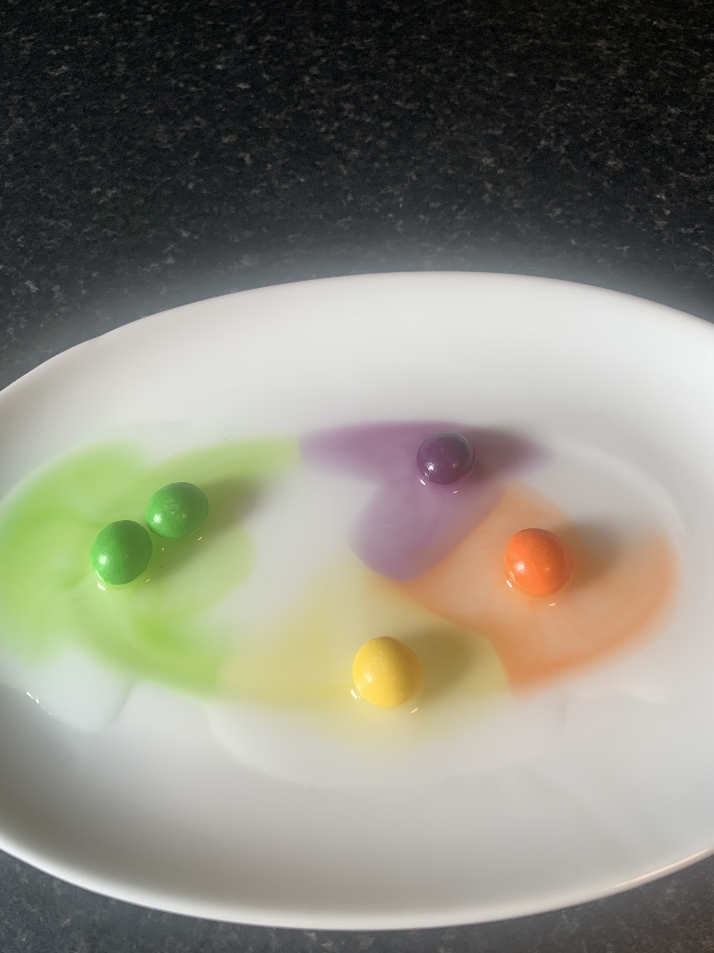
Skittles = Infected cells
Dye = warning signal
These signals warn other cells that they are infected and need HELP!

Slide 13
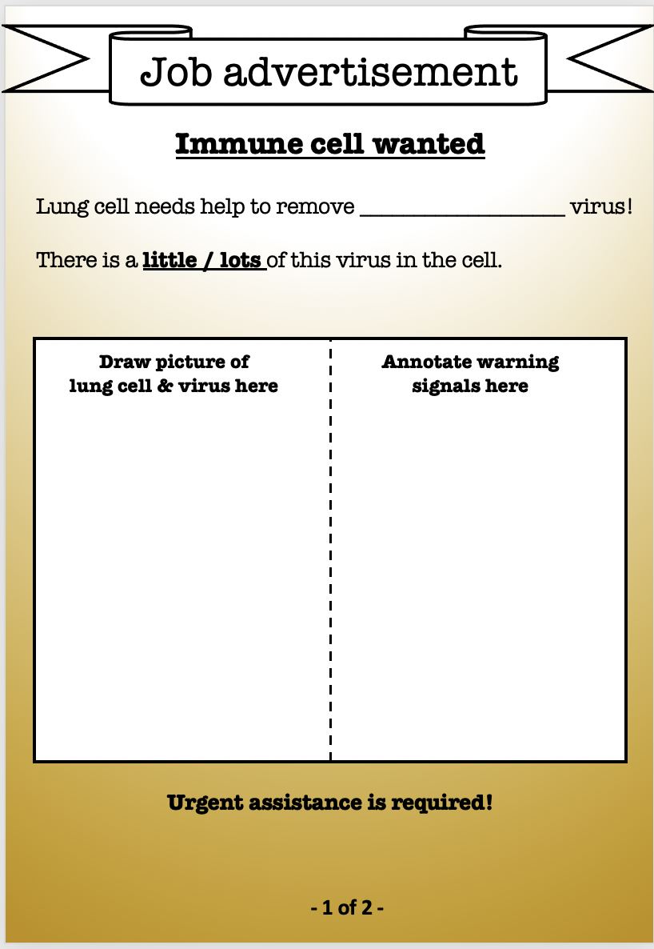
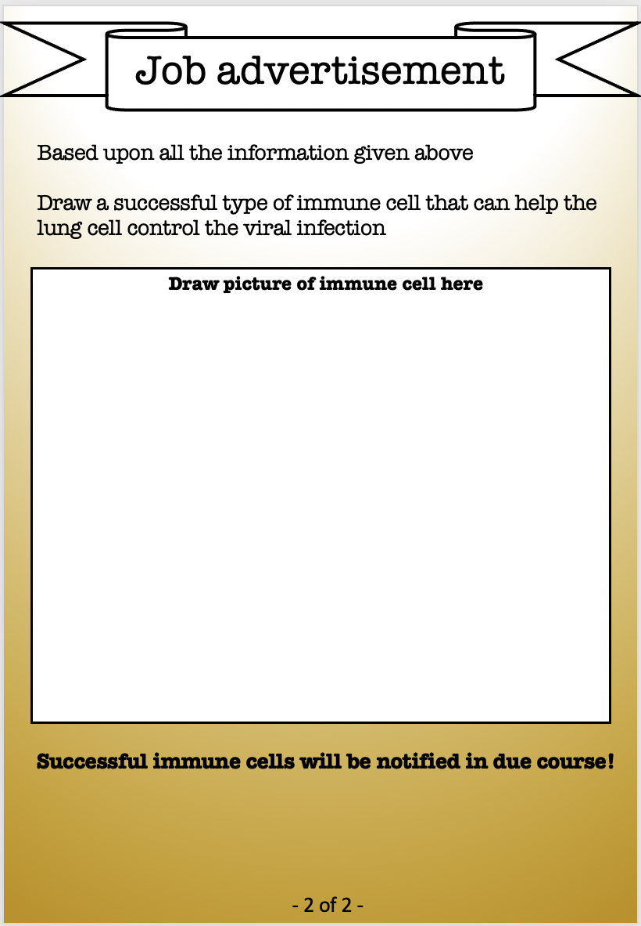
Drawing activity

Slide 14
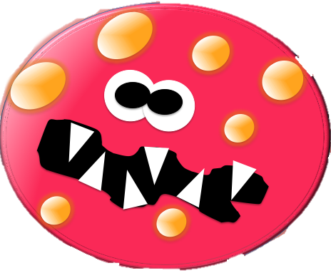
On your job advert
Draw a lung cell
What virus is it infected with?
Is it infected with a little or a lot of virus?
Draw the virus inside your cell

Slide 15
Co-IMMUNnicate 2021
Day 2
How do cells communicate?

Slide 16
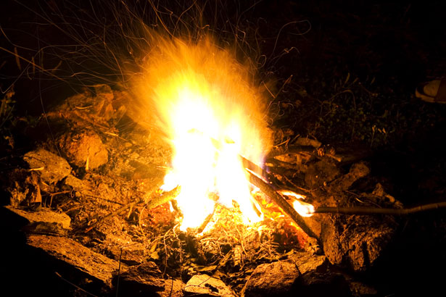
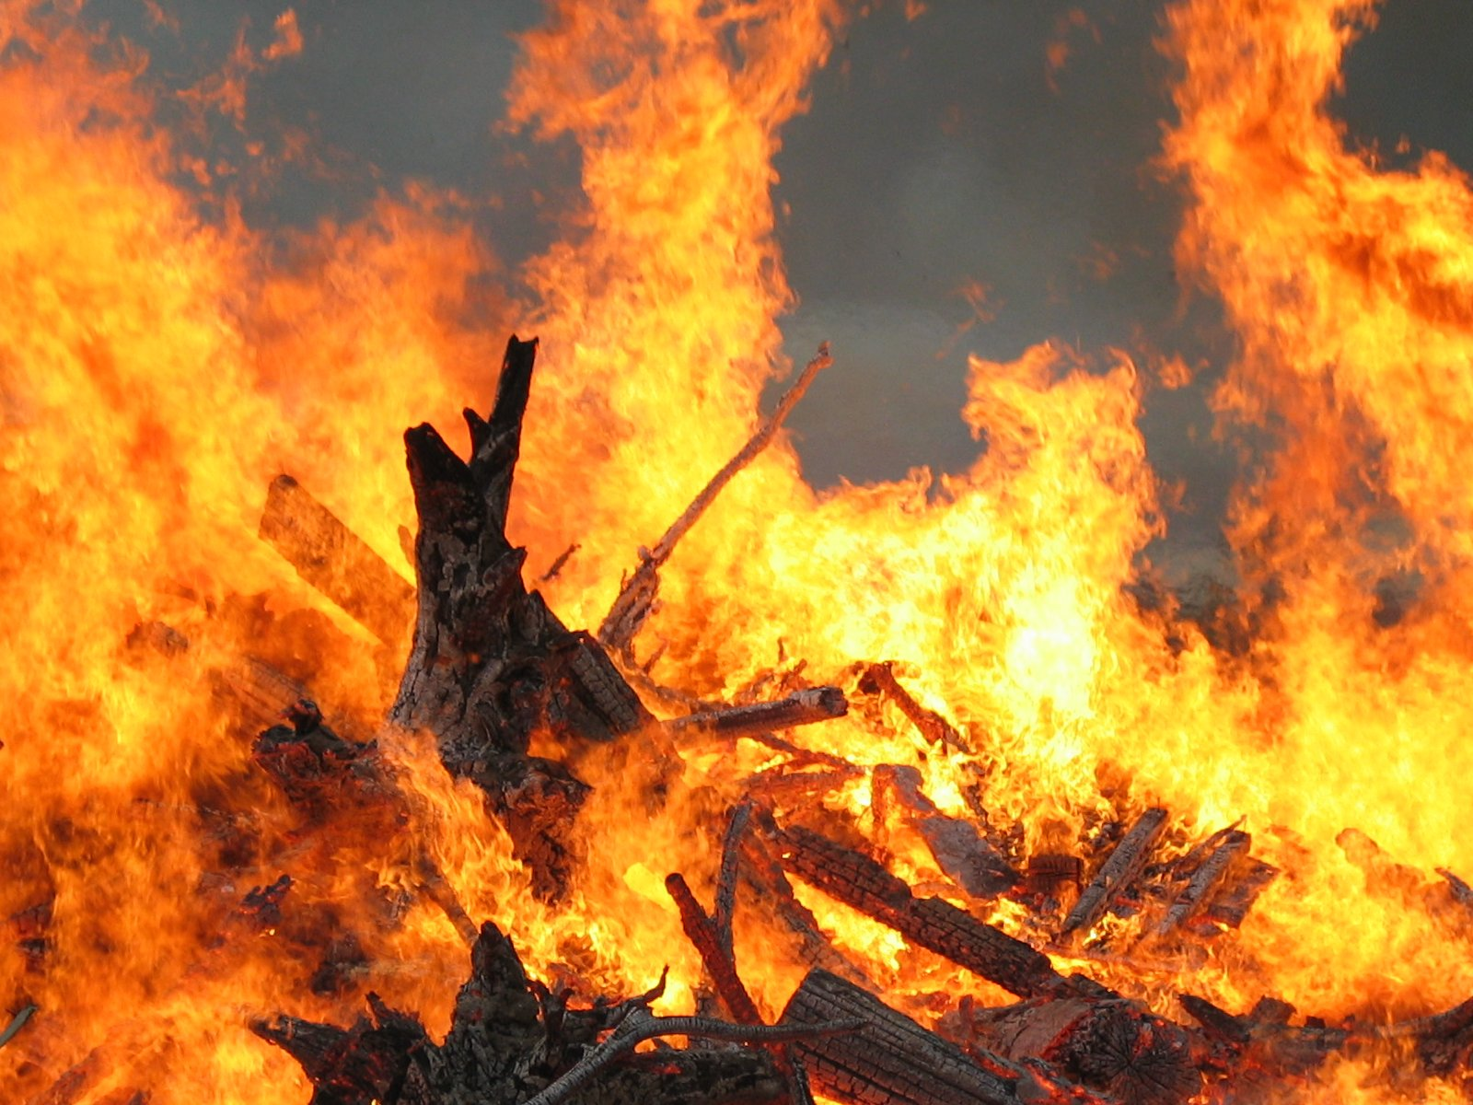

When to call for help!
If there is a small fire – you probably don’t need to call the fire brigade
But it’s good to have a plan in place if it gets out of hand!
For big fires that are out of control – call the fire brigade!

Slide 17
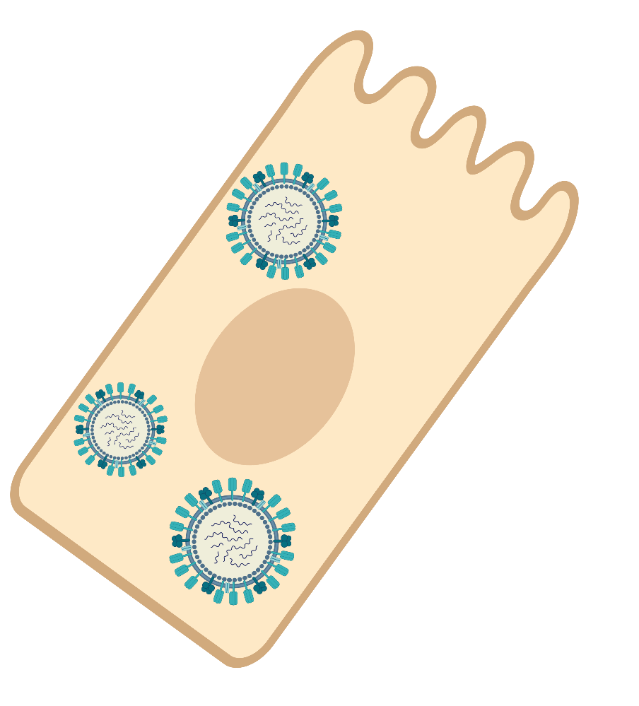
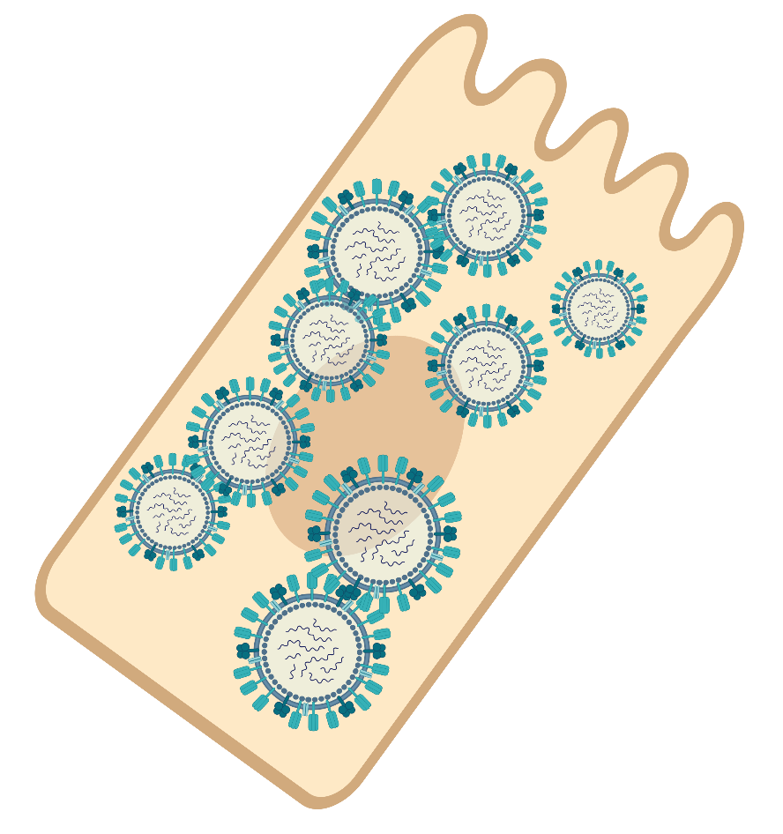
When to call for help
Lung cell with a little virus
Warning signals – have some immune cells on hand to manage any problems
Lung cell with a lot of virus
Need to call for lots of help!!
Bio render image

Slide 18
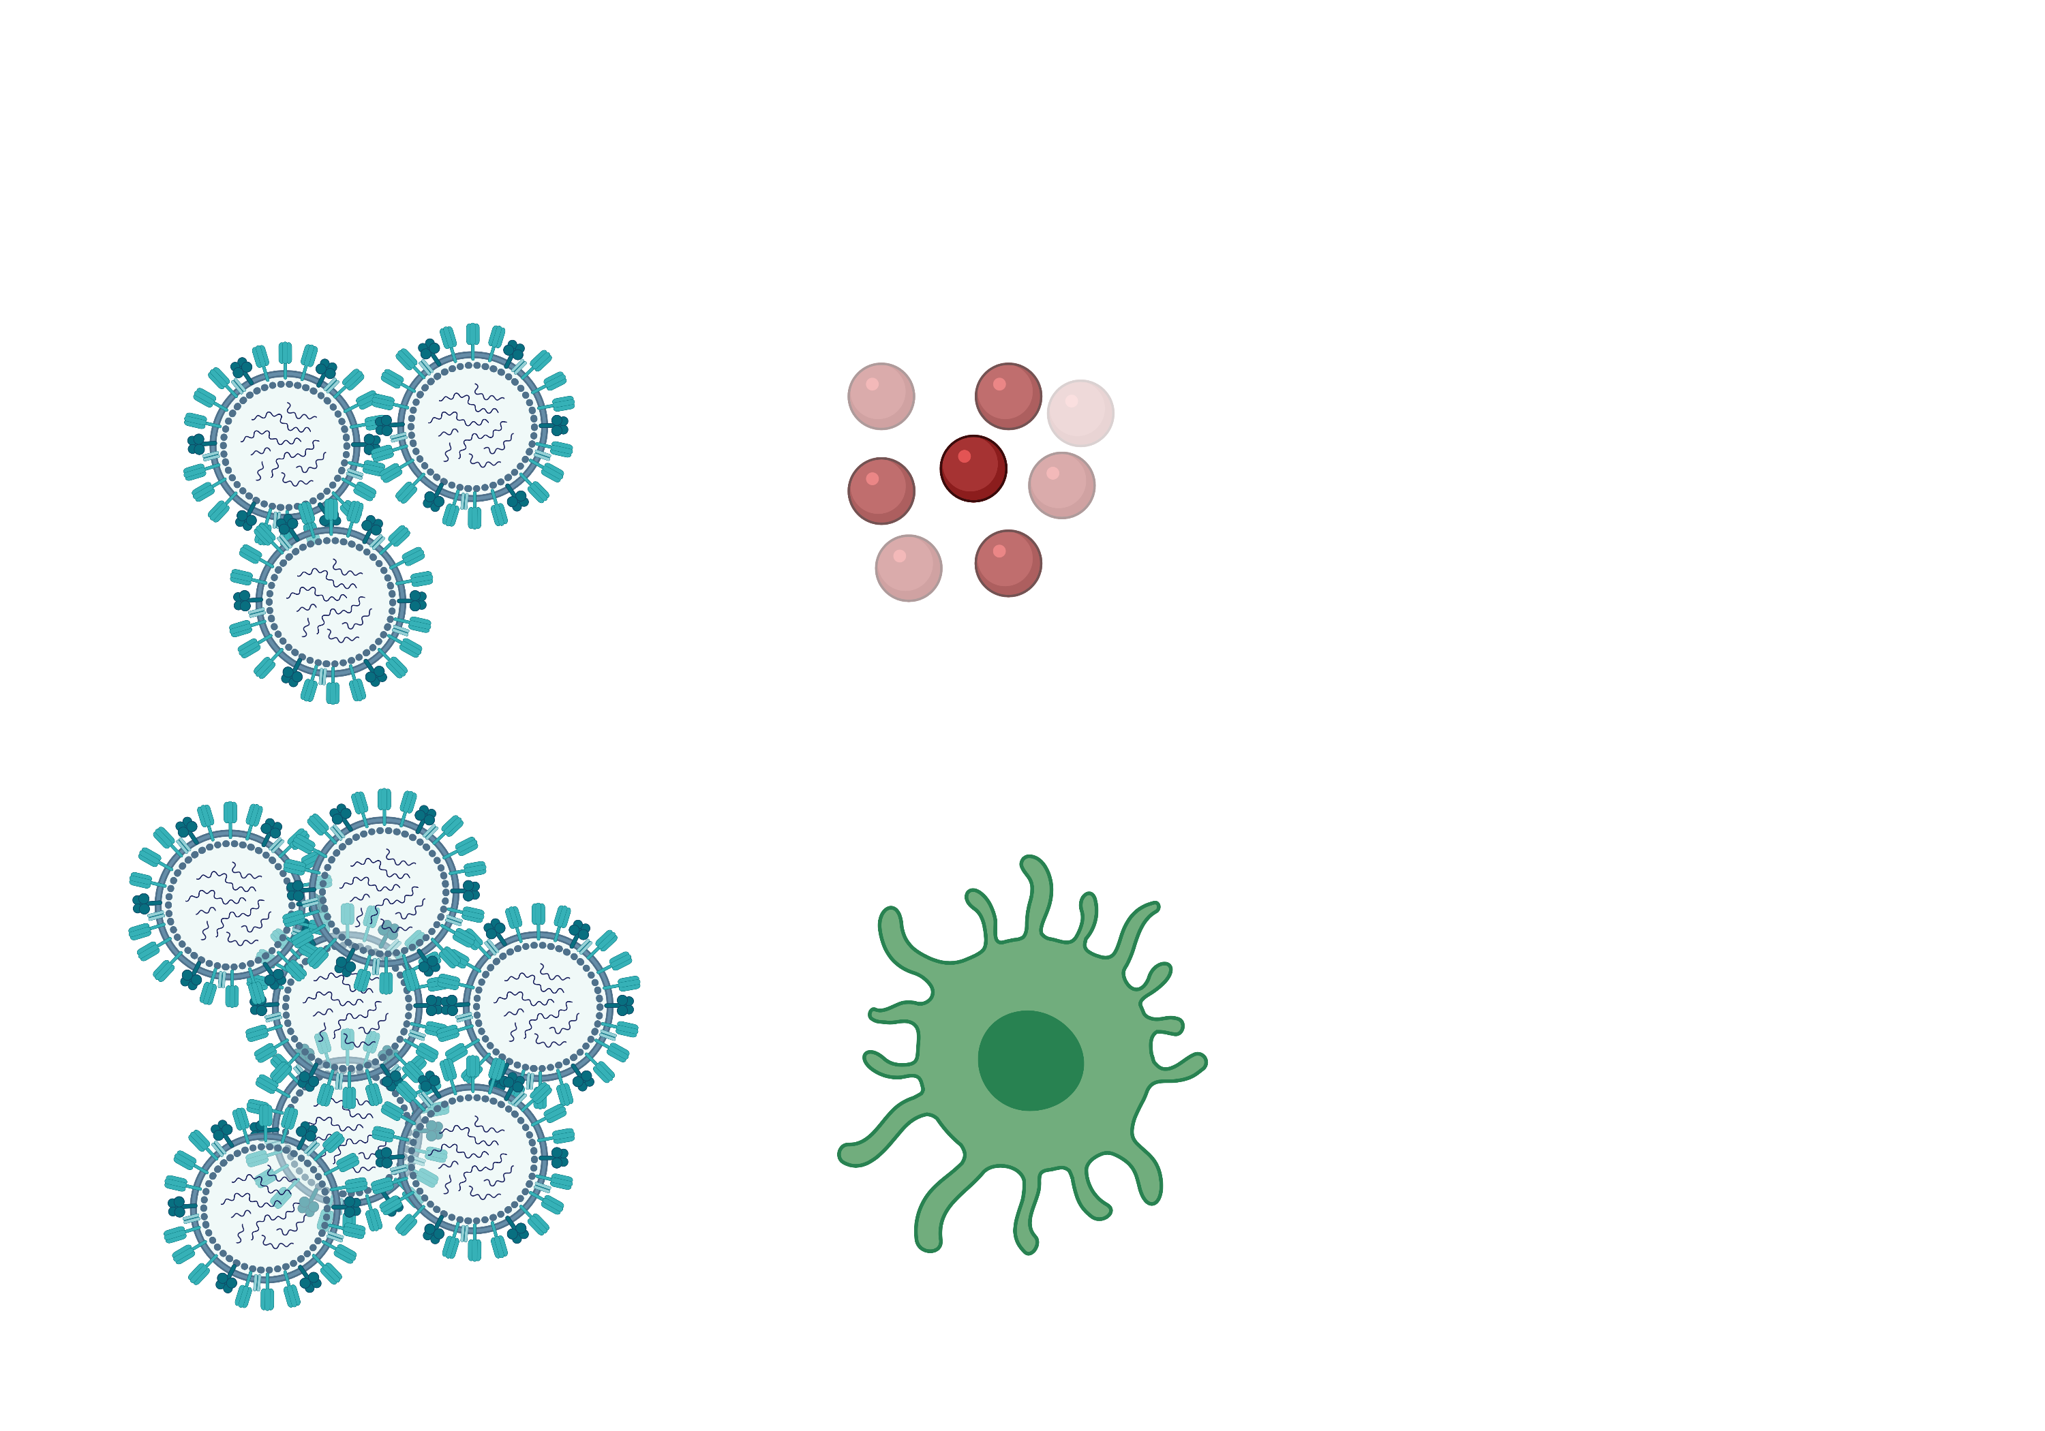
How to call for help!
Small amount of virus
Warning signals: Small proteins that tell your immune cells to be prepared!
Warning cells that tell your body to be prepared
AND
A communicating cell to tell your immune cells all about the virus
Large amount of virus
Bio render image

Slide 19
On your job advert
If you have a lot of virus – add in a communicating cell on your job advertisement file

Slide 20

Find the infected cell!
Infected cell
Immune cell
Communicating cell

Slide 21
Co-IMMUNnicate 2021
Day 3
How do cells communicate?

Slide 23


Be prepared: warning signals bring immune cells to the infection site in case of problems
Bio render image

Slide 24
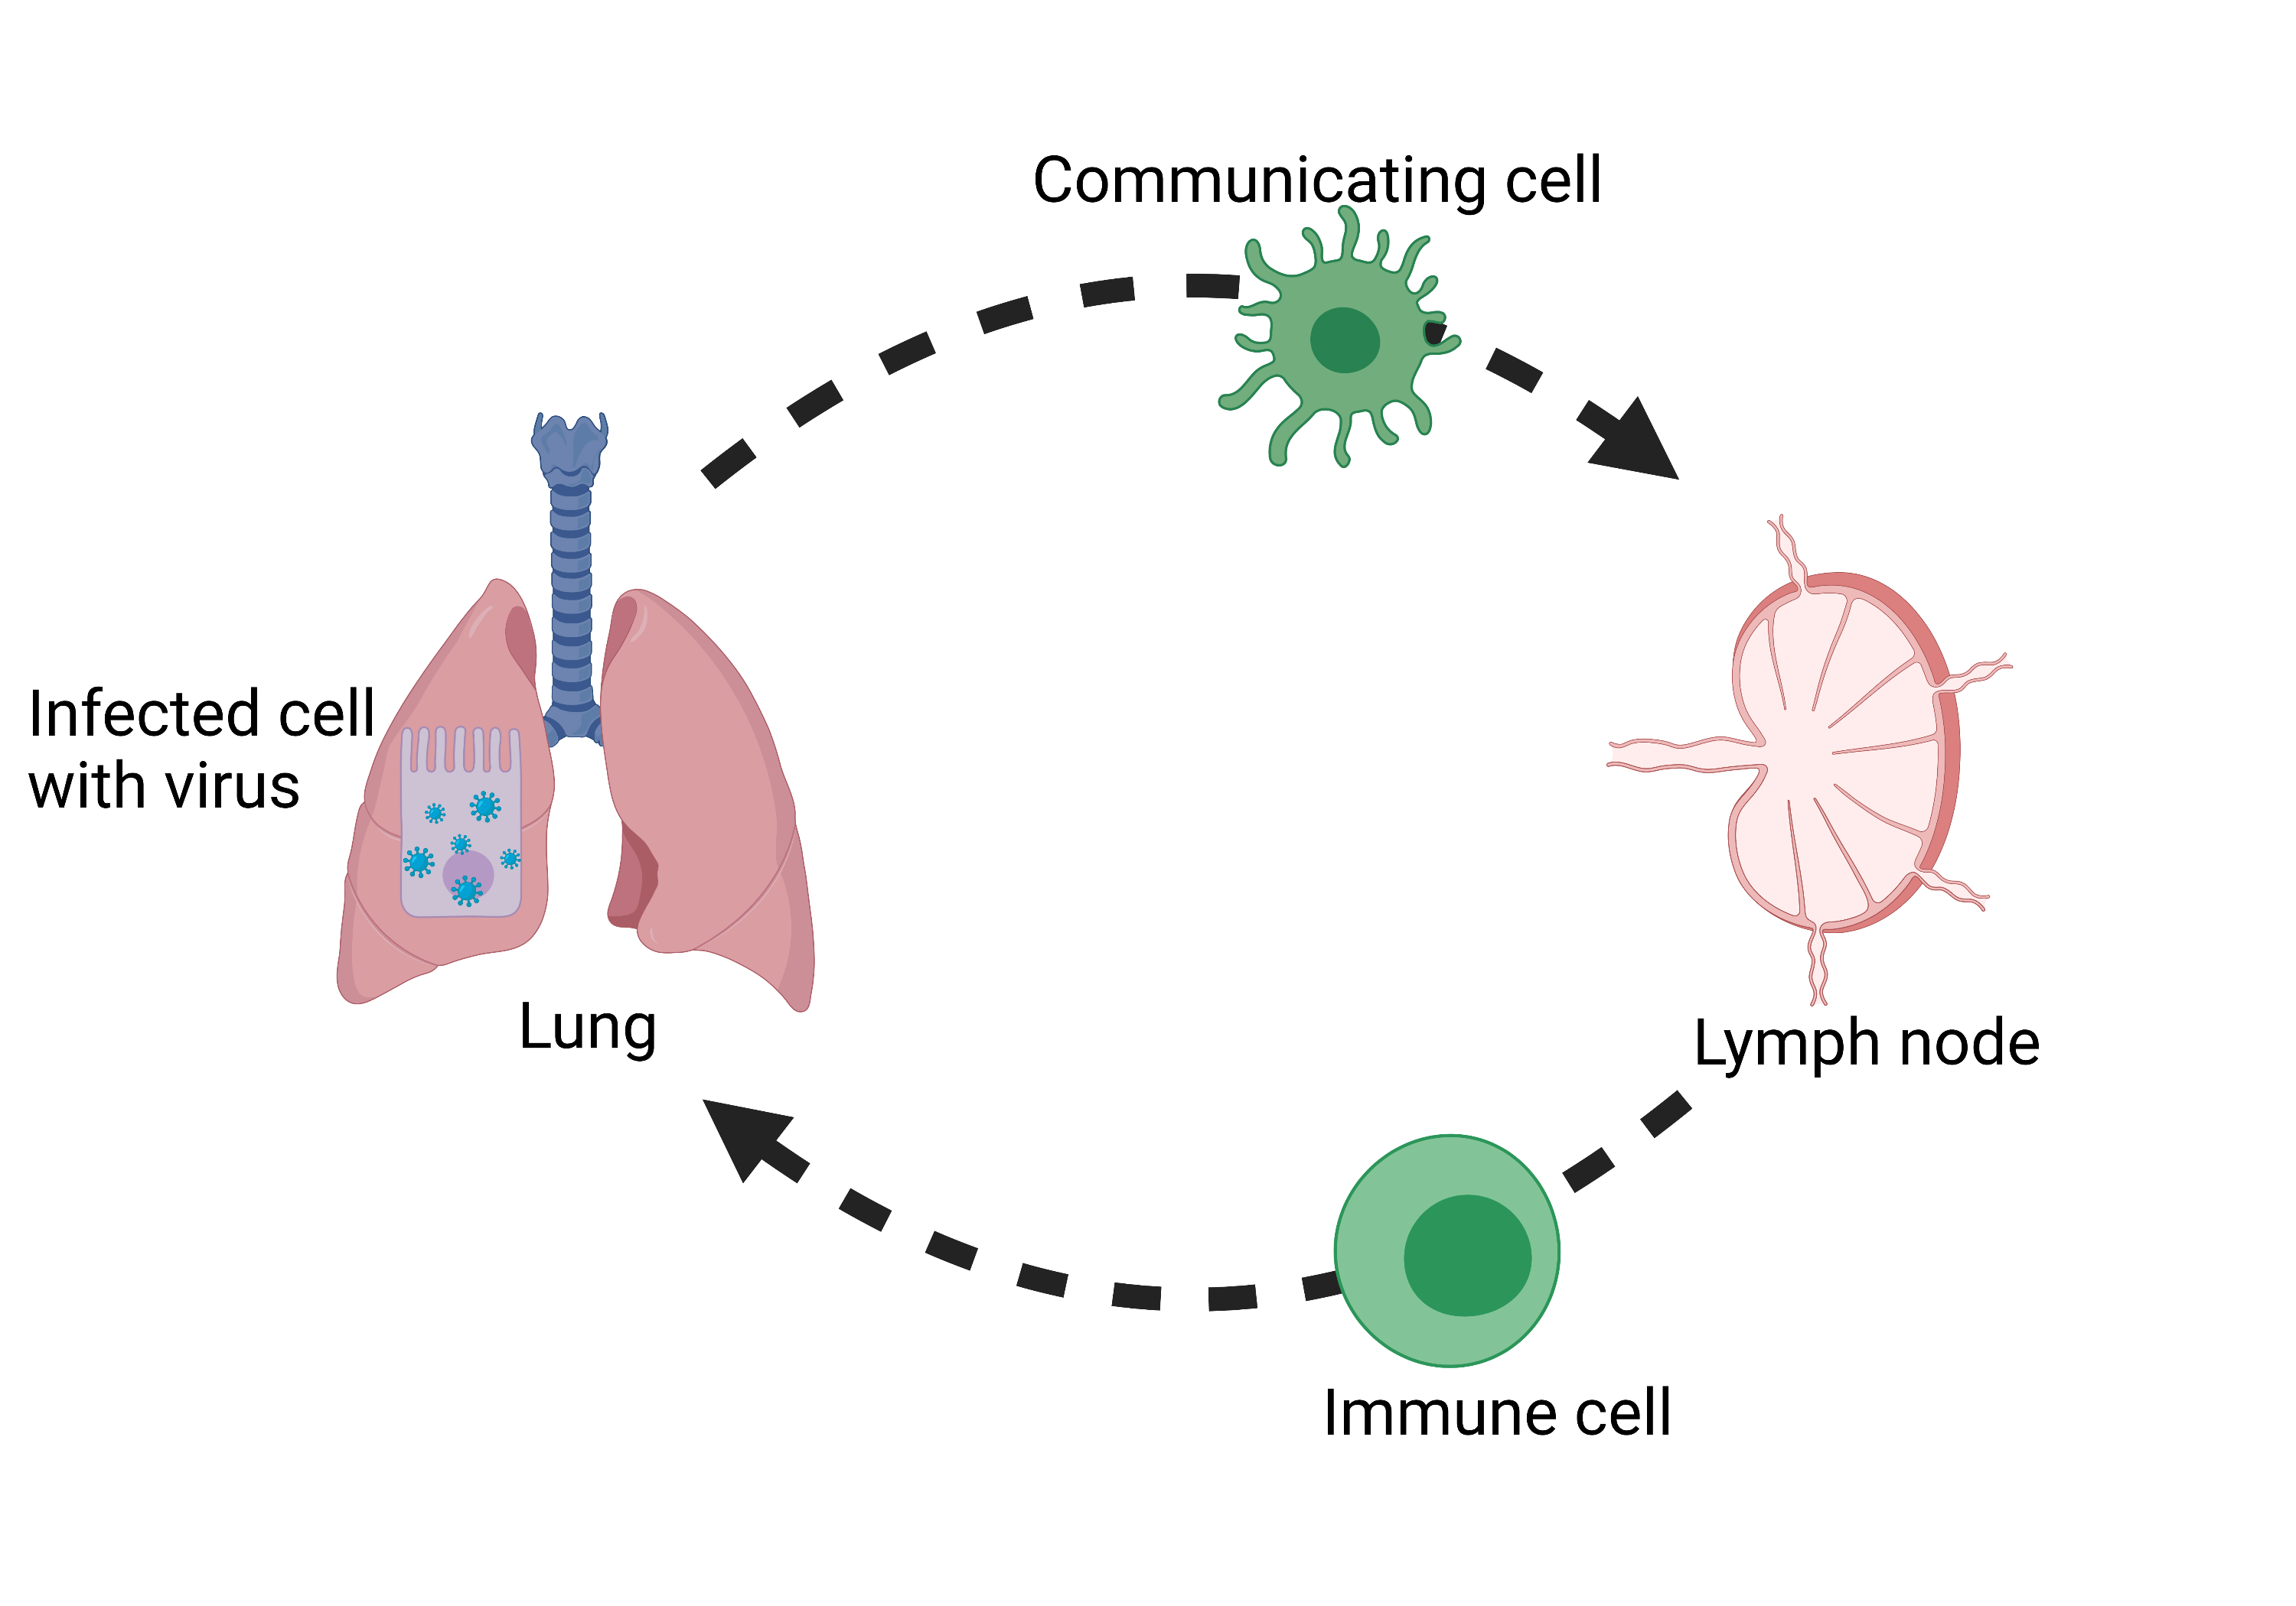
Communicating cells travel to immune fire stations to alert immune cells
Lung
Immune fire station
Bio render image

Slide 25
Depending on what’s caused the fire, you need a different fire extinguisher
WATER
FOAM
POWDER
CO2
WET CHEMICAL
Used on paper, wood, and other solid fuel fires
Used on any kind of fire except for cooking oils
Used on solid fuel fires
Used on flammable liquids and electrical fires
Used on cooking oil fires

Slide 26
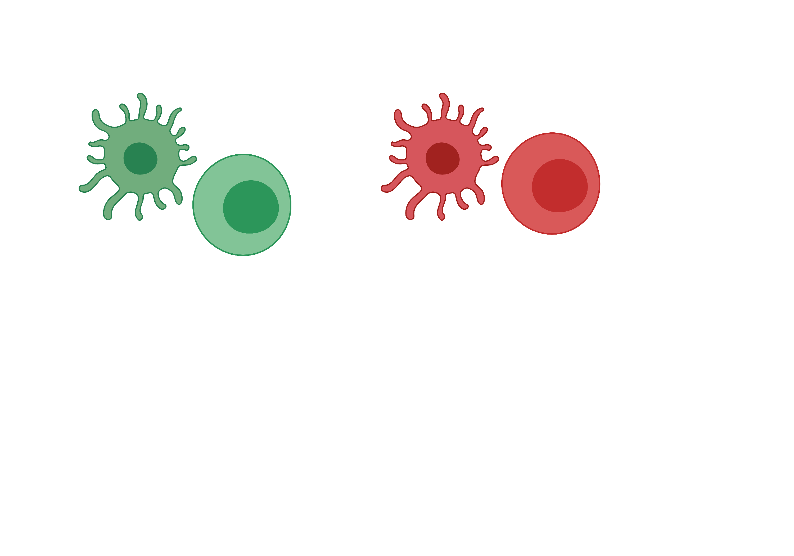
The communicating cell matches the virus up to the right immune cell
I’ve here to tell you there are lots of influenza viruses in the lung!!
Can you come and help!
I’ve here to tell you there are lots of SARS-CoV-2 viruses in the lung!!
Can you come and help!
Bio render image

Slide 27
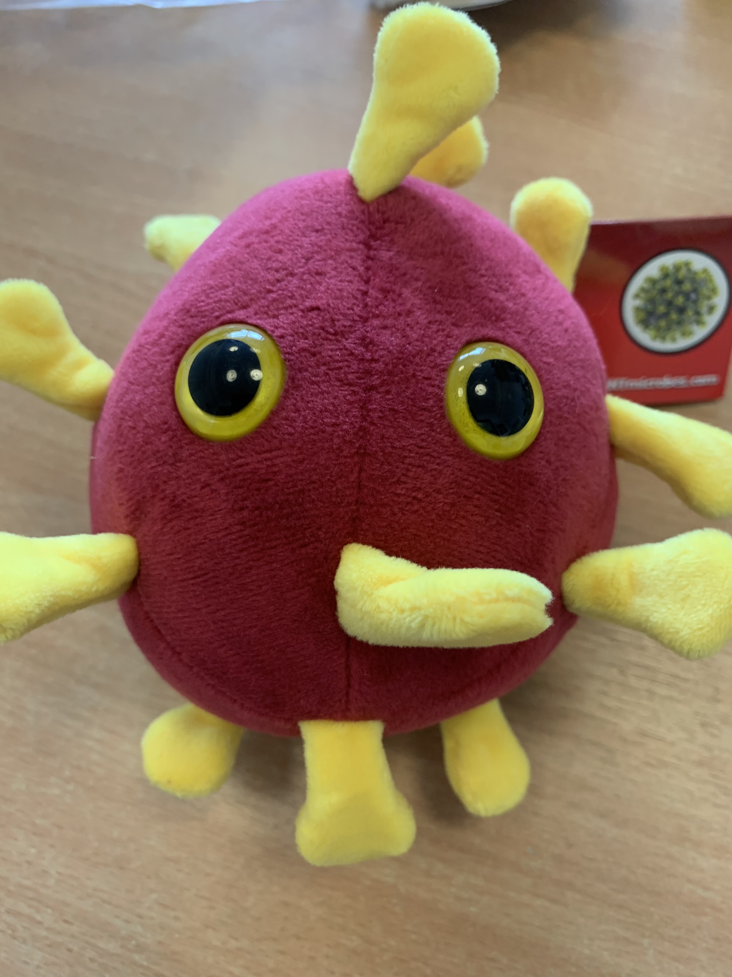
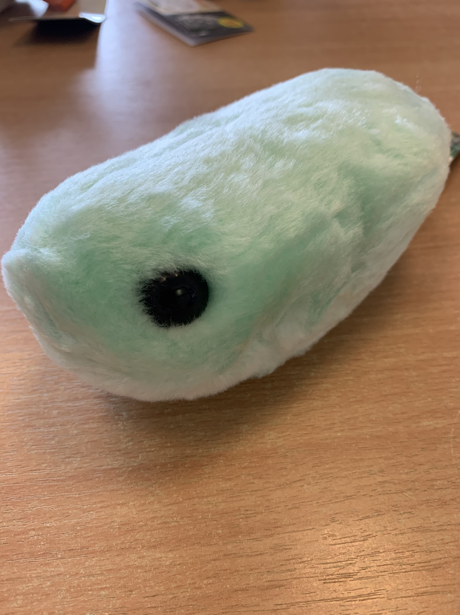
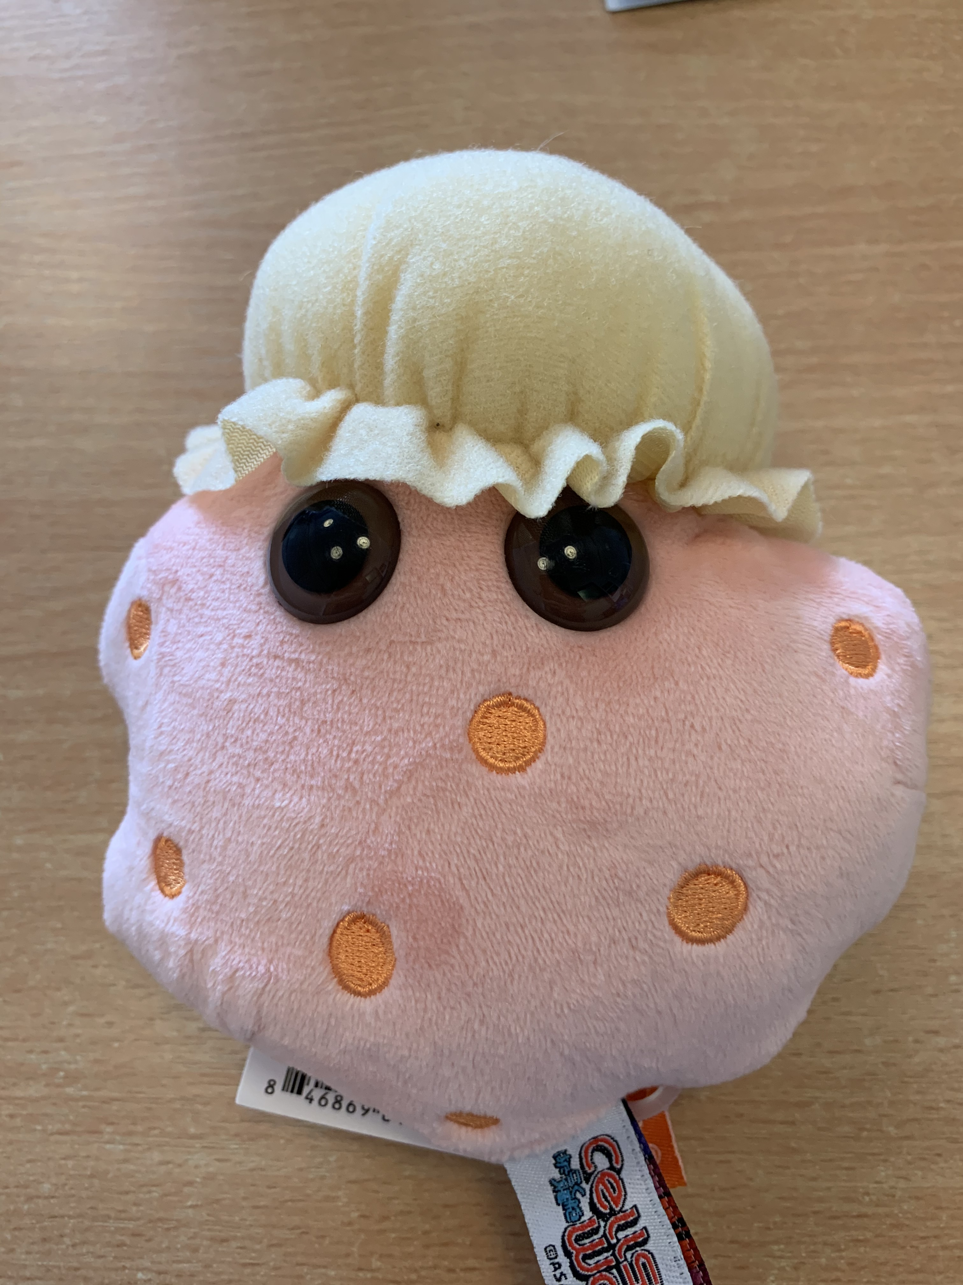
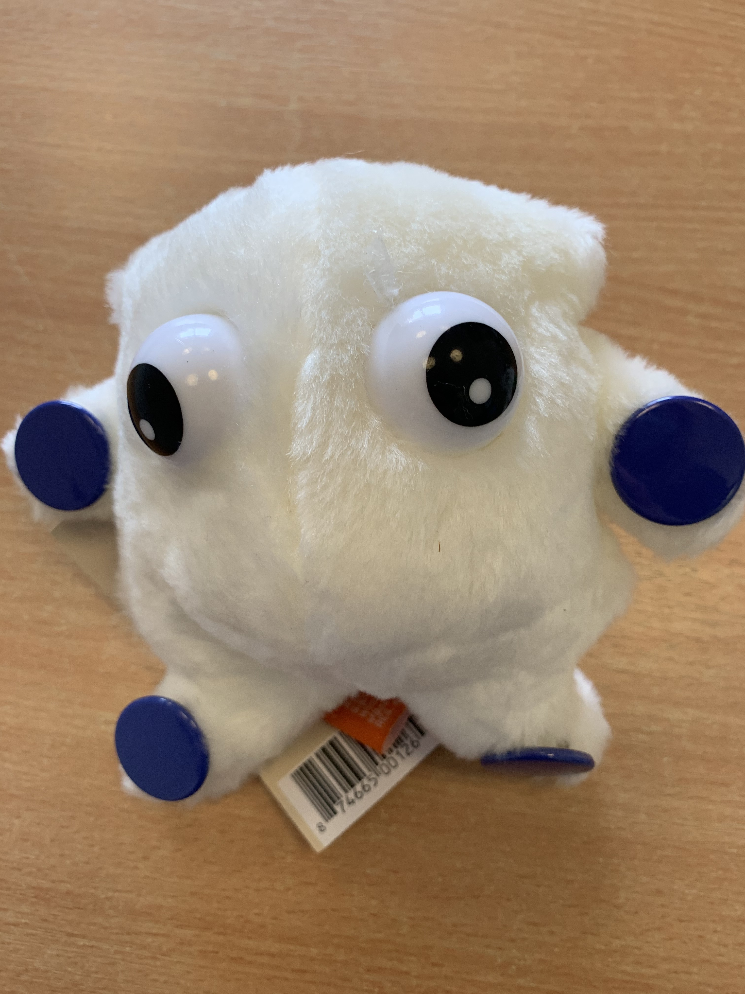
Co-IMMUNicate – can you match up the virus, the size of the response, and the immune cell?

Slide 28
Co-IMMUNicate game
5 pupils will get a virus – is it BIG (lots of virus) or small (little virus)?
5 pupils will get warning signals – they need to match with a virus
Only a few pupils will get a communicating cell – who do they need to match up with?
5 pupils will have a ‘be prepared’ immune cell or an immune cells that is trained to find the particular virus

Slide 29
On your job advert
Draw an immune cell to come to the lung to fight the infection
  Did you have a little virus – you need a ‘be prepared cell’?
  Did you have a lot of virus – you need a specially trained cells?

