Slide 1

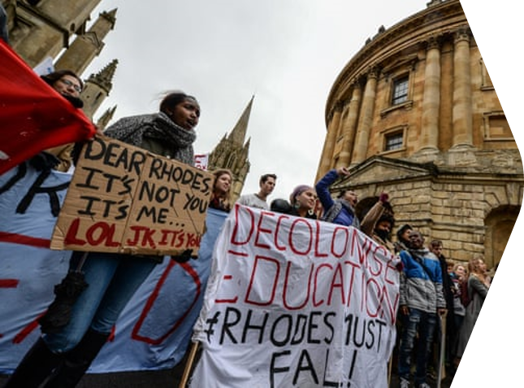
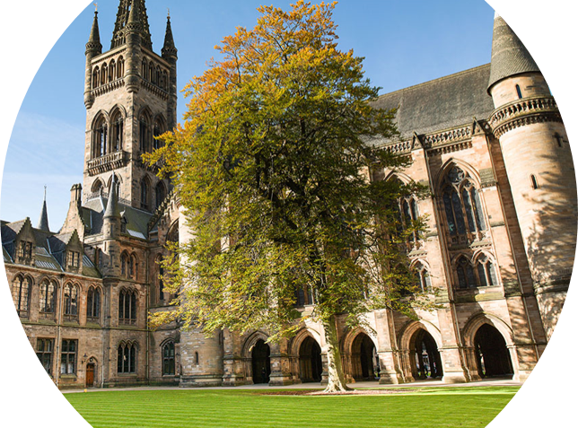

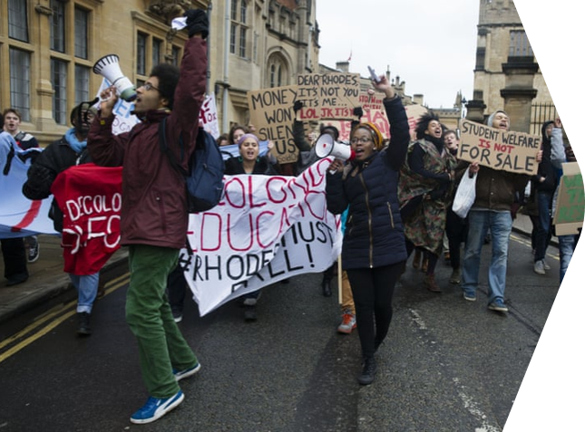
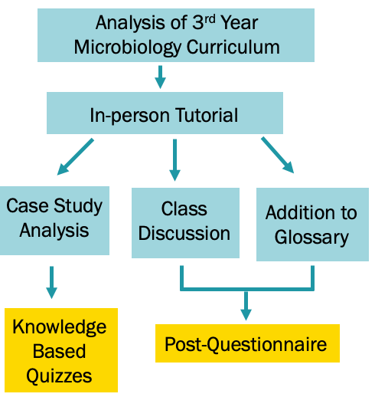
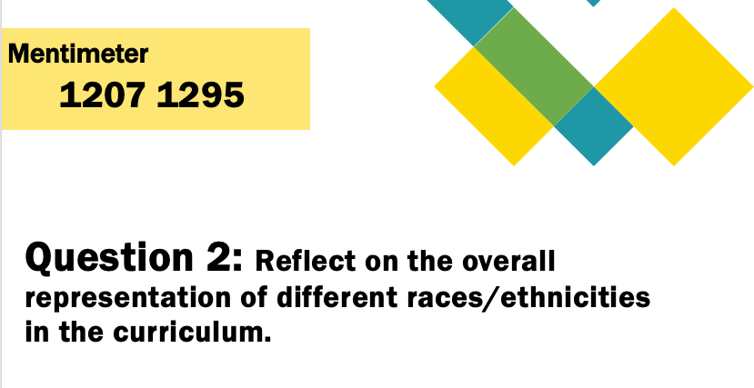
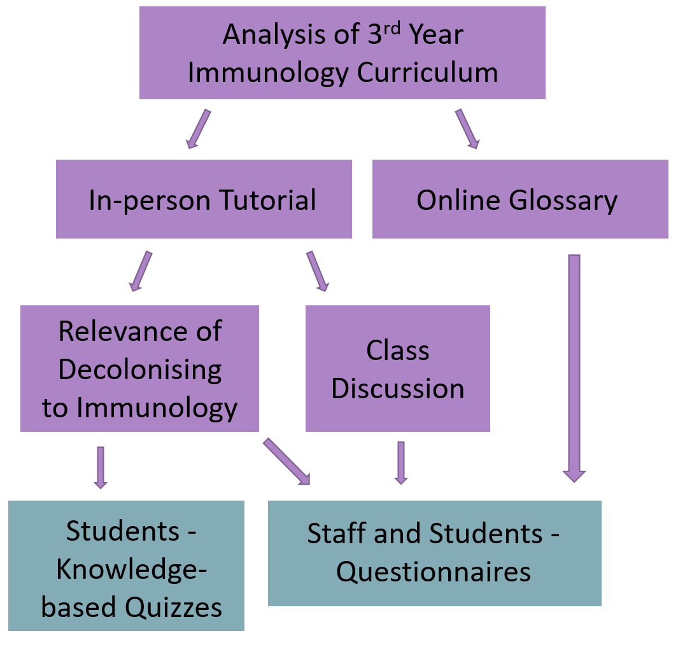
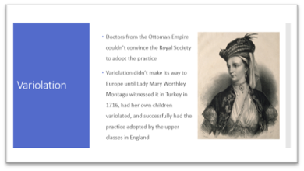
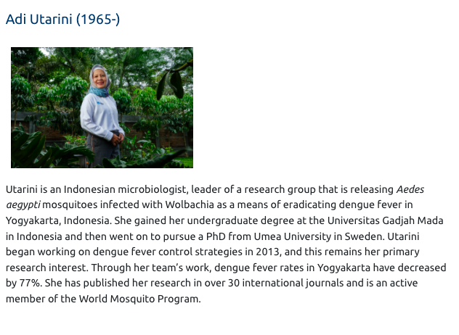
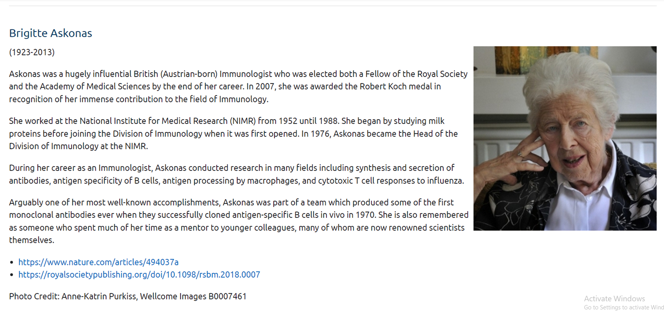
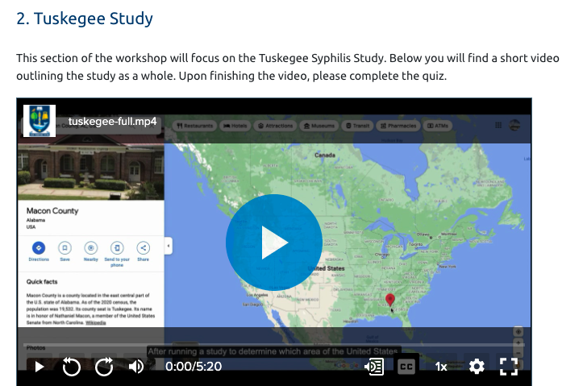
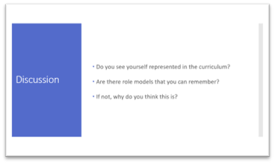


Decolonising the Life Science Curricula at the University of Glasgow
Lidia Errico, Zara Gatt, Leighann Sherry, Nicola Veitch
2377211e@student.gla.ac.uk, 2314298g@student.gla.ac.uk, leighann.sherry@glasgow.ac.uk, nicola.veitch@glasgow.ac.uk
School of Life Sciences
Definition: Decolonising the curriculum seeks to acknowledge and dismantle the way that imperialism and colonialism have shaped global education, with a focus on inclusion and visibility of a wider range of viewpoints which have been historically excluded.
The University of Glasgow's Vision
Reflections
Equality and Diversity Policy:
‘promoting respect or all, and challenging and preventing stereotyping, prejudice, discrimination and harassment’ and ‘inclusiveness which ‘embraces diversity by valuing and respecting the perspectives and contribution of all our colleagues and students.'
The responses from students and staff have been very positive overall and we feel that students did gain knowledge from our resources
Students and staff support the inclusion of resources like ours in Life Sciences curricula at the University of Glasgow
Learning and Teaching Strategy:
  ‘values of inclusivity, wellbeing, integrity and respect in our learning and curriculum design through decolonising the curriculum, […] and engaging in student-staff partnerships.’
It seems there is a lot of interest in work surrounding Equality & Diversity and Decolonising the Curriculum across the University
Aim: To create awareness of the Decolonising the Curriculum movement and its relevance to Life Sciences, learning resources were developed by students undertaking their final year projects and delivered to undergraduate students.
Projects like ours should continue to be supported within the Life Sciences and extend to out to other disciplines within the University
Microbiology:
Immunology:
Students are enthusiastic about this work and should continue to help lead it
What’s Next?
Conclusions:
There is a desire from students for the decolonisation of the curriculum.
Projects such as these can increase student involvement in curriculum development.
Future Consideration:
Inclusion of ethics, so that results can be shared.
Personal edits to tutorial structure.
Grants being awarded by the University of Glasgow to teaching staff for the development of such projects.
Next:
Incorporation of these projects within the curriculum, starting 2022/23.
Continued encouragement for students to pursue such projects in their final year.
School of Life-Science wide approach, with projects in all faculties.
Glossary:
40 diverse scientists and their achievements within Microbiology
Glossary:
15 scientists representing historically marginalised groups and their achievements within Immunology
Tutorial:
3h in-person tutorial, with 22 students in attendance.
Tutorial:
1h in-person tutorial with 9 students in attendance
Adapted into 4 videos and a facilitator's handbook for feedback from 3 staff members
          Tutorial Sections:
          What is Decolonising the Curriculum?
          Smallpox, variolation and vaccination
          Vaccine hesitancy in communities of colour
Case Studies:
Analysis of unethical experimentation on historically marginalised populations:
    Tuskegee Syphilis Study
    Willowbrook Study
    Robert Koch’s establishment of ‘Medical Concentration Camps’ in Colonial Africa
Lidia Errico
Zara Gatt
University of Glasgow. 2019. Equality and Diversity Policy. [online] Available at: <https://www.gla.ac.uk/myglasgow/humanresources/equalitydiversity/policy/equalitypolicy/#d.en.308442> [Accessed 4 February 2022]. University of Glasgow. 2021. Learning and Teaching Strategy. [online] Available at: <https://www.gla.ac.uk/myglasgow/senateoffice/policies/learningandteachingstrategy/> [Accessed 8 February 2022].

