Slide 1
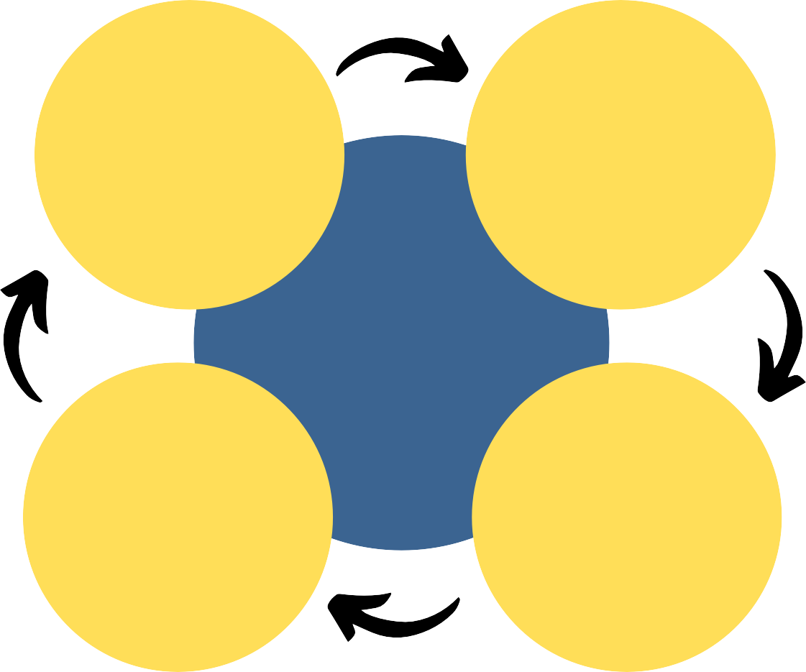
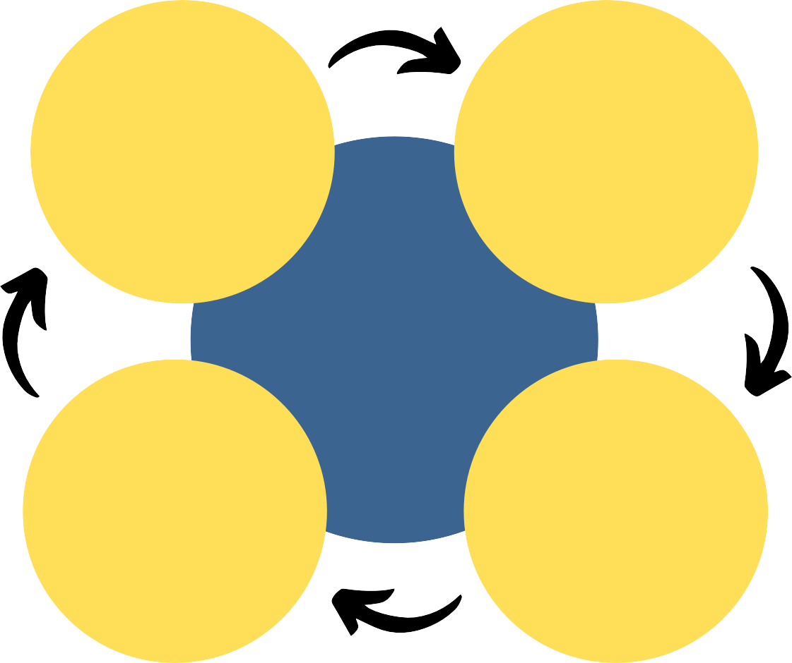
Mental Health and Employability
in Psychology Online Distance Learning Students
Dr. Steven McNair & Dr. Kieran O'Shea Steven.McNair@glasgow.ac.uk Kieran.O'Shea@glasgow.ac.uk
Rationale
The MSc Psychology Conversion ODL : 30 month, part-time course, is taught jointly by the School of Psychology & Neuroscience and the School of Education.
Research Themes
Student-led projects
Work-life balance and self-help strategies (Li Fangnan).
Performance & retention
Challenges
Perfectionism, engagement, and wellbeing (Xuejin Peng).
ODL Conversion continues to see a rise in student numbers: Year 19/20 = 15, Year 20/21 = 115, Year 21/22 = 146.
Mental Health
LGBTQ+ students' gender expression (Xuqing Feng).
ODL attracts a broader demographic of students compared to traditional on-campus learners.
LGBTQ+ students' mental health and academic support (Ewan Steel).
Coping strategies
Support available
ODL students are as likely to encounter mental health difficulties as on-campus students (Barr, 2014; Harrer et al., 2019; Richardson, 2015) but are often unable to obtain the same levels of support as on-campus learners (Barr, 2014; Lister & McFarlane, 2021).
LGBTQ+ international students' mental health and online social support (Jinyi "Iris" Chen).
Gender representation, self-efficacy and employability outcomes (Suzie Green).
ODL and on-campus students differ in their employability priorities (Butcher & Rose, 2014).
Perception of work readiness
Strategies in developing employability and work readiness (Audrey Dee).
Barriers to development
Much of the scholarship work done within the University focuses on F2F learning, which may not generalise to ODL students.
Employability
Further Information
We welcome comments, suggestions, and/or input from those with experience in this area. There are many ODL, MOOC, and online micro-credential courses within the University and we would be delighted to explore the possibility of an ODL pedagogical network.
References
Barr, B. (2014). Identifying and Addressing the Mental Health Needs of Online Students in Higher Education. Online Journal of Distance Learning Administration, 17(2). http://www.westga.edu/~distance/ojdla/summer172/barr172.html
Butcher, J., & Rose-Adams, J. (2015). Part-time learners in open and distance learning: Revisiting the critical importance of choice, flexibility and employability. Open Learning, 30(2), 127-137. https://doi.org/10.1080/02680513.2015.1055719
Harrer, M., Apolinário-Hagen, J., Fritsche, L., Drüge, M., Krings, L., Beck, K., Salewski, C., Zarski, A.-C., Lehr, D., Baumeister, H., & Ebert, D. D. (2019). Internet- and App-Based Stress Intervention for Distance-Learning Students With Depressive Symptoms: Protocol of a Randomized Controlled Trial. Frontiers in Psychiatry, 10. DOI: https://doi.org/10.3389/fpsyt.2019.00361
Lister, K., & McFarlane, R. (2021). Designing for wellbeing: An inclusive learning design approach with student mental health vignettes. Open Praxis, 13(2), 184-200. http://doi.org/10.5944/openpraxis.13.2.126
Richardson, J. T. E. (2015). Academic Attainment in Students with Mental Health Difficulties in Distance Education. International Journal of Mental Health, 44, 231– 240. https://doi.org/10.1080/00207411.2015.1035084
Development strategies
Prior experience benefits
@stevenwmcnair @OSheaKJ @UofGPsychNeuro

