Slide 1
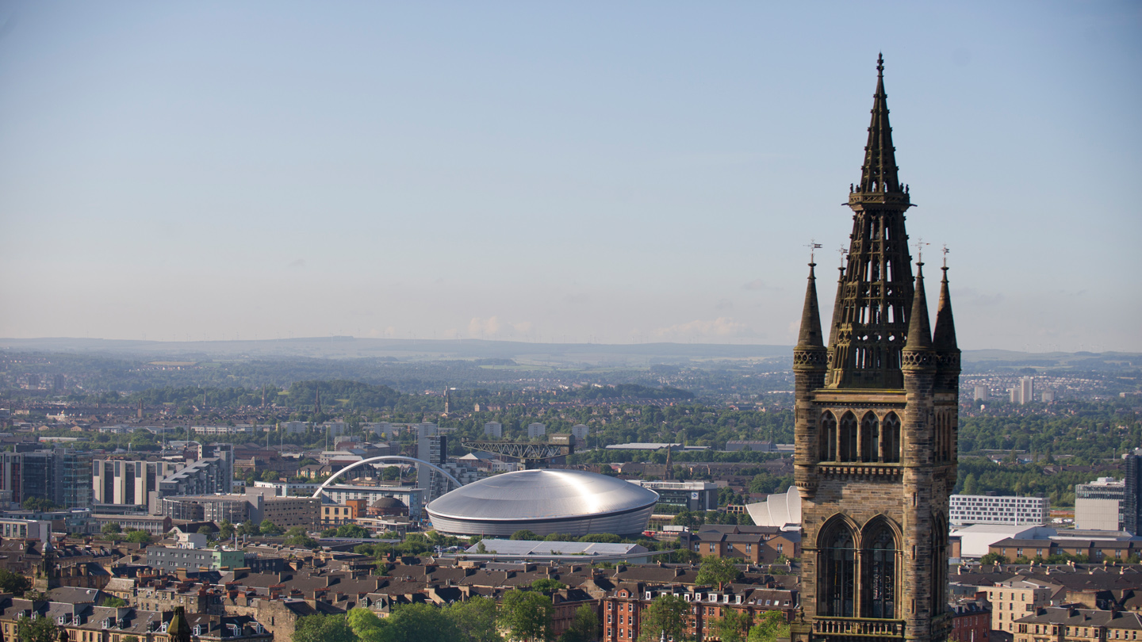


Inclusivity in Learning, Teaching and Assessment
Moira Fischbacher-Smith, Vice Principal Learning & Teaching
Mia Clarke, SRC Vice President Education

Slide 2
Educational Purpose at the University of Glasgow
Our core educational purpose is to develop and support our students through an excellent University experience so that they fulfil their academic potential and contribute in the fullest way possible to culture, society and the economy locally and globally throughout their lives. We seek to create an inclusive environment where students develop meaningful relationships with one another and with staff, and through those encounters, create new knowledge, challenge received wisdom, build inter-cultural and leadership capabilities, and develop disciplinary excellence and an appetite for lifelong learning and enquiry. (Learning & Teaching Strategy, 2021-25)
Source: https://www.gla.ac.uk/myglasgow/learningandteaching/strategy/

Slide 3
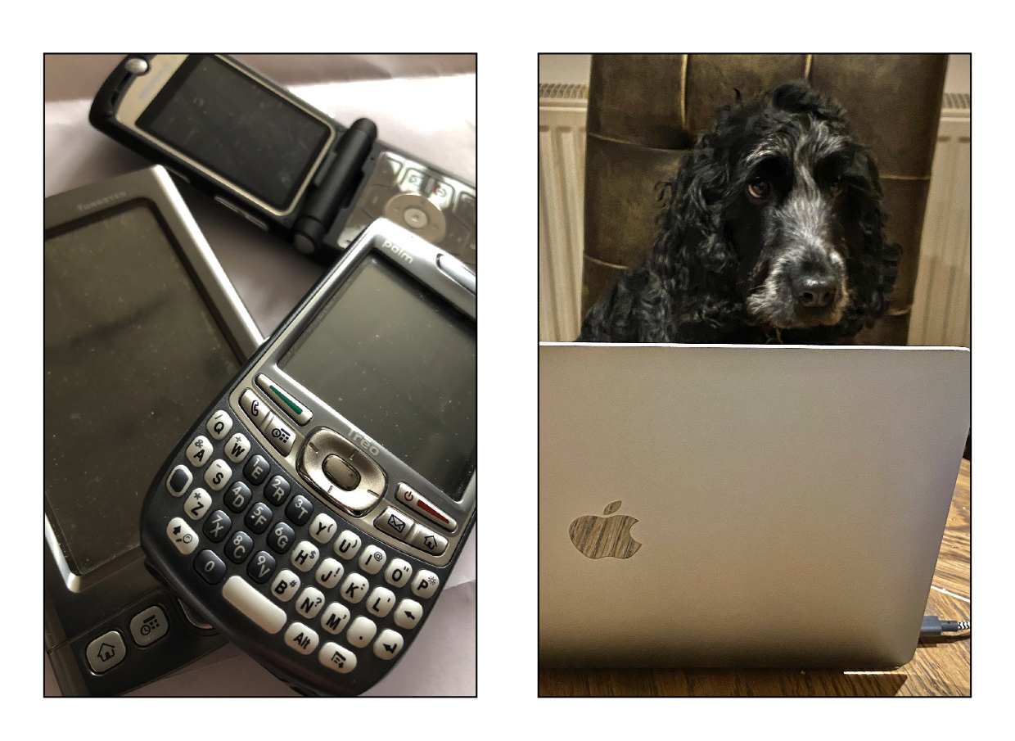
UNESCO (United Nations Educational, Scientific and Cultural Organisation)
“ UNESCO promotes inclusive education systems that remove the barriers limiting the participation and achievement of all learners, respect diverse needs, abilities and characteristics and that eliminate all forms of discrimination in the learning environment.”
Source: https://en.unesco.org/themes/inclusion-in-education

Slide 4


Perspectives on Inclusivity in Higher Education
“The intercultural curriculum creates a space in which learners and teachers cohabit and where different perspectives are acknowledged, welcomed and learned from. These spaces for learning in higher education are invaluable in UK higher education in our times.”
(Source: “How would you create the intercultural curriculum?” Advance HE Thematic Series, https://www.advance-he.ac.uk/scotland/thematic-series/intercultural-curriculum#how)
“There is however a variation in terms of language used in the responses with those who use phrases like 'anti-racism' and 'decolonisation' in addition to the more commonly used terms like inclusion, diversity and addressing unconscious bias.”
(Source: “Teaching in a Diverse Scotland” (2021) Scottish Government, https://www.gov.scot/publications/teaching-diverse-scotland-increasing-retaining-minority-ethnic-teachers-3-years/documents/)

Slide 5
“… necessitates a shift away from supporting specific student groups through a discrete set of policies or time-bound interventions, towards equity considerations being embedded within all functions of the institution and treated as an ongoing process of quality enhancement.
Making a shift of such magnitude requires cultural and systemic change at both the policy and practice levels.”
(May and Bridger, 2010, p.6).

Slide 6
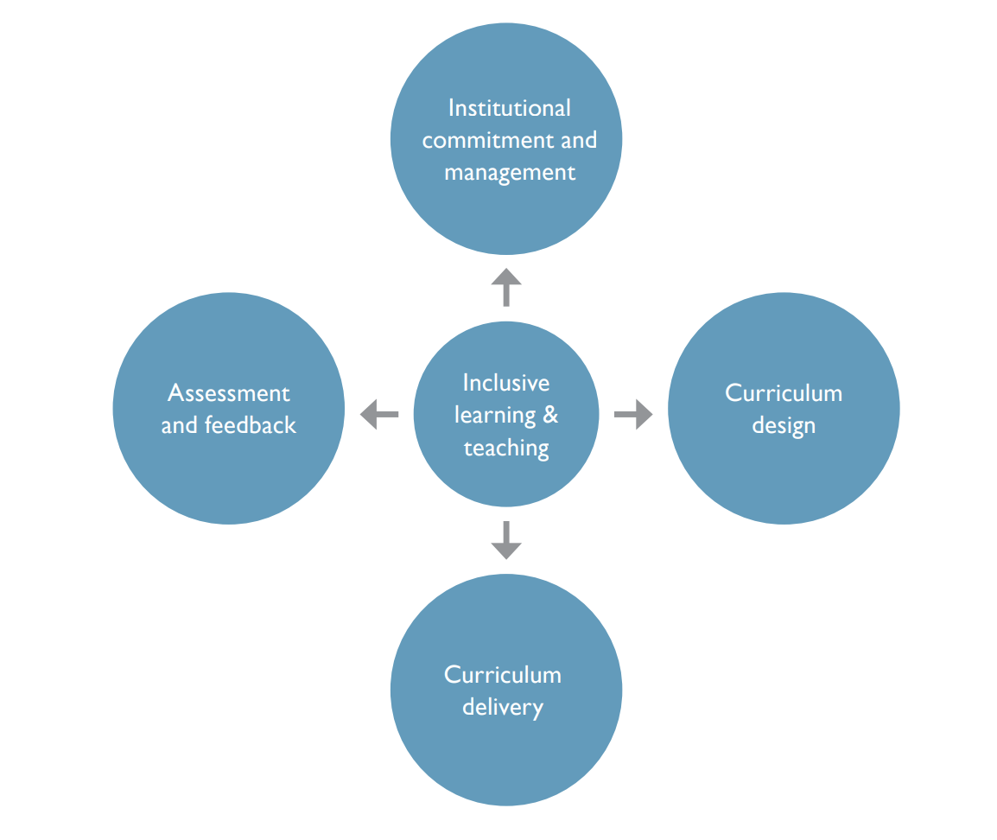
Elements of Inclusive Learning & Teaching
Source: Thomas and May, (2010) “Inclusive learning and teaching in higher education”, Higher Education Academy.

Slide 7
Initial ‘Simple’ Actions
Housing all teaching materials on the virtual learning environment in such a way that students can access them when they are needed, before or after formal teaching.
Improve the accessibility of all materials provided (even if just with the right sub-headings or an appropriate use of font).
Ensure reading lists are focussed and up to date
Allow or facilitate the recording of teaching
The use of plain English and clear presentation in lectures
The pre-selection of diverse learning groups
Diversify the range of learning opportunities, approaches and assessment methods
Regarding students as learning partners
The embedding of inclusive practice in recruitment, promotion, performance development review and other staff focussed processes
Source: “Inclusive Teaching and Learning in Higher Education as a route to Excellence”, UK Government, 2017. www.gov.uk/government/publications

Slide 8

Strategy Pillars
Evolving Approach to Student-Centred Active Learning
Transforming curricula and assessment
Students’ Professional & Skills Development
#Pivotonline
#Coronavirus
Image source: theguardian.com

Slide 9
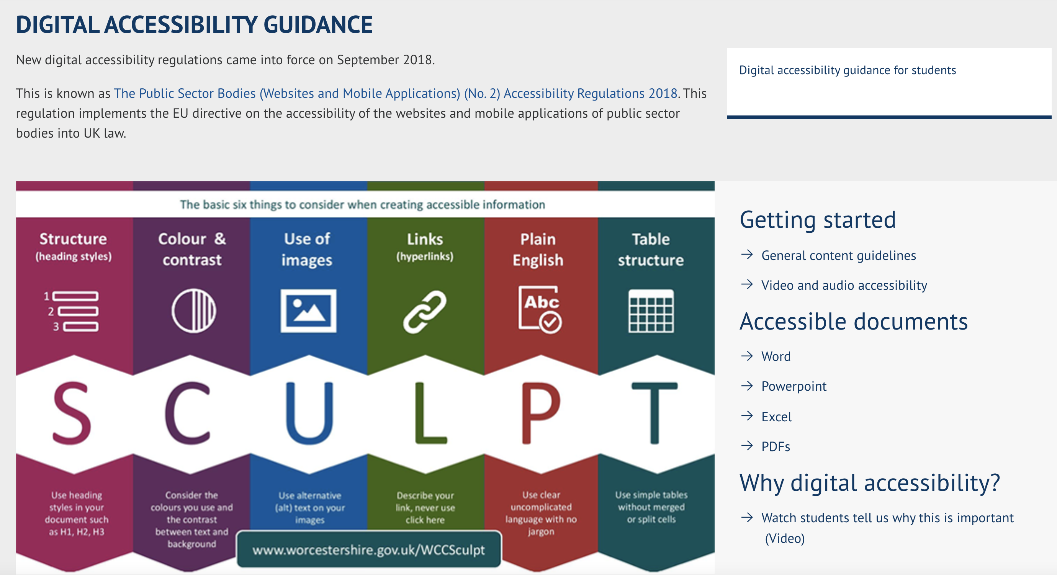
Source: https://www.gla.ac.uk/myglasgow/digitalaccessibility/

Slide 10
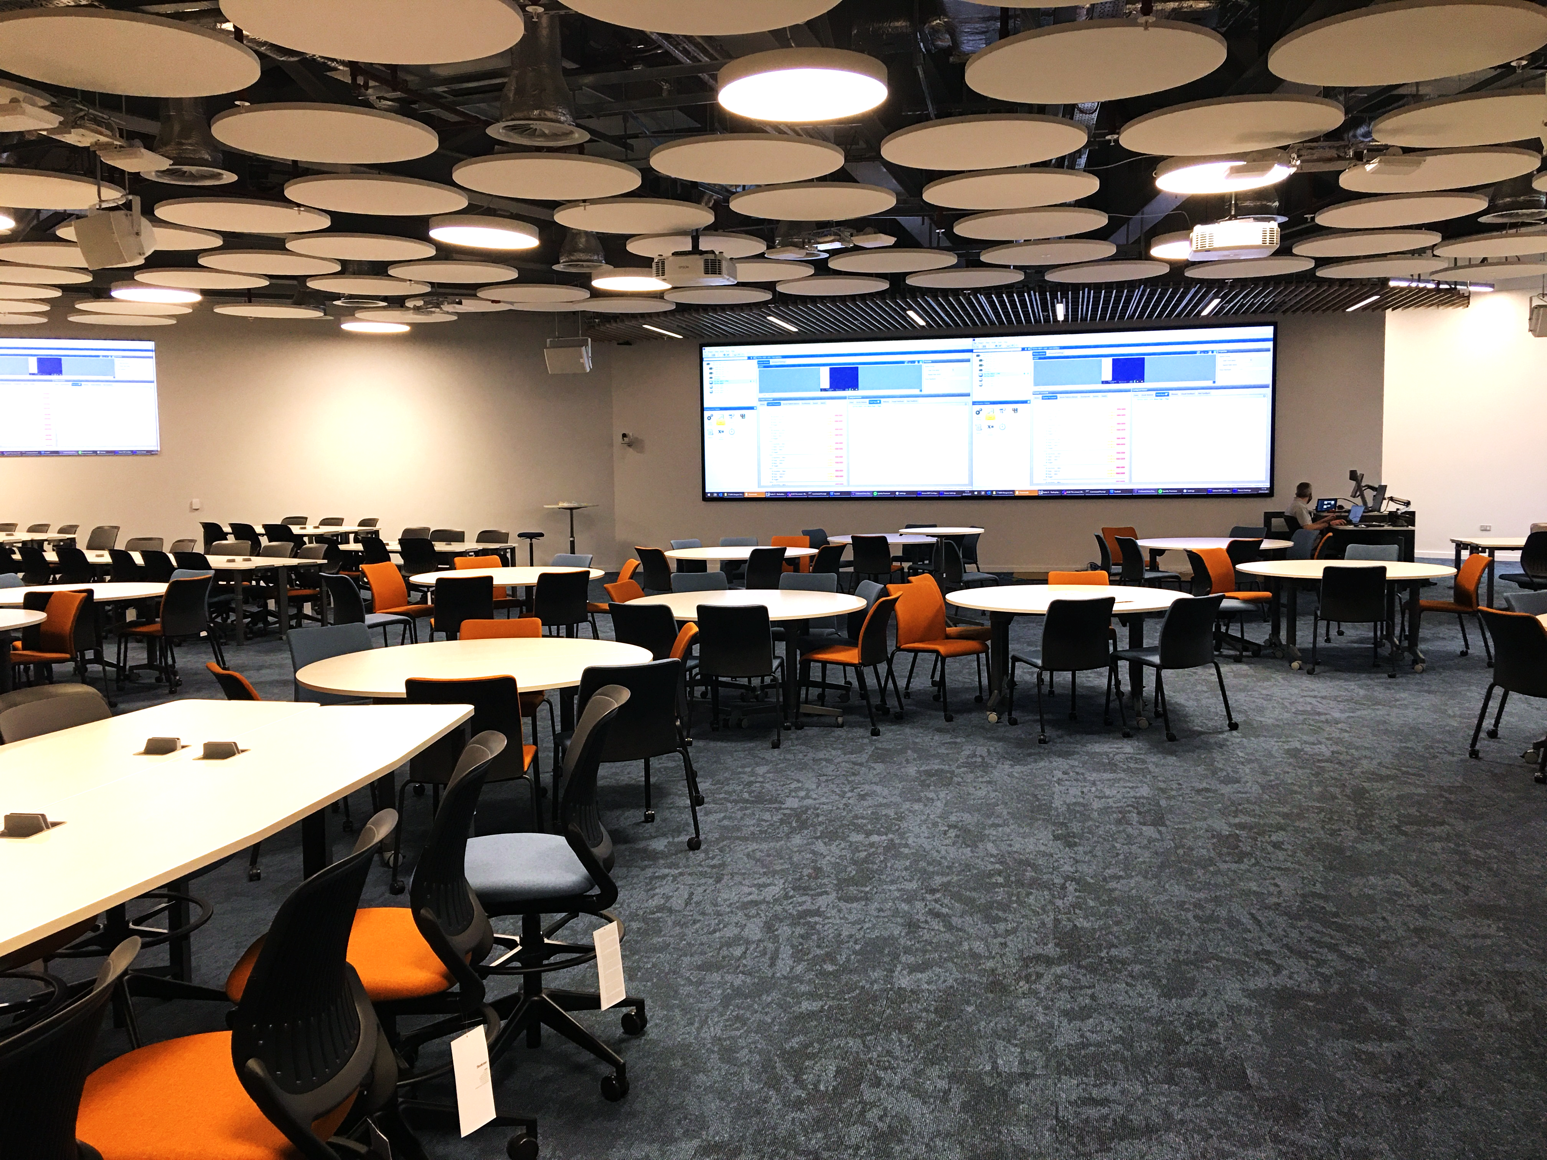
Pillar 1: Evolving Approach to Student-Centred Active Learning
Redesigning teaching to support interaction
Maximising, and supporting engagement with, blended learning opportunities
Developing team approaches to design and delivery of teaching
Redesigning formative and summative assessment to connect to real world challenges
Flexibility to support relevant course combinations and multidisciplinarity
Easier transition through routes to study
Image source: David Anderson, Information Services

Slide 11
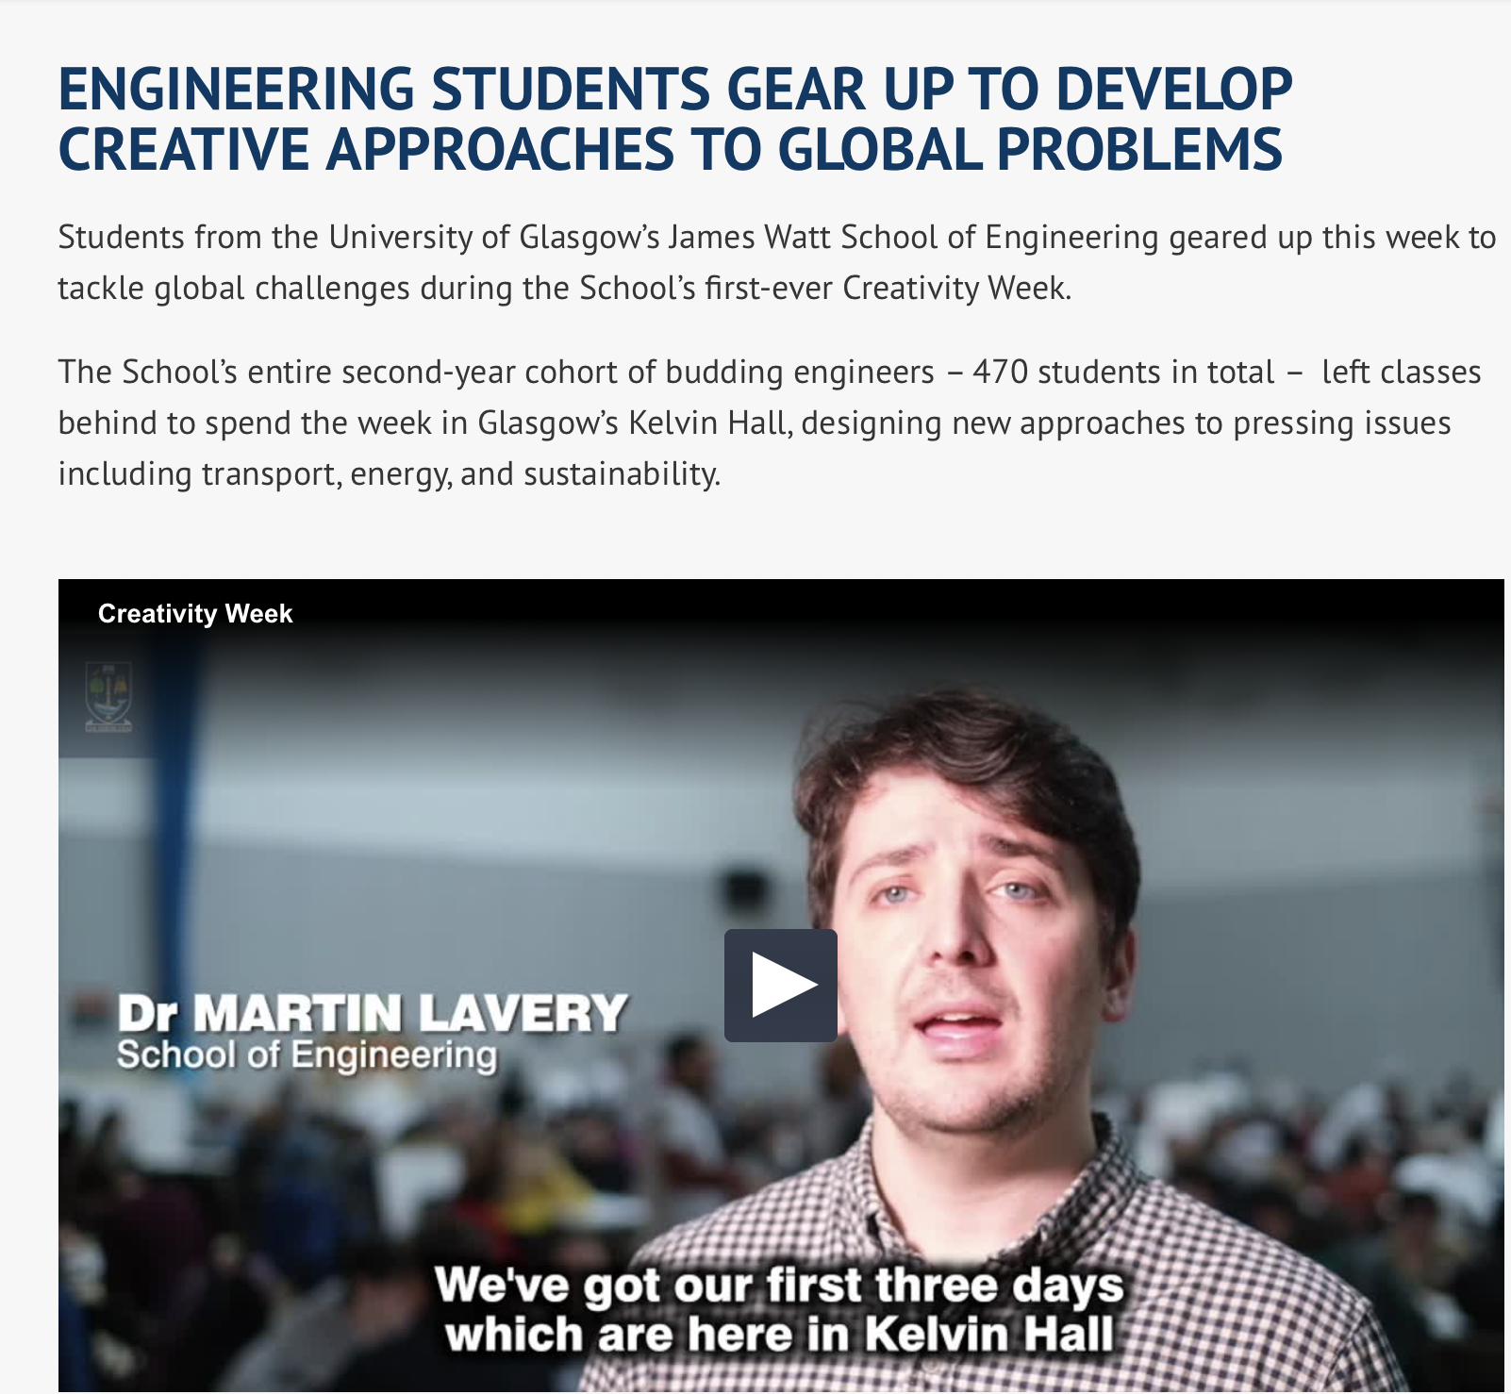
Pillar 2: Transforming Curricula and Assessment
Connecting with real-world challenges
Programmes and assessment that foster creativity and problem solving
Programmatic and inclusive curriculum design and assessment
Work-based learning, employer engagement and student-led practice engagement
Developing students’ independent learning and groupworking skills
Enabling relationship building to support wellbeing and retention

Slide 12
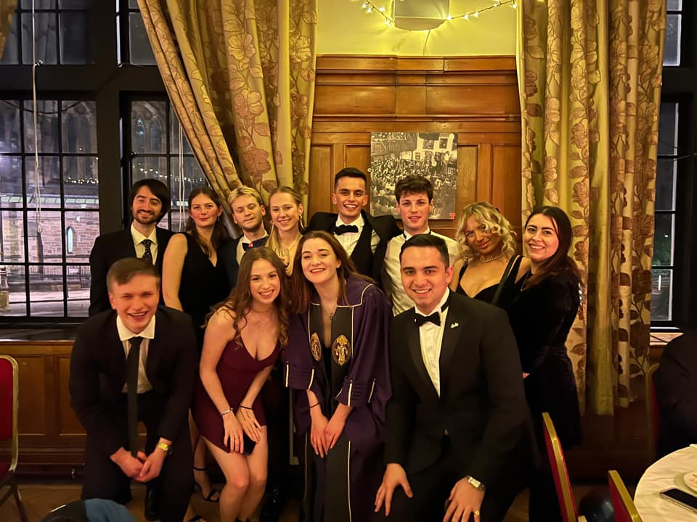
The SRC and our work in this area
Staff / Student partnership means our work is often mirrored to the University
Inclusive Education Charter
SRC Representation pyramid
Decolonising the Curriculum movement

Slide 13
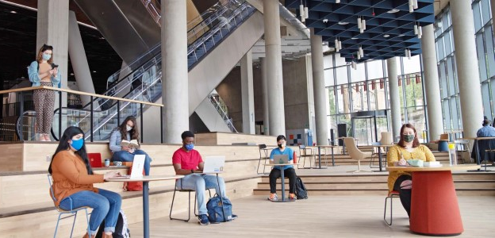
Student Perspectives on Inclusive Education
Introducing Decolonising the Curriculum as teaching practise and collective dialogue
Consideration of tokenism
Lack of common understanding of what inclusive education means in practice

Slide 14
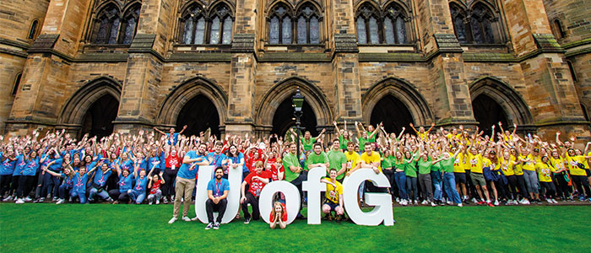
Future of Inclusive Education from the student population

Slide 15

Specific Initiatives
Student Staff Partnerships (x60)
LTDF projects linked to values in the strategy
URTUC Action Plan (https://www.gla.ac.uk/myglasgow/humanresources/equalitydiversity/understandingracism/)
Decolonising the curriculum Community of Practice
Inclusive Learning & Teaching theme for L&T Conference 2022 (!)
New appointments to support curriculum redesign
Assessment & Feedback Transformation Project (Accessible & Inclusive Learning Policy)

Slide 16
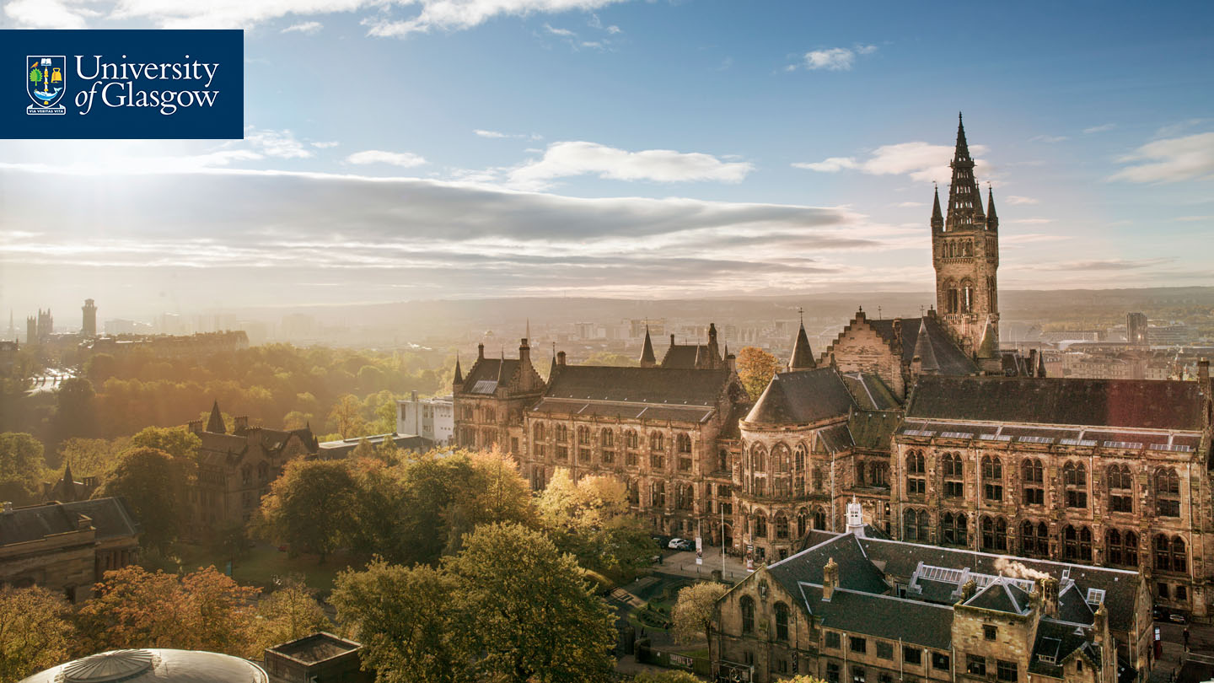



Thank you.
#UofGWorldChangers
@UofGlasgow

