Slide 1
Three Case Studies in Incremental Moodle Course Enhancements
15th Annual University of Glasgow Learning & Teaching Conference
March 2022
William Farquharson
Julian Hopkins

Slide 2

Cognitive Load Theory – Cognitive Processing
Extraneous processing
Essential processing
Generative processing
“cognitive processing that does not support the instructional objective and is created by poor instructional layout (such as having a lot of extraneous text and pictures)”
“cognitive processing aimed at mentally representing the core material (consisting mainly of selecting the relevant material) and is created by the inherent complexity of the material”
“cognitive processing aimed at deeper understanding of the core material (consisting mainly of organizing and integrating) and is created by the motivation of the learner to make sense of the material and can be supported by instructional methods that promote engagement with the material.”
(Clark and Mayer, 2016: 37)

Slide 3

Cognitive Load Theory
“good instructional design should reduce extraneous cognitive load and use the liberated cognitive resources to increase germane cognitive load and learning” (Plass et al., 2010: 4; emphasis added)

Slide 4
Mayer’s 15 Principles of Multimedia Design
Extraneous processing
Essential processing
Generative processing
Coherence
Signalling
Redundancy
Spatial Contiguity
Temporal Contiguity
Segmenting
Pre-training
Modality
Personalisation
Voice
Image
Embodiment
Immersion
Generative Activity
(Clark and Mayer, 2016: 39; Mayer, 2020)

Slide 5
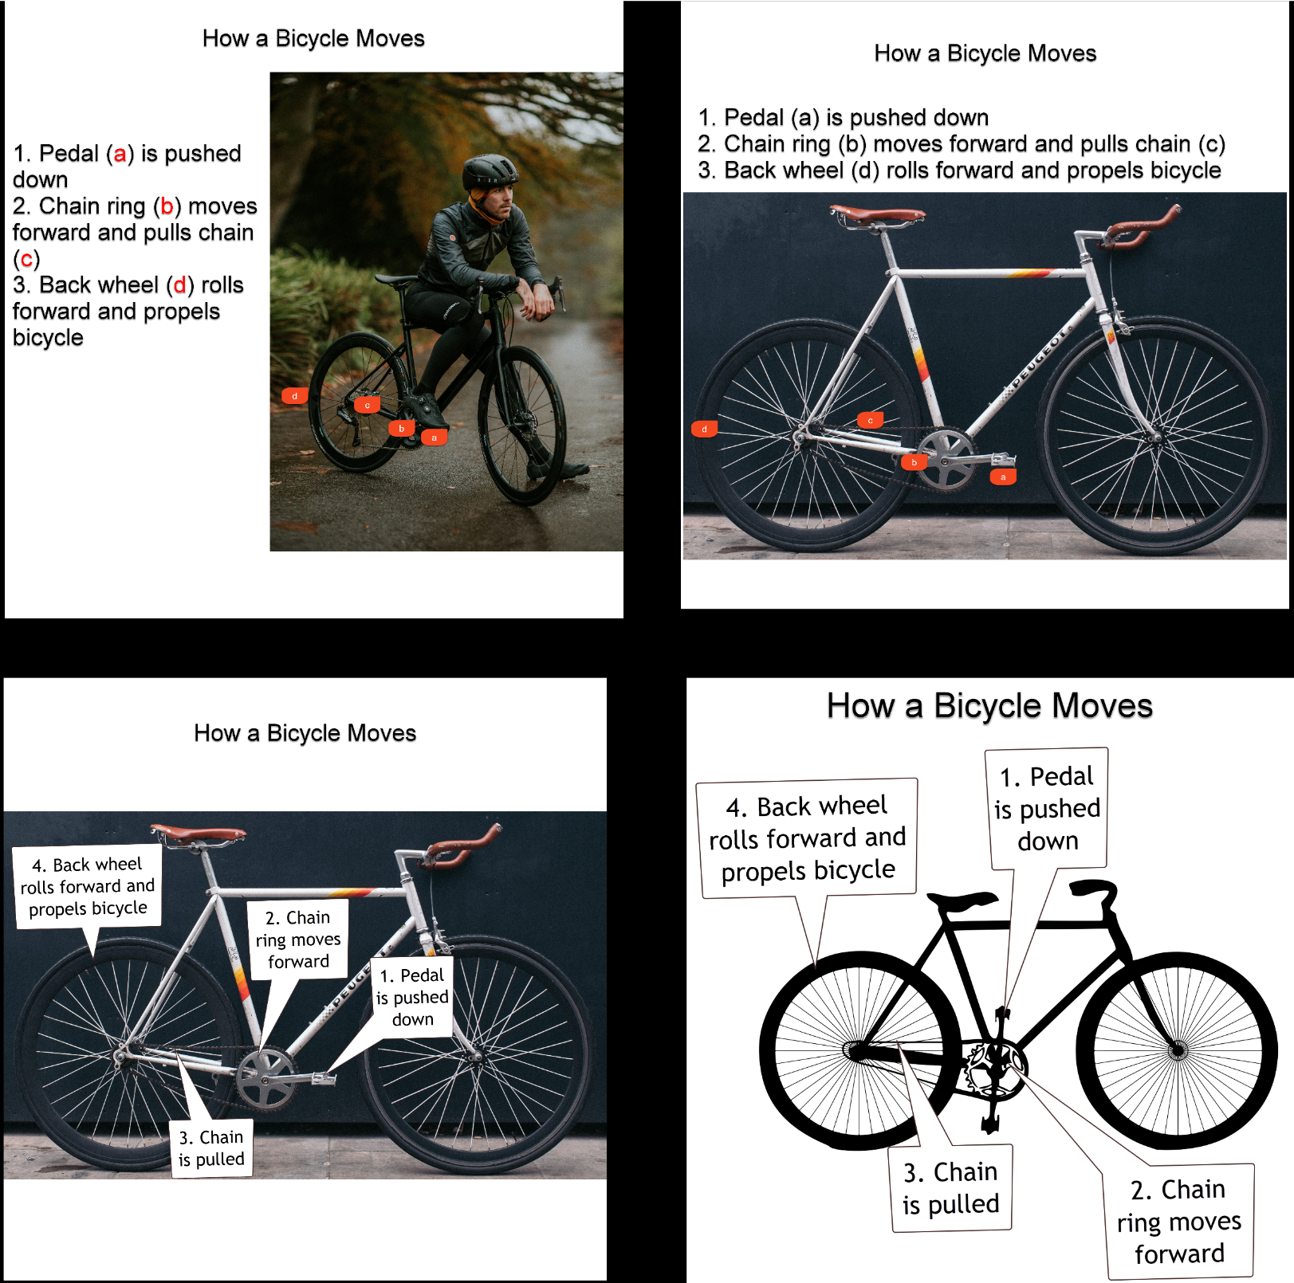
Image Comparison
A
B
C
D

Slide 6
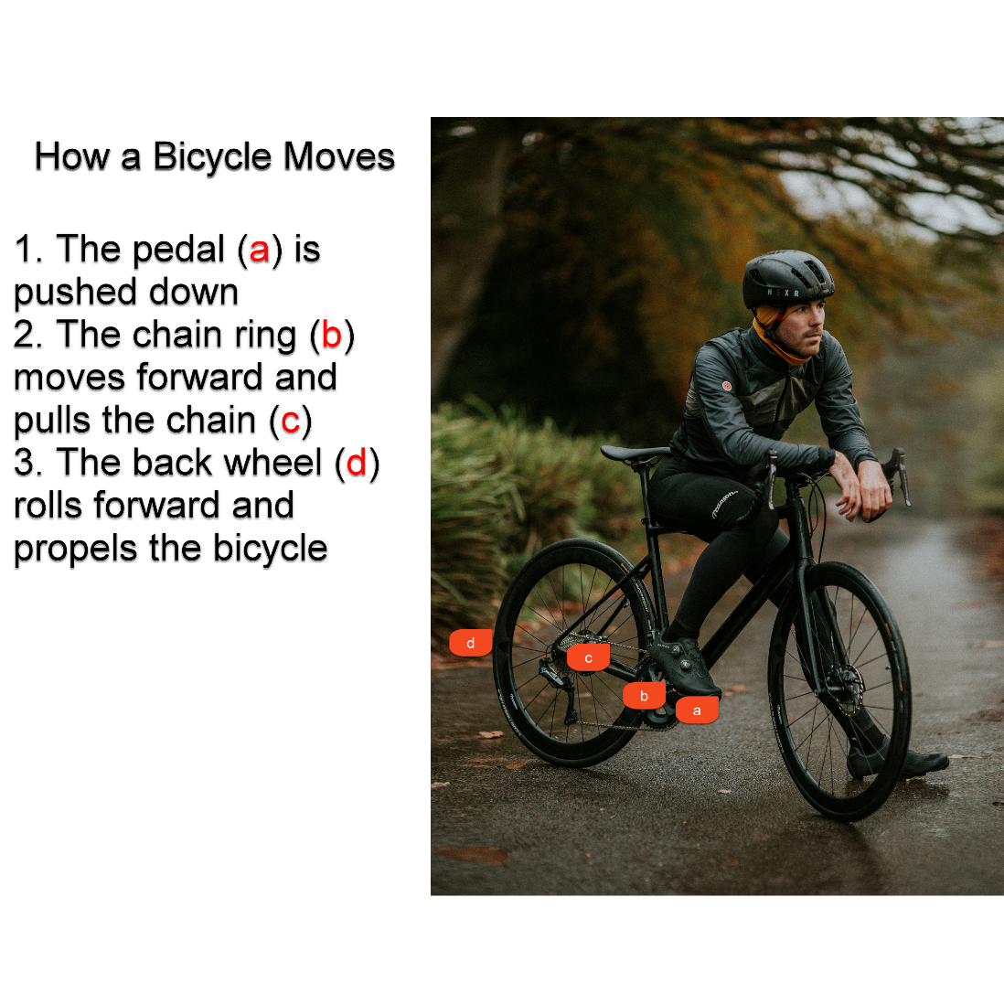
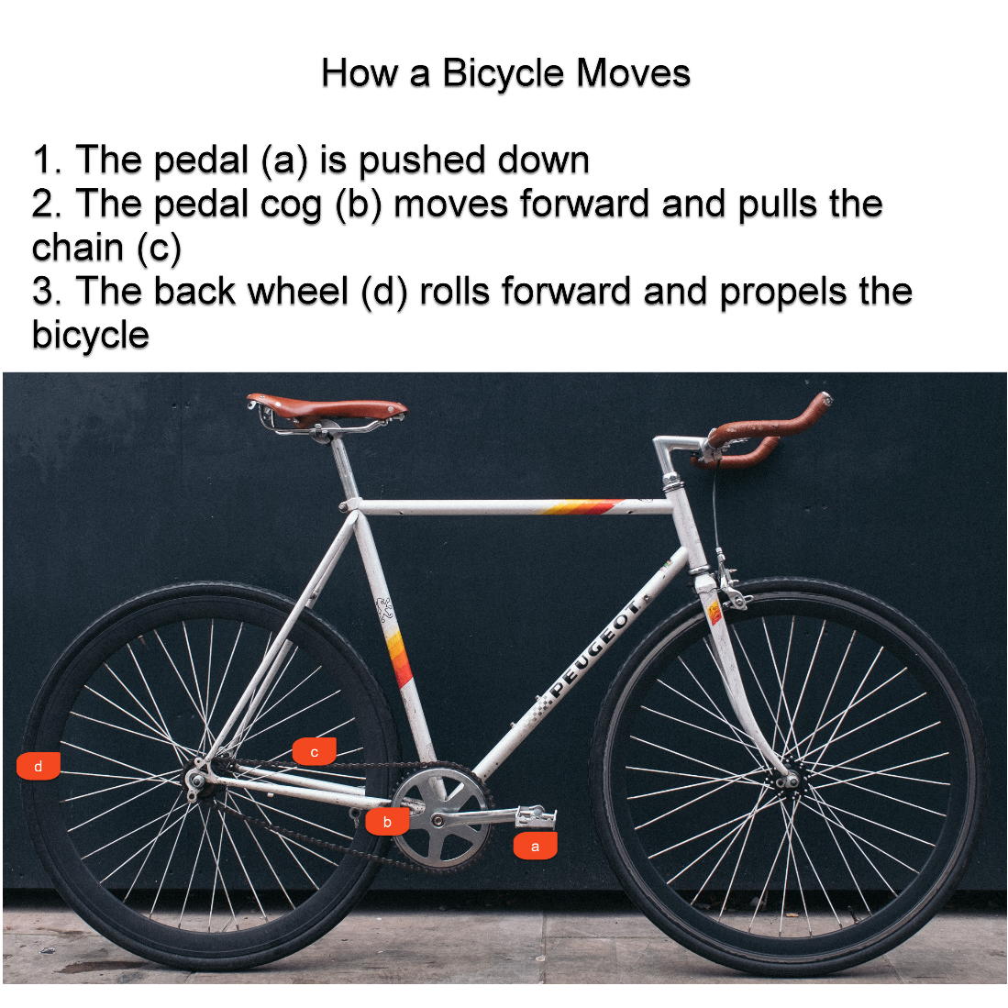
Coherence Principle
“Do not use unneeded words, sounds, or graphics.” (Clark and Mayer, 2016: 39)
Notes:
1. Pedal (a) is pushed down
2. Chain ring (b) moves forward and pulls chain (c)
3. Back wheel (d) rolls forward and propels bicycle

Slide 7
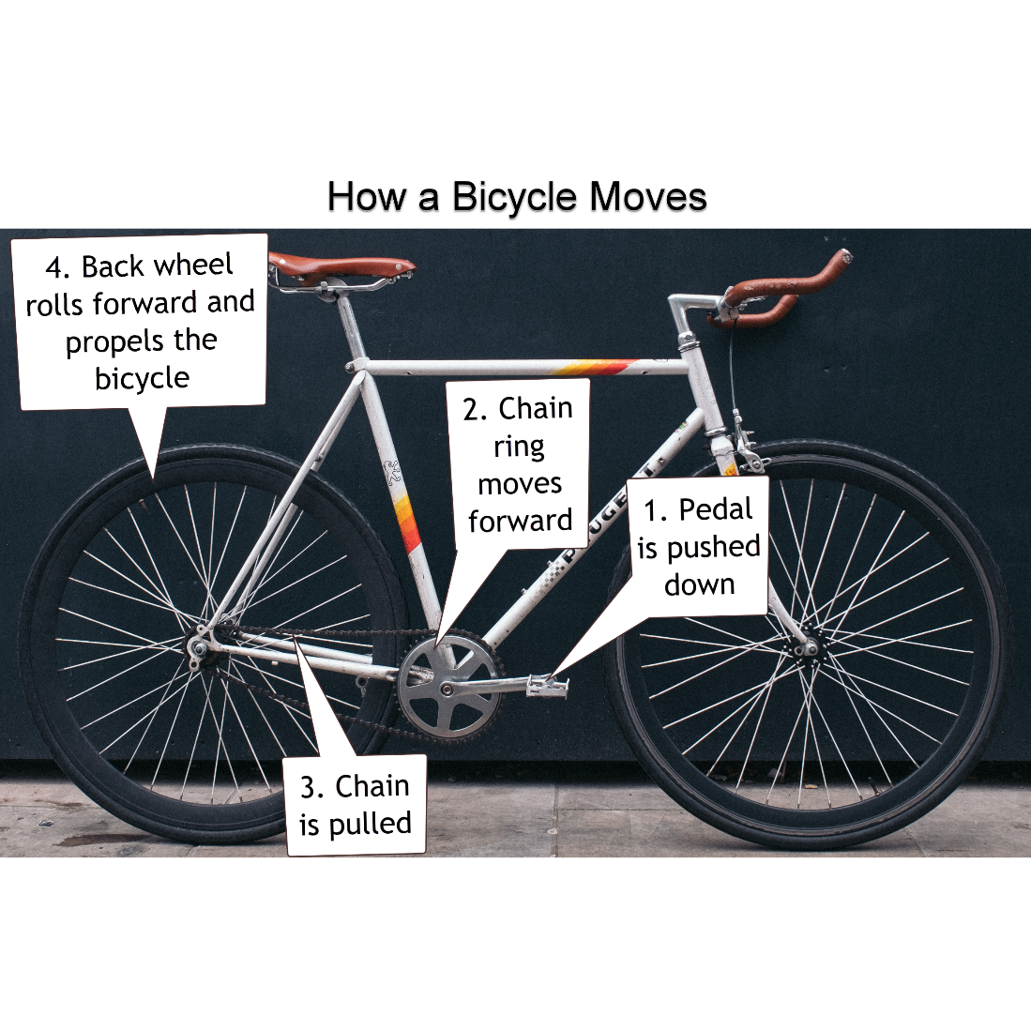
Spatial Contiguity Principle
“Place printed words near corresponding part of graphic.” (Clark and Mayer, 2016: 39)
Notes:
1. Pedal (a) is pushed down
2. Chain ring (b) moves forward and pulls chain (c)
3. Back wheel (d) rolls forward and propels bicycle

Slide 8
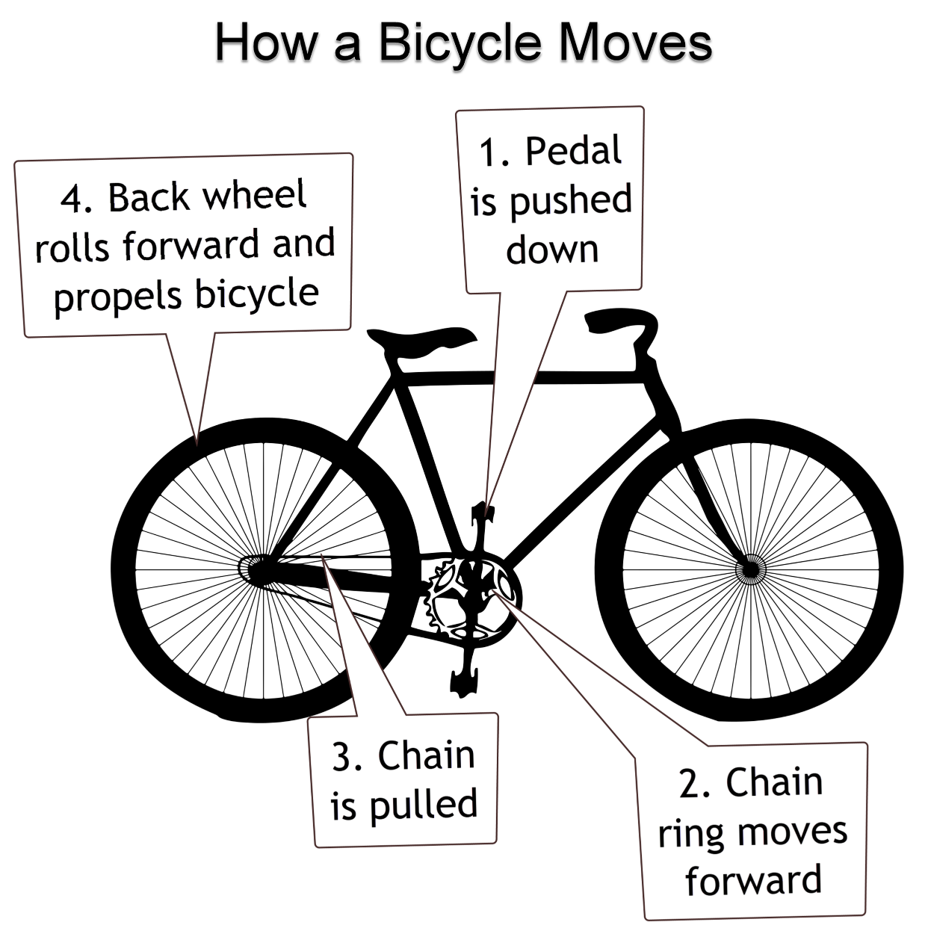
Coherence and Spatial Contiguity Principle
Notes:
1. Pedal (a) is pushed down
2. Chain ring (b) moves forward and pulls chain (c)
3. Back wheel (d) rolls forward and propels bicycle

Slide 9
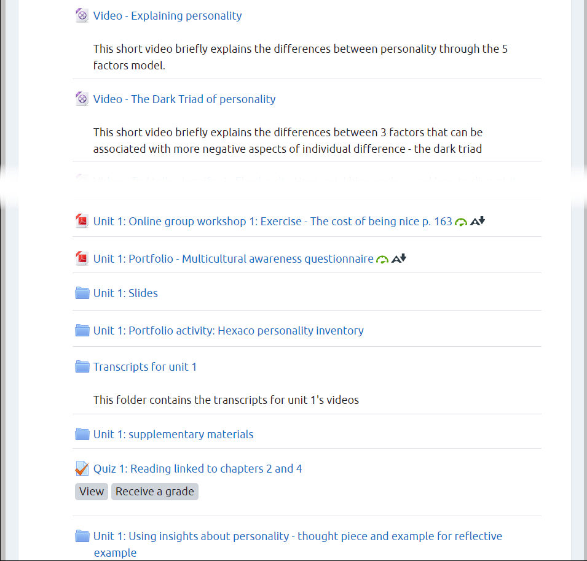
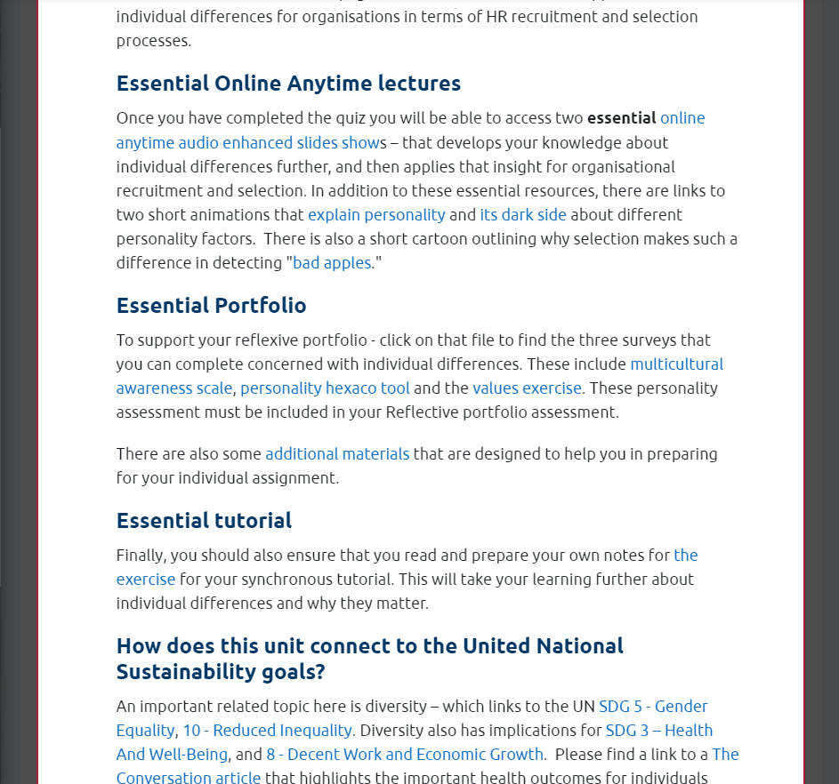
Using 'Available but not shown on course page’ and Labels – Coherence and Spatial Contiguity
Original Content
Redesigned Content

Slide 10
Feedback (1)
Prof Rosalind Searle, Course Convenor
  “ … it was a great way to hide the components and [make] clear essential and desirable components that they could simply click [on] … students could focus on the touch down page for the unit and everything was there for them”
Student feedback
  “The assignments are all clearly listed and the unit materials are well explained on the moodle.”
  “course structure and plans are clear”

Slide 11
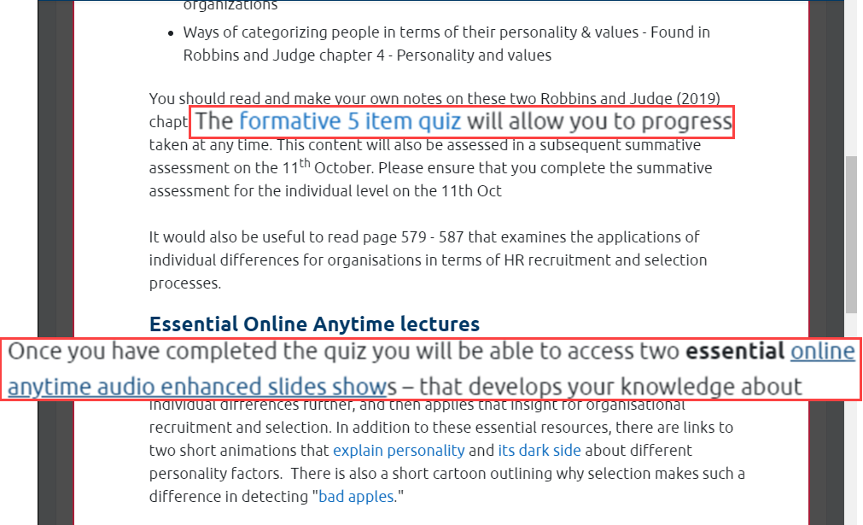

Scaffolding Student Progression with Completion Tracking – Segmenting and Contiguity (1)
Students must complete a formative quiz before accessing the lecture slides

Slide 12
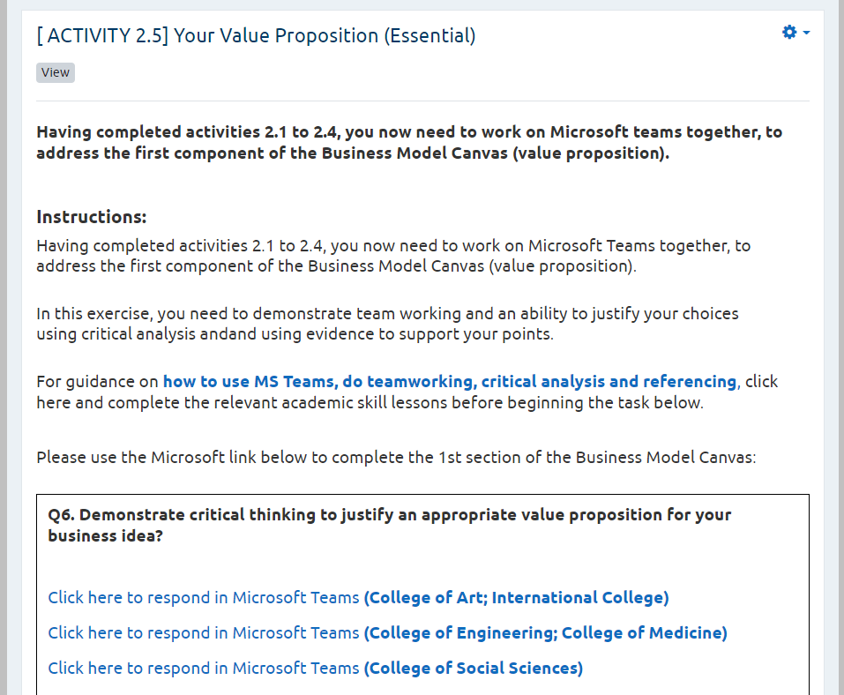
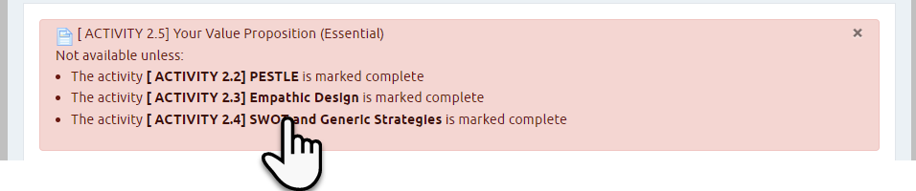
Scaffolding Student Progression with Completion Tracking – Segmenting and Contiguity (2)
Completion tracking
Restricted view requires students to view all the activity pages before opening the final essential activity

Slide 13
Feedback (2)
Prof Rosalind Searle, Course Convenor
  “it helped me to deliver the course by ensuring students had the necessary foundations from the reading”
Student feedback
  “Quiz is help students to reading well before preparing tutorial.”
  “Each unit test and summary test can urge me to keep up with the course as soon as possible.”

Slide 14
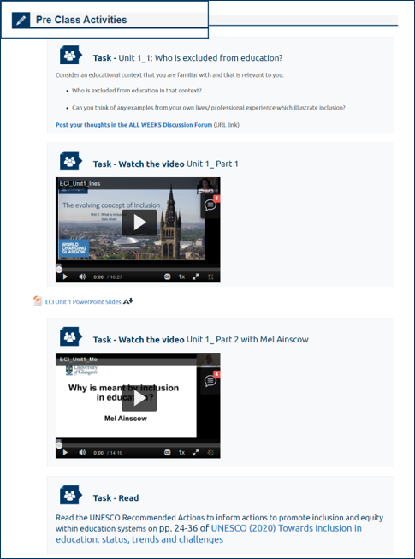

Course Comparison
2021/22
2020/21

Slide 15
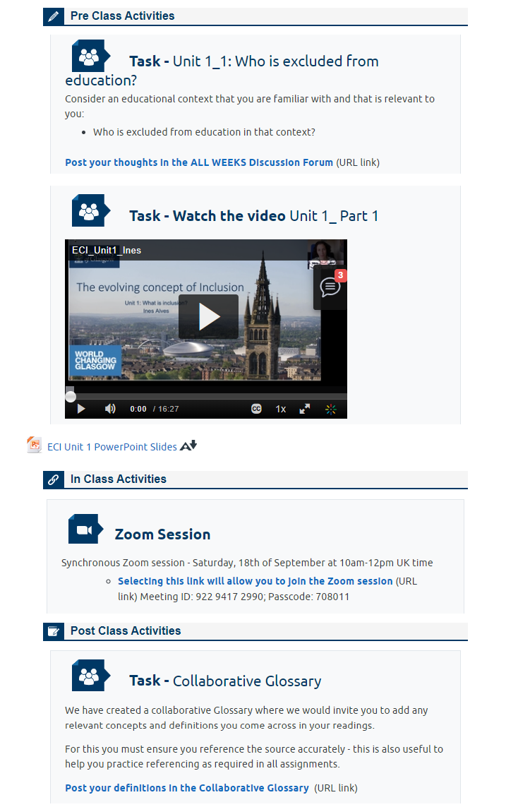
Segmentation Principle
Group related content
Aid students to perceive the underlying structure
Define event boundaries

Slide 16
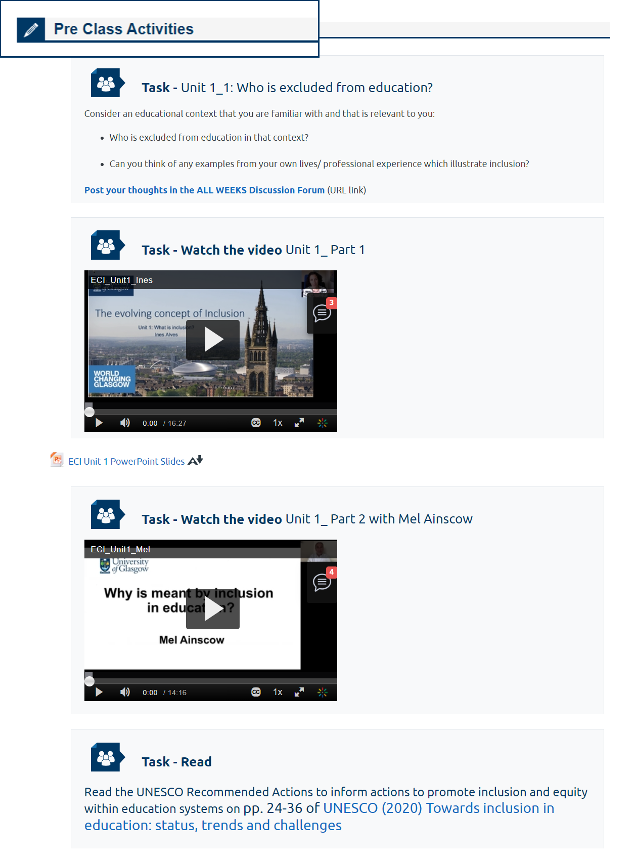
Signaling Principle
Customised labels assist visual organisation
Use cues to highlight the organisation of the material
Signifiers
Headings
Graphic organisers
Typographical cues

Slide 17
Flipped learning
Flipped Learning
Customised labels assist visual organisation
“The flipped classroom model of teaching focuses on moving content that fits in the lower levels of Bloom’s Taxonomy (understanding and remembering) outside class, reserving in-class time for the higher order levels (creating, evaluating, analyzing, and applying)” (See and Conry, 2014: 586)

Slide 18

A flipped model (1)
“The flipped classroom model of teaching focuses on moving content that fits in the lower levels of Bloom’s Taxonomy (understanding and remembering) outside class, reserving in-class time for the higher order levels (creating, evaluating, analyzing, and applying)” (See and Conry, 2014: 586)

Slide 19
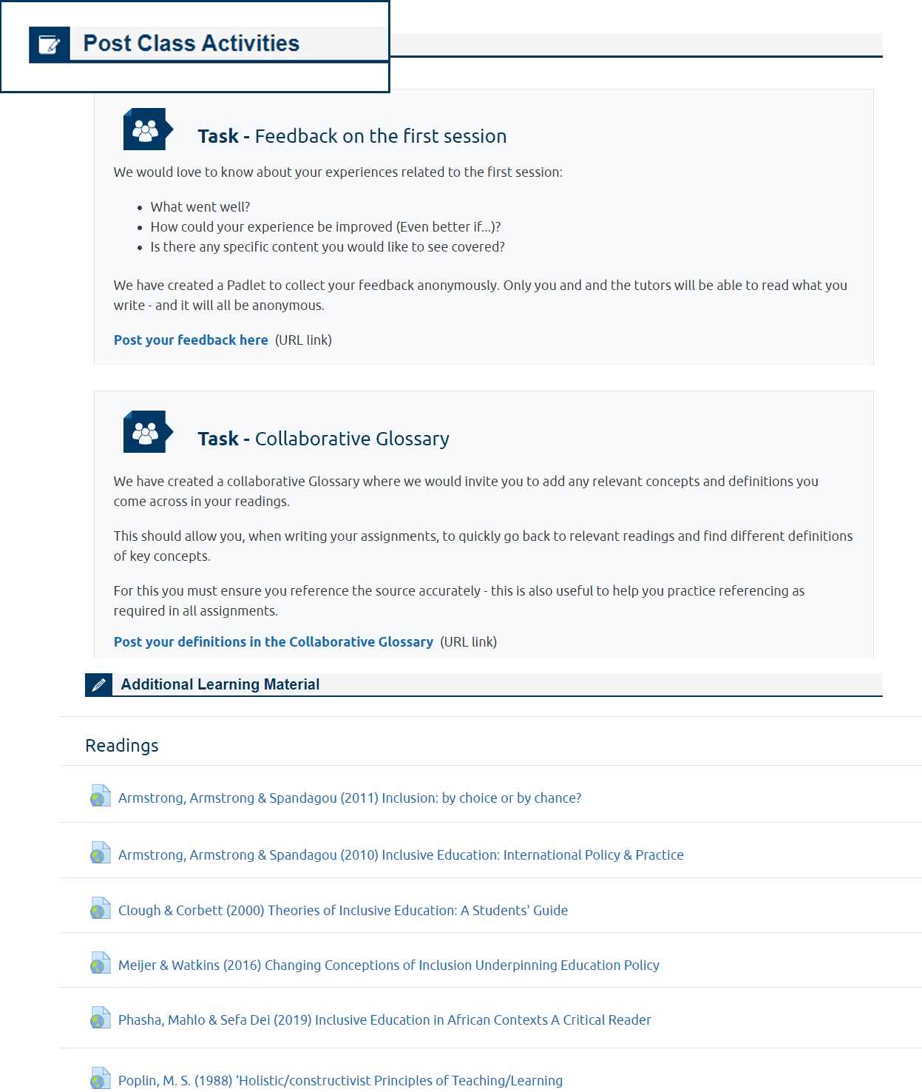
A flipped model (2)

Slide 20
Student Feedback
"I really like the way that Moodle is set up with clear, pre-class, in-class and post-class activities. This makes it easy for me to keep track of where I am and make sure I am prepared for the synchronous sessions."
"The mixture of tasks required to be completed pre and post zoom sessions is really good."
"I really like the fact that there are many pre-session and post-session activities and also that reading for each session is structured in separate units by weeks."
"I really like the way that Moodle is set up with clear, pre-class, in-class and post-class activities. This makes it easy for me to keep track of where I am and make sure I am prepared for the synchronous sessions."
"Enjoying everything so far - like the balance between pre-class activities, in-class activities and post-class activities. Also enjoy the breakout groups a lot"
"Very good balance of pre, during and post class activities. Excellent that we can also carry out our tasks in an asynchronous fashion."
What went well?

Slide 21
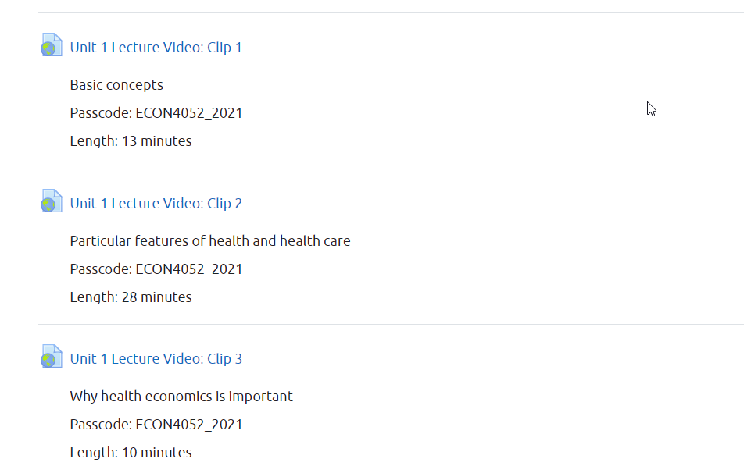
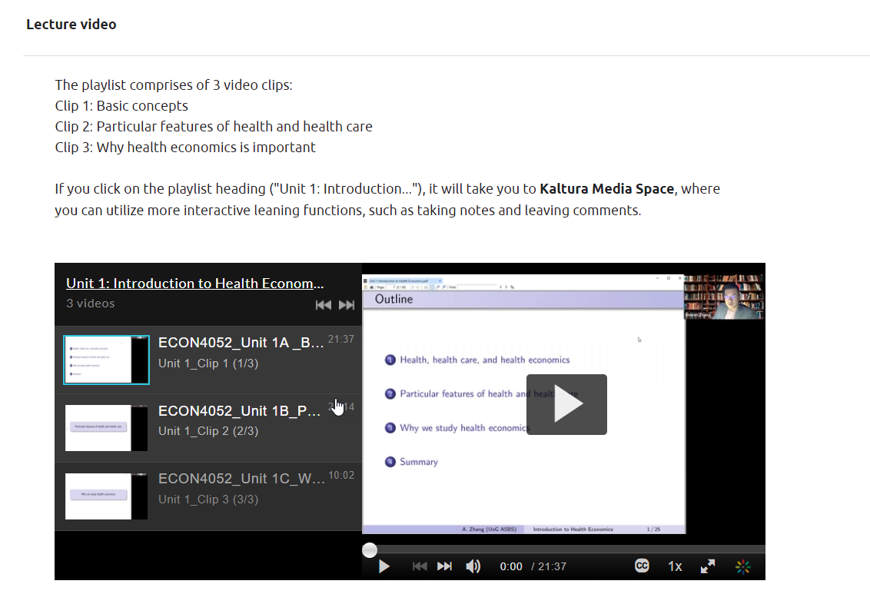
Migrating Zoom Videos to Kaltura Media Gallery Playlists

Slide 22
Convenor Feedback
"I don't have formal evidence, but based on student feedback it's much better than links to Zoom videos. The playlist for sure was a nice feature from my perspective, making the structure of the video much clearer and more visible."

Slide 23
Conclusions
Applying the principles of coherence and contiguity help to reorganise content on a Moodle course in ways that improve navigation and user experience
A flipped learning approach can be improved by drawing on design elements to segment and signal the different stages of the lesson – pre-class (pre-training), in-class, and post-class

Slide 24
Bibliography
Mayer RE (2020) Multimedia Learning. Cambridge, UK: Cambridge University Press. DOI: 10.1017/9781316941355.
Plass JL, Moreno R and Brünken R (eds) (2010) Cognitive Load Theory. Cambridge: Cambridge University Press. DOI: 10.1017/CBO9780511844744.002.
See S and Conry JM (2014) Flip My Class! A faculty development demonstration of a flipped-classroom. Currents in Pharmacy Teaching and Learning 6(4): 585–588. DOI: 10.1016/j.cptl.2014.03.003.
Sweller, John (2010) Cognitive Load Theory: Recent Theoretical Advances. In: Plass JL, Moreno R, and Brünken R (eds) Cognitive Load Theory. Cambridge: Cambridge University Press, pp. 29–47. DOI: 10.1017/CBO9780511844744.002.

Slide 25



Closing Slide
Thank You ☺
Email TEL@CoSS
Book a drop-in session with TEL@CoSS
Browse How-tos and guides
#UofGWorldChangers
@UofGlasgow

