Slide 1

Interculturality and the International Classroom
Dr Julia Bohlmann
15th Annual Learning and Teaching Conference University of Glasgow
29th March 2022

Slide 2
Interculturality and the International Classroom
Why interculturality and the international classroom?
SESSION OUTLINE
Part 1
Can classic cultural dimensions explain our teaching experience in international classrooms?
Part 2
What could interculturality in the classroom look like?
Notes:
My background/ Introduction
Worked as international ELA for four years
Started intercultural group work training, something that I constantly evolve based on the feedback from students
What I wanted to share with you are the cultural dimensions that resonated with the students and see whether they might give you a possible explanation for lack of engagement in class or the misinterpretation of assignments

Slide 3
Part 1 –
Can cultural dimensions explain our teaching experience in international classrooms?

Slide 4
Interculturality and Othering
‘The positioning and negotiation of individuals who come from different space-times’ (Dervin 2011)
Dervin avoiding the term culture and has good reason to – intercultural studies as a field is problematic
Anthropologist Edward Hall (US) and social psychologist Geert Hofstede (Netherlands) considered the founding fathers of intercultural communication studies
Explaining the Other from an American-Eurocentric perspective
BUT some of their insights still resonate

Slide 5
One of Hofstede’s cultural dimensions: Power distance (intracultural and intercultural)
How people from different cultures view power relationships
Low power distance
  Question authority and expect to participate in decisions that affect them
  Expect power relationships to be participatory, democratic, and consultative
  Feel entitled to participate in decision making
High power distance
  Deferential to figures of authority and generally accept an unequal distribution of power
  Tend to view power as a reality of life and believe everyone has a specific place in the hierarchy of power
Notes:
Explain that there a 6 cultural dimensions and that this one students in intercultural classrooms grapple with most
Study based on statistical analysis of national values, so nations are on a spectrum between high and low power distance, but this is the aspect of Hofestede that has been criticised because it lends itself to creating national stereoptypes and othering
But taking the national aspect out of it, power distance as a concept, can be used to understand different approaches in different societies and the relational aspect of this between societies –

Slide 6
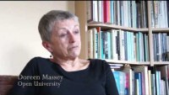

Example: Perceived hierarchy within and between cultures
‘I have British flatmates, and they always talk about the Queen or the royal family, and it’s quite comfortable to talk. But in Thailand, we cannot talk about this stuff. You have to keep silent, all the time, you have to keep quiet. I dunno why. We cannot criticise the royals… It affects me like less than other Thai people, but it also is something that affects me. And, I don’t feel confident enough to criticise a big name. If someone is the professor in a subject or something like that, and I have to criticise their work, I will feel a bit nervous about my thoughts and if they are good enough. And, I really struggle[d] with the first half of this year of my study.’
Sociologist Doreen Massey
Thai student MA Philosophy, University of York
Photo by Anthony Tran on Unsplash

Slide 7
One of Hall’s cultural dimensions: High and low context cultures
The extent to which people focus on contextual (indirect) or verbal (direct) information varies:
Low context cultures: Rely on explicit communication
  A message needs to be spelled out and verbalised
  Rules and expectations are explicitly outlined
High context cultures: Rely on implicit communication and non-verbal queues
  A message cannot be understood without background knowledge
  Roles are implicit, clearly defined, and one acts according to one's role
Common problem area between high and low: silence
  Low context cultures find silence uncomfortable and view it negatively – silence communicates a problem or that something is wrong
  High context cultures are happy with silence – silence can communicate mutual understanding

Slide 8
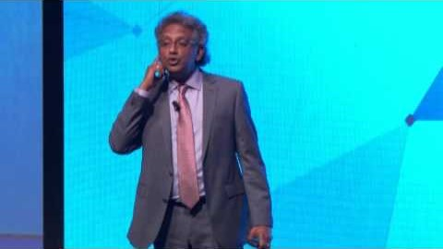
Cultural coach Dr. Tom Verghese on low vs high context cultures
Notes:
Play if there is time, don’t play of it gets tight. There might also be a better visual example

Slide 9
Your break out room discussions
Power Distance Group
Low vs High Context Group
Have you experienced power distance in your classrooms?
What happens when a teacher comes from a society with low power distance teaching students from a society with high power distance? Or vice versa
What happens when there is power distance between different groups of students?
How could this distance be reduced?
Have you found students not understanding or misinterpreting your classroom activities and/or your formative and summative assessments?
What happens to students from high context cultures when they switch to another cultural context?
What do you think happens if a teacher from a low context culture teaches students from a high context culture?
→ What contextual information could you spell out more explicitly for your students so that they understand your ILOs, assignment expectations, the concept plagiarism, etc.?
Please choose 1 person to feedback on your discussions to the main group
Notes:
Choose the cultural dimensions that most closely applies to experiences you have had in the intercultural classroom and join relevant table
Discuss how the concept might apply/explain these experiences
Choose one person to report back from your table during the debrief

Slide 10
From cultural dimensions to interculturality
The way we just used the classical cultural dimensions framework moves away from cultural essentialism towards a reflective practice that is detached from national stereotypes
Interculturality does not try to explain the ‘Other’ but reflects on the constantly evolving relationships between groups
Intercultural teaching then is a transformative and equity seeking practice → it’s not about mastering knowledge or competencies but is a relational, critical and reflective journey
Fine, but HOW DOES IT LOOK IN PRACTICE?

Slide 11
Part 2 –
What could interculturality in the classroom look like?

Slide 12
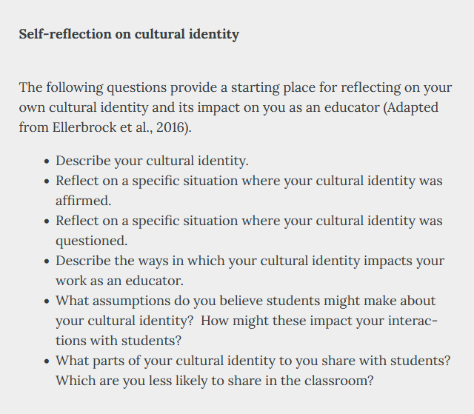

Get to know yourself
A realignment of teaching practice with an international student audience starts with self-awareness
(Example from Page 2021: https://kpu.pressbooks.pub/foundationsofinterculturalteaching/chapter/culturalanddisciplinaryidentities/ )

Slide 13
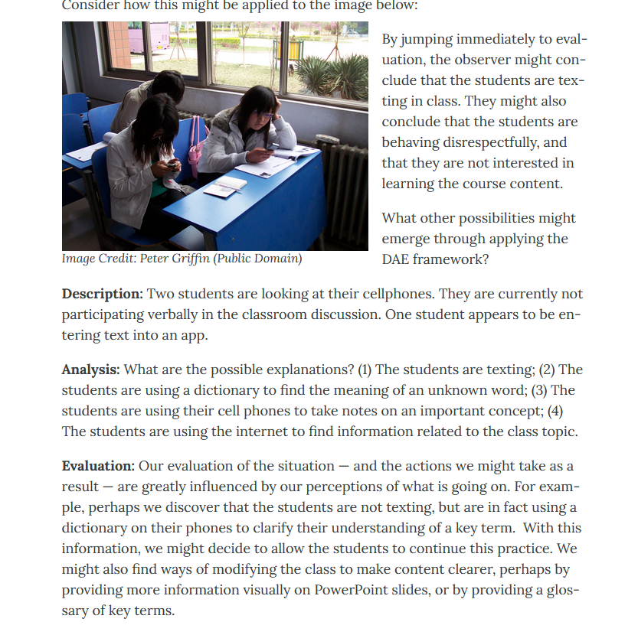
Analyse tricky classroom situations without judgement
Describe
Analyse
Evaluate
(Example from Page 2021: https://kpu.pressbooks.pub/foundationsofinterculturalteaching/chapter/foundational-practice-2-approach-difference-without-judgement/ )

Slide 14

Get to know your international students
Lee et. al. (2017) also emphasise the importance of self-awareness through critical reflection and the time this takes but they also suggest some simple things you could do
To improve the classroom climate and enable students to participate, they suggest a number of relatively easy rapport building activities that can be integrated at the beginning as well as throughout a course:
Learn names and attempt correct pronunciation – model this for everyone in the class.
Ask students anonymously what to them supports a feeling of being respected.
Ask your students whether they are familiar with active learning. Explain what it is and emphasise the value of active and peer interactive learning. Tell them a few times throughout the course.
Incorporate time for quiet writing and organisation of thoughts before verbal discussions.
Introduce ungraded post-discussion reflections to give students a chance to feedback on whether they feel included or whether there are unaddressed needs or barriers.

Slide 15
Break out room discussions
Choose one of the 3 scenario and join your table
Discuss how you might apply them or take your preferred idea forward into your teaching practice
Choose 1 person to feedback to the main group on your discussions

Slide 16

Suggestion – Community of Practice
Interested? Get in touch: Julia.Bohlmann@glasgow.ac.uk
Notes:
Let’s form a community of practice – could take shape of a reading group – I have built up a library of resources on various theoretical and pedagogical approaches
Could be just to discuss experiences and testing new ideas and practices
E-mail me if you are interested and I will set up a Teams channel

Slide 17
References & Resources
Dervin, Fred. “A Plea for Change in Research on Intercultural Discourses: A ‘Liquid’ Approach to the Study of the Acculturation of Chinese Students.” Journal of Multicultural Discourses, vol. 6, no. 1, Mar. 2011, pp. 37–52, https://doi.org/10.1080/17447143.2010.532218.
Hall, Edward T. Beyond Culture. Anchor Books ed, Anchor Books, 1989.
Hofstede, Geert. Culture’s Consequences: International Differences in Work-Related Values. Cross-Cultural Research and Methodology 5. Beverly Hills CA: SAGE, 1980a.
Lee, Amy, et al. Teaching Interculturally: A Framework for Integrating Disciplinary Knowledge and Intercultural Development. Stylus Publishing, LLC, 2017, http://ebookcentral.proquest.com/lib/gla/detail.action?docID=4983583.
Page, Christina. Foundations of Intercultural Teaching. Kwantlen Polytechnic University, 2021, https://kpu.pressbooks.pub/foundationsofinterculturalteaching/.
Name pronouncing tools: https://www.howtopronounce.com/names/index.php
https://www.nameshouts.com/

