Slide 1


Graduate Attribute Infographics: Embedding graduate attributes in the psychology curriculum
Dr. Steven McNair (he/him)
School of Psychology and Neuroscience, University of Glasgow
Steven.McNair@Glasgow.ac.uk
@stevenwmcnair

Slide 2
Rationale
Professional development is a key focus of the University’s learning and teaching strategy
At college-level one priority is to “embed employability into our curricula” (MVLS Education Strategy Pillar 3)
Student have a general awareness of importance of employability, but career-building implications are less well understood early in UG programmes (Tymon, 2011)
Within SPaN, we needed to review how we embedded GAs within our UG and PGT (MSc Conversion courses) programmes
Need for a ”one-stop” resource to signpost GA development to students and link GAs to key aspects of their programme
We created a series of infographics linking GAs to key activities and assessments, and linking GAs to key graduate careers (both psych and non-psych)

Slide 3
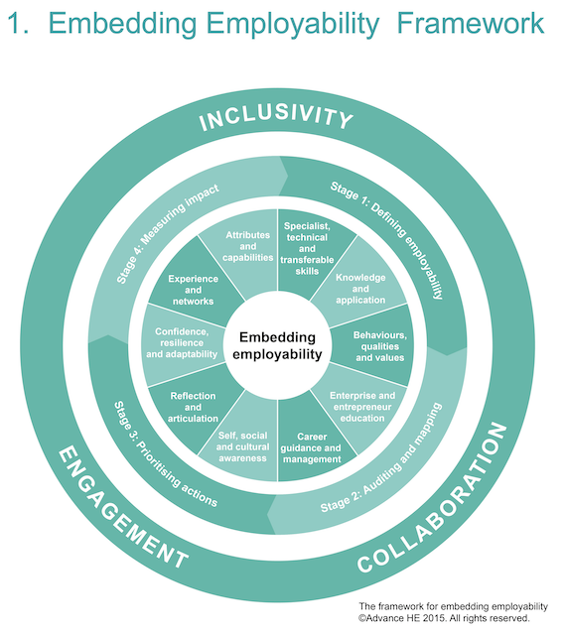
Our approach
Define employability in terms of Subject-specific (psychology) dimension (Stage 1):
  E.g. Subject specialism – what are the values, principles, methods, limitations that are relevant to a practitioner in psychology?
  Informed by professional bodies (BPS, NHS, etc.)
Consider our own employability model (Stage 2):
  What are we doing as a School and at what point?
  Mapping how activities and assessments at all levels in UG and PGT courses aligned with GAs
Link psychology skills onto what employers want (Stage 3):
  Mapping GAs onto job specifications for key psychology graduate destinations (NHS, Prison service, Local Authorities, prospects.ac.uk, Target Jobs)
Tibby & Norton (2018)

Slide 4
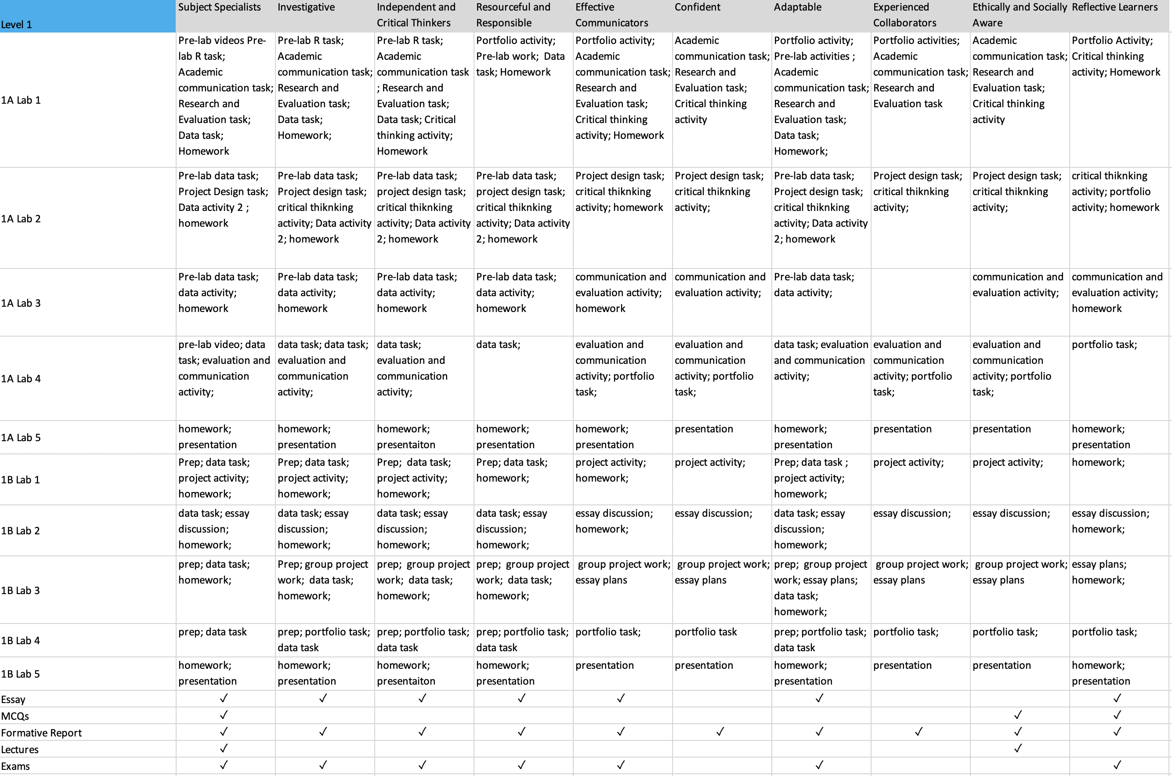
Mapping the curriculum

Slide 5
Graduate Attributes themes
Problem solving
Subject specialist
investigative
Independent and critical thinker
Self-management
Resourceful and responsible
Adaptable
Reflective learners
Social attributes
Effective communicator
Confident
Ethically and socially aware
Experienced collaborators

Slide 6
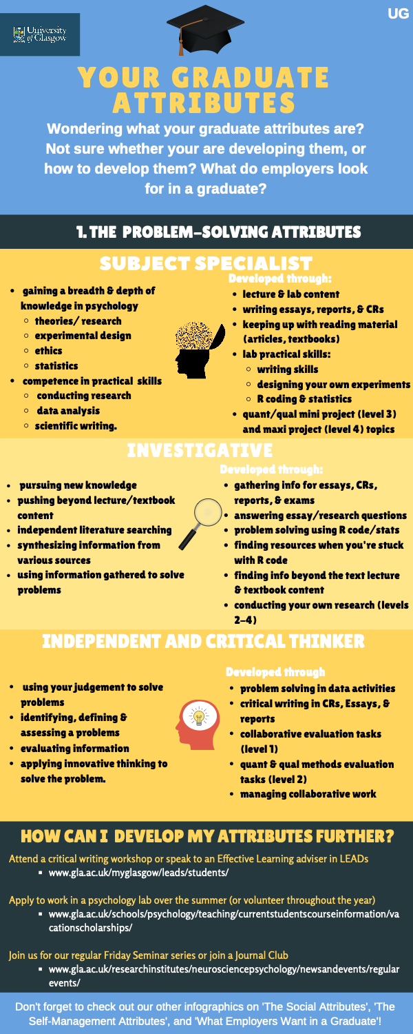
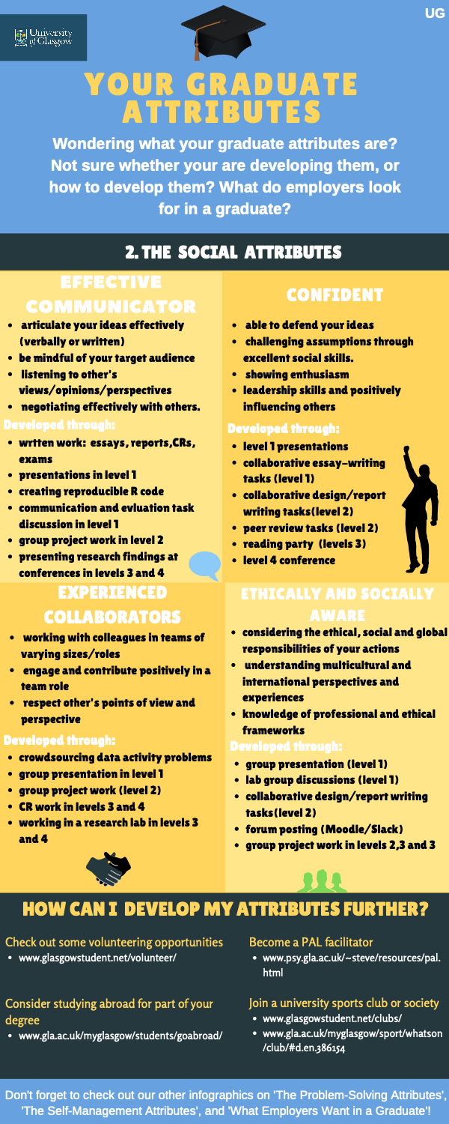
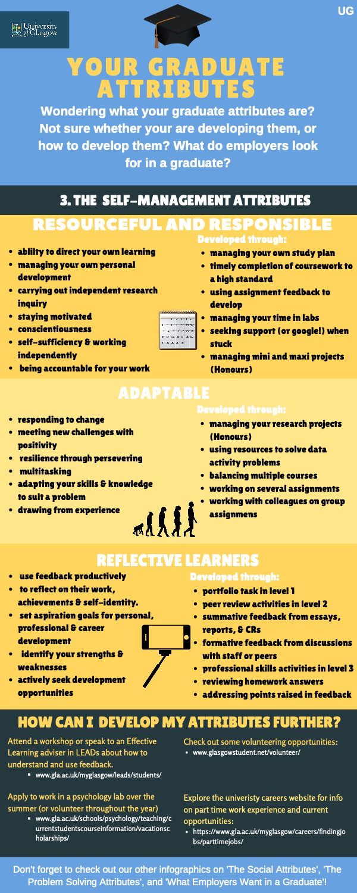
GA Infographics: mapping the curriculum to GAs

Slide 7
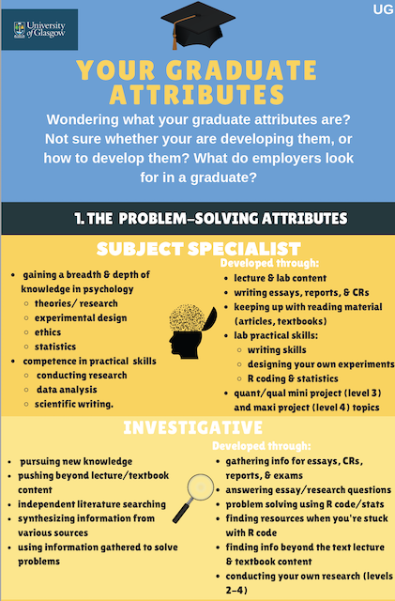
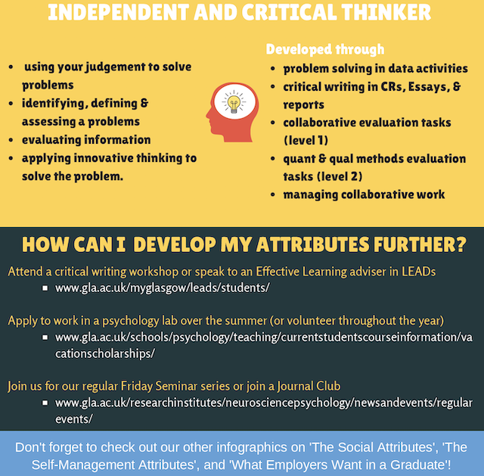

Slide 8
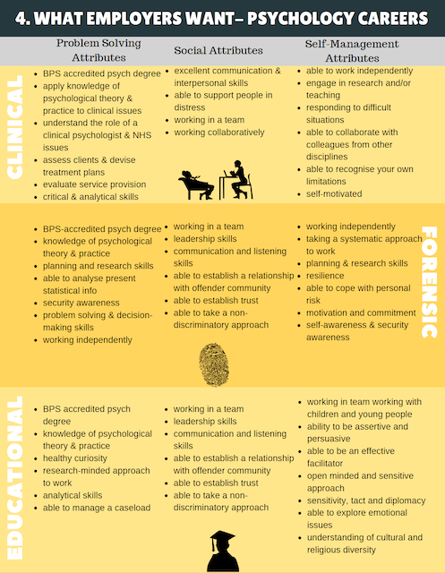
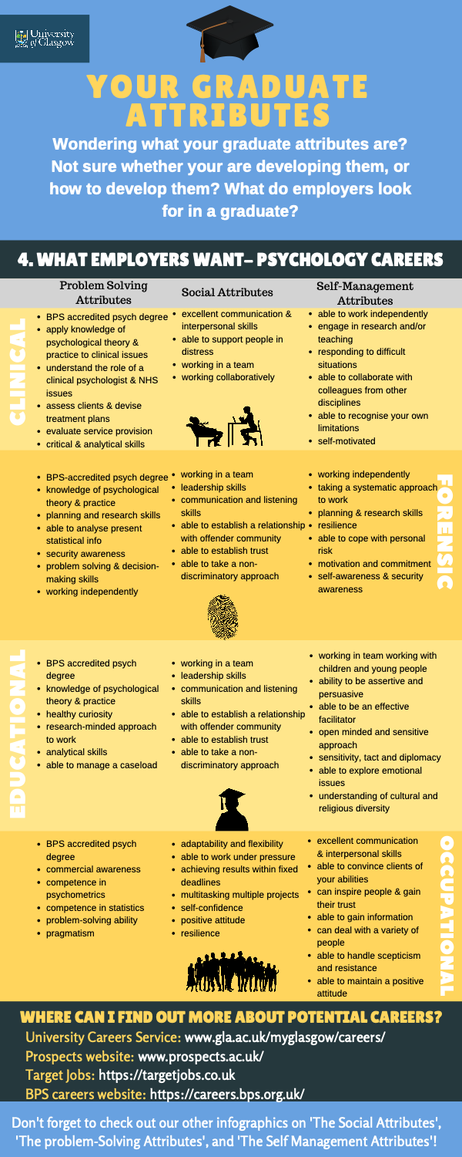
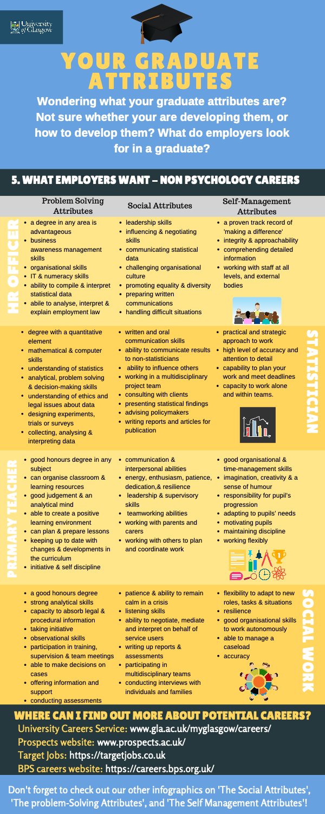
GA infographics: mapping the GAs onto careers

Slide 9
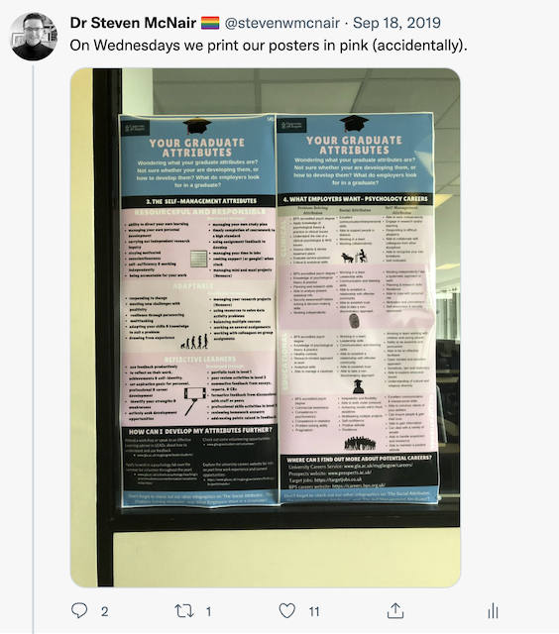
How we use the infographics
Professional Skills Course - GA reflection activity
  Choose a GA, develop a SMART goal to develop it further, reflect on development
As posters in our lab spaces
  Positive feedback from students as an area of good practice
On Moodle as a reference for students and staff
  Continuous reflection on development
  Help identify key skills/experiences for applications
Available publicly via Open Science Framework:
  https://osf.io/5wn9c/

Slide 10
Moving forwards
Assess impact of infographics (Stage 4 of embedding employability framework)
Expanding the infographics to include MSc Conversion ODL students
  See Poster 6 for some of our planned work on employability in ODL
Within SPaN we will establish an Employability sub-committee
Creating a psychology employability guide for students
Wider discussion of embedding employability – is there a place for a wider employability network?

Slide 11



Thanks for listening!
Dr. Steven McNair (he/him) steven.mcnair@Glasgow.ac.uk
#UofGWorldChangers
@UofGlasgow

