Slide 1
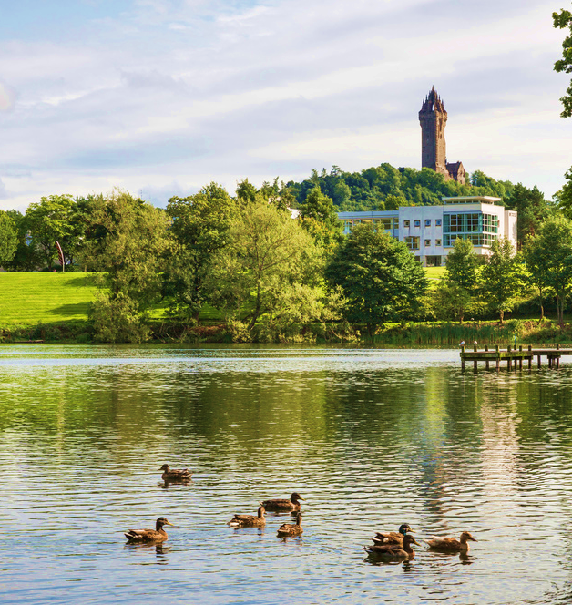



Amplifying our students' voice: the co-production of undergraduate field courses (residential and non-residential) to address DEI
Martina Quaggiotto
Alison Young
Jo Clarke
15th Annual Learning and Teaching Conference
University of Glasgow
29th March 2022

Slide 2
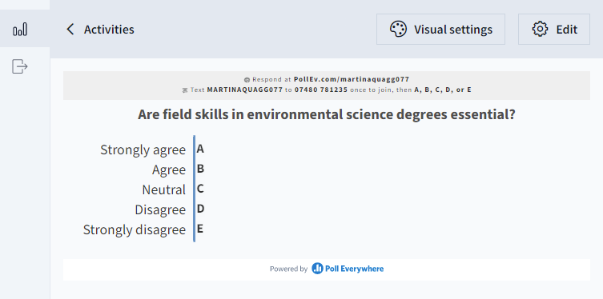
Diversity, Equity and Inclusion in environmental science
Are field skills in environmental science degrees essential?
Give us your answer via PollEverywhere!
Notes:
In REMO – Share window> select powerpoint window
Slideshow>Set up slideshow>Browsed by an individual window

Slide 3

Diversity, Equity and Inclusion in environmental science
Field skills in environmental science degrees are ESSENTIAL
.. Therefore, we need to make sure that field course are accessible and inclusive for a diverse student community
What are the barriers to DEI encountered by our students in field courses?
Can we find solutions to address these challenges?
What approach should we use to succeed in this?
Notes:
Our current undergraduates are the next generation of environmental scientists, and field skills are essential for this role. Finding solutions and approaches to make fieldwork accessible, inclusive, and diverse is therefore our prerogative

Slide 4
Aims
Identify DEI barriers and solutions to fieldwork
Co-produce field courses with students to improve DEI
Test, verify and further refine the co-produced field courses
Disseminate case study and good practice for improving DEI in field work.

Slide 5


Methods
Questionnaires and workshops
Conferences and workshops to support DEI policy for field work
Questionnaires and workshops
Residential and on campus field course
Evaluation: self report of participation and ad-hoc questionnaires
Notes:
and promote a culture of EDI in environmental sciences.

Slide 6

Questionnaires
Workshops
55 students; 30 staff
Both from environmental sciences
Identify barriers
Structural
Environmental
Attitudinal
Protected characteristics
Identity characteristics
9 students; 3 staff
Identify solutions to barriers
Structural
Environmental
Attitudinal
Quantitative and
qualitative methods

Slide 7
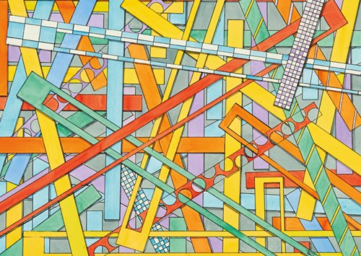
Barriers
Structural barriers can include timetabling, curriculum, and other practices that are embedded within the running of higher education institutions
Environmental barriers can include access to a building, to a location and other obstacles related to the use of space.
Attitudinal barriers can include, for example negative behaviour of students, staff or others.

Slide 8
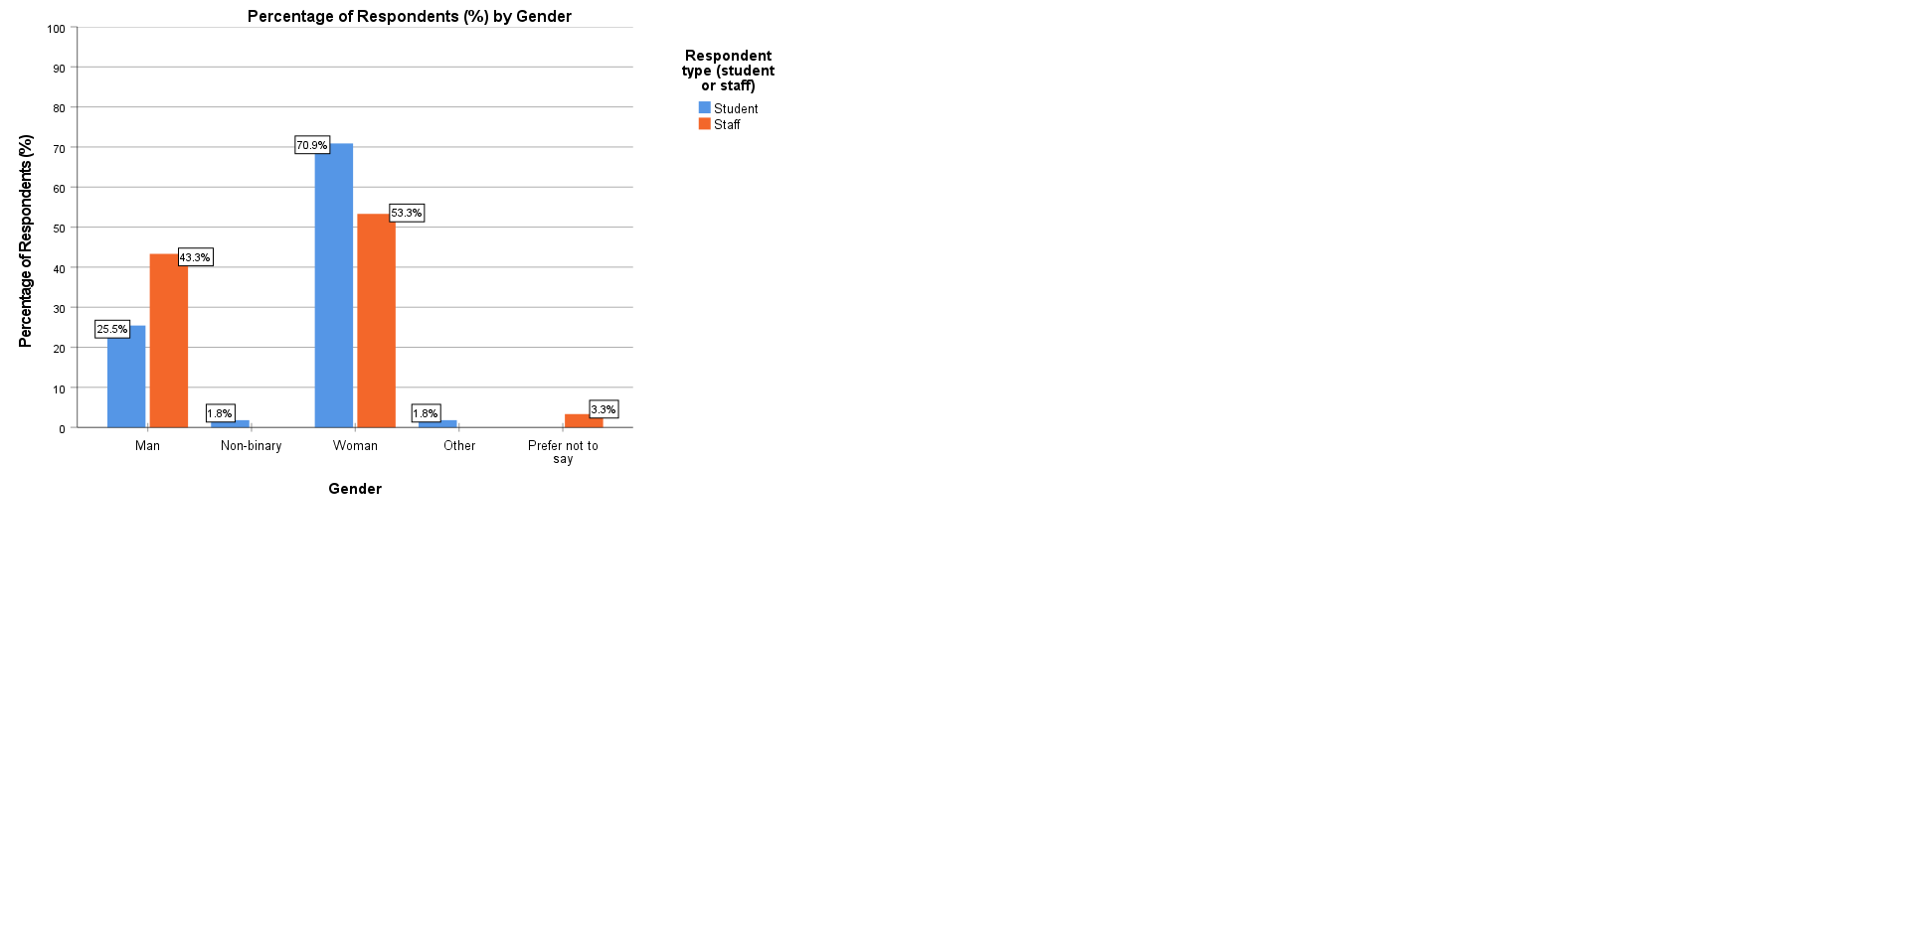
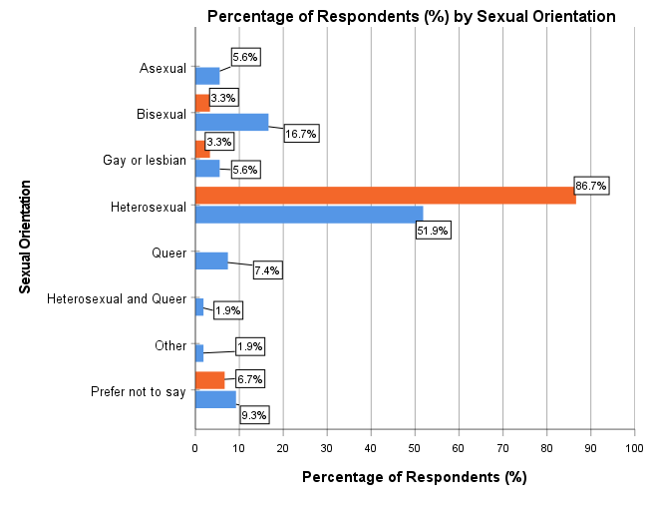
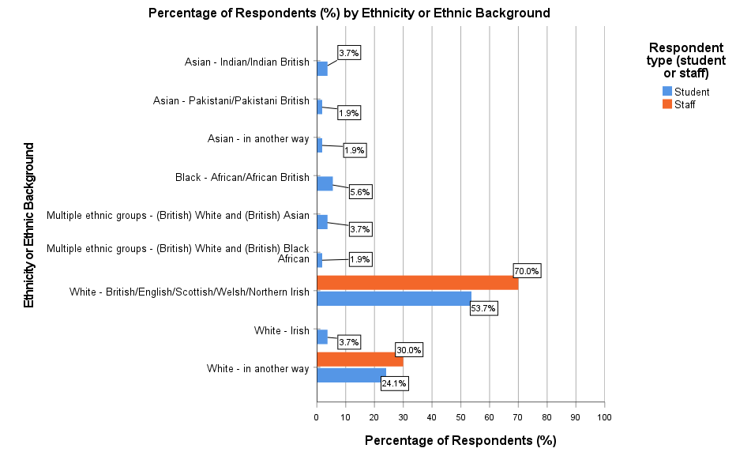
Although neither student nor staff samples are very diverse, the student sample is more diverse, highlighting a need for greater representation and more diverse role models
Questionnaires

Slide 9
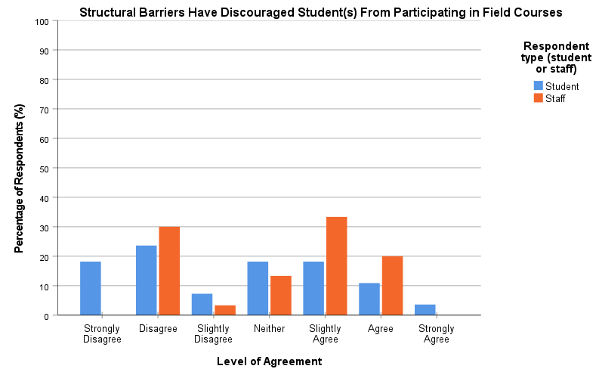
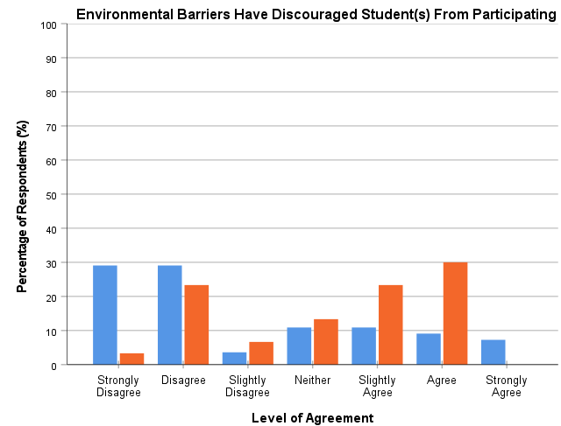
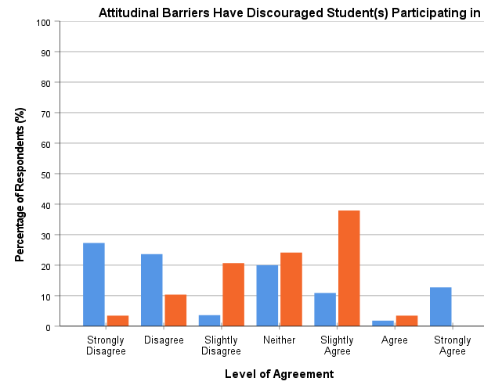
Staff sample believe that barriers can discourage students from participating in field course more than students do.
Community Vs. individual experience
Barriers have discouraged you as a student/your students (if staff) from participating in field courses
53% staff
31% students
agree
53% staff
26% students
agree
43% staff
26% students
agree

Slide 10
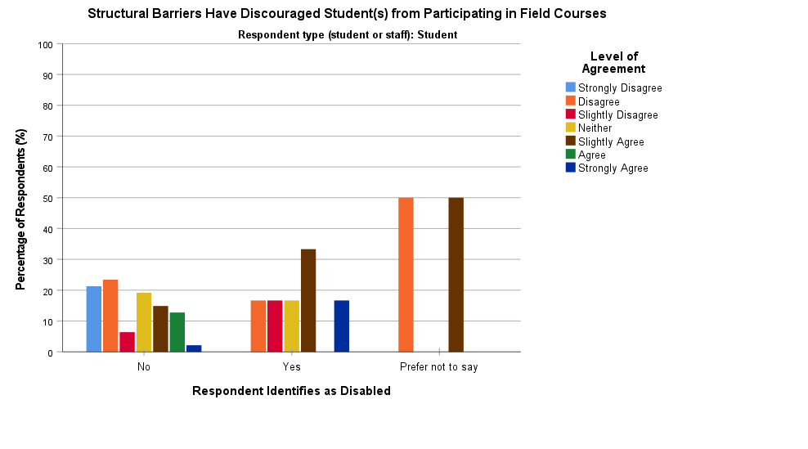
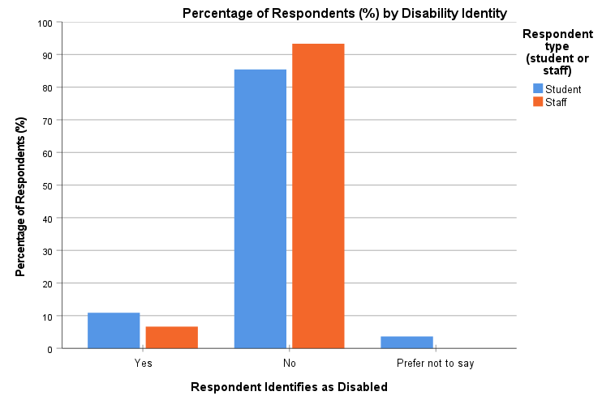
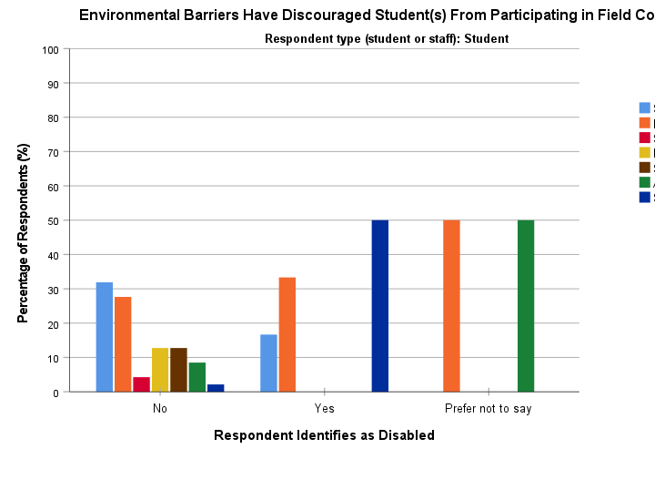
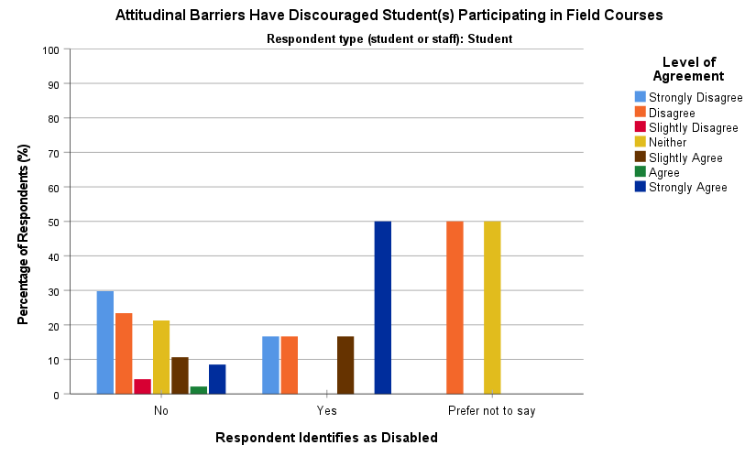
It is important to consider attitudinal barriers, invisible disabilities, and that not everyone with an impairment/health condition/learning difference will identify as disabled
Questionnaires

Slide 11
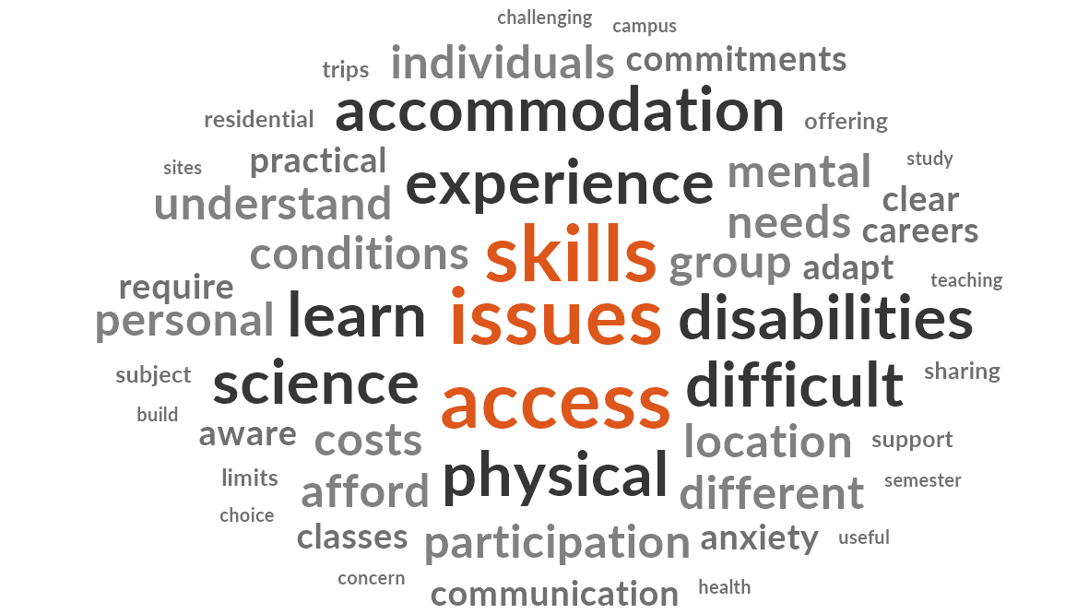

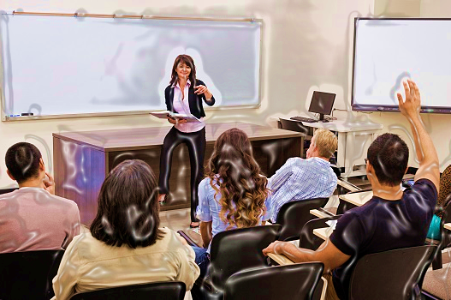
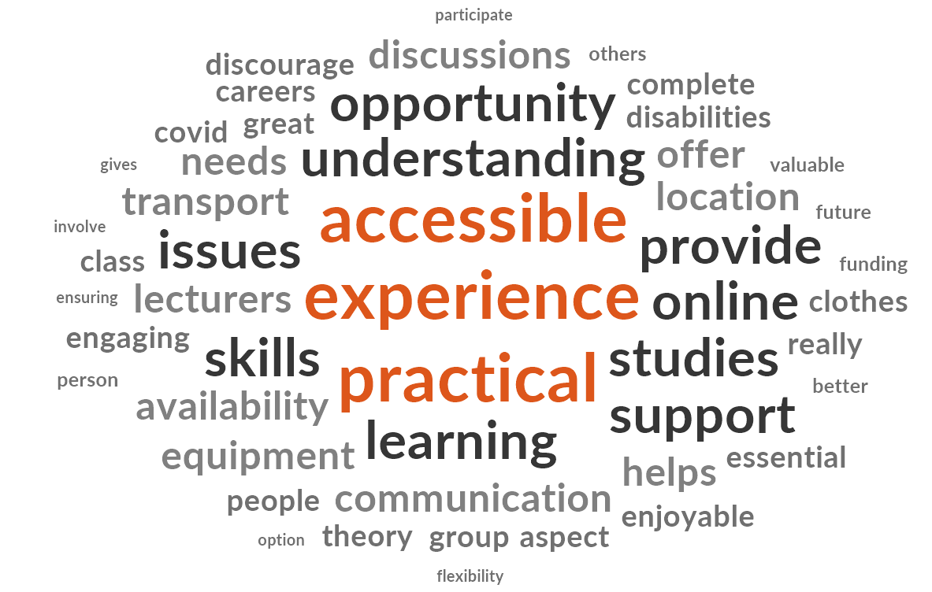
Different perspectives

Slide 12

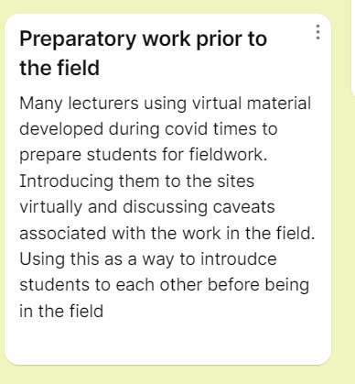
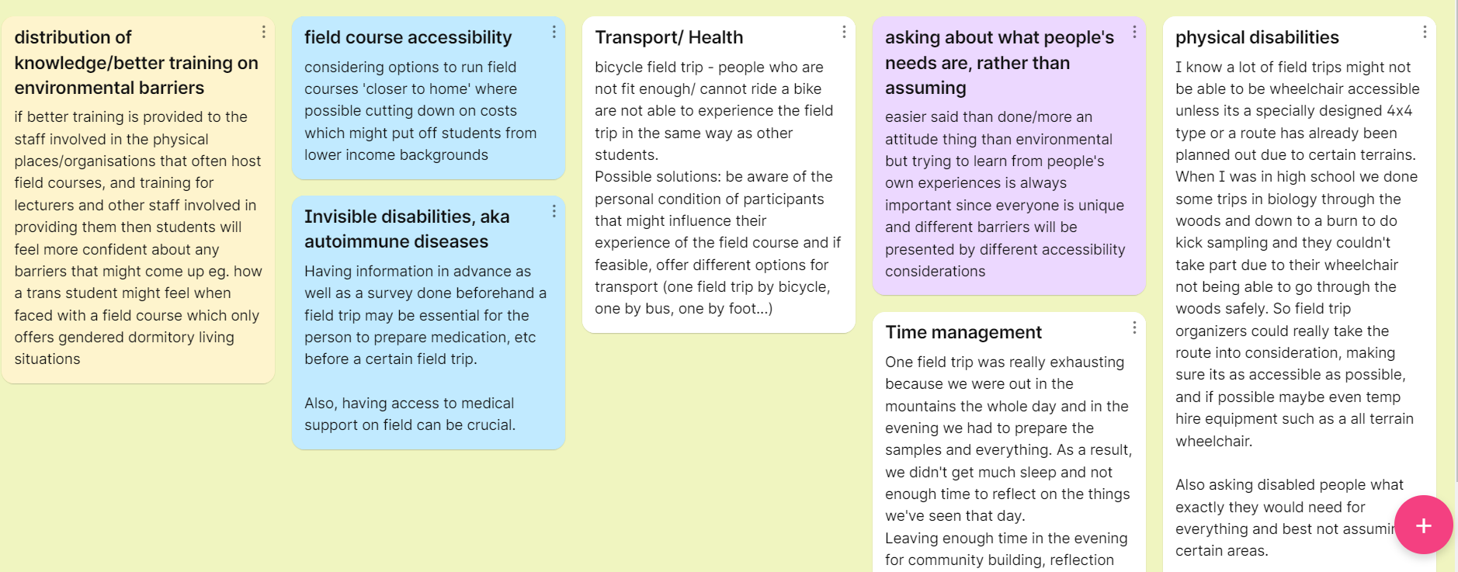
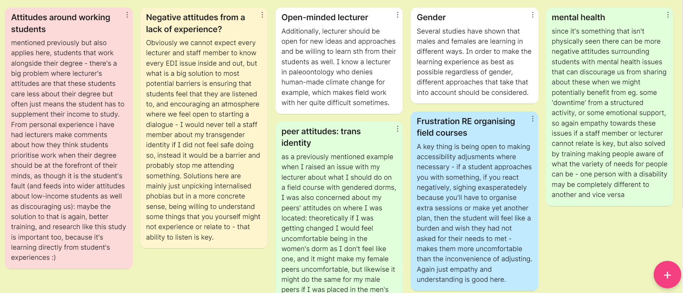
Solutions
Structural barriers
Attitudinal barriers
Environmental barriers

Slide 13
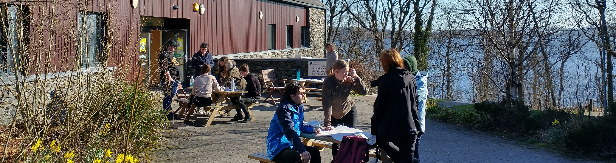
Next steps
Thematic analysis: coding underway
Co-designed a residential field course with students
Evaluation and feedback
The best part was being able to work together to make a tangible difference to future field courses.
I loved the fact that my voice mattered in the organization of the activities
I felt working with lecturers without barriers and them taking on board feedback was rewarding. It made me feel a sense of freedom.

Slide 14
Thank you for your attention!
Any questions?

