Slide 1

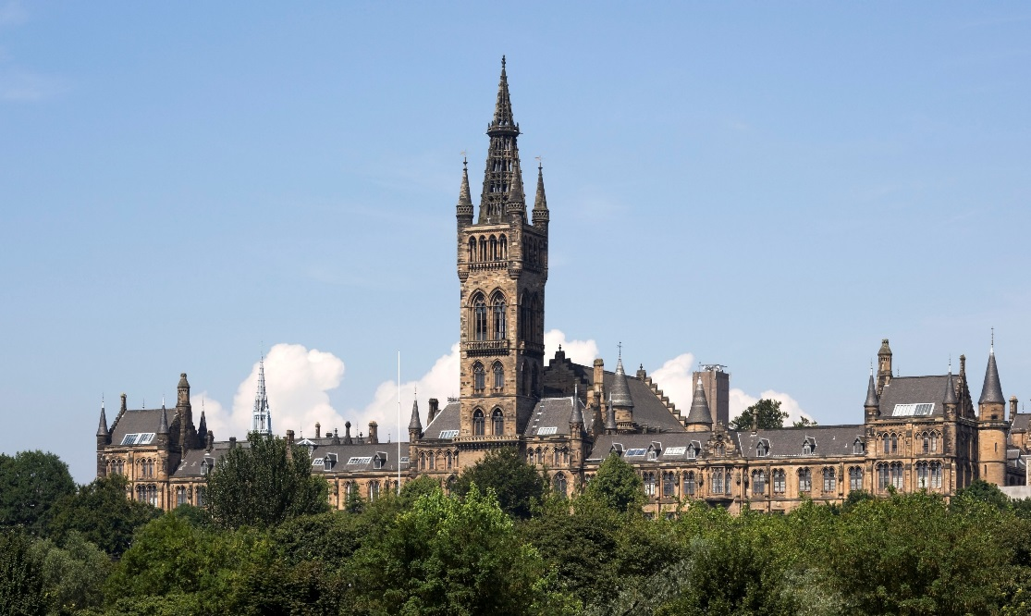
Connecting Real-world Experiences with Real-world Challenges
Kerry Trewern
Rhona McNair
15th Annual University of Glasgow Learning & Teaching Conference
Tuesday 29 March 2022

Slide 2

What is the Diploma in Professional Legal Practice?
PEAT One
Bridge: academia to practice
Simulated environments
Tutors: practising solicitors
Student cohort

Slide 3

Sample PEAT One Outcomes - Interviewing
  Meets and greets the client
  Explains the structure of the interview
  Demonstrates a courteous attitude to the client
  Uses listening techniques
  Can focus on a fact pattern without losing sight of the whole
  Conduct a client-centred interview
  Draws the interview to an appropriate close

Slide 4
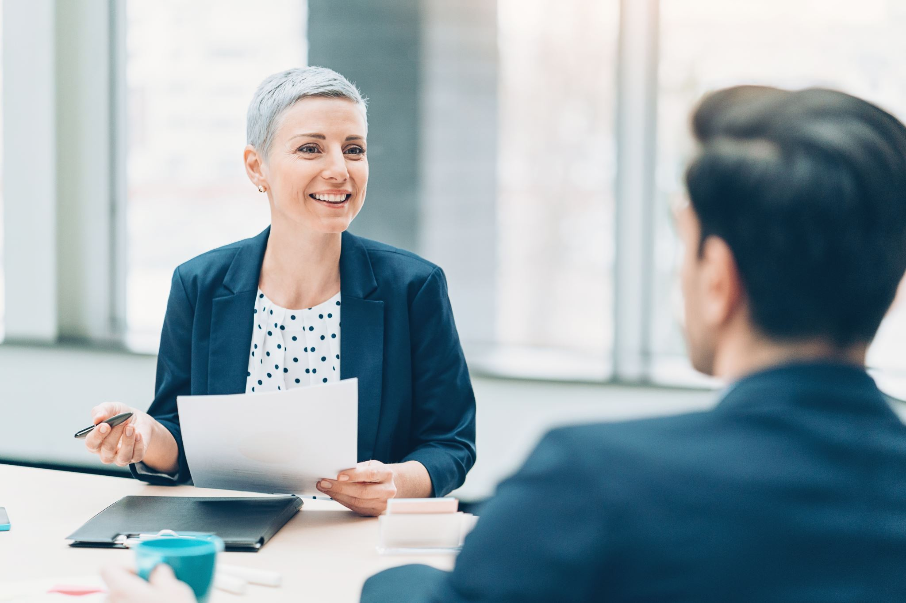
Mock Client Interviewing
Lecture and guide
Groups of three
Actor
Observing solicitor / feedback
Scenarios
Transferable skills
Real-world experiences
Competition

Slide 5

Notes:
KT

Slide 6
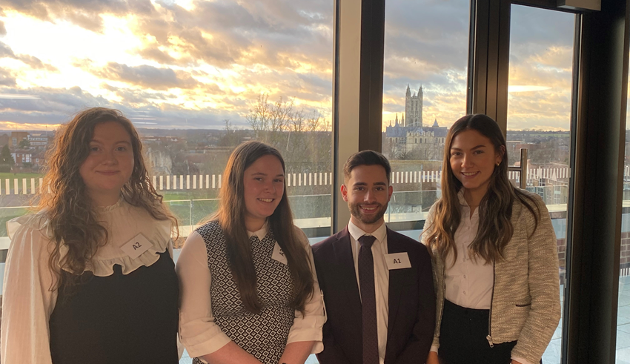
Questions?
Kerry Trewern, Director:
kerry.trewern@glasgow.ac.uk
Rhona McNair, Deputy Director:
rhona.mcnair@glasgow.ac.uk

