Slide 1
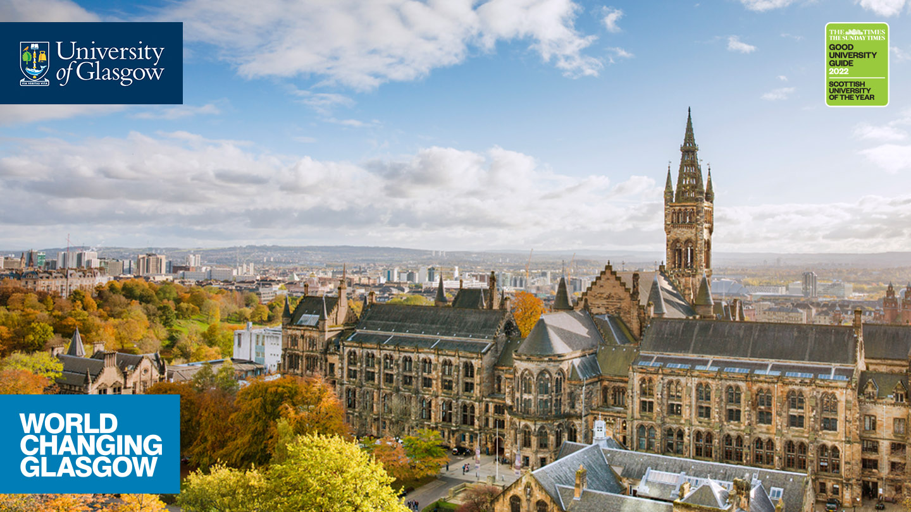
Welcome to the Active Learning Network University of Glasgow satellite group
https://activelearningnetwork.com/

Slide 2
UofG satellite steering group
Vicki Dale
Frances Doherty
Sarah Honeychurch
Nathalie Tasler
Academic & Digital Development Adviser (Active and Blended Learning)
Good Practice Adviser
Academic and Digital Development Adviser (Creative pedagogies and Scholarship of Teaching and Learning)
Lecturer, Chemistry

Slide 3

Overview
About the Active Learning Network:
Dr Tab Betts
Activity: Padlet
  What can the ALN offer us?
  What can UofG offer the ALN?
  Ideas for next meeting/webinars etc.
Questions, discussion, volunteers?

Slide 4
Padlet activity
In breakout rooms, discuss:
  What can the ALN offer us?
  What can UofG offer the ALN?
  Ideas for next meeting/webinars etc.
https://padlet.com/uofgadd/ALNUofGsatellite

Slide 5
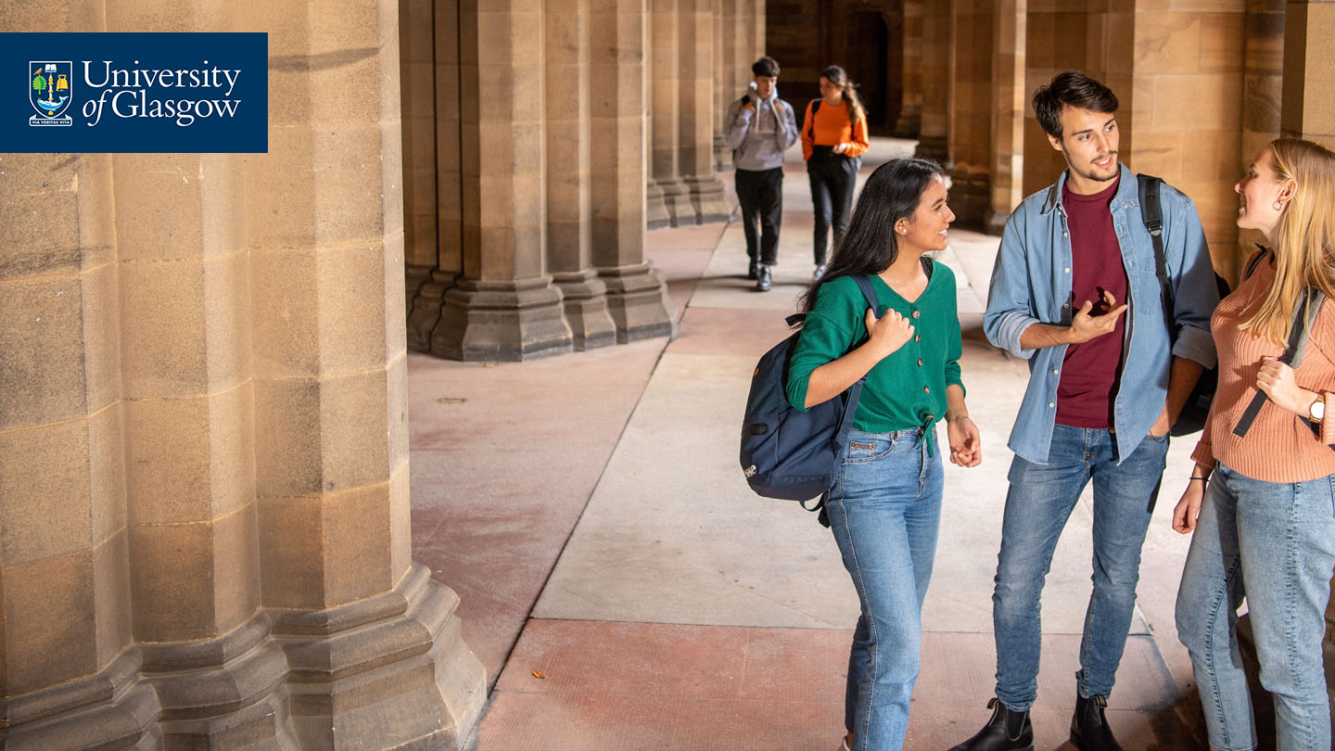
What do we want from the ALN?
Networking with like-minded people nationally and internationally
Ideas, inspiration, teaching strategies and methods
Opportunity to present at ALN events and contribute to scholarly outputs

Slide 6
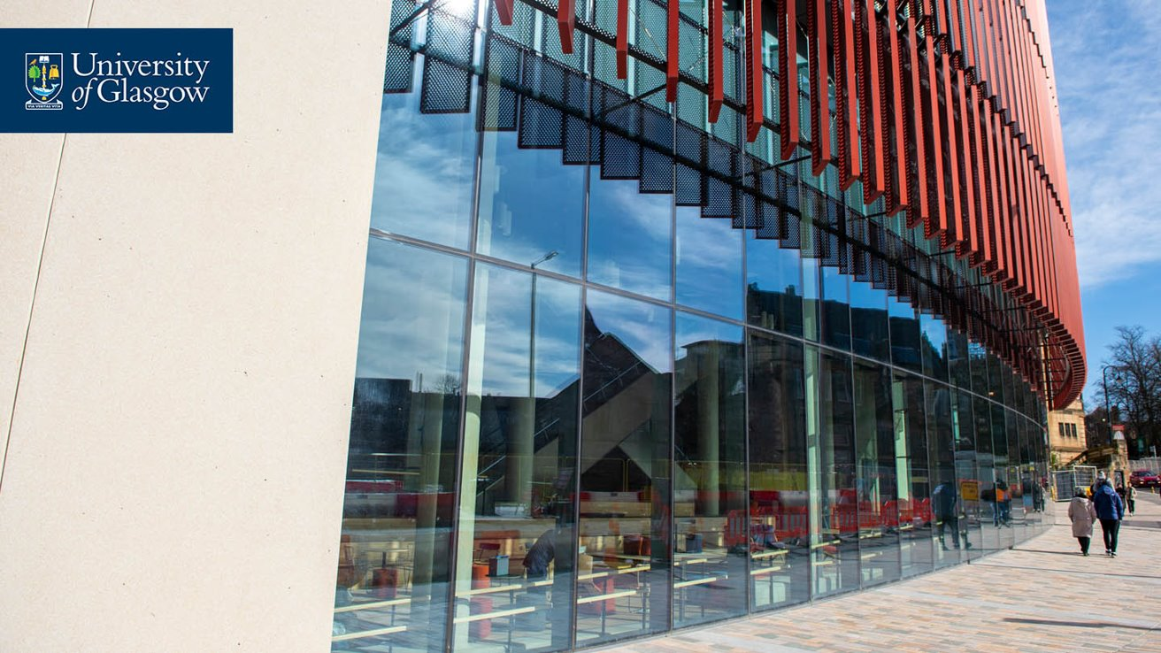
What can we offer the ALN?
Experiences of using the JMS hub
Sharing good practice case studies
Share scholarship methodologies
Cross-institutional projects
Events e.g. webinars, workshops

Slide 7
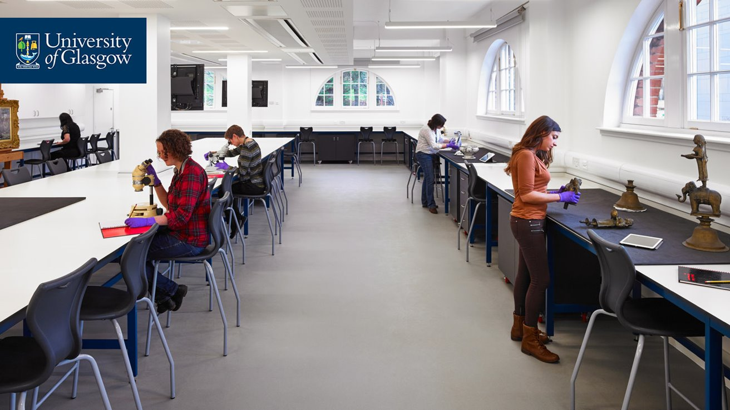
Ideas for next meeting, events etc
Next ALN conference (online) to be jointly organised by UofG in partnership with University of Coventry colleagues
Themed workshops?
Joint webinars?

Slide 8
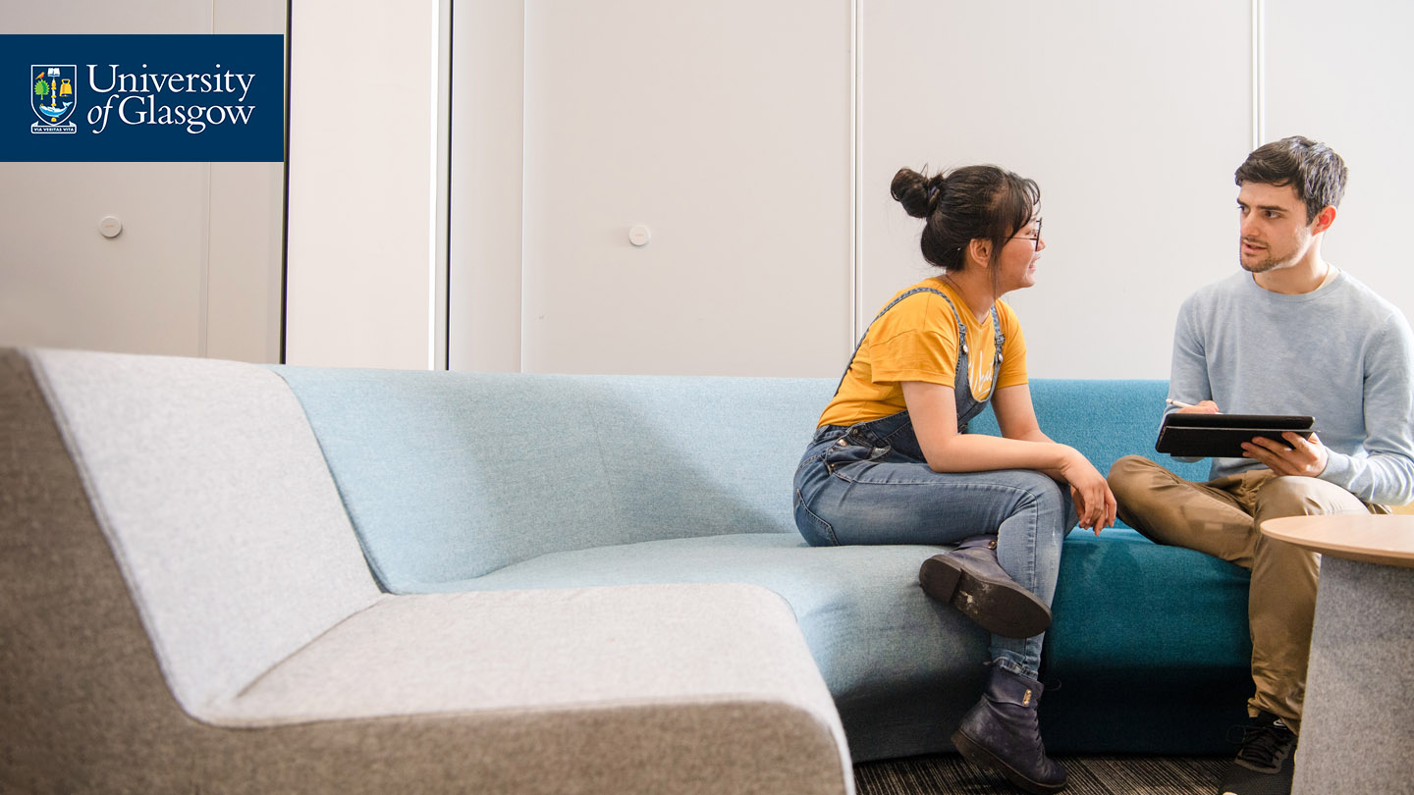
Discussion
How else can we meaningfully engage with the ALN?

Slide 9



https://activelearningnetwork.com/
@ActiveLearnNTW
Teams:
#UofGWorldChangers
@UofGlasgow

