Slide 1
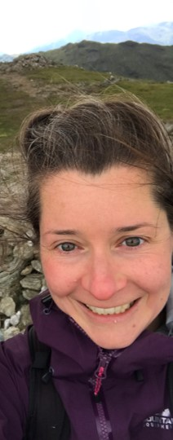
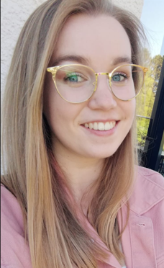
Mulling it over: Valuing reflection and cohort-centred learning in virtual field class design
Course leader
r
Peer observer
& adviser
Honours student (participant)
Dr Hannah Mathers, Dr Pamela Campbell, Miss Emma Cameron,
School of Geographical & Earth Sciences, University of Glasgow

Slide 2
Outline of this presentation
How the virtual field class (VFC) was approached
Observations & pedagogic analysis
Interactive window: Cohort building
The student experience
Take home messages for any discipline

Slide 3
Ethos & Objectives of the virtual field class: Staff approach & considerations
How can we replicate the cohort building experienced during residential fieldwork?
How can reflective practice be embedded so that it feels meaningful to students and provides insight for staff into student experience during the VFC?
How can we deliver an end of year experience that is personal to this cohort and leaves them with positive course associations?
How can students be actively engaged in decision-making, data critique, engagement with landscape and creative scientific synthesis?

Slide 4
Communication & Consultation
Before
Cohort info (Padlet)
Groupwork consultation (Moodle)
During
MS Teams for 1:1s
VLE Forum for updates
Course info (Moodle)
Timetable adjustments
Polls via VLE (Menti.com)
Anonymous Qs (Padlet)
After
Student reflective assignment
Individual student feedback
Menti poll feedback
Peer Observation
Collaborative reflection

Slide 5
Mechanical design of virtual field class (VFC)
Live component 1: Lecture intro:
Theoretical context, assessment explanation & resource-awareness.
Zoom quizzes prompt students to revisit lectures.
Live component 2: Group-based projects:
Groupwork in break outs for investigative collaborative learning
Materials on OneDrive & subject-specific digital platforms.
Asynchronous components:
Lecture slides and references (VLE).
Lecture recordings available same day (MS Stream). Field photos and videos (MS Stream).
Assessments submitted next day (extensions poss).
Logistics: 5 days, Quick assessment turn around, 1 x staff, Limited technical ability.
Cohort: Mixed level Honours. Assessed & non-assessed.
Approach: Low-tech, familiar platforms. Echo lecture course structure for familiarity & cross-referencing. Avoid onerous marking, promote peer-learning & cohort-building, leave everyone with a feeling of a shared positive experience.

Slide 6
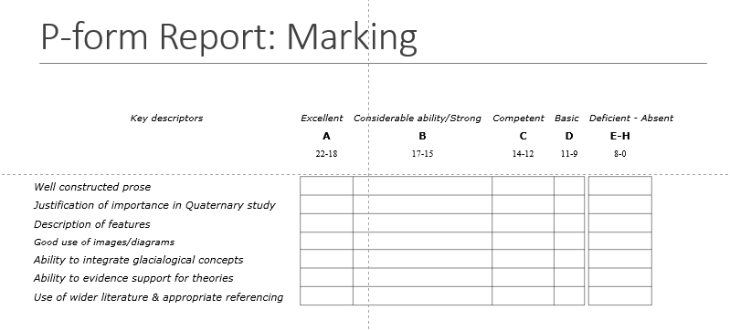
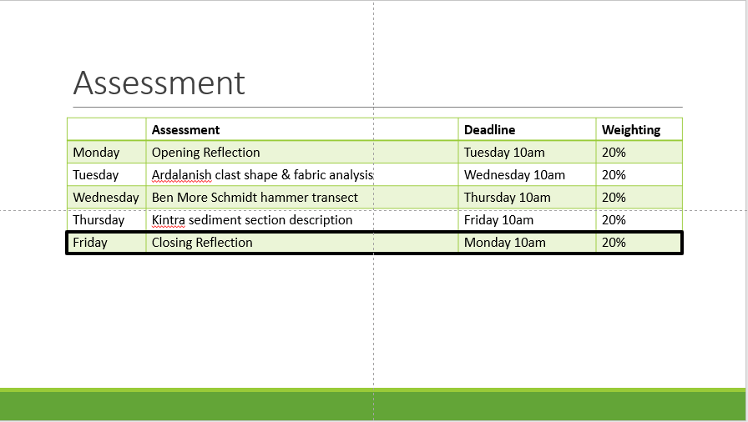
Staff approach and considerations: Providing a positive experience – Clarity & consistency

Slide 7
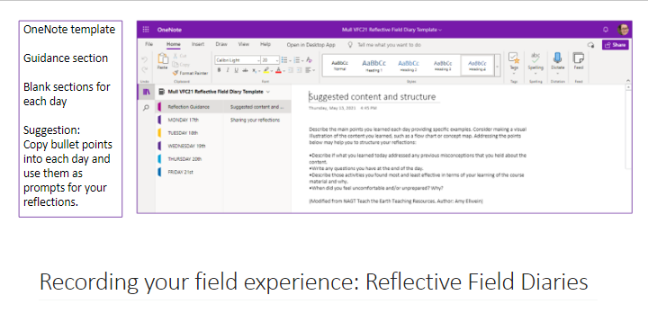
Staff Approach & considerations: Embedded & meaningful reflective practice (RP)
Use RP to acknowledge students' individual situation and build from there.
Bookended by reflective assignments:
1st = personal goal setting.
2nd = recognition of personal challenges, achievements and attainment of Graduate Attributes.
Encouraged and scaffolded in the keeping of a VFC reflective diary.

Slide 8
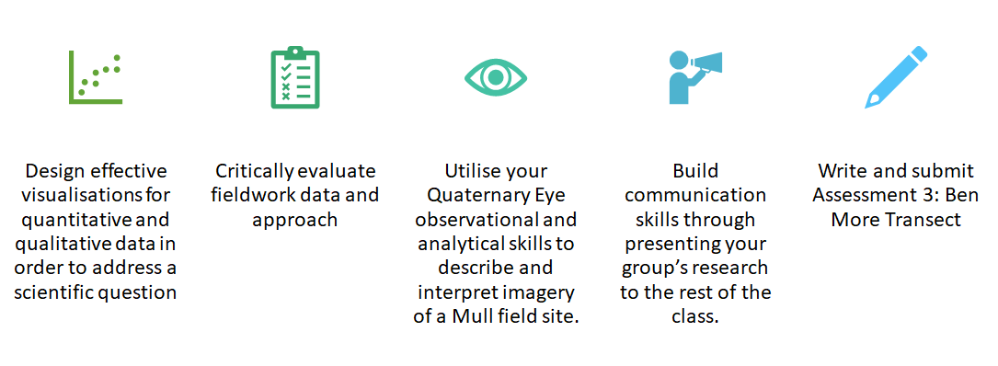
Staff Approach & Considerations: Actively engaging students
Skills-building visible
Groups are accountable for communicating specific findings
Different routes for engagement
Questions welcomed
Objectives set in relation to 'passive' tasks

Slide 9
Staff Approach & Considerations: Cohort Building through Accessibility
Engage your way
Asynchronous option
Multiple Q routes
Live material recorded & available same day
Appreciate peers
Consistent groups
Groupwork not assessed
No physical barriers
Breaks signposted
Peer-assisted vocalisation
Live groupwork not compulsory
Inclusive

Slide 10
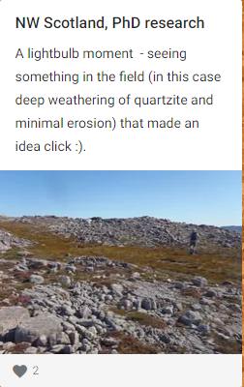
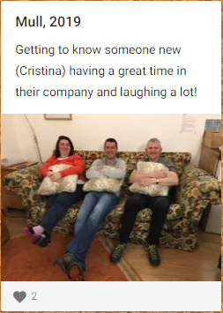
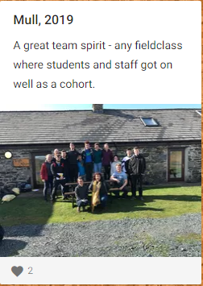
Staff Approach & Considerations: Cohort-building through sharing
Reframing the value of fieldwork away from physical endurance and towards self- and learning reinforcement

Slide 11
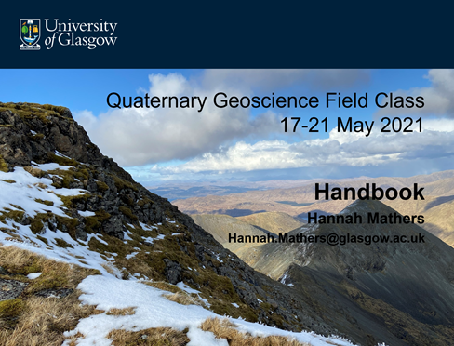
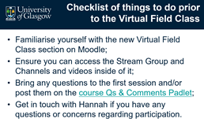
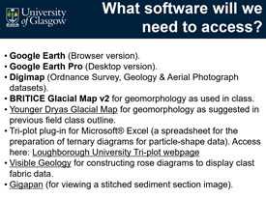
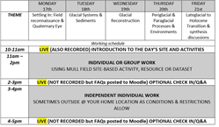
Peer observations of effectiveness (Pamela)
Easy to navigate format
Straightforward and consistent signposting of materials
Clear etiquette and ground rules laid out, managing expectations both of and for students.
Clear daily working structure
Flexible and intuitive
Tailored to suit the needs and group dynamics of the group.
Materials/timing were adapted and adjusted throughout, responding to the students.
Notes:
Clear and consistent signposting of preparation, instructions, live sessions, materials, software and expectations both of and for students.
Clear daily working structure, with a mix of individual and group tasks. Live 'check-in' sessions each day, presenting lots of opportunities to feed-in, ask questions and for support. This created a friendly and open environment, where students knew how to engage, and had many means to engage.
Adaptability of materials and responsiveness to students, recognising the need to adjustments to level of interaction, and allowing for more time for student-led activities and/or individual working.

Slide 12
Peer observations of effectiveness
Authentic, immersive learning experiences
Critical evaluation of fieldwork data and approach (e.g. sampling, size and reproducibility of data sets): using authentic data to investigate scientific questions and critiquing the process.
Collaborative, immersive learning activities: Authentic learning experience (Edelson, 1997): providing an opportunity to practice critical field skills in a 'safe' environment.
Notes:
A range of hands-on, collaborative activities
Opportunities to bring in knowledge from other areas of the course and apply it to the problems
Practical, real-work scenario-based examples in a meaningful context
work collaboratively on analyzing and solving authentic problems
Important skills in reading the landscape and recording and communicating their observations

Slide 13
Observing student interaction and feedback
"How are you finding the field class so far?"
"I'm really enjoying the group work and all the discussions with my group, especially since we don't get much of a chance to work together in other classes"
"I wasn't sure what to expect but it's turned out much better than I imagined. I think it's been good because it is a bit different"
"Yeah fine. I was a bit lost yesterday but Hannah was really helpful"
"It's quite full on but I'm learning a lot and it's been quite social which is nice"
Themes identified from the student feedback:
Overwhelmingly positive views midweek
Active participation from group members in Zoom Breakout rooms
Strong sense of community – students valued the social and collaborative aspect
Acknowledged it was challenging but felt supported and capable
Notes:
Consistent level-specific groups (3rd or 4th year) as this was most popular when asked their choice via Moodle Poll – honing in on the needs of the students, and giving them responsibility and choice in their learning – replicating the ‘natural’ groups that form during f2f field work
- What would you like to get out of the field class? (initial question during first session): geological knowledge, developing skills further, developing skills, confidence in field notes, improving observations, understanding the field, skills building.
Such a big part of fieldwork for me as an undergraduate, and during my postgraduate, was the close-knit community and comradery among peers that occurs due to working intensely and intimately with a small group, and experiencing the same challenge and triumphs of the field trip or expedition.

Slide 14
A Student's Experience of the Field Class (Emma)
Before
During
After
Tired after exams
Anxious about deadlines
Opening reflection gave personal motivation.
Group work made it social.
Lots of additional support with assessments.
Sense of Achievement.
Gained skills and confidence.
Notes:
Before: 3 week long exam period had just ended. I had my last exam 4 days before. Moral was a bit low, everyone else was finished and we knew we all still had a week left and 5 assessments to do. The timetable and structure ahead of time set our expectations and was very helpful.
During: Opening reflection really helped motivation. Gave us personal motivation and value. We enjoyed seeing the same faces each day and working together after a few weeks not having seen each other. The amount of effort put in made us want to pull on the other end. The assessment guidance was very helpful and Hannah was always available to help 1:1 on teams when we got stuck which was really valuable. In the middle of the week we got a bit tired and Hannah seemed to sense this and scaled down the zoom time which worked really well.
After: I learned I am more capable of sticking to deadlines than I thought. I am much more confident about field sketches. Gained research skills and found out that even experienced geomorphologists cannnot always say the origin of a feature definitely. Group work helped our research and communication skills. Also learned about presenting data.

Slide 15
3 Things that worked Well
Group work.
Class interaction via polls and Padlet.
Assessment support.
Notes:
What worked well: group work, consistent groups, polls, practical exercises to consolidate and practice what we had learned.
Blended assessment format between essay style and practical skills.
Staff availability for help on teams was really good.
The assessment guidance for very helpful for such quick turnarounds.

Slide 16
What could be improved?
Less time on Zoom, as was adopted later in the week, allowed students to manage their own time better and schedule in breaks.
Indicate what the product of group work needs to be, with a time frame – advanced notice for group work presentations might help to increase participation.

Slide 17
5 words to describe the Field Class
Collaborative
Challenging
New
Interesting
Thoughtful

Slide 18
Take homes for any discipline - ORGANISATIONAL
Clear consistent intuitive set-up on VLE.
Clear regular 2-way communication and consultation.
Provide material & timetable pre-session.
Scaffold asynchronous groupwork.
Be authentic. Try something new! Novel approach can really work.

Slide 19
Take homes for any discipline - VALUE & MEANING
Foster collaboration & class community through group work.
Underpin subject-specific learning with reflective practice.
Tie reflective practice to Graduate Attributes.
Support confidence-building with challenging assignments.

Slide 20
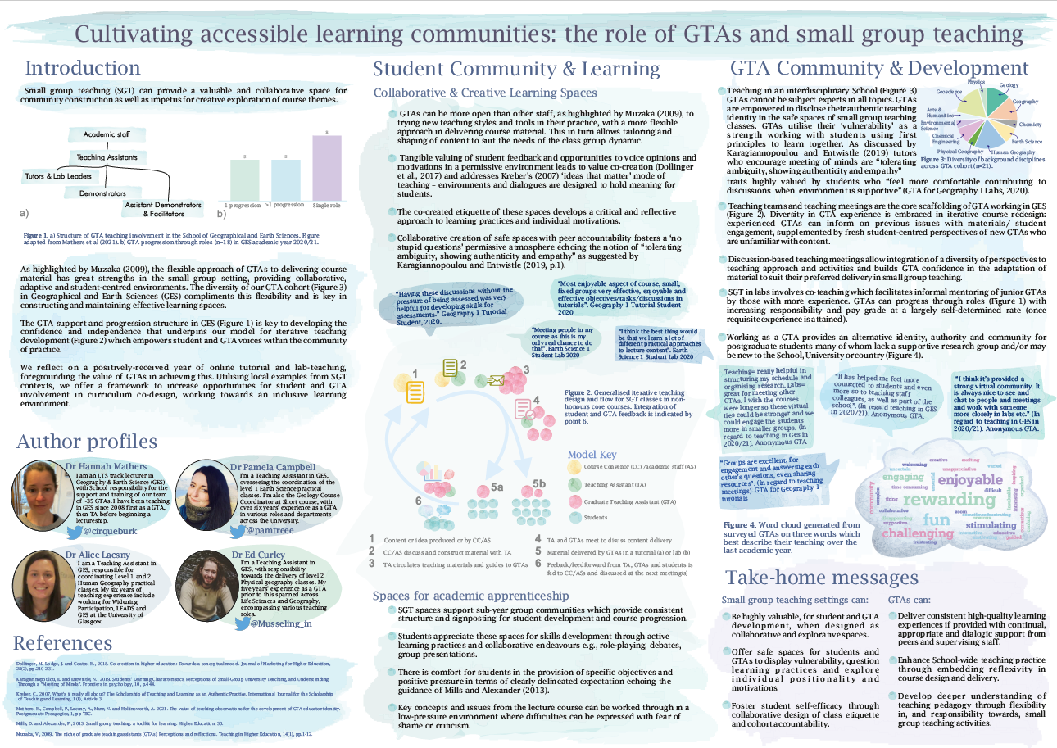
Thank you for your engagement! Any questions or comments?
Contact:
Hannah.Mathers@glasgow.ac.uk @cirqueburk
Further discussion & resources:
Cultivating accessible learning communities: the role of GTAs and small group teaching

Slide 21
Interactive window: Individual or Group Activity
Individual Activity:
Contribute a georeferenced photo to the group padlet to build up a map of participants and share chosen view.
Group Activity:
Site observation & description. Work with others to provide locational information about a field site.
Notes:
We invite participants to engage in replication of an interactive cohort-building exercise. Using Padlet and simple drawing tools (e.g. PowerPoint/Paint) volunteered participant location data (spots on maps) and simple sketches are shared to provide a visualisation of cohort distribution, a sense of parallel experience as well and an introduction to simple landscape component analysis. Estimated duration ~ 5 minutes.
Live demo of the process and instructions to demonstrate ease and speed.

Slide 22
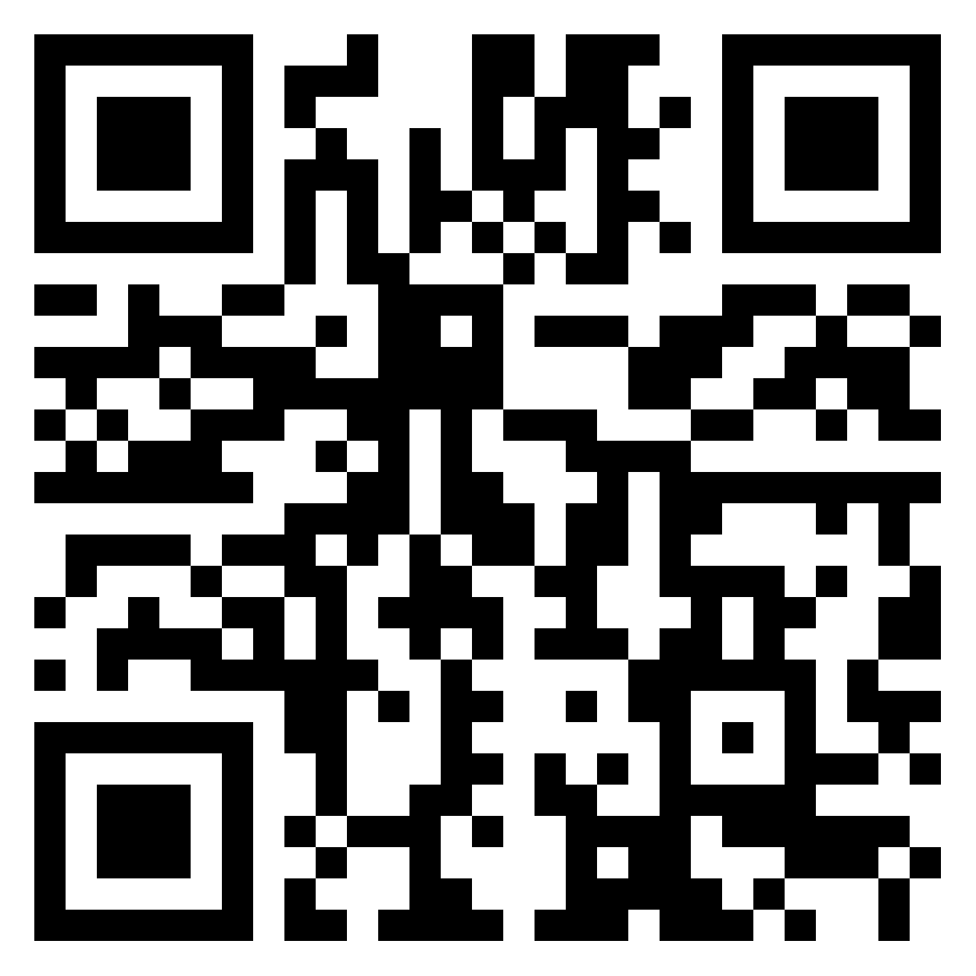
Interactive window: Individual Activity Contribute to the Group Padlet
https://padlet.com/hannah_mathers1/eu3f3ijtyelxo34p
Step 3: Using the pink (+) button, upload a photo to your location (general locations, no addresses!)
Step 1: Take a photo of your location (e.g. out of your window)
Step 2: Access the Padlet using QR code or link
Notes:
We invite participants to engage in replication of an interactive cohort-building exercise. Using Padlet and simple drawing tools (e.g. PowerPoint/Paint) volunteered participant location data (spots on maps) and simple sketches are shared to provide a visualisation of cohort distribution, a sense of parallel experience as well and an introduction to simple landscape component analysis. Estimated duration ~ 5 minutes.
Live demo of the process and instructions to demonstrate ease and speed.

Slide 23
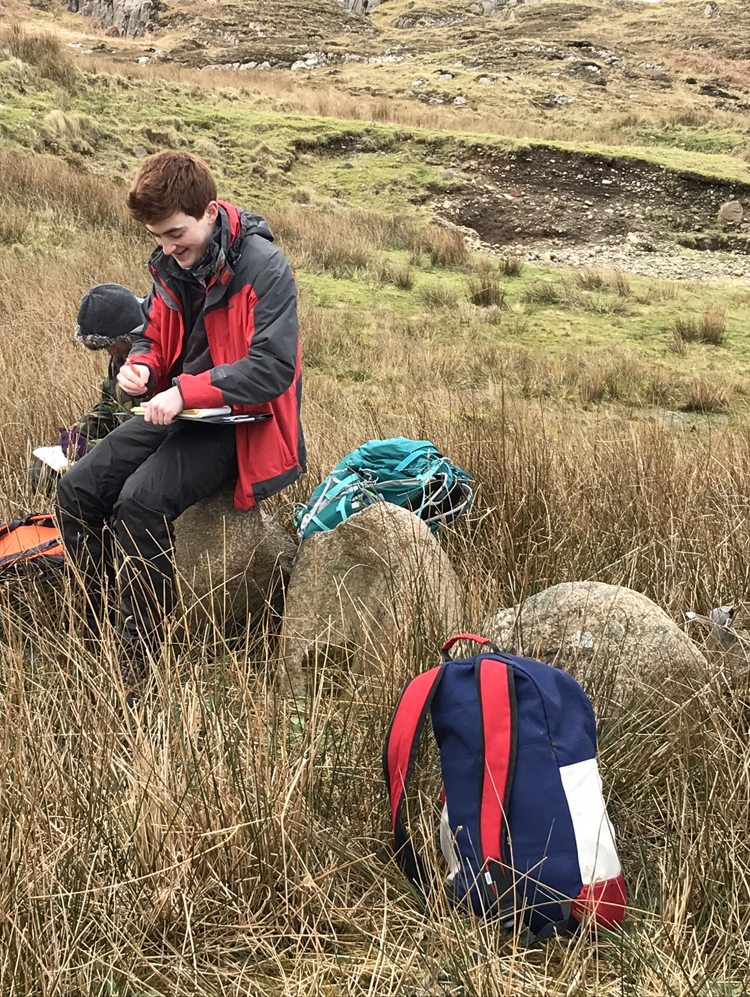
Group Activity: Site observation & description
Scenario: You have fallen asleep on the minibus and woken up to be dropped off at your group’s field site. You don’t know where you are.
You need to be collected by the minibus (this time with a different driver) – they know the sites, but not who is where. You have no 4G, map etc.
Describe your location in a way that would be helpful for driver to discern your location – specifically:

Slide 24
Group Activity: Site observation & description
Scenery
Orientation
Elevation
Think about what can't you be sure about/need more info on/to investigate?

Slide 25
Field Site (on Mull, Western Scotland)

Slide 26
References
Edelson, D. C. 1997. Realising authentic science learning through the adaptation of scientific practice. In: Tobin, K. & Fraser, B. 1997. International Handbook of Science Education, Kluwer, Dordrecht, NL.

