Slide 1

ASSESSING YOUR ASSESSMENT: CREATING INCLUSIVE ASSESSMENT TASKS
Dr Kimberly Wilder-Davis
Academic and Digital Development Services

Slide 2
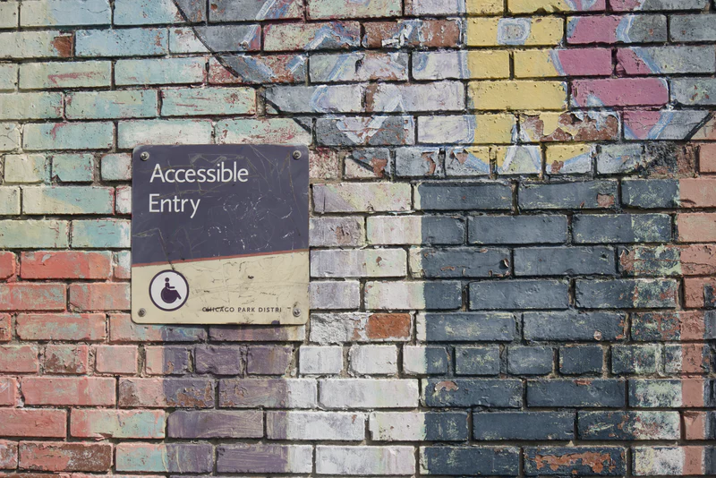
What is an Accessible Assessment?
The word “accessible” means different things to different people. Accessibility in higher education is no longer just about removing the physical barriers that can hinder a student, but the potential social, environmental and cognitive barriers that can make it harder for students to succeed.

Slide 3

Inclusive learning and teaching in higher education refers to the ways in which pedagogy, curricula and assessment are designed and delivered to engage students in learning that is meaningful, relevant and accessible to all. It embraces a view of the individual and individual difference as the source of diversity that can enrich the lives and learning of others.
(Hockings, 2010, my emphasis)
Notes:
Define any new/potentially confusing vocab for students
Pedagogy: the study of the methods and activities of teaching
Ask students what they think inclusive learning means in context of your programme

Slide 4

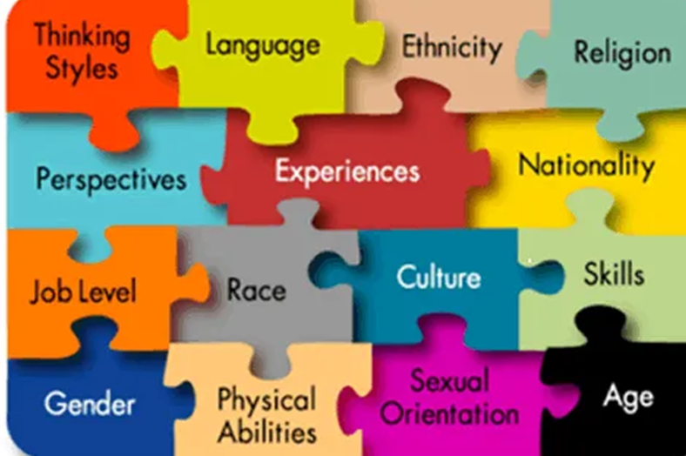
What is Diversity?
the fact of many different types of things or people being included in something; a range of different things or people

Slide 5

How do we use this conceptualization to make decisions towards more inclusive learning design?
Part 1: Reflection
Making decisions about more inclusive instructional design is an exercise in pedagogy, which can be seen here as an intersection of disciplinary mastery, rigor of psycho-social concepts, and empathy. Making these decisions requires data relevant to all parts of that intersection. This data can be functionally obtained through critical self reflection that asks the following types of questions in the following order:
Academic/content questions: What is the material? What are the complex ideas? What are the fundamental concepts?
Logistical: Think of this as stats for you session - # of students, how much time you have, place in the learning journey of the semester/programme? What is the lesson plan? What has to be in the lesson? How is the material assessed? What technology do you use? Is there an important “why” to any of these answers?
Notes:
Inclusive Constructive Alignment comes from Dr Errol Rivera
Reflections on (Session/module/Programme)
Name, Date
1) Biography of the lesson
This includes
When does the session run? Where is it in the semester, in the programme?
In what space is the session run? Whats it like?
What materials and technology do you use?
How many students?
Why does the session exist?
What content is covered? What is the session like (I.e. brief outline of the lesson plan
What you’d like the session to be/be able to do in an ideal world
2) Reflections on student expectations/experience/reactions
This is based on your experiences as well as student feedback, and includes:
What students normally say about the session
What your students’ performance is typically like
The problems your students have had with the session, inclusivity related and otherwise
your previous insights as the “why” of the above reflections
3) What value must remain in the lesson, no matter what, and wher you see flexibility
This includes:
how the session currently supports the assessment, and what must remain even after a redesign
time and resource related matters, such as session length, materials, or texts
links to other parts of the programme
ambitions you have for the session

Slide 6

Continued
Think about the academic/content and logistical reflections together, and ask yourself:
Necessarily Empathetic questions: How does everything you’ve reflected upon make learning hard for students in that lesson? What kind of background would make it difficult for a student to learn from your lesson? – from an emotional point of view i.e. Have students identified with it too much? Or to little? How challenging is the material? From a practical point of view, i.e. How complex are the ideas? Do experienced practitioners ever find it easy? Are students pressed for time? Is discussion difficult because of class size? Does a student need a lot of spare time outside class?
Your answers to these empathetic questions need to be a synthesis of:
your academic/content reflections, and
your logistical reflections, you can begin
your experience with students
This is because your empathetic reflections will serve as the basis of your inclusion fail-points.

Slide 7


Part 2: Alignment
Separately, the lesson being delivered will need to have its learning outcomes re-written/ expanded to include all three domains of learning. Once these are complete, each fail-points can then be aligned to the verb/domain of learning that it most compromises.
Once inclusion fail-points and domains are aligned, the lecturer can begin using the verb in the intended learning outcome to “cancel” out the fail-point’s impact.
Ex:
If the cognitive verb of the intended learning outcome is “explain” but aligned fail-point is “dense material in limited class time”, the lesson can be redesigned so that students have to explain the material in a situation where its density is less of a factor, such as breaking the material up between individual students or groups of students.

Slide 8
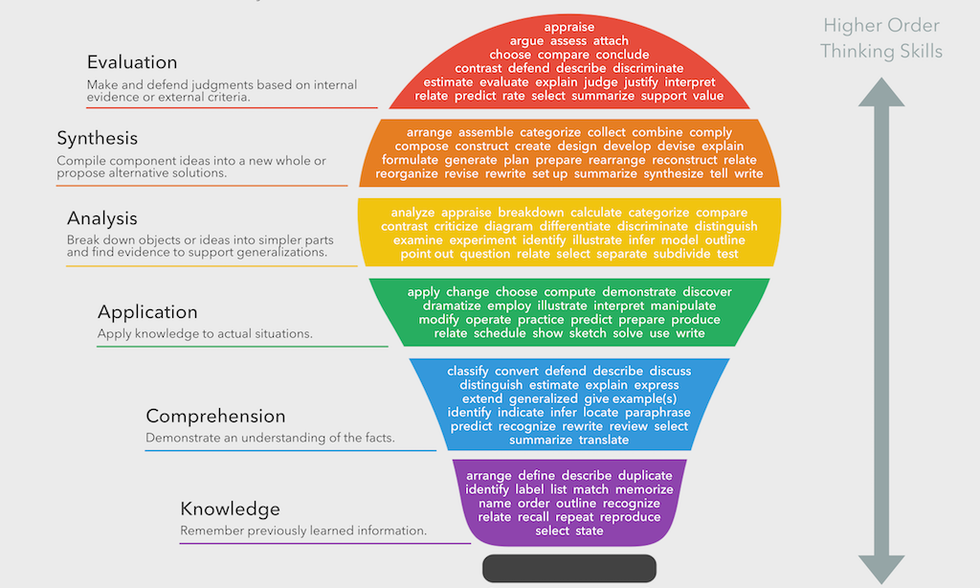

Slide 9
The COGNITIVE Domain
The cognitive domain deals with how we acquire, process, and use knowledge. It is the "thinking" domain. The table below outlines the six levels in this domain and verbs that can be used to write learning objectives.
Cognitive Domain Levels
-------------------Increasing Complexity------------------->
Remember | Understand | Apply | Analyze | Evaluate | Create
Retrieve relevant knowledge from long-term memory | Construct meaning from instructional messages, including oral, written, and graphic communication | Carry out or use a procedure in a given situation | Break material into its constituent parts and determine how the parts relate to one another and to an overall structure or purpose | Make judgments based on criteria and standards | Put elements together to form a coherent or functional whole; reorganize elements into a new pattern or structure
Arrange Cite Choose Count Define Describe Duplicate Identify Label List Locate Match Name Outline Recall Recite Recognize Record Repeat Restate Review Select State | Abstract Associate Categorize Clarify Classify Compare Conclude Contrast Exemplify Explain Extrapolate Generalize Illustrate Infer Interpret Map Match Paraphrase Predict Represent Summarize Translate | Apply Carry out Demonstrate Determine Develop Employ Execute Implement Operate Show Sketch Solve Use | Analyze Attribute Deconstruct Differentiate Discriminate Distinguish Focus Organize Outline Parse Select Structure | Argue Assess Check Conclude Coordinate Criticize Critique Detect Evaluate Judge Justify Monitor Prioritize Rank Rate Recommend Test | Assemble Build Combine Compose Construct Create Design Draft Formulate Generate Hypothesize Integrate Plan Produce

Slide 10
The AFFECTIVE Domain
The affective domain deals with our attitudes, values, and emotions. It is the "valuing" domain. The table below outlines the five levels in this domain and verbs that can be used to write learning objectives.
Affective Domain Levels
-------------------Increasing Complexity------------------->
Receiving | Responding | Valuing | Organization | Characterization
Openness to new information or experiences | Active participation in, interaction with, or response to new information or experiences | Attaching value or worth to new information or experiences | Incorporating new information or experiences into existing value system | Full integration/ internalization resulting in new and consistent attitudes, beliefs, and/or behaviors
Ask Choose Describe Follow Give Hold Identify Locate Name Select Reply Use | Answer Assist Aid Compile Conform Discuss Greet Help Label Perform Practice Present Read Recite Report Select Tell Write | Complete Demonstrate Differentiate Explain Follow Form Initiate Join Justify Propose Read Share Study Work | Adhere Alter Arrange Combine Compare Complete Defend Formulate Generalize Identify Integrate Modify Order Organize Prepare Relate Synthesize | Act Discriminate Display Influence Listen Modify Perform Practice Propose Qualify Question Revise Serve Solve Verify Use

Slide 11
The PSYCHOMOTOR Domain
The psychomotor domain deals with manual or physical skills. It is the "doing" domain. The table below outlines the five levels in this domain and verbs that can be used to write learning objectives.
Psychomotor Domain Levels
-------------------Increasing Complexity------------------->
Imitation | Manipulation | Precision | Articulation | Naturalization
Observing and copying another's action/skill | Reproducing action/skill through instruction | Accurately executing action/skill on own | Integrating multiple actions/skills and performing consistently | Naturally and automatically performing actions/skills at high level
Adhere Copy Follow Repeat Replicate | Build Execute Implement Perform Recreate | Calibrate Complete Control Demonstrate Perfect Show | Adapt Combine Construct Coordinate Develop Formulate Integrate Master Modify | Design Invent Manage Project Specify

Slide 12
The COGNITIVE Domain
The cognitive domain deals with how we acquire, process, and use knowledge. It is the "thinking" domain. The table below outlines the six levels in this domain and verbs that can be used to write learning objectives.
Cognitive Domain Levels
-------------------Increasing Complexity------------------->
Remember | Understand | Apply | Analyze | Evaluate | Create
Retrieve relevant knowledge from long-term memory | Construct meaning from instructional messages, including oral, written, and graphic communication | Carry out or use a procedure in a given situation | Break material into its constituent parts and determine how the parts relate to one another and to an overall structure or purpose | Make judgments based on criteria and standards | Put elements together to form a coherent or functional whole; reorganize elements into a new pattern or structure
Arrange Cite Choose Count Define Describe Duplicate Identify Label List Locate Match Name Outline Recall Recite Recognize Record Repeat Restate Review Select State | Abstract Associate Categorize Clarify Classify Compare Conclude Contrast Exemplify Explain Extrapolate Generalize Illustrate Infer Interpret Map Match Paraphrase Predict Represent Summarize Translate | Apply Carry out Demonstrate Determine Develop Employ Execute Implement Operate Show Sketch Solve Use | Analyze Attribute Deconstruct Differentiate Discriminate Distinguish Focus Organize Outline Parse Select Structure | Argue Assess Check Conclude Coordinate Criticize Critique Detect Evaluate Judge Justify Monitor Prioritize Rank Rate Recommend Test | Assemble Build Combine Compose Construct Create Design Draft Formulate Generate Hypothesize Integrate Plan Produce

Slide 13

Accessibility and Learning Differences
Layout
  Ensure that documents given to students with dyslexia contain only the instructions needed for the exercise; omit any unnecessary details as these could be distracting
  All materials for students with dyslexia should have a clear layout, short sentences and an uncomplicated structure.
Illustrations
  Use images that exemplify sentences or unfamiliar words
  Space out the instructions and add a diagram, so that students can follow it without having to understand every word.

Slide 14

Accessibility and Learning Differences
Fonts and background colours
  Use sans serif fonts, such as Arial and Comic Sans, as letters can appear less crowded. Alternatives include Verdana, Tahoma, Century Gothic, Trebuchet, Calibri, Open Sans.
  Font size should be 12 to 14 points. Some dyslexic readers may request a larger font.
  When you can, avoid using stark white backgrounds.

Slide 15
Accessibility and Learning Differences
Microsoft tools
  Show students the Immersive Reader option for Microsoft Word, which will read out the documents for them.
  Make sure that you have used the “Check Accessibility” function on all Microsoft products.

Slide 16

Inclusive Language
Consider the diversity of your student population with inclusive language. Inclusive language further highlights our respect for the diversity of backgrounds in the classroom.
Use varied names and socio-cultural contexts in test questions, assignments and case studies.
Use language that is truly generic, ie, winter/holiday break instead of Christmas break and house of worship instead of church.
Use language to acknowledge different lived experiences: “For those of you who have studied abroad/seen Field of Dreams/been on a ferry…”

Slide 17

Accessible Assessments
Alternative formats
  Consider whether a written brief is the best way to deliver the task to your students.
  Make sure there are closed captions and transcripts available for any video or audio files you provide.

Slide 18

Meaningful Assessments
Creating a meaningful assessment is about de-obfuscating achievement – creating a situation where the learning that students display cannot be faked by preparation or go unrecognised by the conventions of teaching.
These assessments also mirror what students might be asked to do in a real-world scenario. Thinking about assessments this way further supports the accessible nature of the assessments because both meaningful assessments and accessible assessments are designed with the idea of excising the arbitrary, and arbitrarily alienating, tasks that hinder student engagement with the assessments.

Slide 19

Accessibility Through Assessment Literacy
The last tip is perhaps the most important. All assessments can be accessible to students if they understand what the assessment is and how they are supposed to engage with it. Assessment literacy means that students have the knowledge of how to complete an assessment regardless of the format.
Take the time to help your students become assessment and feedback literate.
Teach students to understand the purpose of assessment and be explicit about your expectations related to how they engage with and complete the assessment.
Explain how feedback will be provided and how it can be used to support the students in their learning.

Slide 20

The Perfect Assessment
What does the perfect assessment look like for your course?
  If time, the number of students, the number of students, the number of people who can mark, and the resources available were no object, what type of assessment would you present to your students?

