Slide 1
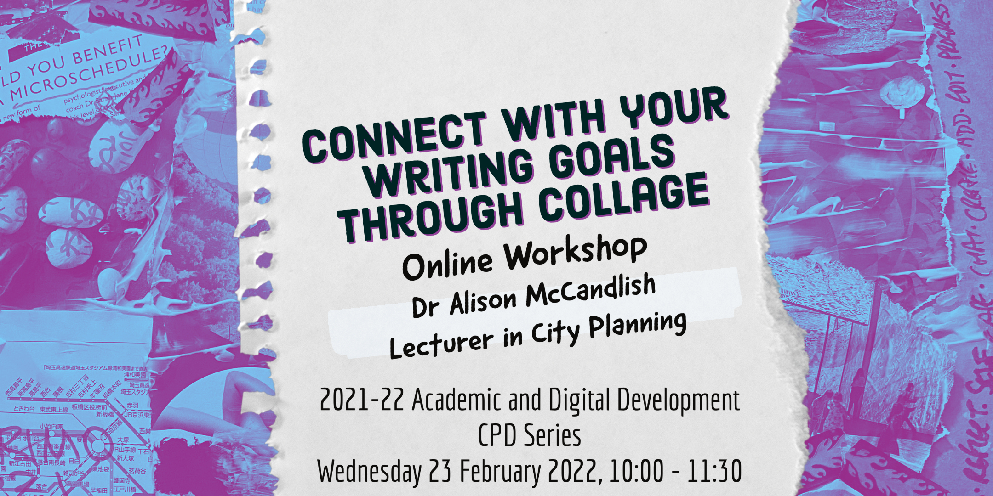
Using Collage to Connect with your Writing Goals
Dr Alison McCandlish
Lecturer in City Planning

Slide 2
Consider our influences
Solidify our writing intentions
Connect with our writing goals through collage
Make writing goals which work for us
Permission to play

Slide 3
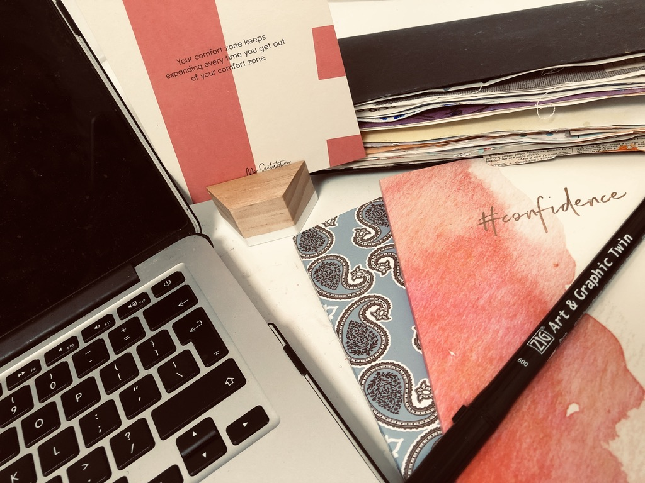

Slide 4
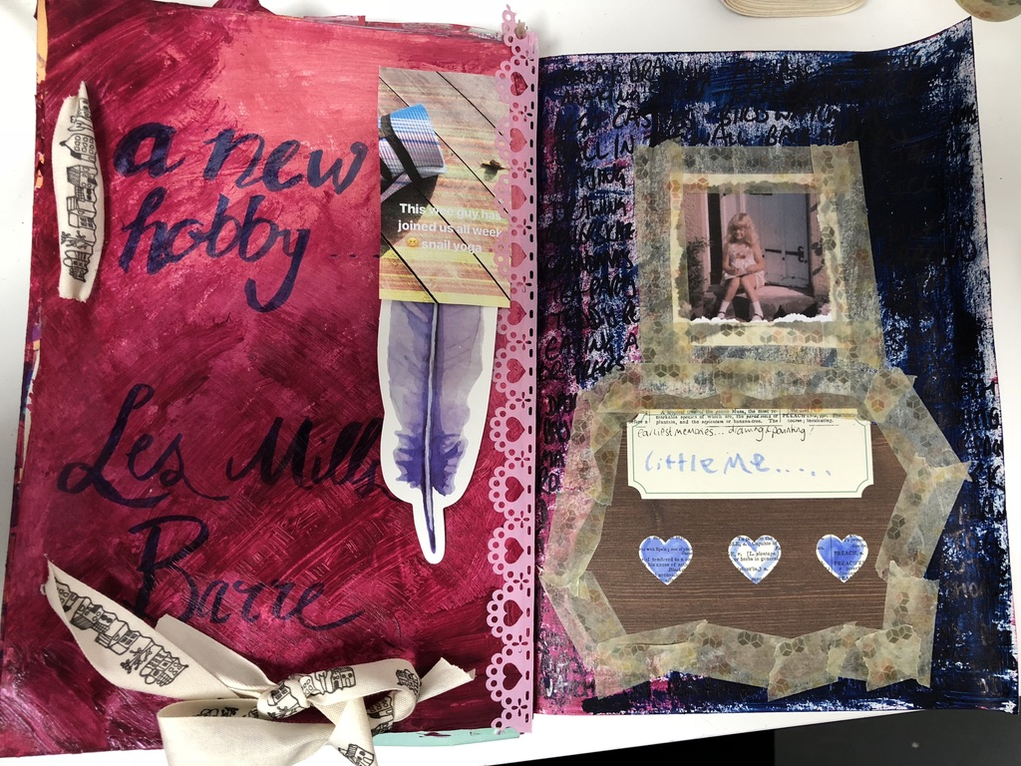

Slide 5
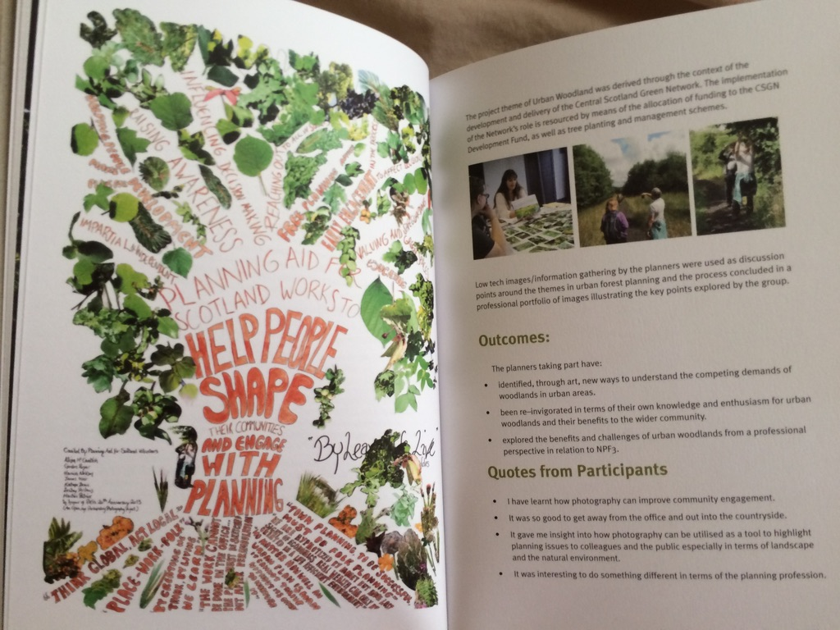

Slide 6
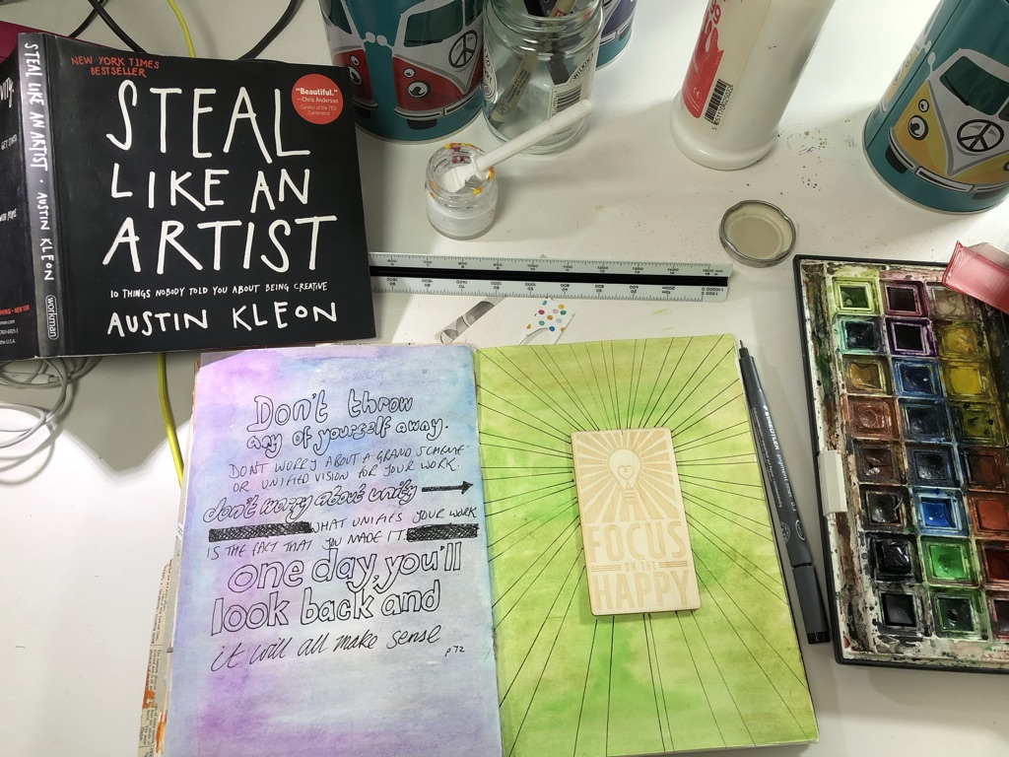

Slide 7
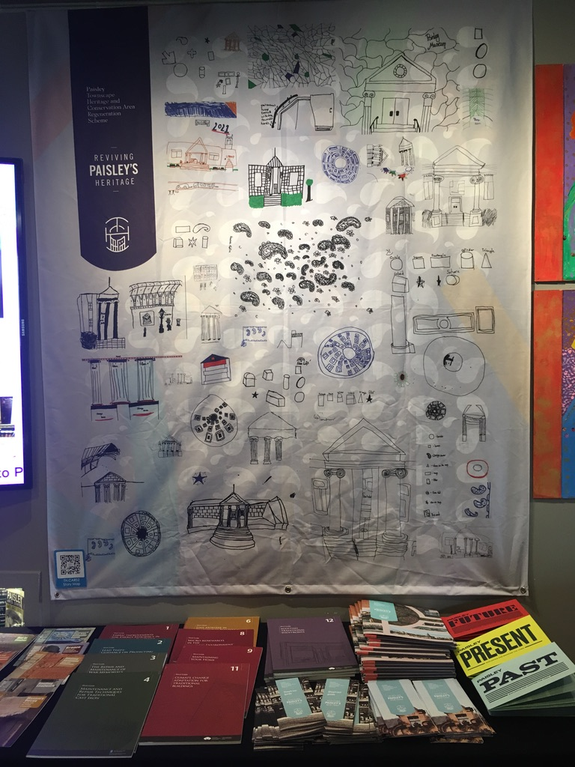
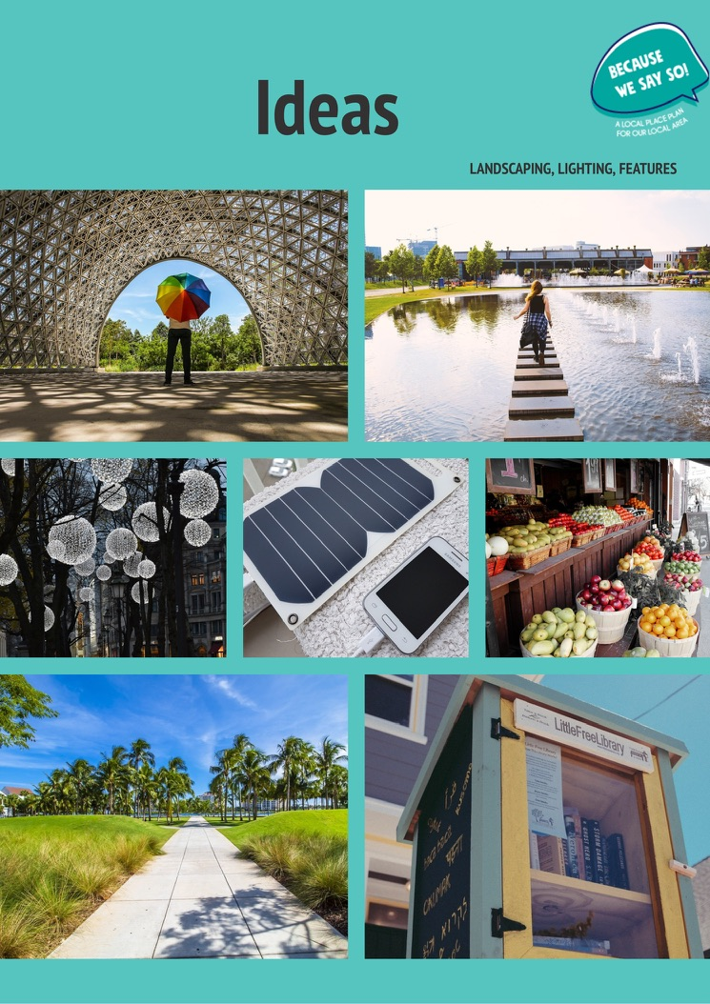

Slide 8
UNESCO IESALC
Learning Design
and ESD
bootcamp

Slide 9
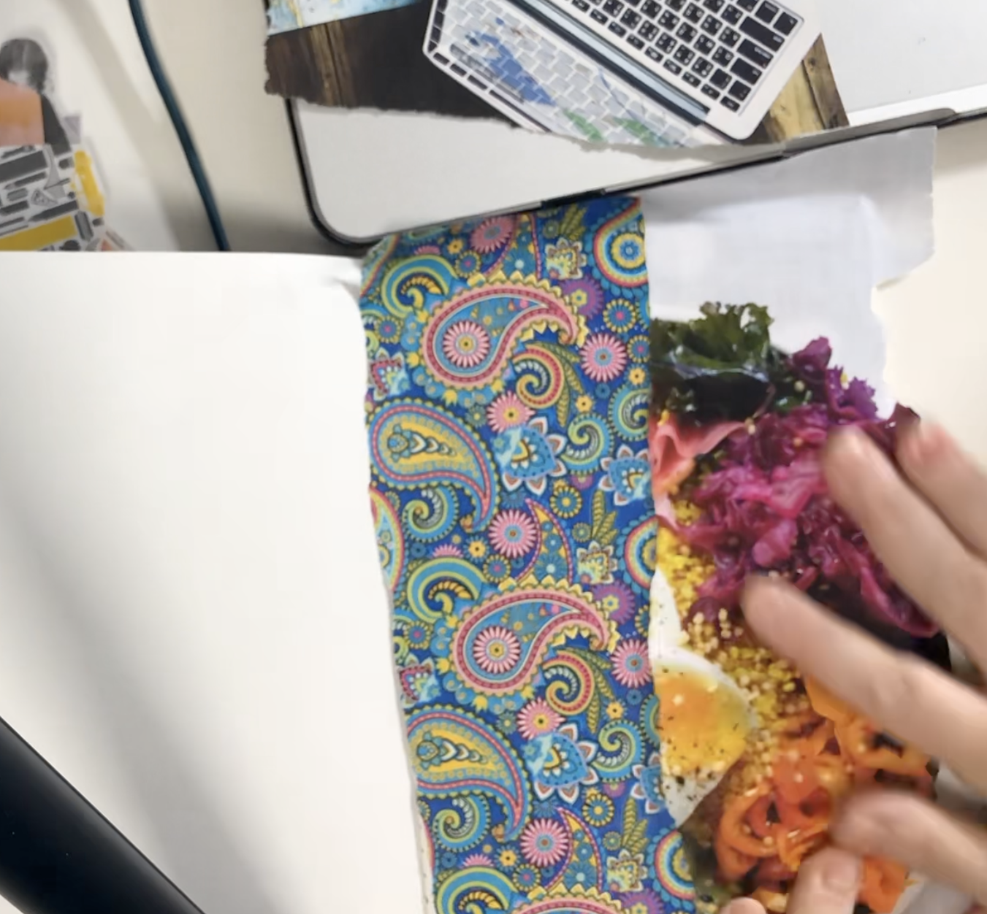
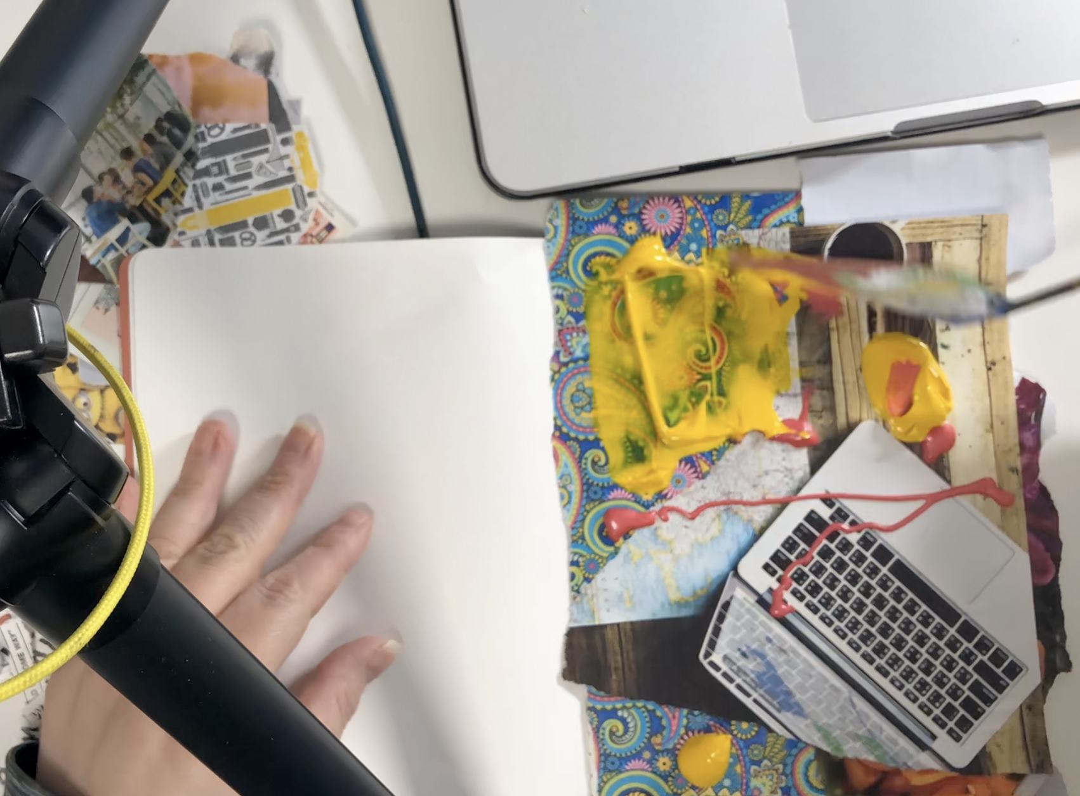
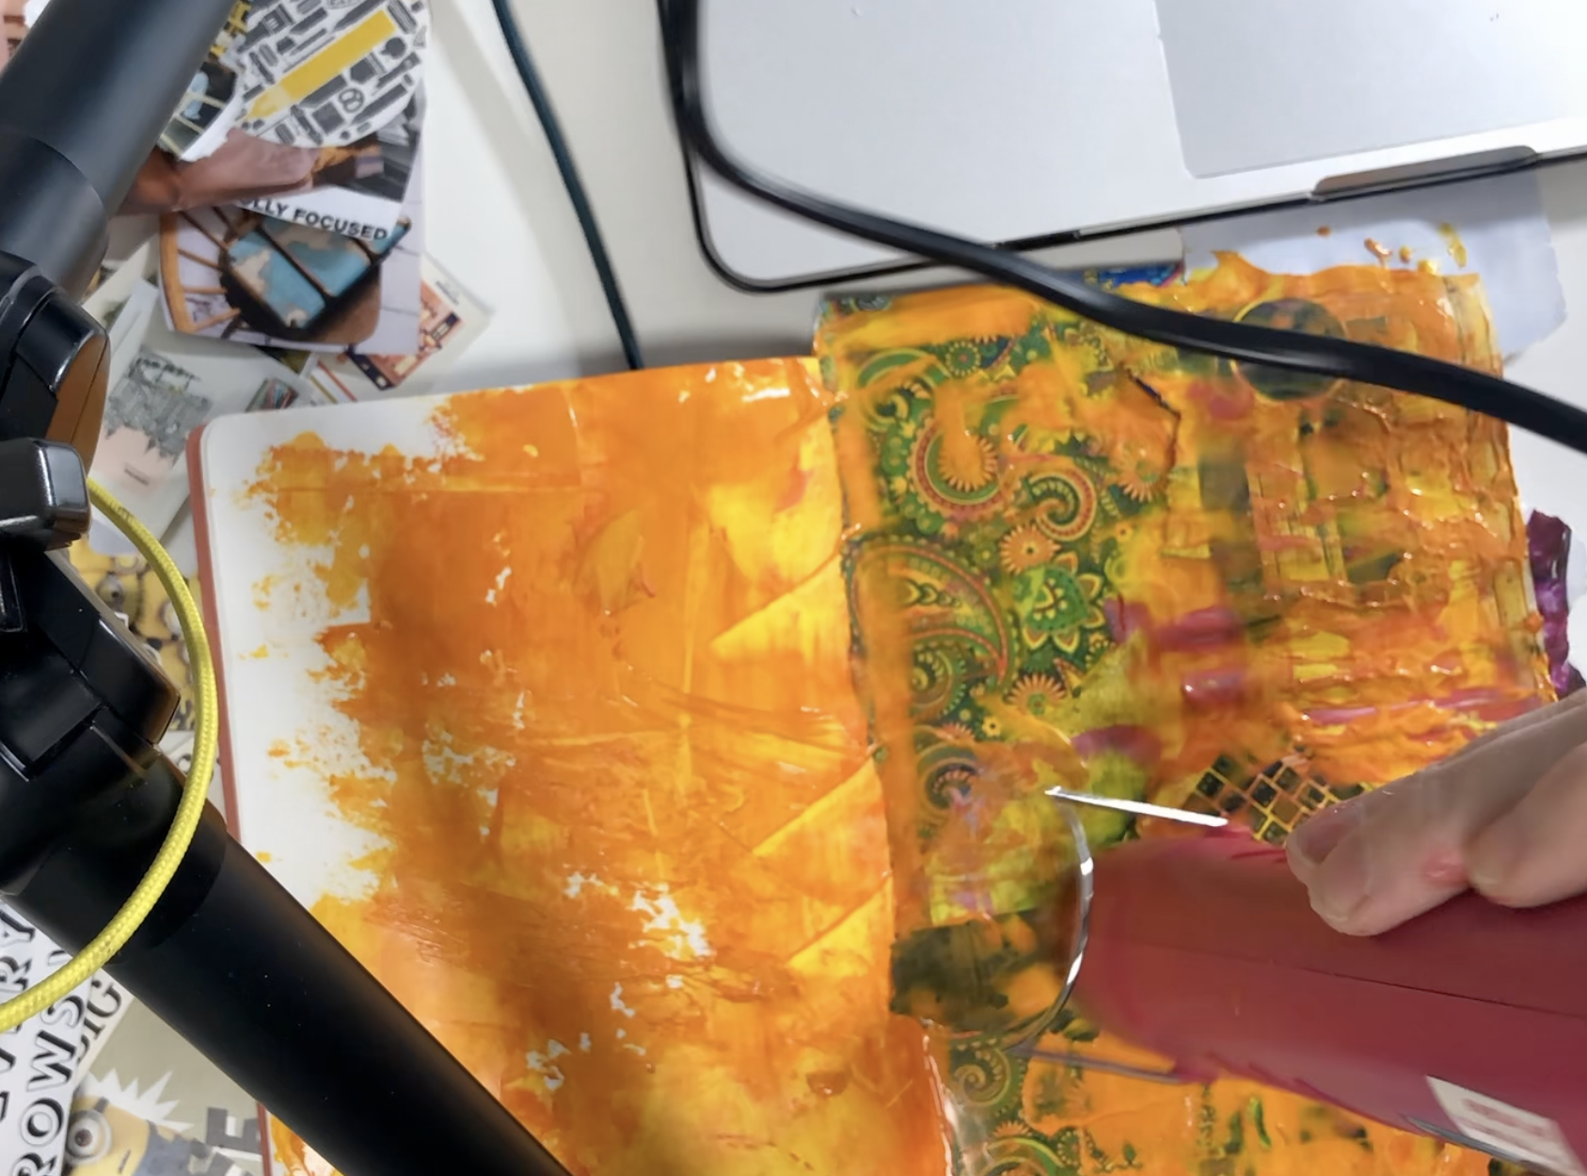
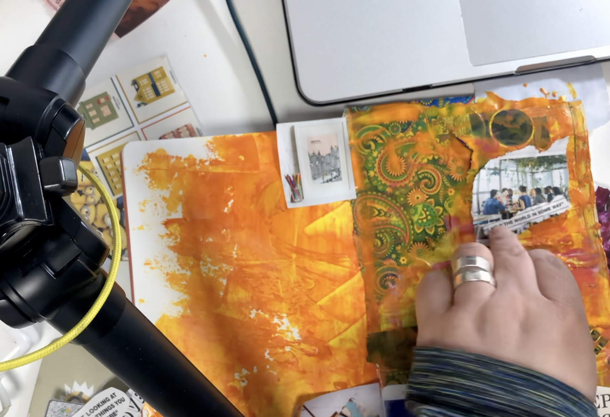
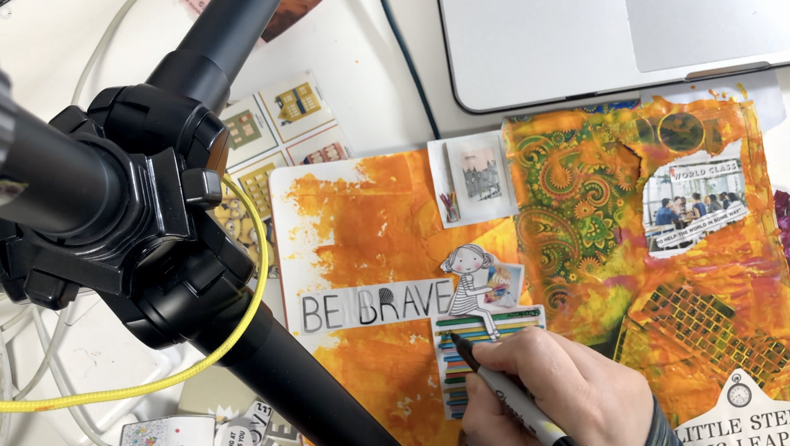
Analogue tools
magazines, brochures, prospectuses, newspapers, flyers or even (eek!) books which you do not mind cutting up
quotations from literature which are relevant to your research
ephemera you have lying around which is not yet recycled (travel tickets, receipts, paper scraps, wallpaper, tissue paper, wrapping paper, tags..
glue
scissors
pens or any other craft or stationery supplies you have access to (e.g. poster paint, watercolours, Sharpies, Tippex, washi tape, Sellotape, crayons, chalks). No need to buy anything specially unless you want to
Blank paper, card or wallpaper/ lining paper
Optional: hairspray, if you have it
Optional: hair dryer if you have one

Slide 10
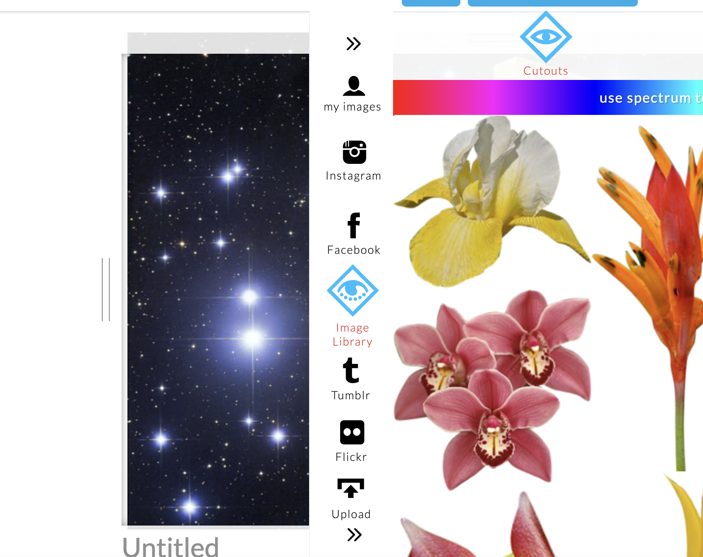
Digital Tools
Make in Powerpoint- make by hand by moving images around, or use the "design ideas" wizard for a quick collage
Microsoft Whiteboard (manually create mind maps and collage with the insert graphics tools)
Gimp (free graphics editing software from IT here)
Creative Cloud Express https://www.adobe.com/express/ (free trial, excellent for graphics, but costs after trial)
Freemix https://www.freemix.com/newdoc
Instagram stories (save, not necessarily share)

Slide 11
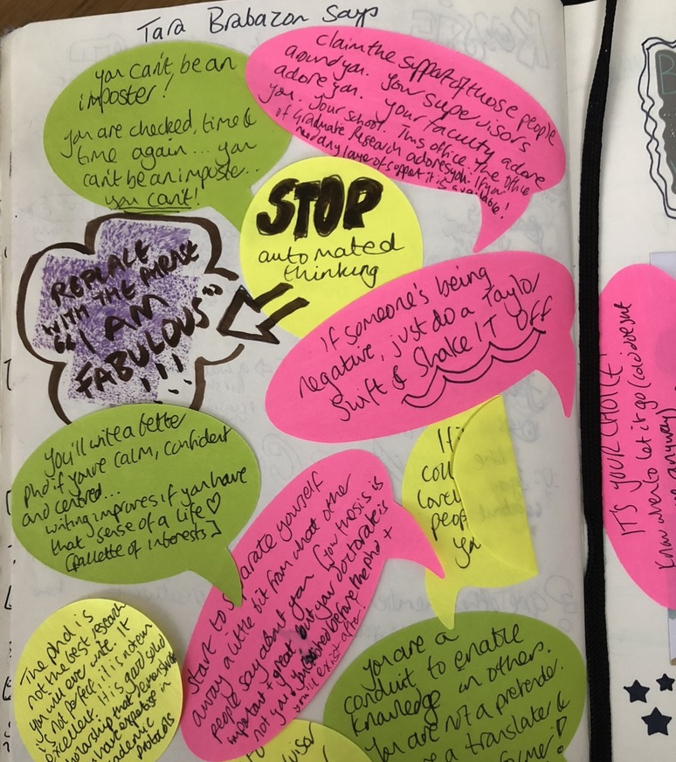
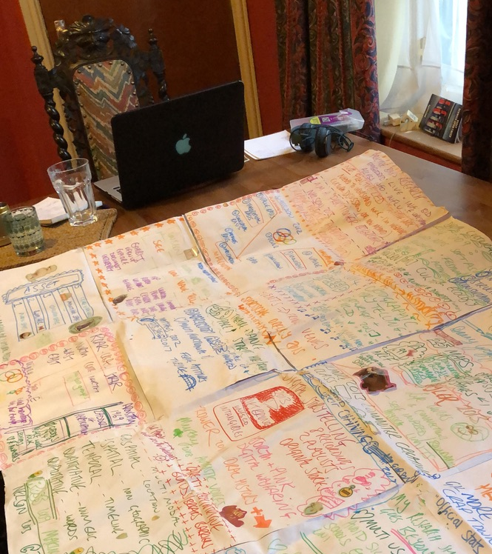
Who or what inspires you?
What do they say/do?
Key authors?
What do you already know about this topic?
Consider our influences

Slide 12
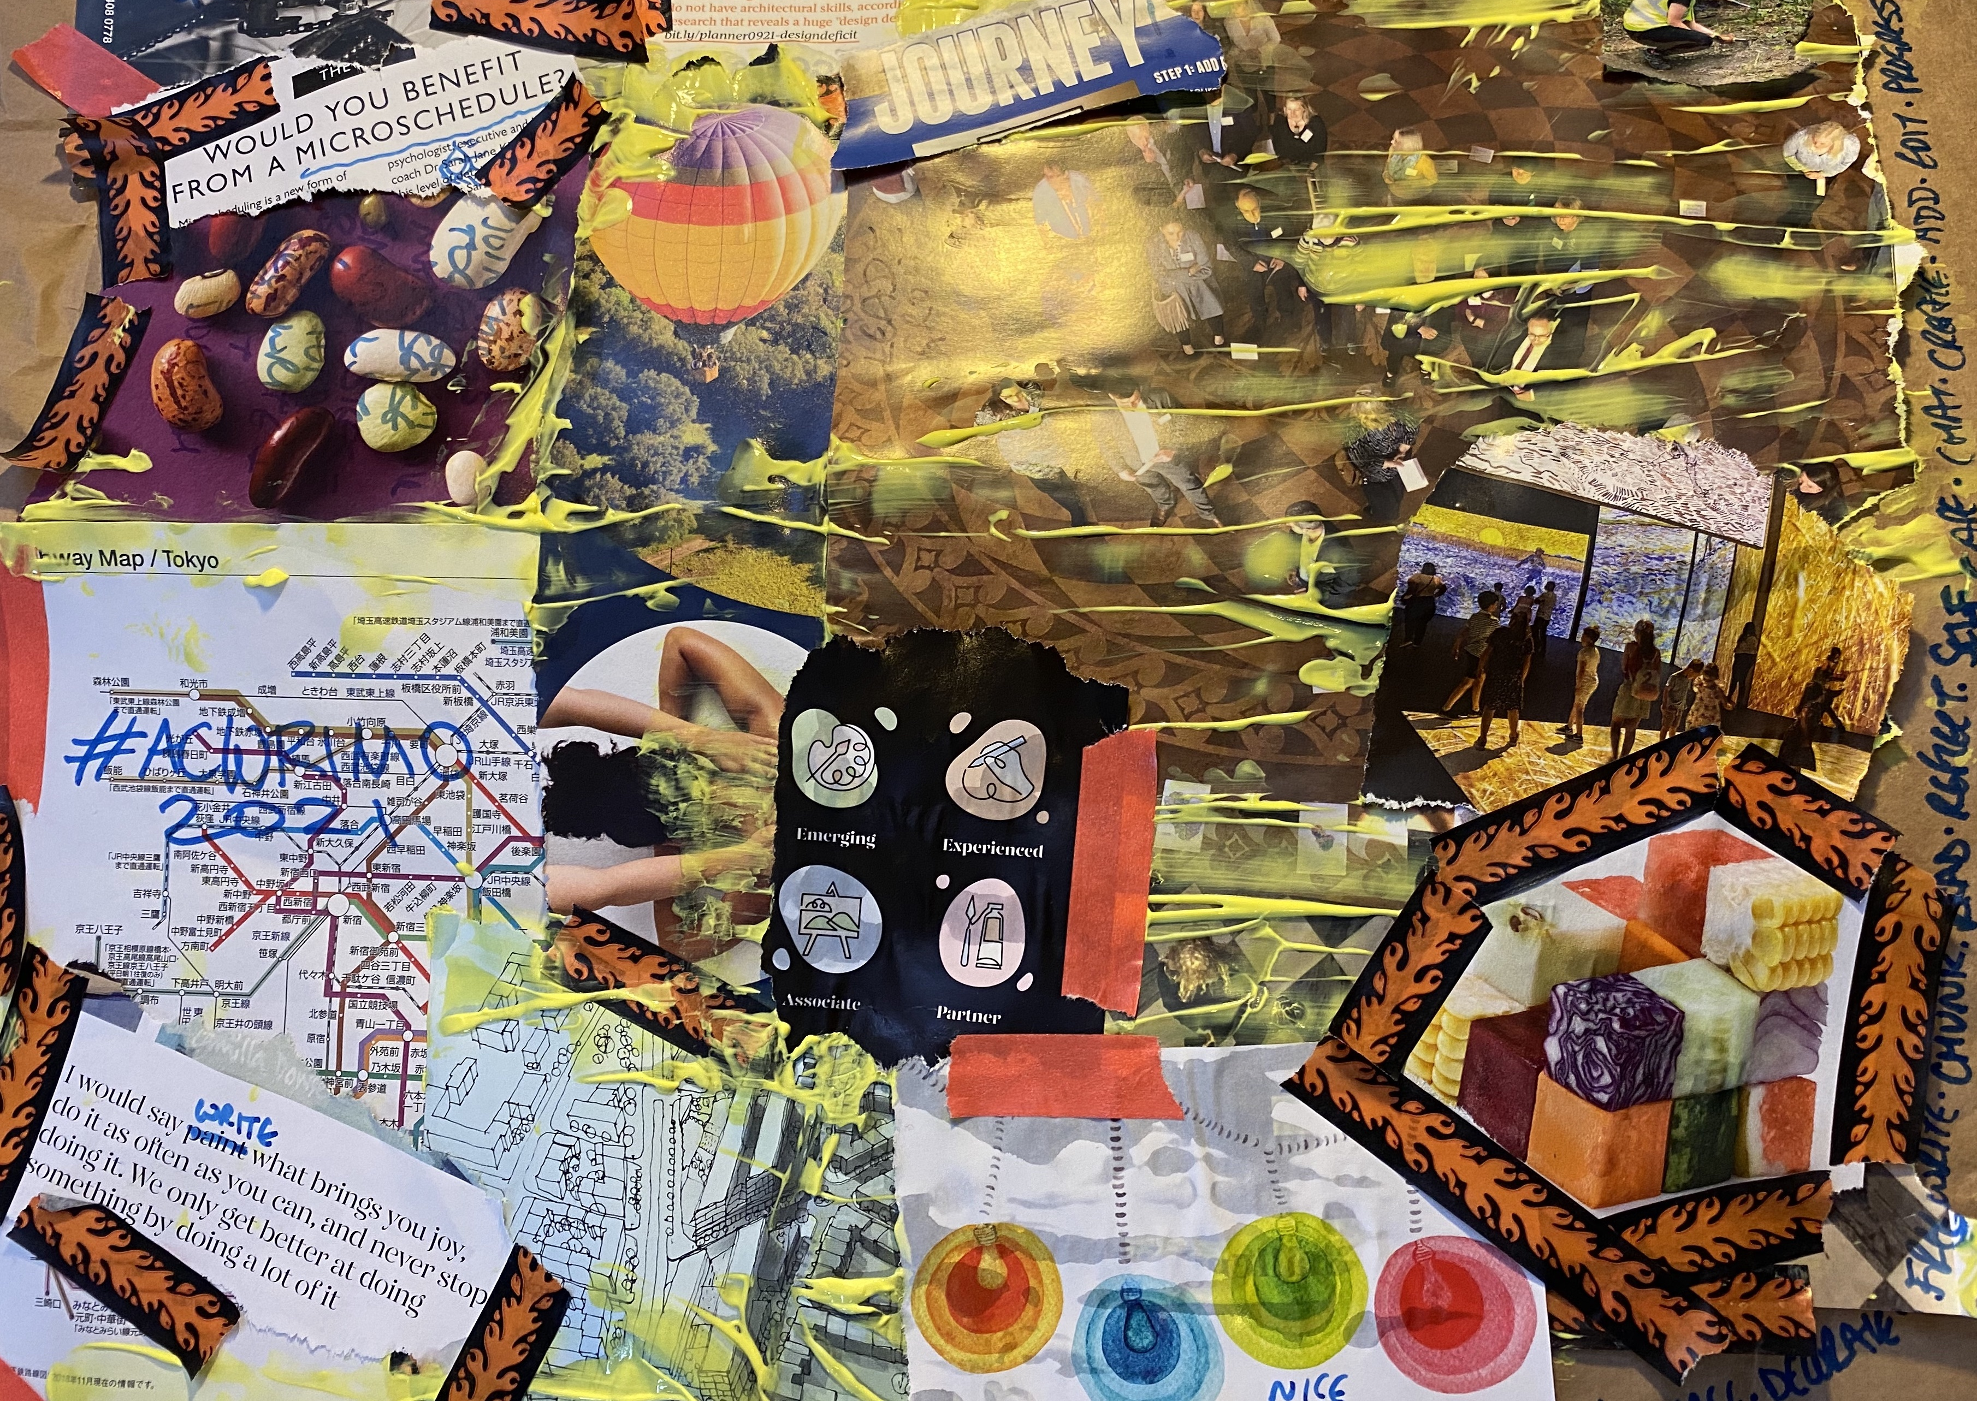
What would a little you tell you? (after Gauntlett and Holzwarth, 2006)
Things I do in my role (after Childs, Mapasa, Ward, 2020)
“struggling is..” (after Culshaw, 2019)
Solidify our writing intentions
Collage can be a way to make new connections and ideas (Gauntlett and Holzwarth, 2006)
Explore your own teaching and learning practice (Childs, Mapasa and Ward, 2020)
Overcome SoTL related issues which you may struggling with (Culshaw, 2019).

Slide 13
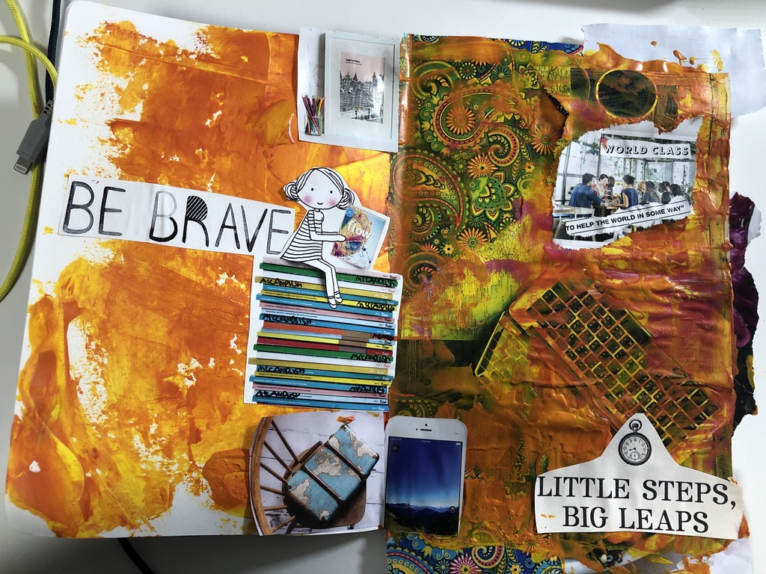
Make goals which work for us
Imagine the future?
Inspire your future self!
Act “as if..”
Freewrite or collect images

Slide 14
Permission to play!
“Collages can be tin-openers for talk (MacBeath, 2002)..
or conveyors of meaning in their own right (Roberts and Woods, 2018)”
(Culshaw, 2019:271)

Slide 15
References
Childs, M., Mapasa, T. and Ward, M. (2020) “Considering craft-and arts-based practitioner inquiry activities as a prompt for transforming practice” Educational Research for Social Change, 9(2). doi:10.17159/2221-4070/2020/v9i2a6.
Culshaw, S. (2019) “The unspoken power of collage? Using an innovative arts-based research method to explore the experience of struggling as a teacher,” London Review of Education, 17(3). doi:10.18546/LRE.17.3.03.
Gauntlett, D. and Holzwarth, P. (2006) “Creative and visual methods for exploring identities,” Visual Studies, 21(1), pp. 82–91. doi:10.1080/14725860600613261.

