Slide 1

Designing questionnaires for scholarship
Dr Vicki Dale, Senior Academic & Digital Development Adviser, Academic & Digital Development
CPD session, May 2022

Slide 2
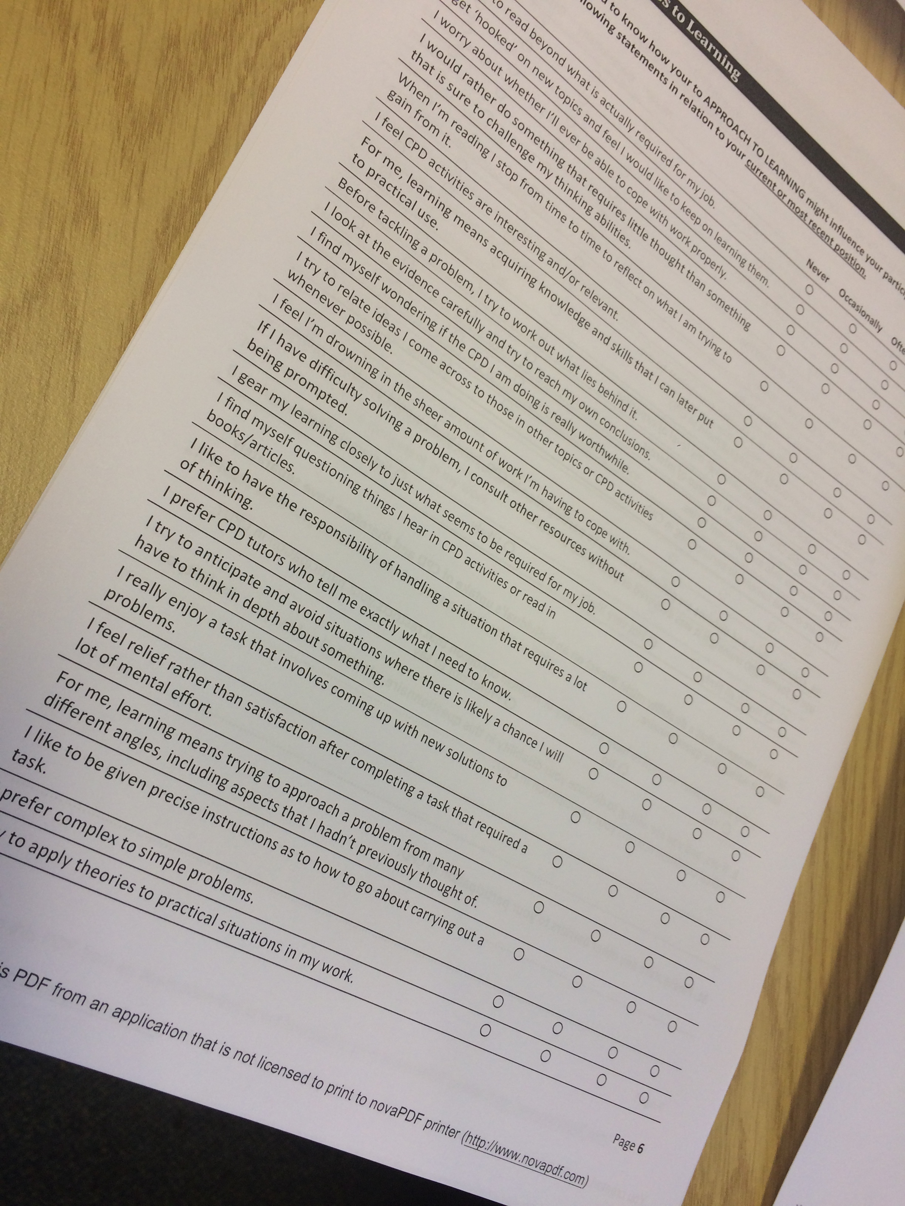

Overview
Why questionnaires?
Design phases
Design considerations
Task: Review an example
Data analysis & reporting
Optional Task: Share draft survey, give feedback

Slide 3
Why questionnaires?
 | Survey | Focus group/interview
Purpose? | Generalisations, trends | Insight into individual experiences
Research questions? | What, when, how many | Why, how,
Approach | Typically quantitative, may be (partly) qualitative | Exclusively qualitative
Sample/population size? | Large | Small (<50)

Slide 4
Design phases
Evidence-based design
  Engagement with relevant L&T studies, prior studies
  in area of interest
  Good survey design guidelines
Ethics permission
Pre-pilot phase & refinements
Pilot-phase (including analysis) & refinements
Implementation
Analysis
  Summary statistics
  Quantitative
  Qualitative
Reporting
A well-designed questionnaire for large scale dissemination can take up to 6 months to design!

Slide 5
Ethics
Always seek ethics permission BEFORE gathering data!
You will need:
  Information sheet or Plain Language Statement (PLS) AND
  EITHER Consent form, making reference to the General Data Protection Act
  OR explicit instructions in survey intro that completing survey implies consent AND
  Privacy notice for GDPR processing
Guidance:
  www.bera.ac.uk/researchers-resources/resources-for-researchers

Slide 6
Ethics – college specific guidance
Arts
https://www.gla.ac.uk/colleges/arts/research/ethics/ethicsapplicationprocedures/
MVLS:
https://www.gla.ac.uk/colleges/mvls/governance/
Social sciences:
https://www.gla.ac.uk/colleges/socialsciences/students/ethics/
Science and Engineering:
https://www.gla.ac.uk/colleges/scienceengineering/staff/committees/ethicscommittee/
However, best to log straight into MyGlasgow –> Business Systems –> Research Ethics system and download guidance and templates from there.
If in any doubt, contact college ethics officers with your questions.

Slide 7
Design considerations
Underpinning research question(s)
A one-off or pre-post or longitudinal survey?
Question types
Question wording
Order and grouping of questions
How will you analyse the data?

Slide 8
Question types
Type | Examples | Data
Dichotomous | Yes/No | Categorical/nominal
Multiple choice (single or multiple answers) | Gender School Which of the following (select all that apply)…? | Categorical/ nominal
Likert scale | Strongly disagree - Strongly agree Not at all useful - Extremely useful Very poor - Very good Not at all confident - Extremely confident | Ordinal
Ranking | Rank the following (most to least important) | Ordinal
Numerical | Age Number of hours CPD in last year | Continuous/ scale
Open-ended | What did you like best about …? | Qualitative

Slide 9
Question wording
Simple language
Short questions
Avoid:
  Double-barrelled
  Complex questions
  Leading questions
  Negative questions (statements including the word ‘not’)
  Ambiguity
  Irritating questions or instructions
  Too many open-ended questions
Don’t assume prior knowledge
Robson (2002, citing de Vaus 1991) and Cohen et al (2000)

Slide 10
Order and grouping of questions
Demographics typically at start or end
Group related questions under themes
  Cognitively easier for respondents to interpret and respond
  e.g. see vet CPD example questionnaire
Use branching so respondents don’t have to skip past irrelevant questions
If using inventory questions, mix related items within that section
  May wish to reverse direction of questions to check reliability, but avoid *not* questions e.g. "I never/occasionally/often/always NOT do something"

Slide 11
When designing a survey...
Think about …
  Purpose of survey
  Research questions
  Are you looking for descriptions, correlations, differences, trends, predictions, or insights into experiences/views?
Possible research questions:
How do students rate the use of technology-enhanced learning in my course?
To what extent do students feel that my school listens to the ‘student voice’?
What are students' experiences of assessment and feedback in my college?

Slide 12
Task: Let’s review a survey…
Veterinary CPD survey
Think about…
Question types – are these appropriate?
Question wording – is it clear?
Order and grouping – is it well organised? Does it ‘flow’?
Length – is it too short or too long? About right?
Any other comments?

Slide 13
Online survey platforms
Commercial tool e.g. SurveyMonkey
Commonly used for social research
But can be expensive for non-freemium features.
Sharing an account with others has ethical implications
Not GDPR compliant so shouldn't be used
Moodle Feedback
Easily accessible in Moodle
But all teachers in course can see data (ethics)
Online Surveys (formerly BOS)
Free to use
Allows export of data to Excel and SPSS
Can give access to co-researchers
Best option for scholarship research
Online Surveys
Email ris-research-surveys@glasgow.ac.uk
with details of your proposed survey(s) and confirmation of ethical approval.
Or visit:
https://www.gla.ac.uk/research/
strategy/ourpolicies/useofonline
surveystoolforresearch/

Slide 14
How to boost response rates
Online
Consider timing of release to avoid survey fatigue or busy times
Clear introduction/ purpose and instructions
Personalised invitation
Plain language statement/consent with reassurance of confidentiality or anonymity, and privacy notice
Clearly organised & signposted
Clear language (piloting can help with this)
Keep questionnaire short
Can set up system to send regular reminders to non-respondents
Mobile-friendly
Paper
Clear introduction/purpose and instructions
Personalised invitation
Reassurance of confidentiality
Clearly organised & signposted
Keep questionnaire short
No more than four sides of A4
Self-addressed envelope
Different coloured paper
Anonymous identifier on survey which can be detached from personalised invitation
Make alternative online version available

Slide 15
Paper versus online
Paper
Pros:
Tangible
Higher response rate
More control over design
Cons:
Manual data entry & coding
Secure storage
Not so easy to keep a backup
Expensive (consumables & postage)
Online
Pros:
Automatic data entry & coding
Can answer anytime from any device
No consumables/postage costs
Secure storage
Can limit no. responses by category
Cons:
Lower response rate
If sociological surveys, likely to be an age response bias
Less control over design

Slide 16


Number crunching…
Don’t worry about remembering the details … this is simply a reference guide

Slide 17
Explore and visualise the data
To gain insights into the data:
Frequency tables
Look at measures of central tendency & distribution
Bar charts (e.g. use clustered bar charts to compare different groups)

Slide 18
Parametric vs. non-parametric stats
Design | Parametric | Non-parametric
Central tendency | Mean | Median, mode
Dispersion/variance | Standard deviation, variance | Range, inter-quartile range
2 independent samples | Chi-square (nominal) t-test (independent samples, scale) | Chi-square (nominal) Mann-Whitney U (ordinal)
2 related samples | t-test (related samples) | Wilcoxon signed ranks test
K independent samples | ANOVA | Kruskal-Wallis ANOVA
K related samples | Repeated measures ANOVA | Friedman’s two-way ANOVA
Correlation | Pearsons | Spearman’s Rho

Slide 19
Non-parametric stats
See chapter on non-parametric stats in Pallant, J. (2016). SPSS survival manual: a step by step guide to data analysis using IBM SPSS, 6th edn, Open University Press, Maidenhead.
Measures of central tendency and dispersion:
  Average: Median or mode
  Range: Minimum-Maximum and/or inter-quartile range
Between-group comparisons
  2 related samples (e.g. pre- and post-test)
    Wilcoxon-signed ranks test
  2 independent samples (e.g. control vs. test group)
    Mann-Whitney U test
  k related samples (e.g. Pre-test and immediate post-test and post-test one month later)
    Friedman two-way ANOVA by ranks
  k independent samples (e.g. UK vs. Europe vs. other students or 1st vs. 2nd vs. 3rd year students)
    Kruskal-Wallis ANOVA
Measures of association
  e.g. Scores on learning approach inventory (deep/surface) with performance or ratings of usefulness of educational intervention
    Spearman’s rho

Slide 20
Level of measurement | One-sample case | 2 related samples | 2 independent samples | K related samples | K independent samples | Measures of association
Nominal or categorical (e.g. Yes/No) | Binomial test Chi-square goodness-of-fit | McNemar change test | Fisher exact test for 22 tables Chi-square test for r2 variables | Cochran Q test | Chi-square test for rk tables | Cramer coefficient Phi coefficient for 22 tables The Kappa coefficient of agreement Asymmetrical association, the lambda statistic
Ordinal (e.g. 1-5 Likert scale) | Kolmogorov-Smirnov one-sample test One-sample runs test Change-point test | Sign test Wilcoxon signed ranks test | Wilcoxon-Mann-Whitney test Robust rank-order test Kolmogorov-Smirnov two-sample test Siegel-Tukey test for scale differences | Friedman two-way analysis of variance by ranks Page test for ordered alternatives | Extension of the median test Kruskal-Wallis analysis of variance Jonckheere test for ordered alternatives | Spearman rank-order correlation coefficient Kendal rank-order correlation coefficient Kendall partial rank-order correlation coefficient Kendall coefficient of concordance Correlation between k judges and a criterion Gamma statistic Somer’s index of asymmetric association
Interval/scale i.e. continuous variables) |  | Permutation test for paired replicates
Siegel, S. and N. J. Castellan (1988). Nonparametric Statistics for the Behavioural Sciences. New York, Mcgraw-Hill Book Company.

Slide 21
Levels of significance
Alpha level | Indicated by … | Interpretation
<0.05 | * | Less than a 1/20 probability that the result is due to chance
<0.01 | ** | Less than 1/100 probability that the result is due to chance
<0.001 | *** | Less than 1/1000 probability that the result is due to chance
No such thing as p=0.000
Results reported in this way by e.g. SPSS should be recorded as p<0.001

Slide 22
Reporting your quantitative findings
Prose, charts or tables – no need to report your findings in multiple formats, especially in papers
Which data do you need to report to answer the research question?
Examples of same study presenting different information for different audiences:
Dale, V., S. Pierce and S. May (2013). "Motivating factors and perceived barriers to participating in continuing professional development: a national survey of veterinary surgeons." Veterinary Record 173(10): 1-7.
Dale, V. H. M., S. E. Pierce and S. A. May (2010). "The importance of cultivating a preference for complexity in veterinarians for effective lifelong learning." Journal of Veterinary Medical Education 37(2): 165-171.

Slide 23
Qualitative analysis
Approach used will be informed by methodology.
Some useful generic references:
Braun, V. and V. Clarke (2006). "Using thematic analysis in psychology." Qualitative Research in Psychology 3: 77-101.
Thomas, D. R. (2006). "A general inductive approach for analyzing qualitative evaluation data." American Journal of Evaluation 27(2): 237-246.

Slide 24
Optional task: Your survey
Share a draft survey, give constructive peer feedback
What changes would you make to your questionnaire design as a result?

Slide 25
References & further reading
(*check for later editions of research methods texts)
  Artino, A. R., J. S. La Rochelle, K. J. Dezee and H. Gehlbach (2014). "Developing questionnaires for educational research: AMEE Guide No. 87." Medical Teacher 36(6): 463-474.
  Boynton, P. M. and T. Greenhalgh (2004). "Selecting, designing, and developing your questionnaire." BMJ 328(7451): 1312-1315.
  *Cohen, L., L. Manion and K. Morrison (2000). Questionnaires. Research Methods in Education. London and New York, Routledge Falmer: 245-266.
  Magee, C., G. Rickards, L. A. Byars and A. R. Artino (2013). "Tracing the Steps of Survey Design: A Graduate Medical Education Research Example." Journal of Graduate Medical Education 5(1): 1-5.
  *Oppenheim, A. N. (1992). Questionnaire Design, Interviewing and Attitude Measurement. London & New York, Continuum.
  *Robson, C. (2002). Surveys and questionnaires. Real World Research. Padstow, Blackwell: 227-268.
  *Siegel, S. and N. J. Castellan (1988). Nonparametric Statistics for the Behavioural Sciences. New York, Mcgraw-Hill Book Company.
Qualitative analysis (for open-text responses):
Braun, V. and V. Clarke (2006). "Using thematic analysis in psychology." Qualitative research in psychology 3(2): 77-101.
Thomas, D. R. (2006). "A general inductive approach for analyzing qualitative evaluation data." American Journal of Evaluation 27(2): 237-246.

