Slide 1

Reflective and Reflexive Practices
+ Autoethnography
Dr Nathalie Tasler
Nic Kipar

Slide 2
Why does anyone reflect?
Making the tacit explicit
(Polanyi, 1962, 1967; Csikszentmihalyi, 1997)

Slide 3
Reflective Writing
Versus
Reflexive Writing
Becoming aware of one’s experiences and actions
Relating it to existing literature and discussing critically
Contextualising these and setting them into historic personal context
Implement learning from this

Slide 4
Reflection
On the inadequacy of the reflective practice model and the importance of criticality in professional situations: ‘The primary focus of reflection is on process issues . . . Its focus on knowledge is primarily confined to the application of 'theory to practice’.’
Taylor and White (2000) in Moon (2004), p.198)

Slide 5
Reflexion
Reflexivity takes things further. It problematizes issues that reflection takes for granted . . . For example, it assumes that through reflection the worker can become more adept at applying child development and attachment theories more effectively. Reflexivity suggests that we interrogate these previously taken-for-granted assumptions.
Taylor and White (2000) in Moon (2004), p.198)

Slide 6

Autoethnography
Autoethnography is an ‘autobiographical genre of writing and research that displays multiple layers of consciousness, connecting the personal to the cultural’ (Ellis & Bochner, 2000, p. 739). It is part of a more recent style of anthropological practice known as ‘reflexive ethnography’ in which the researcher’s personal experience becomes the focus of inquiry, illuminating the culture under study. (Ellis & Bochner, 2000, p. 740).
(Duarte, 2007, p.2)

Slide 7
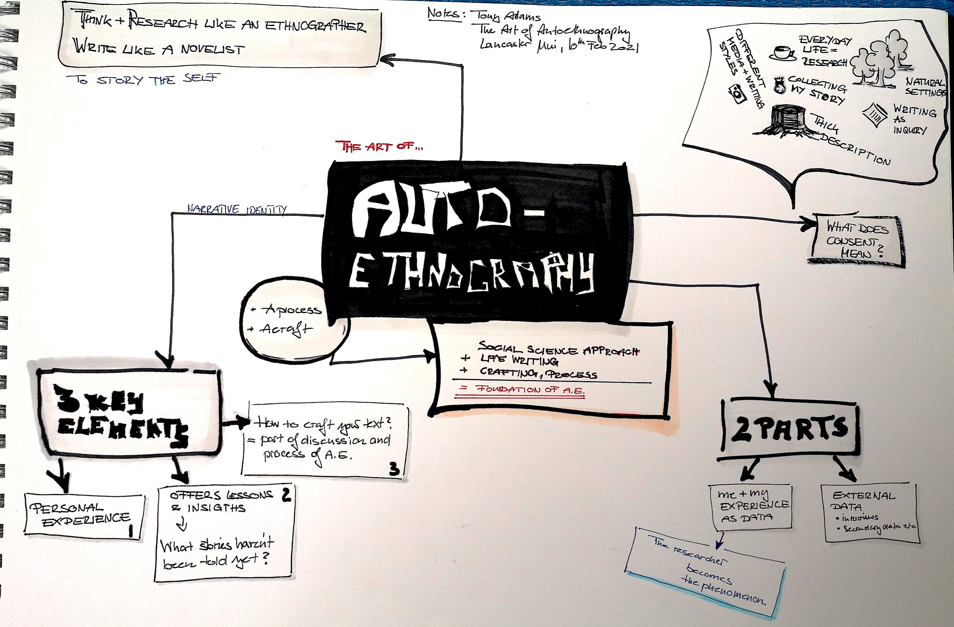
Mind map
Tony Adams Webinar on YouTube:
https://youtu.be/2-CyUBLhk6Q
The graphic written up as a blogpost:
https://acdevadventures.blog/2021/10/01/notes-on-autoethnography/
Notes:
Tony Adams Webinar on YouTube:
https://youtu.be/2-CyUBLhk6Q
The graphic written up as a blogpost:
https://acdevadventures.blog/2021/10/01/notes-on-autoethnography/

Slide 8


Auto-Ethnography
Writing through the I for the other
Autoethnography begins with a personal story. (Wall, 2008, p.39)

Slide 9
Autoethnography II
Autoethnography, a derivative of ethnography, is a process, method and product that 'seeks to describe and systematically analyze (graphy) personal experience (auto) in order to understand cultural experience (ethno)' […] by looking at oneself in a wider context
(Cohen, Manion and Morrison, 2017, p. 297)

Slide 10
Autoethnography and Culture
When researchers do autoethnography, they retrospectively and selectively write about epiphanies that stem from, or are made possible by, being part of a culture and/or by possessing a particular cultural identity.
(Ellis et al., 2011, p.276)

Slide 11
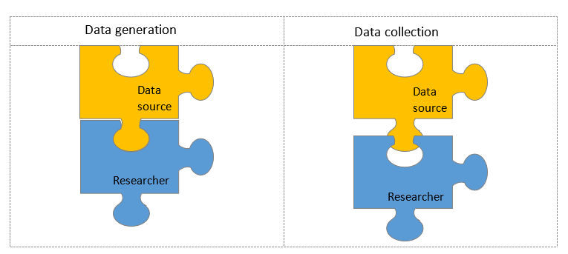
Autoethnography and Data
Data generation versus data collection. After Birks & Mills, 2011, p.74

Slide 12
Data generation: example
7625 words from the reflections on key words [xxx] using OneNote (23rd July 2018 - 11th March 2019)
2820 words of analytic memos during the first coding cycle using OneNote (23rd July 2018 - 3rd May 2019 and ongoing)
4495 words of spontaneous journaling during artefact creation and engagement with the literature using handwriting on paper and OneNote (22nd May 2018 - 9th May 2019)
1190 words of retrospective autoethnographic writing using OneNote (4th September 2018 - 4th December 2018)
3370 of autoethnographic fieldnotes during the practical artefact making using iPages (19th September 2017 – 11th August 2018)

Slide 13

Evocative Autoethnography
Evocative autoethnography aims to evoke emotional responses in the reader and does not necessarily consider analysis to be essential, instead leaving the text to stand on its own.
See: Ellis, Adams and Bochner, 2011; Ellis and Adams, 2014; Bochner and Ellis, 2016

Slide 14
Analytic Autoethnography
Analytic autoethnography emphasises the researcher-self within the process of ethnography. “The researcher is (1) a full member in the research group or setting, (2) visible as such a member in the researcher's published texts, and (3) committed to an analytic research agenda focused on improving theoretical understandings of broader social phenomena.”
Anderson, 2006, p.375

Slide 15

Moderate Autoethnography
Moderate Autoethnography is not a “dichotomy of evocative versus analytic autoethnography”, but a continuum.
Stahlke Wall (2016), p.13

Slide 16
Moderate Autoethnography Example
I adopted a researcher-centred approach which is at the core of evocative autoethnography, while putting as much importance on the analysis of the self-generated data, and on the situatedness of the researcher within the social context as a member of one’s group.

Slide 17

Ethics in Autoethnography
Guidelines have been developed towards “relational ethics” (Ellis, 2007), which apply to the people that are indicated in the autoethnographic writing.
The researcher should gain consent from the people
mentioned in the autoethnographic writing. This
mostly applies to evocative autoethnography
where the narrative form of writing is likely
to implicate people.
Notes:
The question of ethics in autoethnography is complex and has been discussed in the literature but without a definitive solution.

Slide 18
Recommended Reading
Reflective Practice
Bleakley, A. (1999) 'From reflective practice to holistic reflexivity', Studies in Higher Education, 24(3), pp. 315-330.
Hébert, C. (2015) 'Knowing and/or experiencing: a critical examination of the reflective models of John Dewey and Donald Schön', Reflective Practice, 16(3), pp. 361-371.
Moon, J. A. (1999) Reflection in learning & professional development: theory & practice. London: Kogan Page.
Schön, D. A. (1983) The reflective practitioner: how professionals think in action. New York: Basic Books.

Slide 19
References I
Ortlipp, M. (2008) 'Keeping and Using Reflective Journals in the Qualitative Research Process', The Qualitative Report, 13(4), pp. 695-705.
Kipar, Nicole (2020) Reflection in Practice. figshare. Online resource. https://doi.org/10.6084/m9.figshare.12818336.v2
Kipar, Nicole (2020) Reflection as Product. figshare. Online resource. https://doi.org/10.6084/m9.figshare.12818348.v2
Moon, Jennifer (2004) A Handbook of Reflective and Experiential Learning: Theory and Practice, Taylor & Francis. ProQuest Ebook Central, http://ebookcentral.proquest.com/lib/gla/detail.action?
Tasler, Nathalie (2021) AutoEthnography. Part One. Online resource. https://acdevadventures.blog/2021/10/01/notes-on-autoethnography

Slide 20
References II
Anderson, L. (2006a) 'Analytic Autoethnography', Journal of Contemporary Ethnography, 35(4), pp. 373-395.
Anderson, L. (2006b) 'On Apples, Oranges, and Autopsies: A Response to Commentators', Journal of Contemporary Ethnography, 35(4), pp. 450-465.
Atkinson, P. (2006) 'Rescuing Autoethnography', Journal of Contemporary Ethnography, 35(4), pp. 400-404.
Bochner, A. P. and Ellis, C. (2016) Evocative autoethnography: Writing lives and telling stories. London: Routledge.
Cohen, L., Manion, L. and Morrison, K. (2017) 'Qualitative, naturalistic and ethnographic research', Research Methods in Education. 8th ed. London: Routledge, pp. 287-299.
Denzin, N. K. (2006) 'Analytic Autoethnography, or Déjà Vu all Over Again', Journal of Contemporary Ethnography, 35(4), pp. 419-428.

Slide 21
References III
Duarte, F. (2007) ‘Using Autoethnography in the Scholarship of Teaching and Learning: Reflective Practice from “the Other Side of the Mirror.”’ International Journal for the Scholarship of Teaching and Learning ijsotl, 1(2).
Ellis, C. (2007) 'Telling Secrets, Revealing Lives: Relational Ethics in Research With Intimate Others', Qualitative Inquiry, 13(1), pp. 3-29.
Ellis, C. and Adams, T. E. (2014) 'The purposes, practices, and principles of autoethnographic research', in Leavy, P. (ed.) Oxford handbook of qualitative research. Oxford: Oxford University Press, pp. 254-276.
Ellis, C., Adams, T. E. and Bochner, A. P. (2011) 'Autoethnography: An Overview', Historical Social Research / Historische Sozialforschung, 36(4 (138)), pp. 273-290.
Harwood, S. and Eaves, S. 'In search for an autoethnographic method', 16th European Conference on Research Methodology for Business and Management Studies, 22.06.2017, 145-153.

Slide 22
References IV
Ingold, T. (2014) 'That's enough about ethnography', HAU: Journal of Ethnographic Theory, 4(1), pp. 383.
Le Roux, C. S. (2017) 'Exploring rigour in autoethnographic research', International Journal of Social Research Methodology, 20(2), pp. 195-207.
Polanyi, M. (1967) The tacit dimension. London: Routledge & Kegan Paul.
Sparkes, A. C. (2000) 'Autoethnography and narratives of self: reflections on criteria in action', Sociology of Sport Journal, 17(1), pp. 21.
Stahlke Wall, S. (2016) 'Toward a Moderate Autoethnography', International Journal of Qualitative Methods, 15(1), pp. 1-9.
Vryan, K. D. (2006) 'Expanding Analytic Autoethnography and Enhancing Its Potential', Journal of Contemporary Ethnography, 35(4), pp. 405-409.
Wall, S. (2008) ‘Easier Said than Done: Writing an Autoethnography’, International Journal of Qualitative Methods (Vol. 7, Issue 1).

Slide 23

Thank you

