Slide 1

Please interrupt at any time.
Raise Zoom hand or use chat

Slide 2

Round Robin: your interest?

Slide 3

Introduction to (Constructivist) Grounded Theory
Nic Kipar, Academic & Digital Development

Slide 4

What is Grounded Theory?
Origin and development of Grounded Theory
What makes a Grounded Theory
How to undertake a Grounded Theory (how to use Grounded Theory methods)

Slide 5

My Bugbear
Many studies claim they are using Grounded Theory but they are not.

Slide 6


Anyone who wants to use grounded theory has to be able to locate their research within the complicated and contented landscape of grounded theory methodology and methods. (Morse et al., 2009)

Slide 7

My aim is to distil that complex, contested, and complicated landscape of Grounded Theory into a clearer path

Slide 8

My own position is that of Constructivist (Charmazian) Grounded Theory

Slide 9

What do you think is
Grounded Theory?

Slide 10
Easier to say what it is not:
Research does not start with a hypothesis, does not prove or disprove
Thorough literature review is not first task knowledge of literature for sensitising concepts useful
Data analysis does not happen only at the end, after all data has been collected

Slide 11
What is Grounded Theory for?
To generate theories that explain how aspects of the social world works
Uses inductive reasoning/emergent research …but can any research truly be inductive?

Slide 12

Grounded theorists look for patterns, even when focusing on a single case
(Charmaz, 2014)

Slide 13

History of Grounded Theory

Slide 14

Origin of Grounded Theory
Barney Glaser & Anselm Strauss
The Discovery of Grounded Theory: An Approach to Qualitative Research
Notes:
goal was to systematise the collection, coding and analysis of qualitative data for the purpose of generating theory.

Slide 15


The Discovery of Grounded Theory was presented at the time to articulate a credible alternative to the considerable dominance of positivistic paradigms and their associated assumptions of the time.”
Waring (2012) p.297
Notes:
[Glaser and Strauss did not articulate their ontological and epistemological assumptions at the time]

Slide 16
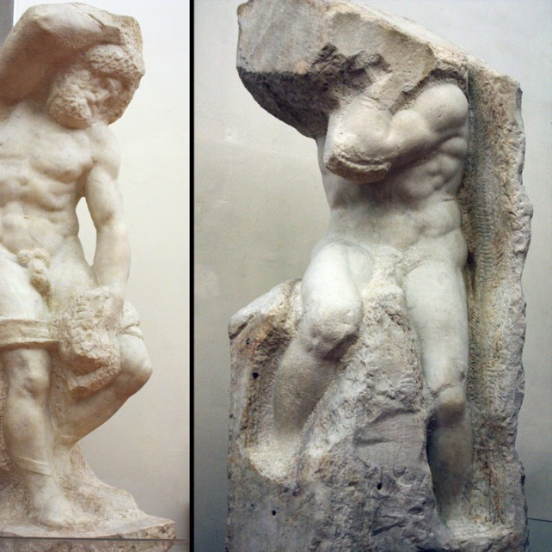
Sculptures by Michelangelo
‘Discovery’ of Grounded Theory
Notes:
Sculptures by Michelangelo http://www.accademia.org/explore-museum/artworks/michelangelos-prisoners-slaves/

Slide 17
Original Grounded Theory is…
Distanced inquiry by objective experts who assumed their training licensed them to define and represent research participants.
(Charmaz, 2008)

Slide 18

Quite like the Colonial Ethnographer…
Positivistic belief in the researcher as a neutral observer, similar to the original idea of the (Colonial) ethnographer, was accepted by Glaser and Strauss in the original publication and continued to be supported by Glaser in his later publications.
But not by Strauss & Corbin.

Slide 19

(Re)Interpreting Grounded Theory

Slide 20
Glaser

Slide 21
Barney Glaser
Glaser maintained “an objective, external reality, a neutral observer who discovers data, reductionist inquiry of manageable problems, and objectivist rendering of data.”
Charmaz (2000), quoted in Cooney (2010)

Slide 22

Glaser vs Strauss
Main difference in data analysis
Glaser remained close to original version
Strauss (with Corbin) reformulated original version

Slide 23
Strauss

Slide 24
Strauss and Corbin
Basics of Qualitative Research 1st edition (1990) very prescriptive analysis techniques
2nd edition (1998) less so
3rd edition (2008) more flexible,
researchers are asked to “use the
procedures in their own way”

Slide 25
Strauss & Corbin difference
sampling proceeds on theoretical grounds
hypotheses can be developed and verified
induction, deduction and abduction can be used, whereas the original model advocated induction alone and rejects deduction
attention must be given to broader structural
contents and influences
    (Cohen et al., 2017, p.716)

Slide 26

Constructivist Grounded Theory

Slide 27
Charmaz

Slide 28
Constructivist Grounded Theory II
Data and analyses are seen as social constructions reflecting their process of production, and each analysis is specific to the time, space, culture and situation.
(Waring, 2012)
CGT specific: coding in gerunds

Slide 29
Charmaz CGT
Charmaz (2008) advocates examining
the relativity of the researcher's perspectives, positions, practices, and research situation,
the researcher's reflexivity [researcher is aware of their effect on process and outcomes of research]; and
depictions of social constructions
in the studied world.

Slide 30

Constructivist Grounded Theory III
Understanding of empirical phenomena must be located in the studied specific circumstances of the research process.
We may think our codes depict empirical reality, but they are our codes, we choose them;
we construct them.

Slide 31

My own ‘flavour’ of Grounded Theory is Constructivist

Slide 32
Grounded ‘Theory’
“Not all grounded theory studies build theory” (Strauss & Corbin)
“Grounded theory evolved as a method of theory construction yet not everyone who uses its strategies intends to develop a theory.” (Charmaz)
Grounded Theory methods can be used to
produce useful descriptions, and can also
be adapted and used flexibly in one’s
own research.
Actually, most don’t.

Slide 33
What it does:
Coding and categorisation
Theoretical sampling
Constant comparison
Memo writing

Slide 34
Coding and categorisation
First phase (initial coding)
Second phase (focused coding)
initial phase involves naming each word, line, or segment of data followed by
focused, selective phase that uses the
most significant or frequent initial codes
to sort, synthesise, integrate, organise
Coding qualitative data: https://www.youtube.com/watch?v=YP3yAX5w6x8
Saldana, J. (2021) The Coding Manual for Qualitative Researchers London: SAGE Publications. Available as ebook
Notes:
Charmaz, 2014

Slide 35
Initial Coding
What: open to exploring any and all theoretical possibilities in the data. Coding is the pivotal link between collecting data and developing an emergent theory to explain these
How: stick closely to the data. Try to see actions in each segment of data rather than applying pre-existing categories to the data
Why: code as action to investigate processes
Notes:
Charmaz, 2014

Slide 36
Initial Coding – practical
What: codes are provisional: you may reword them to improve meanings and actions. Compelling codes capture the phenomenon and grab the reader
How: speed and spontaneity help in initial coding.
Working quickly sparks your thinking.
Why: codes make the leap from concrete events
and descriptions of them to theoretical insights
and theoretical possibilities
Notes:
Charmaz, 2014

Slide 37
Focused Coding
What: categorizes coded data based on thematic or conceptual similarity
How: compare codes with codes. Constantly compare to data.
Why: searches for the most frequent or significant codes
to develop the most salient categories and
requires decisions about which initial codes
make the most analytic sense.
Elevate to analytical codes
Notes:
treating 'suffering as a moral status' as a category, I raised a code to a conceptual level to treat analytically.

Slide 38
Theoretical sampling
What: sampling aimed toward theory construction not for population representativeness. It is strategic, specific, and systematic and refines your theoretical categories.
How: Conducting theoretical sampling depends on having already identified a category. It prompts you to predict where and how to find needed data to fill gaps and to saturate categories.
Why: brings explicit systematic checks and refinements into your analysis

Slide 39
Example
Question: Can you tell me about a memorable learning experience in your life?
Sensitising concept: emotion important factor in learning
Interview Coding: surprised at repeated mention of dismissal
Categories: self-respect, respecting others, being respected
Core category: respect
Theoretical sampling: wanting to hear from
negative or positive learning examples where
learners felt/didn’t feel respected

Slide 40
Constant comparison
What: involves making comparisons during each stage of the analysis
How: when writing memos make comparisons between data & data, data & codes, codes & codes, codes & categories, categories & categories
Why: repeated scrutiny of the data and of
subsequent emerging codes and categories.

Slide 41
Example I
Categories: self-respect, respecting others, being respected Relationship between the categories: value?
Theoretical sampling: wanting to hear from negative or positive learning examples where learners felt/didn’t feel respected
Constant comparison: With each subsequent interview,
each emerging category is compared with the
extant categories to determine if the emerging
category is a discrete category, a property of an
existing category, or representative of a category
at a higher level of abstraction.

Slide 42
Analytic Memo writing
What: provides a space to become actively engaged in your materials, to develop your ideas, to fine-tune your subsequent data-gathering, and to engage in critical reflexivity.
How: write memos quickly, don’t edit. Aim to foster development and preservation of your natural voice
Why: memos raise Focused Codes to
Conceptual Categories
Notes:
Charmaz, 2014

Slide 43
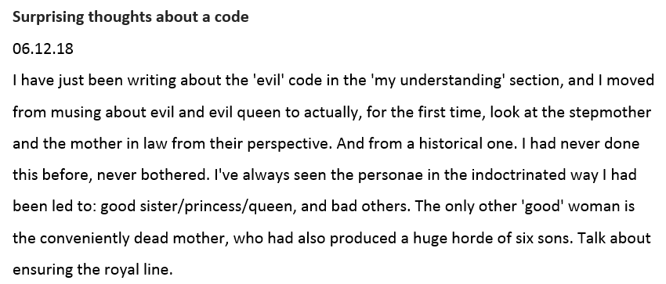
Example II

Slide 44
Theoretical saturation
What: researcher adds cases to sample until data describes what is going on in the situation under study. Theoretical saturation is reached when no new insights, properties, dimensions, relationships, codes or categories are produced even when new data are added (Cohen, 2017)
Categories are 'saturated' when gathering
fresh data no longer sparks new theoretical
insights, nor reveals new properties of these
core categories. (Charmaz, 2014)
Notes:
Charmaz, 2014

Slide 45

To recap

Slide 46
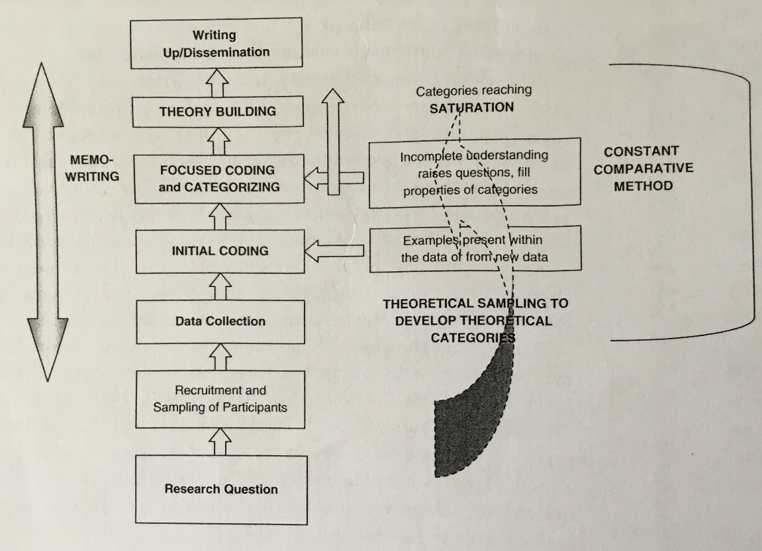
Visual representation of a grounded theory, from Charmaz (2014, p.18)

Slide 47

Why Grounded Theory?
Grounded Theory methods have uses beyond building theory, as they explore social processes.
Grounded Theory is well established as a qualitative research methodology – but you must be clear what ‘flavour’ of GT you employ, and you must be clear what and why and how you are using GT.
Grounded Theory allows inductive/
emergent research to be undertaken
without becoming ‘wishy-washy’.

Slide 48
Recommended Reading I
Apramian, T., Cristancho, S., Watling, C. and Lingard, L. (2016) '(Re)Grounding grounded theory: a close reading of theory in four schools', Qualitative Research, 17(4), pp. 359-376.
Birks, M. and Mills, J. (2011) Grounded theory: a practical guide. Los Angeles, London: SAGE.
Bryant, A. (2014) 'The grounded theory method', in Leavy, P. (ed.) Oxford Handbook of Qualitative Research. Cary: Oxford University Press, pp. 114-136.
Bryant, A. and Charmaz, K. (2007) 'Grounded Theory in Historical Perspective: An epistemological account', in The SAGE Handbook of Grounded Theory, Los Angeles: SAGE.
Charmaz, K. (2014) Constructing grounded theory. 2nd edn. Los Angeles: SAGE.
Charmaz, K. (2017) 'Constructivist grounded theory', The Journal of Positive Psychology, 12(3), pp. 299-300.

Slide 49
Recommended Reading II
Charmaz, K. and Thornberg, R. (2020) 'The pursuit of quality in grounded theory', Qualitative Research in Psychology, pp. 1-23.
Cohen, L., Manion, L. and Morrison, K. (2017) 'Grounded theory', Research methods in education. 8th ed. London and New York: Routledge, pp. 714-724.
Flick, U. (2018) Doing Grounded Theory. The SAGE Qualitative Research Kit London: SAGE.
Glaser, B. G. and Strauss, A. L. (1967) The discovery of grounded theory: strategies for qualitive research. Chicago: Aldine.
Rieger, K. L. (2019) 'Discriminating among grounded theory approaches', Nursing Inquiry, 26(1), pp. 1-12.
Waring, M. (2012) 'Grounded Theory', in Arthur, J., Waring, M. & Coe, R. (eds.) Research Methods and Methodologies in Education. London: SAGE, pp. 297-308.

Slide 50

Thank you

