Slide 1
What is Symbiotic Autoethnography?
Dr. Liana Beattie
Edge Hill University

Slide 3
Variety of autoethnographic approaches
Evocative (Ellis, 2004)
Analytic (Anderson, 2006)
Collaborative (Chang, 2008)
Critical (Holman Jones, 2016; Boylorn & Orbe, 2020)
…and a few more…

Slide 4
Overlapping criticism of all autoethnographic approaches
A few critics argued that, as a methodology, writing about the self is self-indulgent, self-confessional and narcissistic (Etherington, 2004);
Unprincipled ‘preoccupation with and auto-affection of the Self’ (Roth, 2008, p. 10);
‘essentially lazy, literally lazy and also intellectually lazy’ (Delamont, 2007);
‘academic wanking’(Marowitz, 1991, p.72);
‘public masturbation’ through confessional tales (Morrison, 2015).

Slide 5
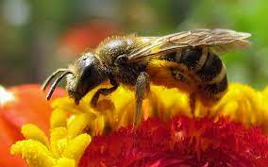
Symbiotic autoethnography
This approach synthesizes central aspects from the diversity of existing arguments into one adaptable 'framework' that combines key characteristic features of AE research.
The concept of 'symbiosis’ is used here in its broader sense to denote close interdependence and interrelation between its suggested 7 attributes (see next slide)

Slide 6
Symbiotic autoethnography

Slide 7
Temporality
‘temporality - the state of existing within or having some relationship with time’(Oxford Dictionary)
symbiotic temporality - researchers’ perceptions of chronological times (subjective), as experienced across different localities (locational) and captured in the moment of writing (evanescent).
In this sense, symbiotic temporality is a ‘snapshot’ of our temporal recollections of events, places, feelings and relations caught in their illusory stillness during one specific moment of writing.

Slide 8
Researcher’s omnipresence
The state of being widespread or constantly encountered (Oxford Dictionary)
CMR status - unlike their peers in the research setting(s), autoethnographers must orient (at least for significant periods of time) to documenting and analyzing action as well as to purposively engaging in it. (Anderson, 2006)

Slide 9
Polyvocality
A space for capturing simultaneously complex entanglements of autoethnographers’ narratives with the Other, where the Other includes the characters from the researchers’ stories, their participants and the researchers’ multiple Selves.

Slide 10
Evocative storytelling
meaning - bringing strong images, memories, or feelings to mind;
Autoethnographers use evocative thick descriptions of personal and interpersonal experience, and then describe these patterns using facets of storytelling, thus, producing accessible texts that may be able to reach wider and more diverse mass audiences.
(Ellis, Adams and Bochner, 2011)

Slide 11
Interpretative analysis
‘good autoethnography is not simply a confessional tale of self-renewal; it is a provocative weave of story and theory’ (Spry, 2001, p.713)
Whilst autoethnographic research incorporates very personal, evocative and poetic accounts, it also requires the researcher to engage in highly analytic and theoretical work (Allen-Collinson, 2012).

Slide 12
Political (transformative)
‘moving it beyond a world of harmonious social order into a political radical world where dissensus and power conflicts prevail’ (Doloriert and Sambrook, 2012, p. 84).
‘personal, political and palpable’ (Spry, 2011, p.15).

Slide 13
Reflexivity
The qualitative research arena would benefit from more “messy” examples, examples that may not always be successful, examples that do not seek a comfortable, transcendent end-point but leave us in the uncomfortable realities of doing engaged qualitative research.”
(Pillow, 2003, p. 193)

Slide 14
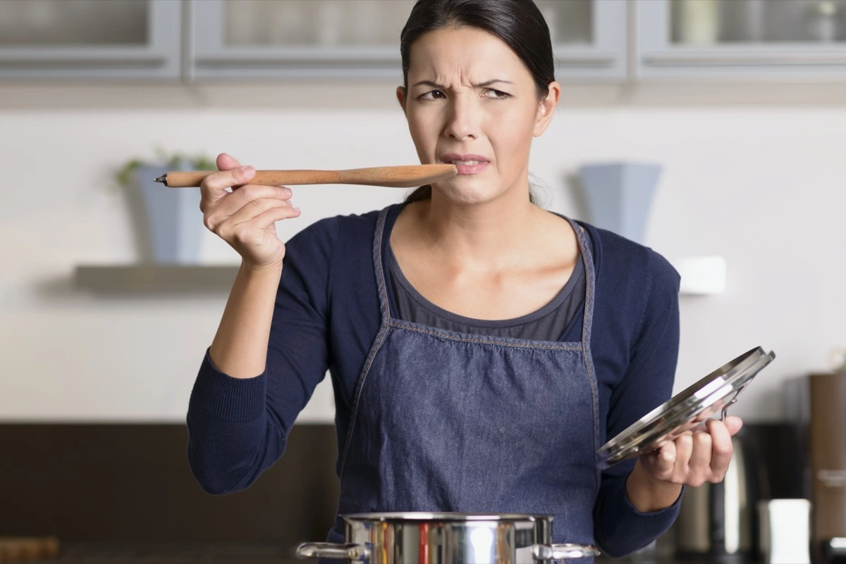
And yet….
‘Any criteria in qualitative research should be viewed as lists of characteristic features that are open to continuous re-interpretation, as times, conditions,
‘and the research purposes change; thus, ‘researchers need to adopt the role of connoisseur in order to pass judgment on different kinds of study in a fair and ethical manner’ (Sparkes and Smith, 2009, p.491)

Slide 15
If you want to find out more, join me on Twitter @SymbioticAutoe1 and follow my channel on YouTube

