Slide 1
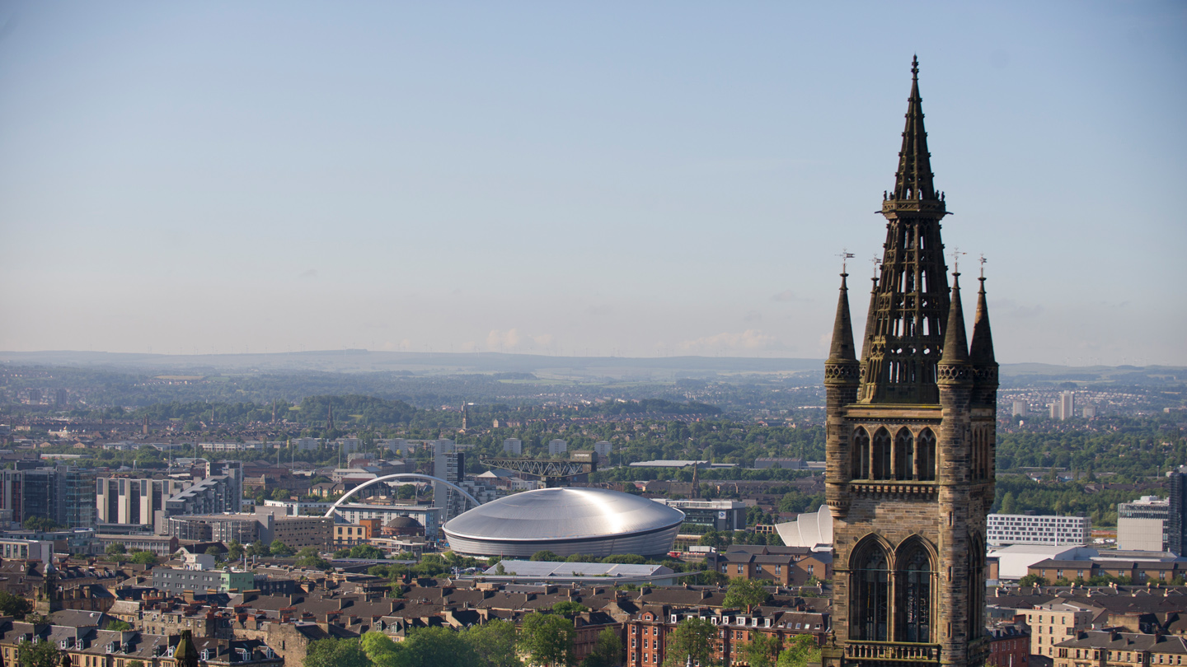



Centre for Immunobiology - Overview and Strategy

Slide 2
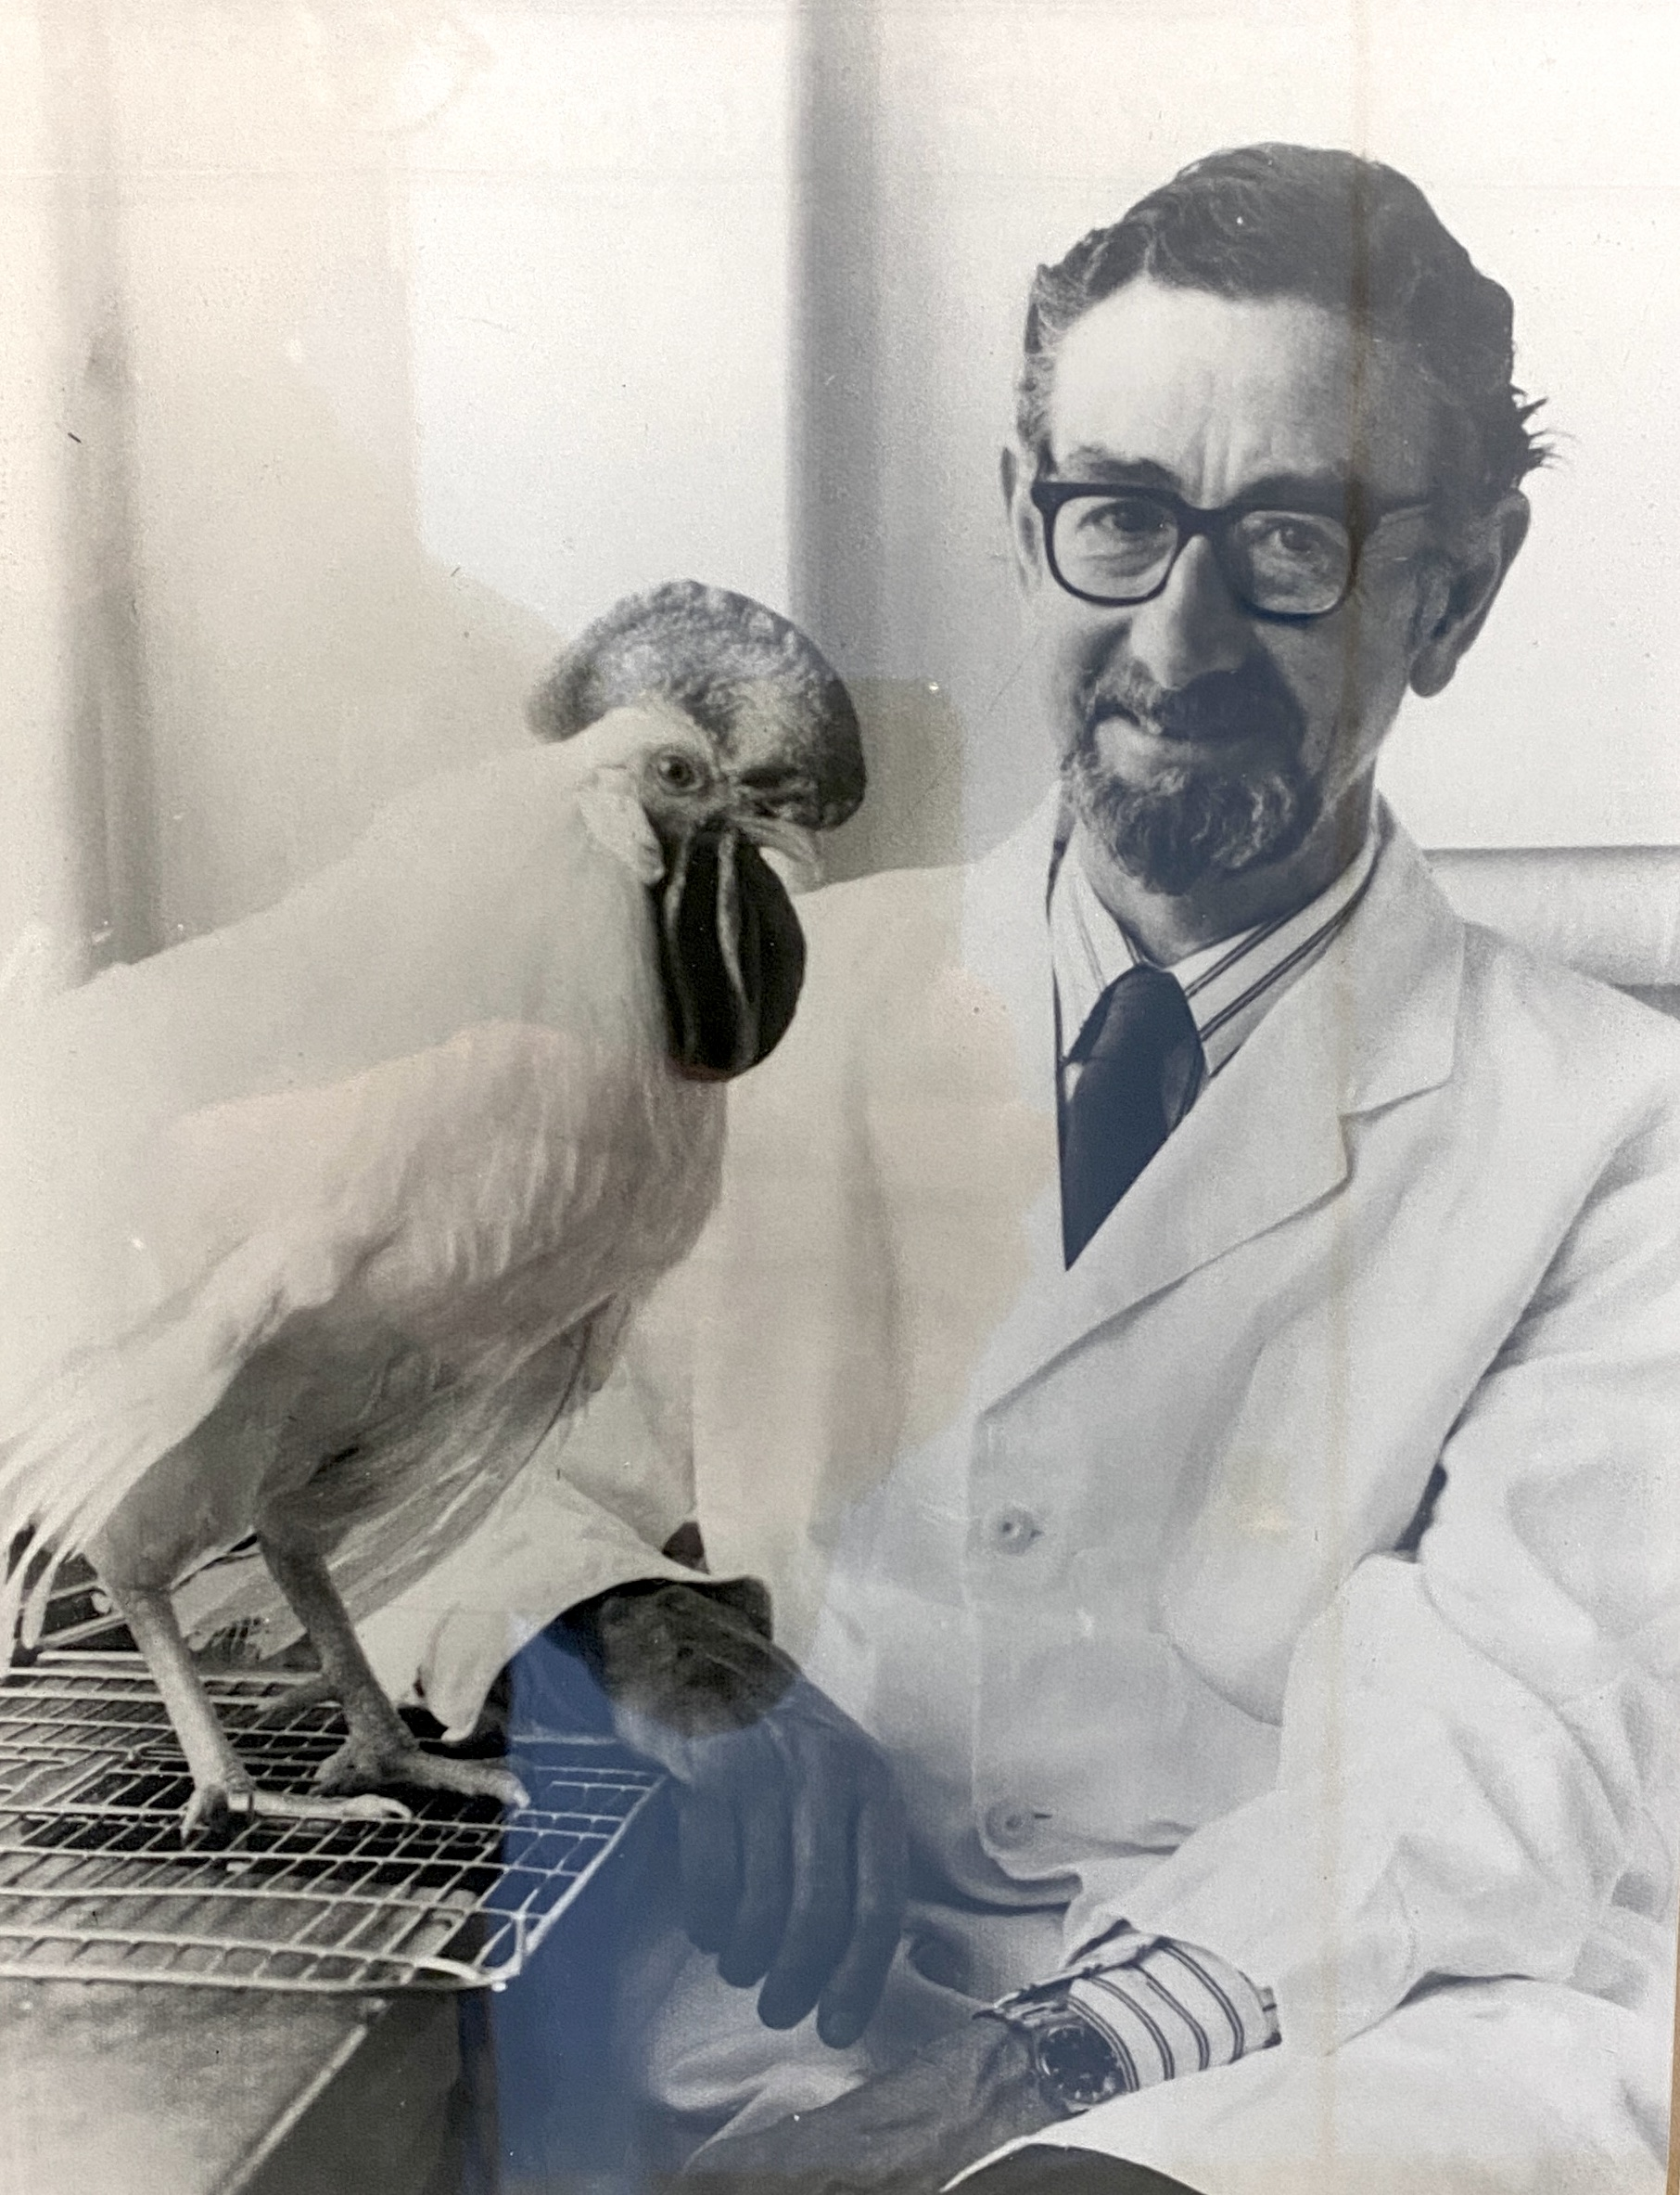
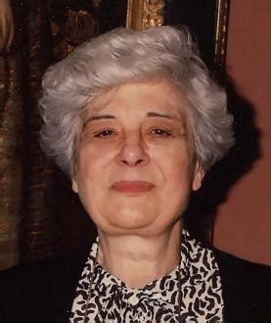
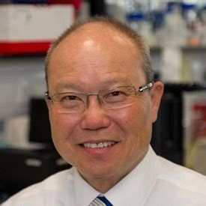
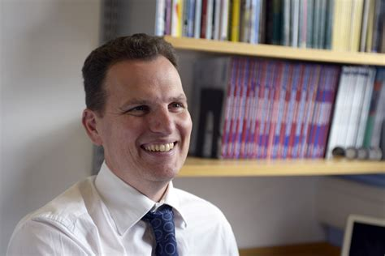
History
Established in 2012.
Builds on Glasgow’s history as an internationally renowned centre for research and teaching excellence in Immunology
Research interests ranging from the basic scientific analysis of immune and inflammatory processes, through translational efforts, to more focused clinical studies.
Notes:
We haven’t lost any staff, in numbers. I guess I’m surprised. Is the point that we need to get more fellows??

Slide 3
CfI Aims
  To define the strategy for Immunobiology research in the Institute and wider College and University contexts
  To preserve, and develop, existing strengths in the fields of immunology and inflammation within the Institute
  To use these strengths to foster strong and sustainable, outward-looking, collaborations within the Institute, College and wider University contexts.
  To act as a focus for recruitment of internationally competitive Research Fellows and academic staff members.
  To seek infrastructural, and PGR-based, support from external funding bodies to enhance research profile and productivity.
Notes:
We haven’t lost any staff, in numbers. I guess I’m surprised. Is the point that we need to get more fellows??

Slide 4
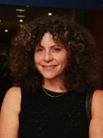
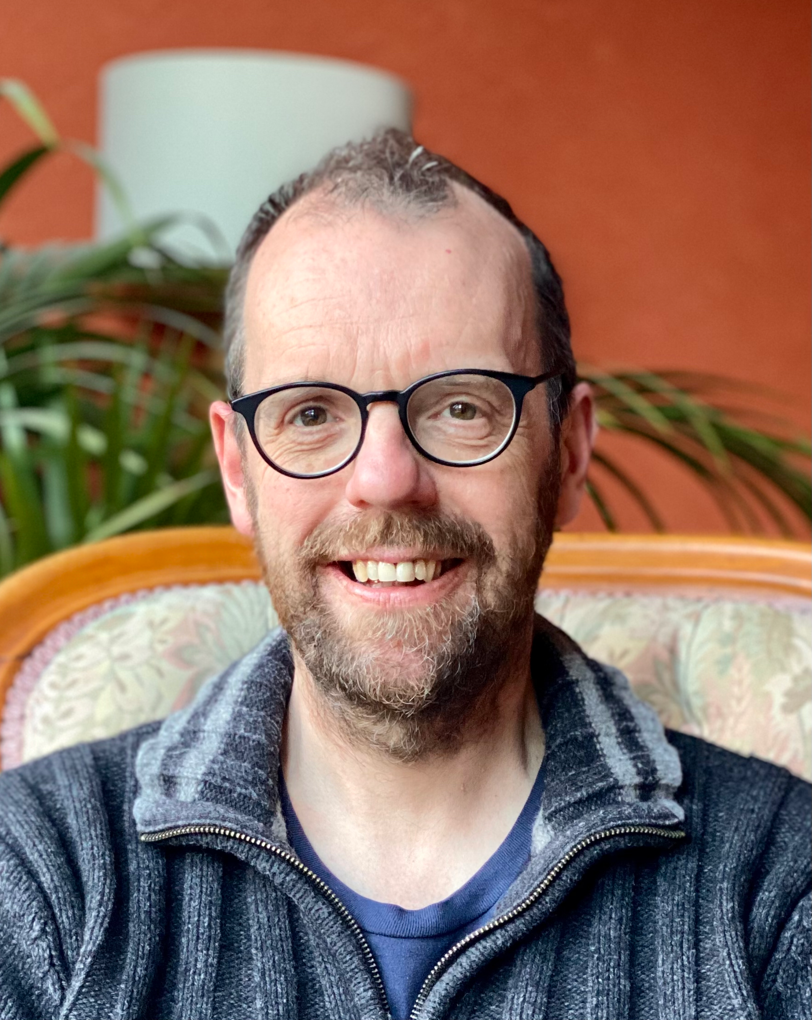
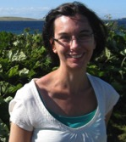
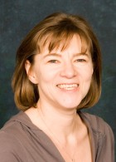
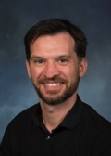
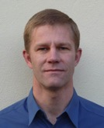
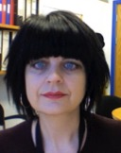
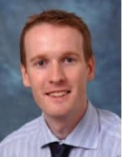
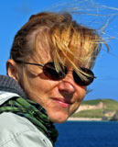
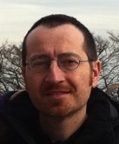
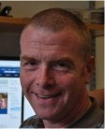
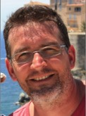
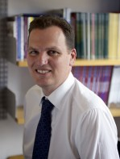
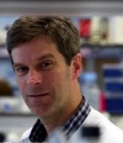
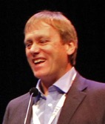
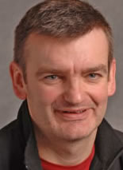
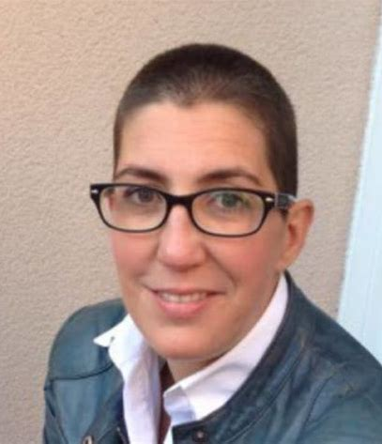
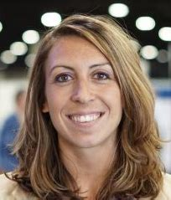
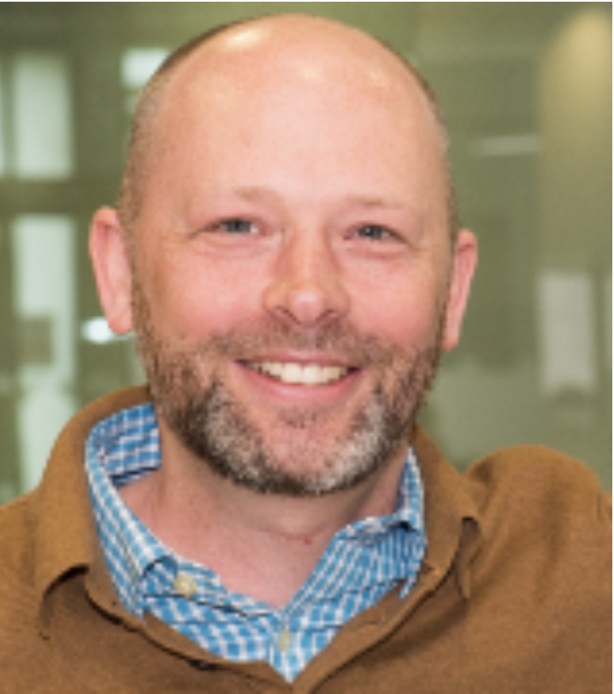
Staff in CfI (2023)
Sue
Barnett
Jim
Brewer
Megan
Macleod
Julia
Edgar
Carl
Goodyear
Thomas Otto
Stefan
Siebert
Georgia Perona-Wright
Maggie
Harnett
Neal
Millar
Mariola
Kurowska
-Stolarska
Pasquale
Maffia
Simon
Milling
Neil Basu
Rob
Nibbs
Kevin Maloy
Jonathan Cavanagh
Iain
McInnes
Gerry
Graham
Hugh
Willison
Paul
Garside
Carmen
Huesa
Aurelie Najm
Seth Coffelt
Notes:
We haven’t lost any staff, in numbers. I guess I’m surprised. Is the point that we need to get more fellows??

Slide 5
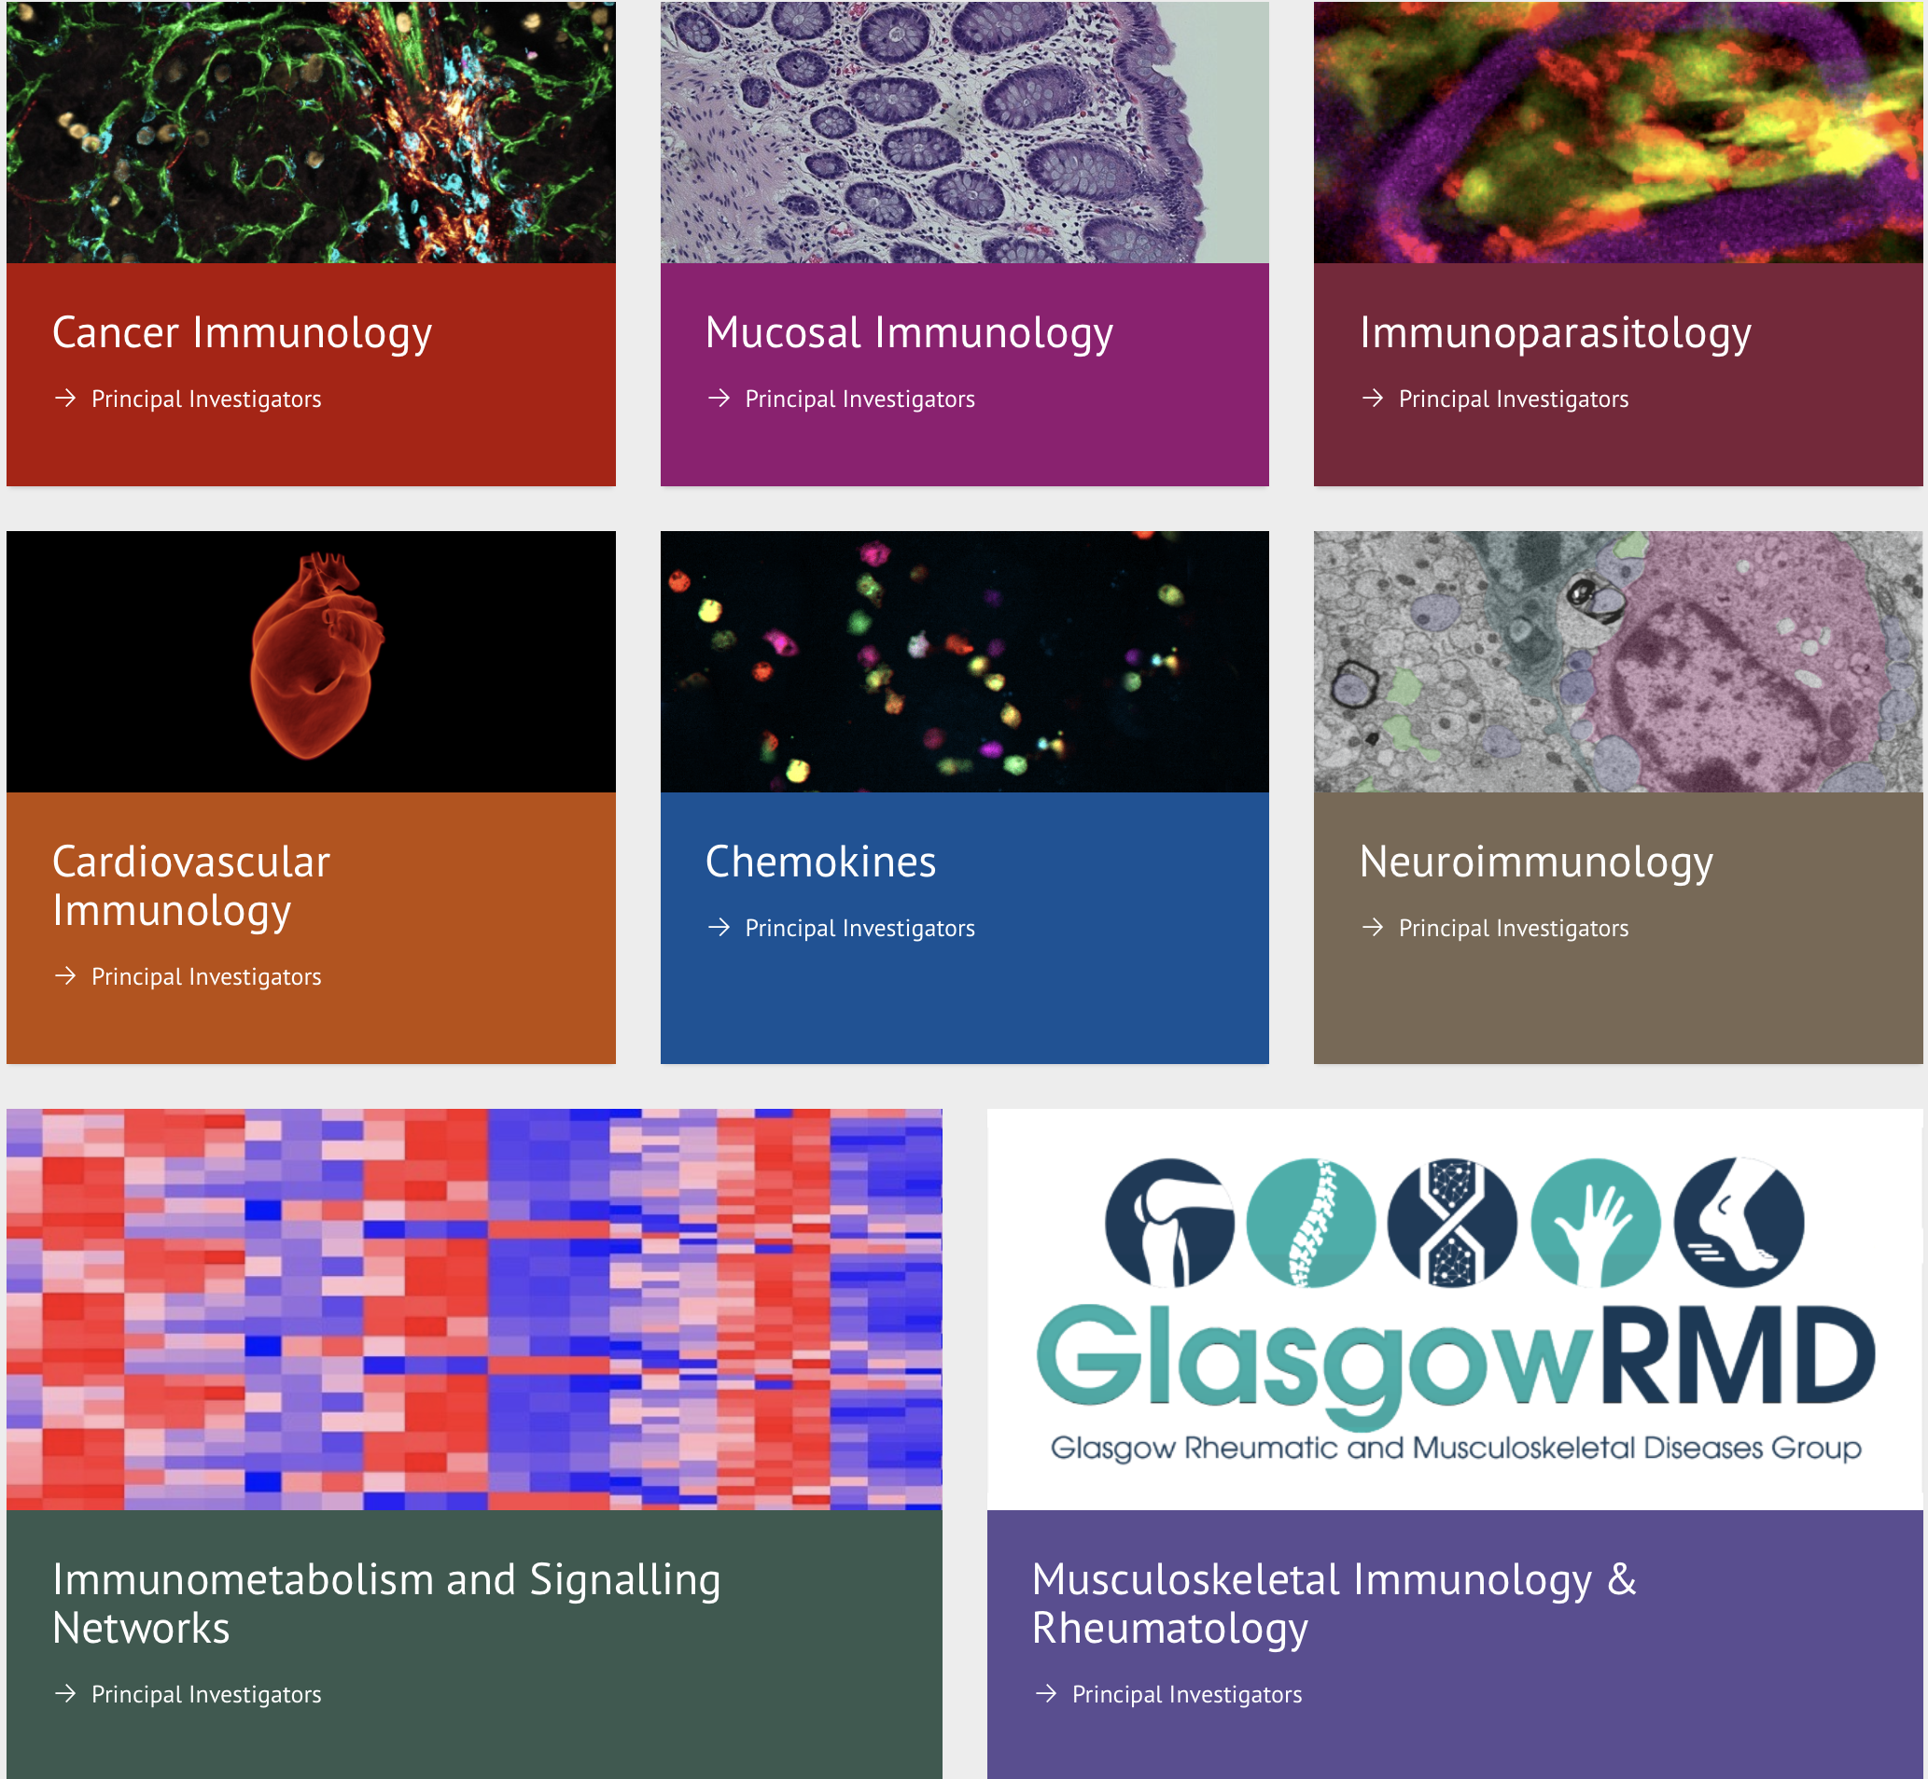
CfI Structure
https://www.gla.ac.uk/research/az/immunobiology/
Notes:
We haven’t lost any staff, in numbers. I guess I’m surprised. Is the point that we need to get more fellows??

Slide 6
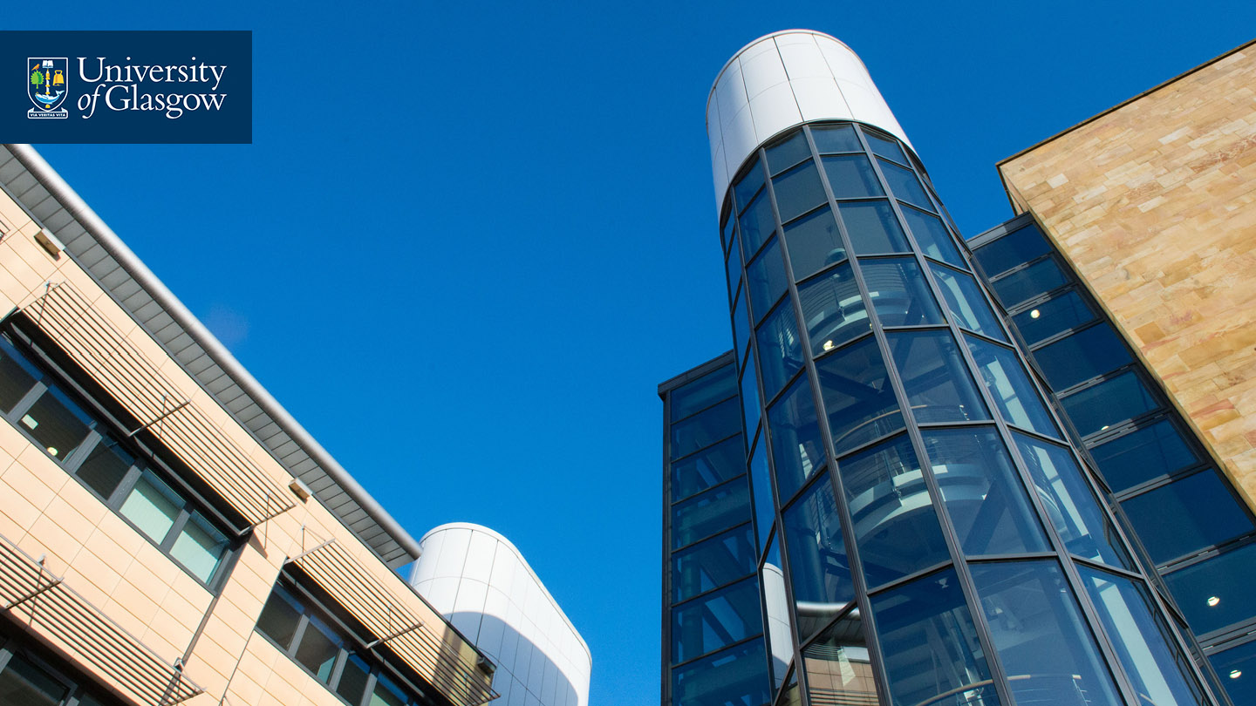
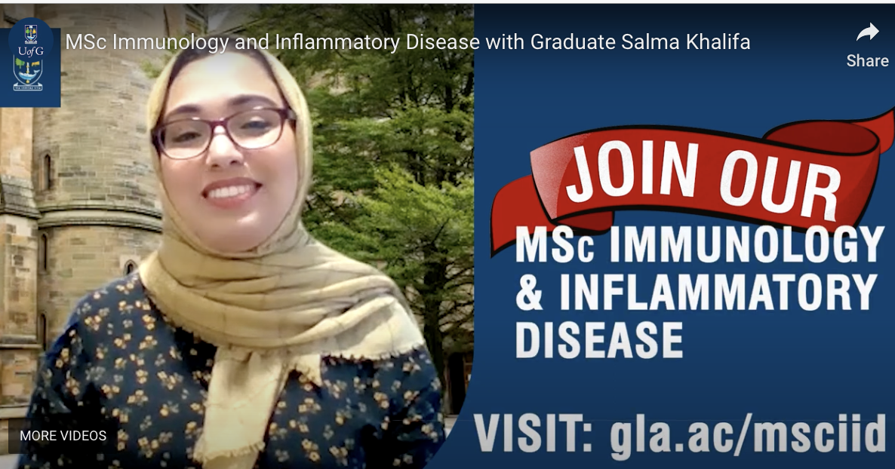
Strategic Teaching Contributions
Coordination: BSc (Hons) Immunology, MSc. Immunology and Inflammatory Disease, BSc (Med Sci) Clinical Medicine - Inflammation Medicine
Management: PGT Convenor, PGR Convenor
Collegiality: Widespread contribution of Immunology to BSc, MSc, MBChB, BVMS (mean staff contribution ~120h pa)
https://www.gla.ac.uk/postgraduate/taught/immunologyinflammatorydisease/

Slide 7
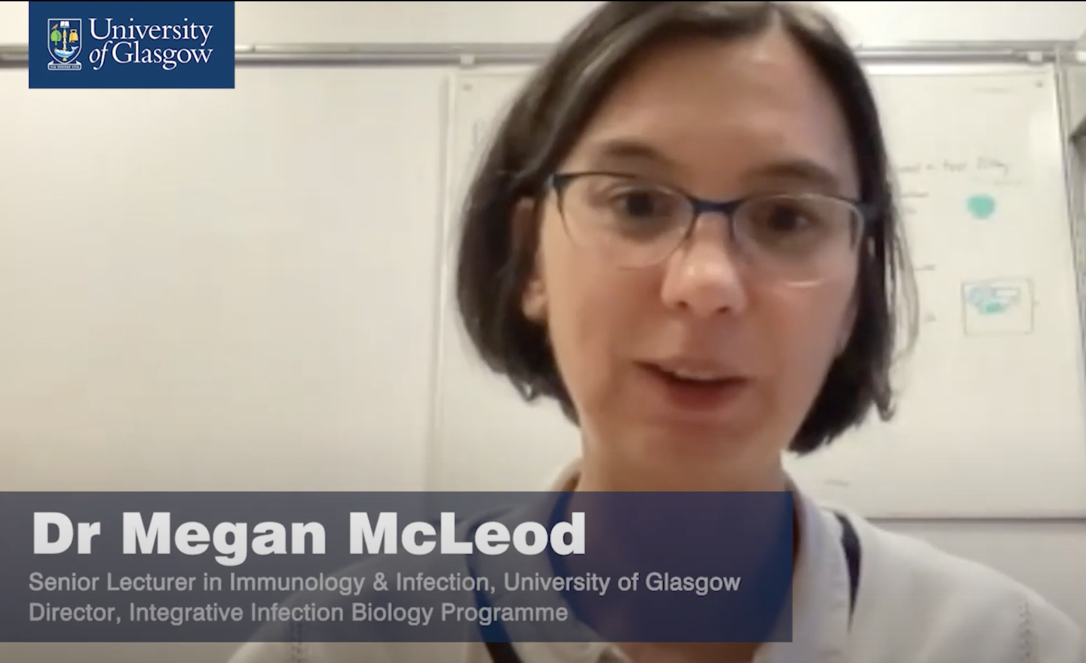
Strategic PGR Contributions
Precision Medicine Doctoral Training Programme,
Rheumatoid Arthritis Pathogenesis Centre of Excellence (RACE)
Wellcome Trust Integrative Infection Biology PhD programme
Currently 63 PhD students with primary supervisor in CfI

Slide 8
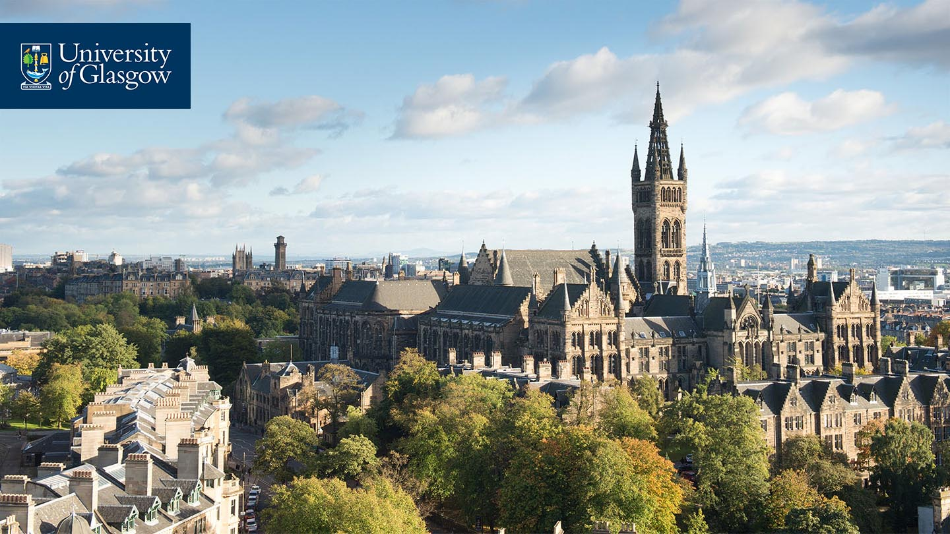
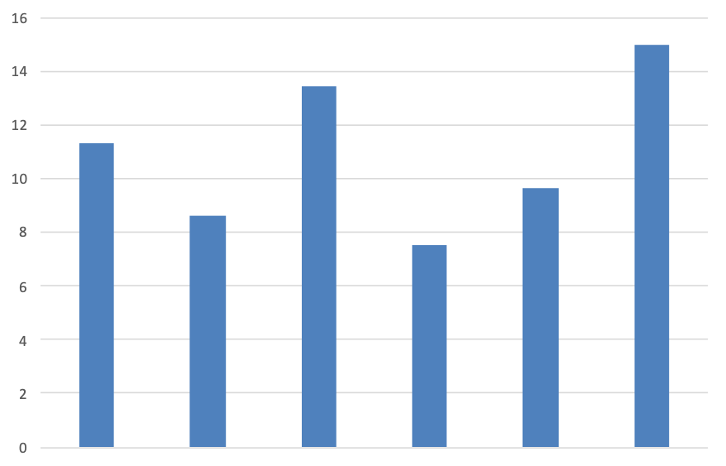
Research
FEC Awards (£m)
245 Research Outputs scored 3 or 4* for REF2021
Publications in various journals including Immunity, Nature, Nature Immunology, Mucosal Immunology, eLIFE, Blood, PNAS, Lancet, Nature Comms, Plos Pathogens, Nature Reviews
Research Awards in last 6 years >£65m
2015
2016
2017
2018
2019
2020
Notes:
These are goo numbers. Also all staff returning all 3* and 4* outputs.
Are these awards including Industry Contracts??

Slide 9
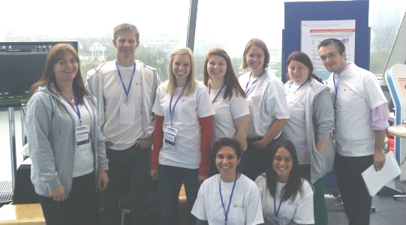

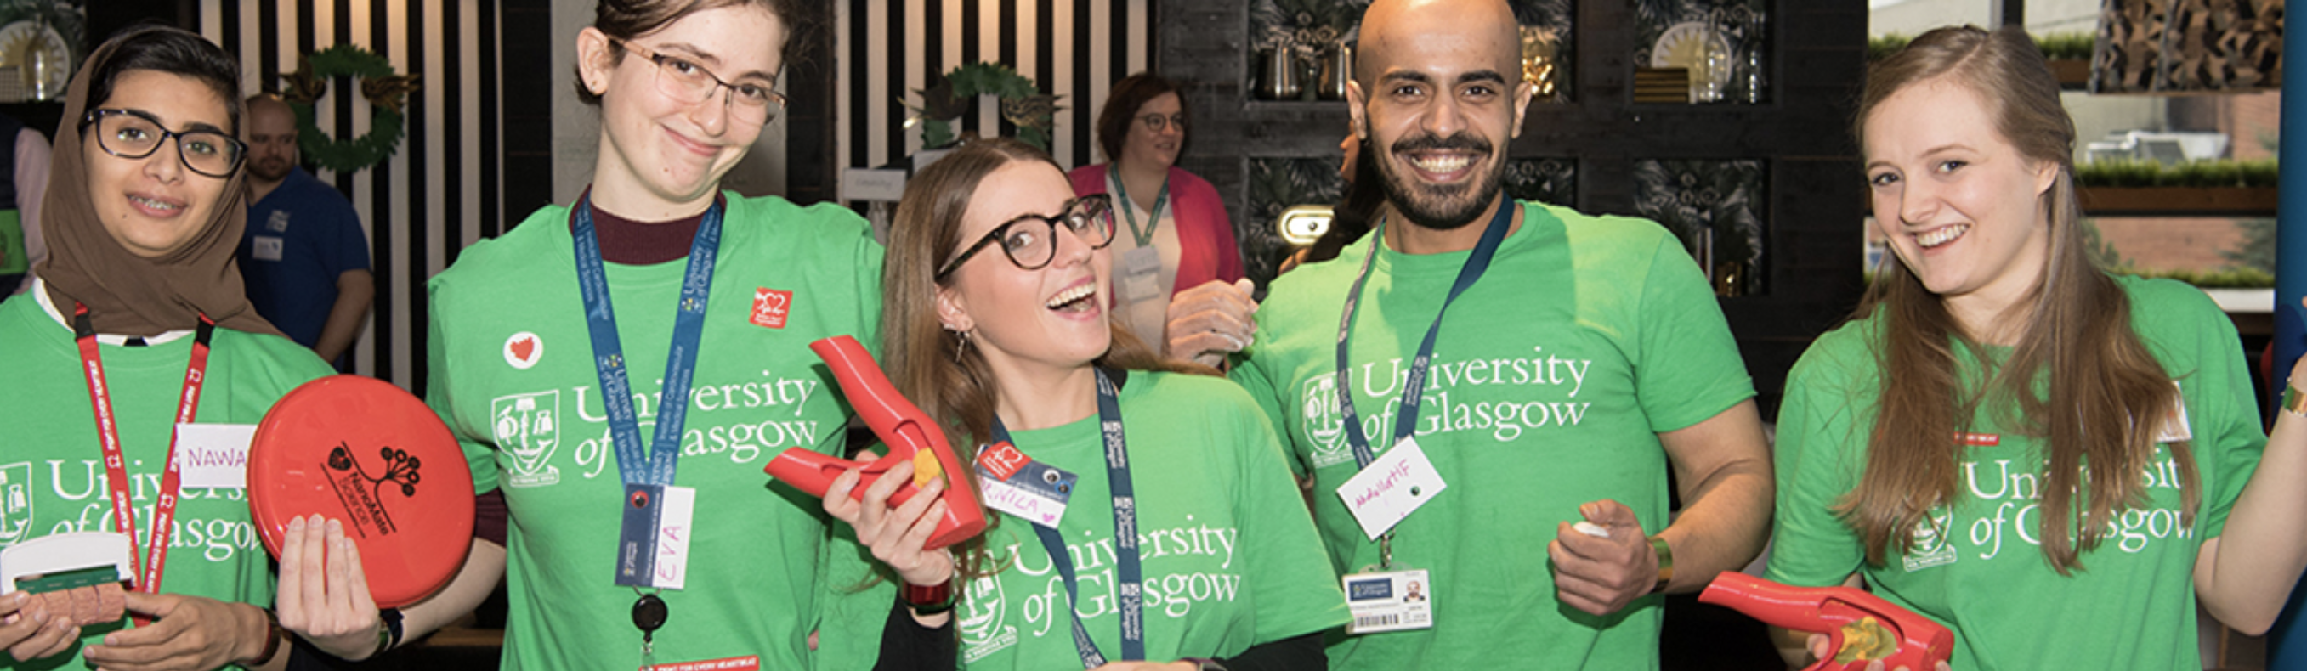
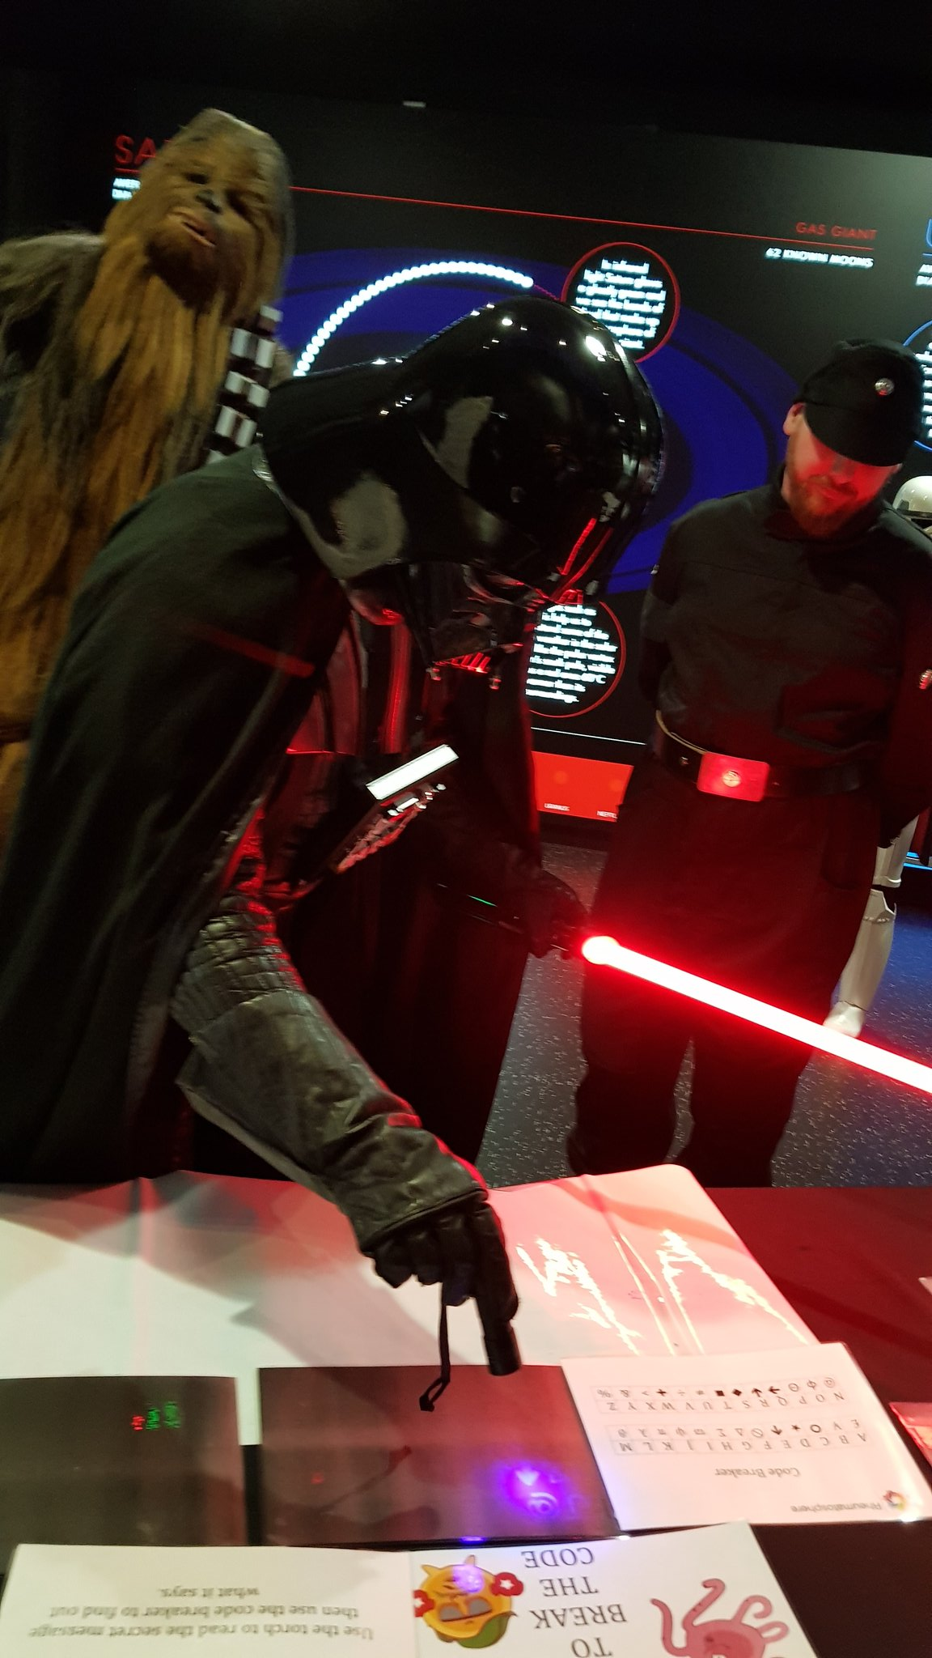

Impact and Engagment
Knowledge exchange and transfer with a variety of stakeholders e.g.
Industry Collaborations e.g.
  GLAZgo Discovery Centre - Collaboration between SII and AstraZeneca, fully integrated drug discovery programme for inflammatory disease
  Glasgow Lilly Collaboration - Next Gen Target Identification and Validation (£4.6m)
Patient Groups e.g. NRAS Greater Glasgow and Clyde Rheumatoid and Inflammatory Arthritis Group
Public Engagement e.g Vaccine Advocacy with BSI, NanoMATE, Schools Outreach, Rheumatosphere, Explorathon.
Research Panel particpation/chairs.
Notes:
We have research contracts with lots of companies - maybe Kim M-J can help with these data, Better to highlight these as a source of significant funding.
I like the patient involvement part too. What else to add? Alopecia UK (me). Lots of patients (CfI medic PIs). Hugh must also do something like this?? BSI - Megan. Georgia - Vaccine advocacy.

Slide 10


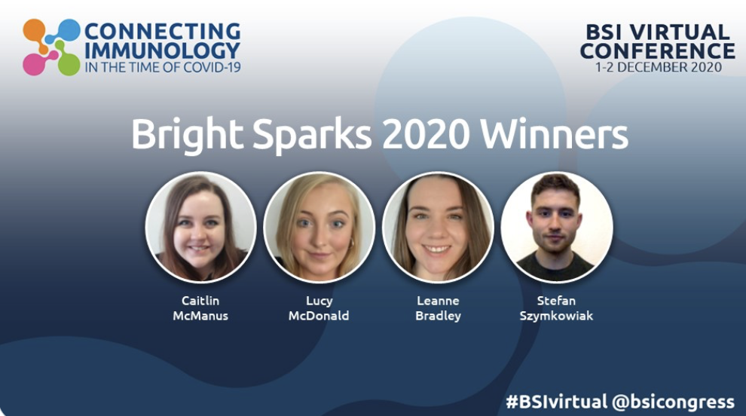
Collaboration/Connection
We have institutional, national and international research collaborations with academia and industry e.g.
  RACE - Rheumatoid Arthritis Pathogenesis Centre of Excellence (RACE) - Doctoral training partnership with Newcastle, Oxford and Birmingham.
  Blantyre-Blantyre Clinical Research Project
  Coordinating the UK arm of IGOS: International GBS Outcome Study.
  Widespread international research collaborations.
Notes:
Can we increase this - improve.

Slide 11
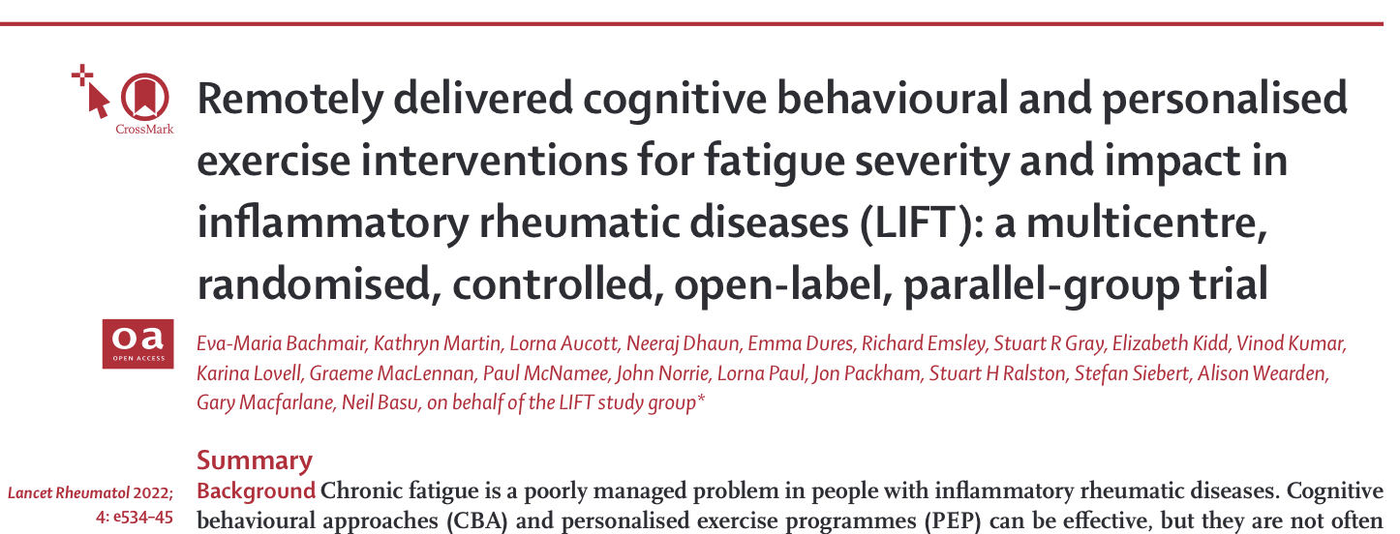
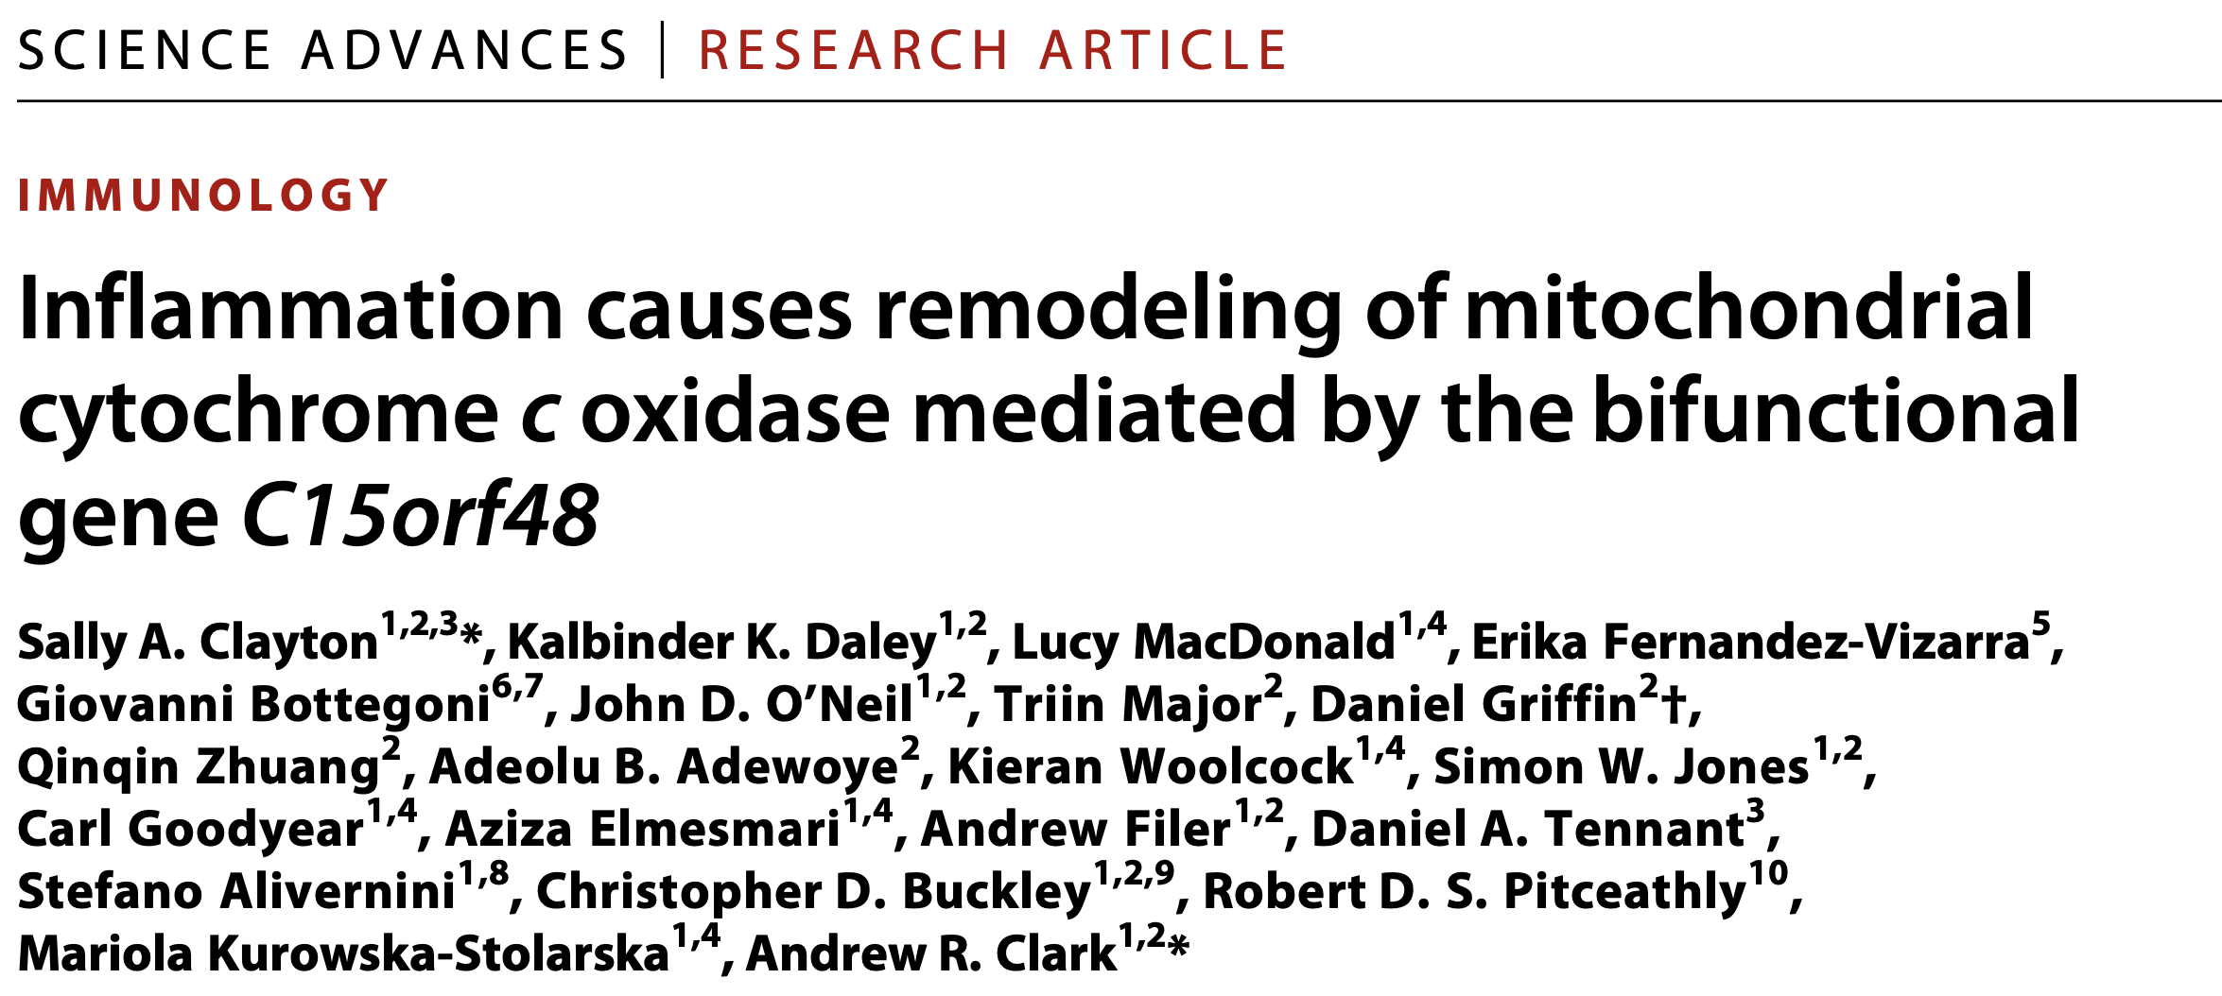
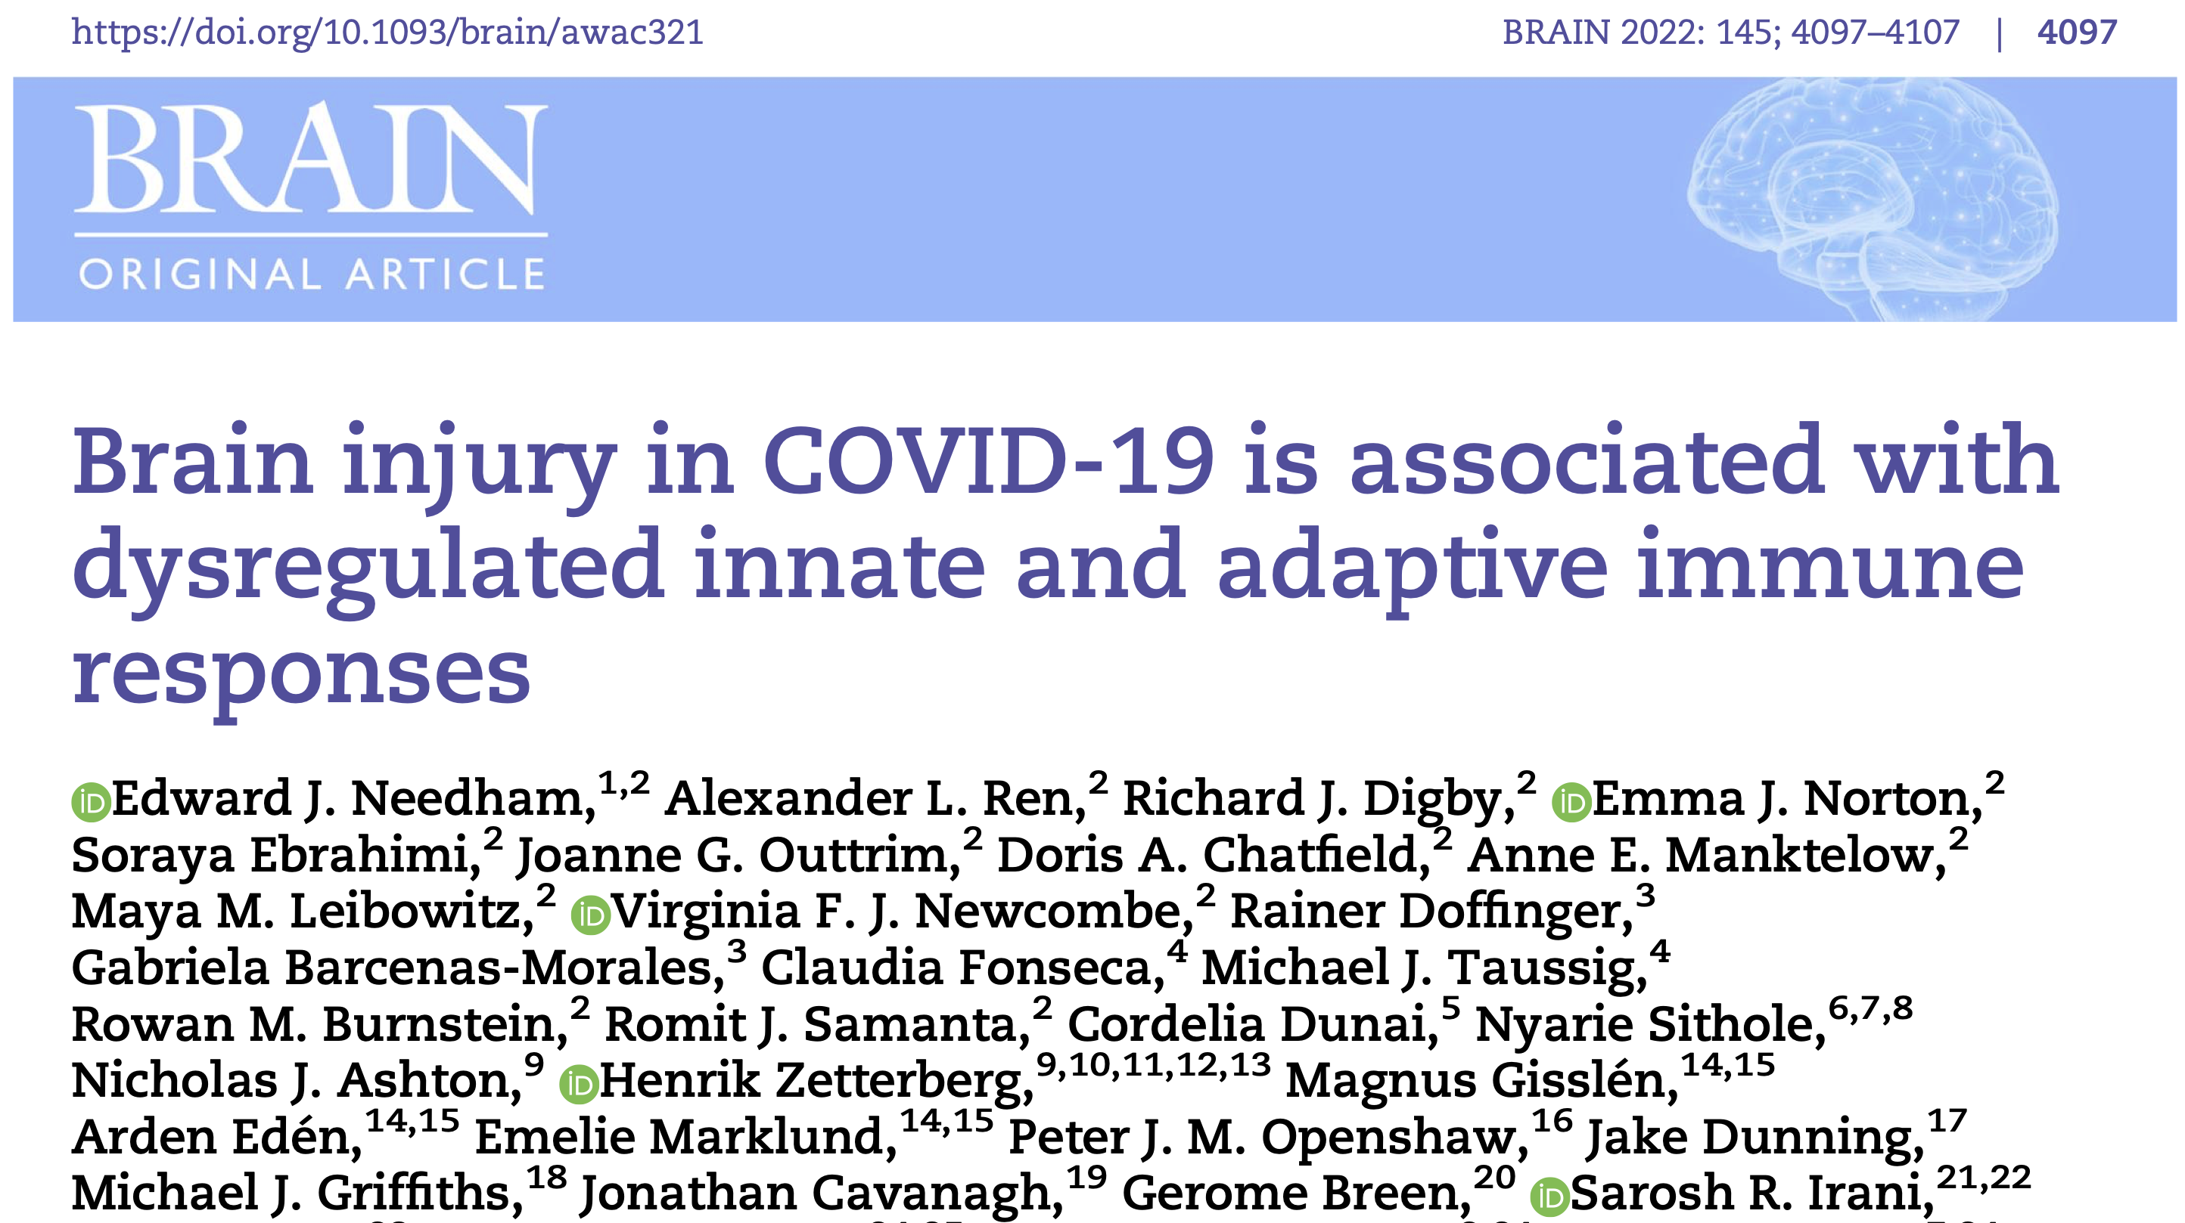
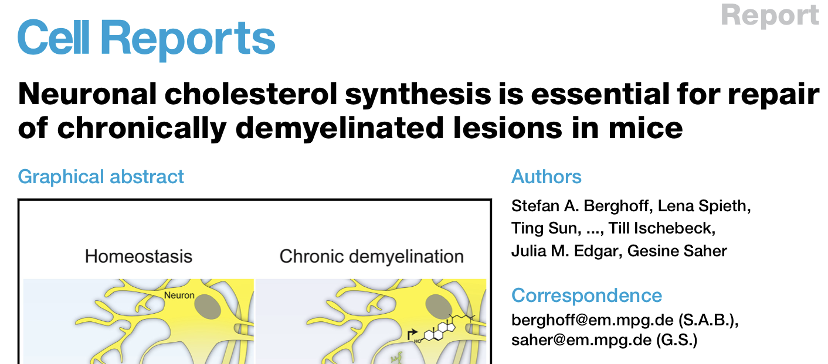
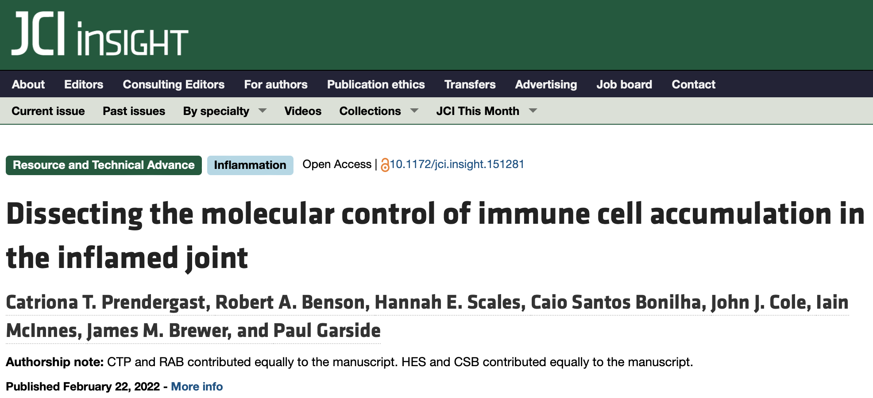
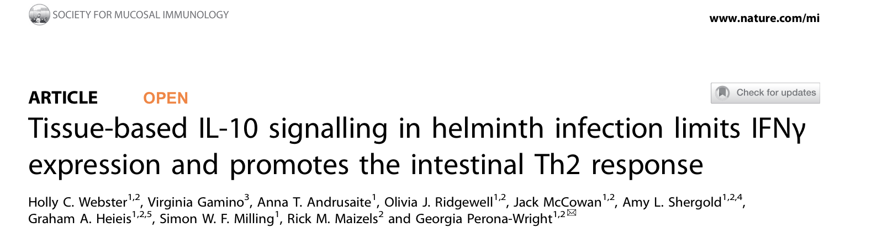
Notes:
These are goo numbers. Also all staff returning all 3* and 4* outputs.
Are these awards including Industry Contracts??

Slide 12
Key Research Strengths/Themes
Core Immunology
Infection
Inflammation
Core Strengths
Supported by Facilities:
FACS, Imaging (GIF).
Notes:
I re-jigged this a bit. Look at slide 10 for the full effect… If you hate it use your version. I won’t mind!!

Slide 13
Key Research Strengths/Themes
Key Research Strengths/Themes
Core Immunology
Autoimmunity/Rheumatology
Chemokines
Mucosal
Infection
Inflammation
Core Strengths
Research Themes
Research Themes
Immuno-parasitology
Metabolism
Neuro-inflammation

Slide 14
Key Research Strengths/Themes
Cancer
Core Immunology
Autoimmunity/Rheumatology
Chemokines
Mucosal
Cardiovascular
Infection
Inflammation
Core Strengths
3Is (B,P,V)
Research Themes
Immuno-parasitology
Neuro-inflammation
Collaborative areas
Metabolism
Neuroscience
Notes:
Tried to put baubles close to their interactors. Only partially works for the blue ones.
Also collars with other Institutes and schools. Medicine. Engineering. BACHMS. Tobin/Milligan. Etc.

Slide 15
Strategic Collaborations
RACE
Malawi/Blantyre
NHS
Engineering
Physics
Chemistry
MVLS
Industrial Partnerships
e.g. Lilly
Notes:
PhD programmes. RACE, mention DTP Precison Medicine, Wellcome Phd programme (molecular infection).
What institutes to we have particlar intereactions with? Can these be built up? (e.g. Cardiff)

Slide 16
Key Strategic Goals v1.0
  Faciliate excellent activity around key themes.
  Recruitment aligned with strategic themes and collaborations - impending retirements.
  Vigorously identify & support Research Fellowship applicants.
  Enhance External visibility (panel membership, advisory board, strategic collaborations).
  Support development of Institute Facilities (equipment grant applications, technical expertise, management.
  Identify and develop strategic External Collaborations

