Slide 1

Overview of the CVR
Towards a national institute for virus research

Slide 2
An MRC Unit for virus research
MRC has a mission to support research and training with the aim of maintaining and improving human health. To address important scientific opportunities and health needs, and when stand-alone grant support alone is insufficient, our three main support mechanisms are:
  Institutes – very long-term flexible multidisciplinary investments
  Units – more focused investments established for as long as needed to support a scientific need or deliver a research vision
  Centres – built on existing MRC, and other, support to add value and help establish a high-profile research centre
MRC-University of Glasgow Centre for Virus Research
cvr.ac.uk
Notes:
Many Units are small investments with limited life-spans - but the CVR/Virology Unit is one of the largest and longest standing units in the MRC portfolio.
Unit first established in 1959 - led by Sir Michael Stoker (after whom our building is named).
John Subak-sharpe, Duncan McGeoch and now Massimo is the fourth director (although there have been several interim directors).
Funding is renewed on a five-yearly cycle through the Quinquennial review process, which we have just undergone.
MRC core funded for the coming quinquennium through a grant of £30M to the University of Glasgow.

Slide 3
Funding 2016-2022
MRC-University of Glasgow Centre for Virus Research
cvr.ac.uk
Notes:
Circa £100M total - supporting a total of 220 staff and students.
Substantial growth over the past decade - and the CVR is a very different centre to the Virology Unit I joined back in 1998!
A substantial portion of our funding comes from MRC core - and this underpins the resources to leverage the external funding through provision of well managed and resourced technical platforms and administrative support.
Hence the high-stakes and considerable effort that went into the QQR renewal process. Key to the Unit model is our focus on our research mission.
MRC have recently reviewed their Unit funding model and will shortly start moving units to a more time limited model (Unit 2.0).
We don’t foresee that the need for virus research will diminish and owing to our scale are working to position ourselves as a NATIONAL VIRUS RESEARCH INSTITUTE - this is our priority for the next five years

Slide 4
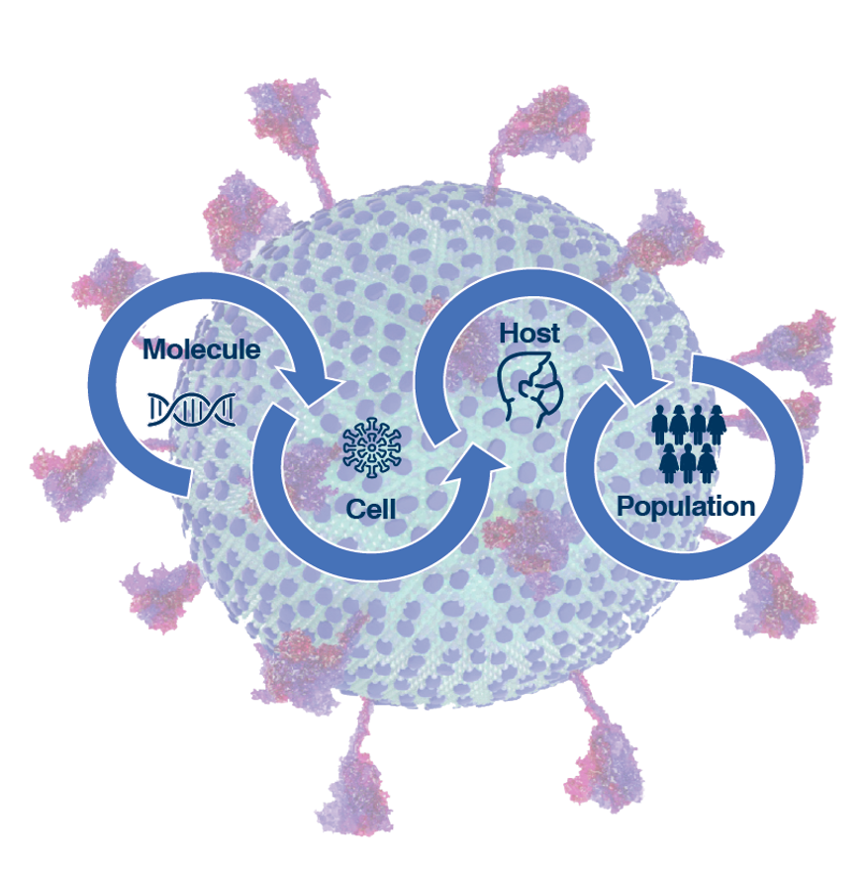
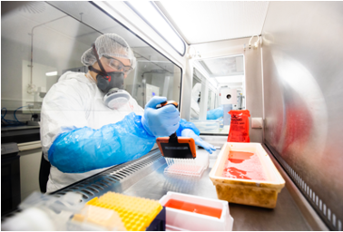
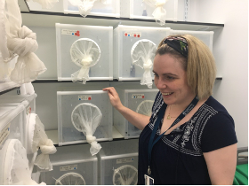
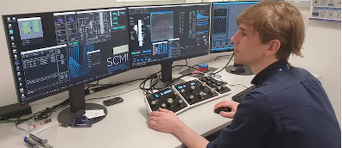
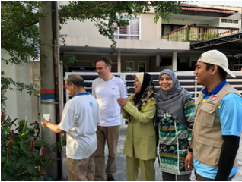
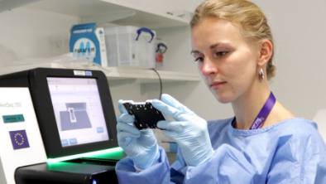
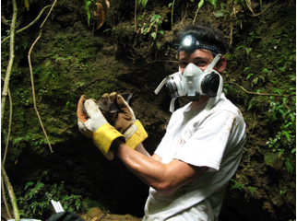
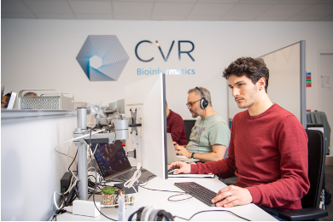
A ‘molecules to populations’ approach
Notes:
Breadth and Depth point out each picture - molecular/structural - genomics and data sciences - insectaries and containment - field studies - Sinkins group in Malaysia, Streiker group bat viruses in South America.

Slide 5
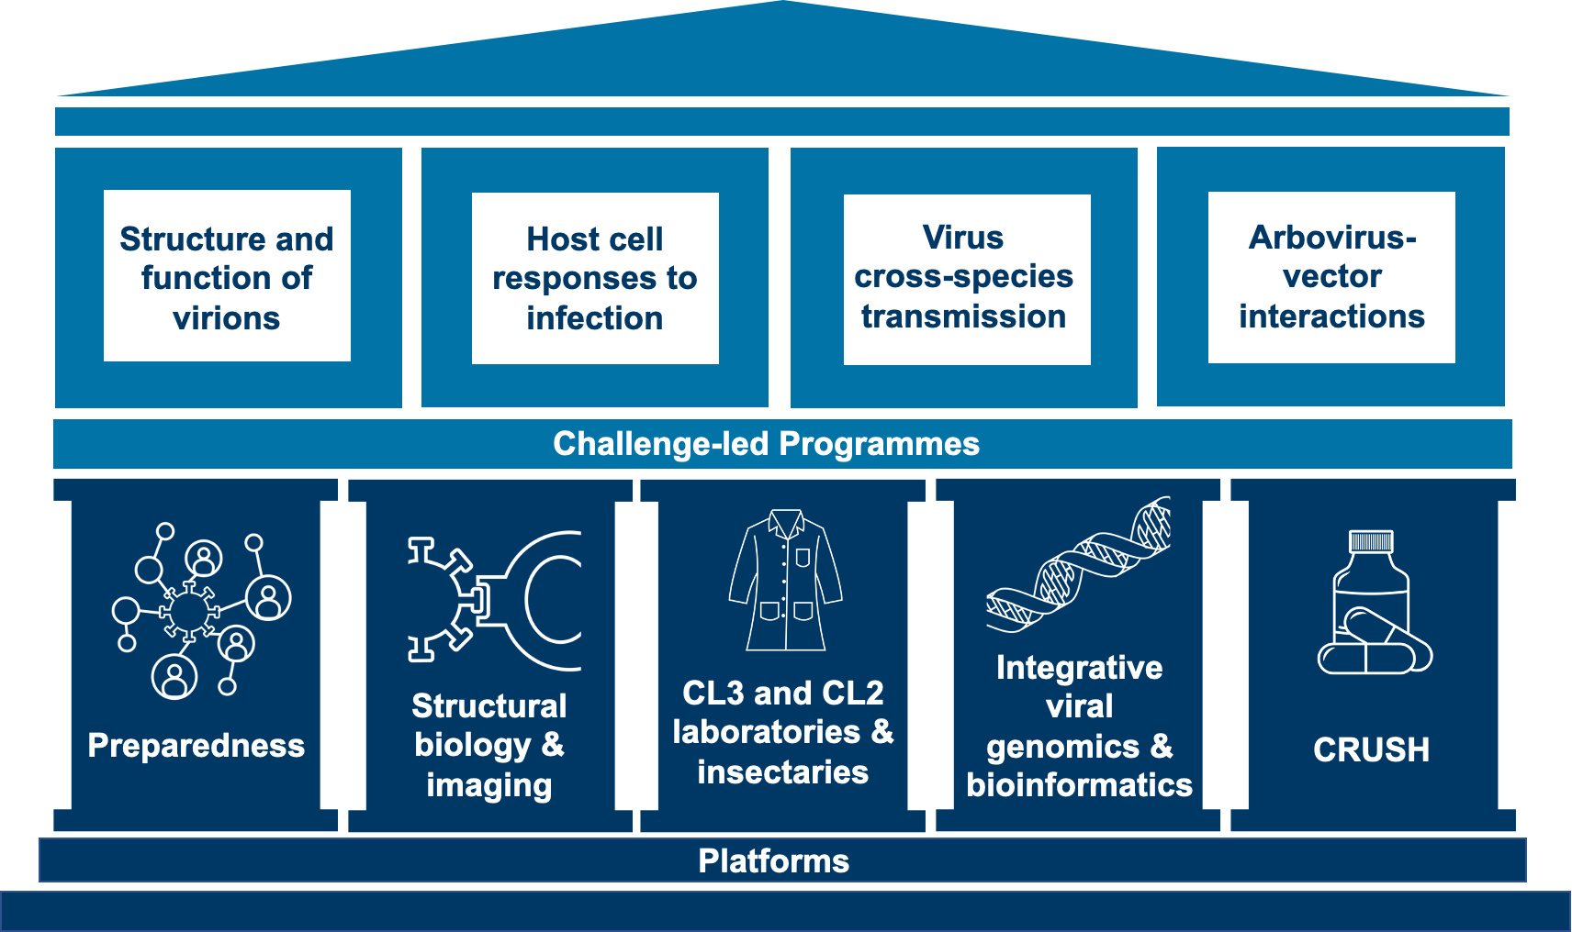
MRC-University of Glasgow Centre for Virus Research
cvr.ac.uk

Slide 6
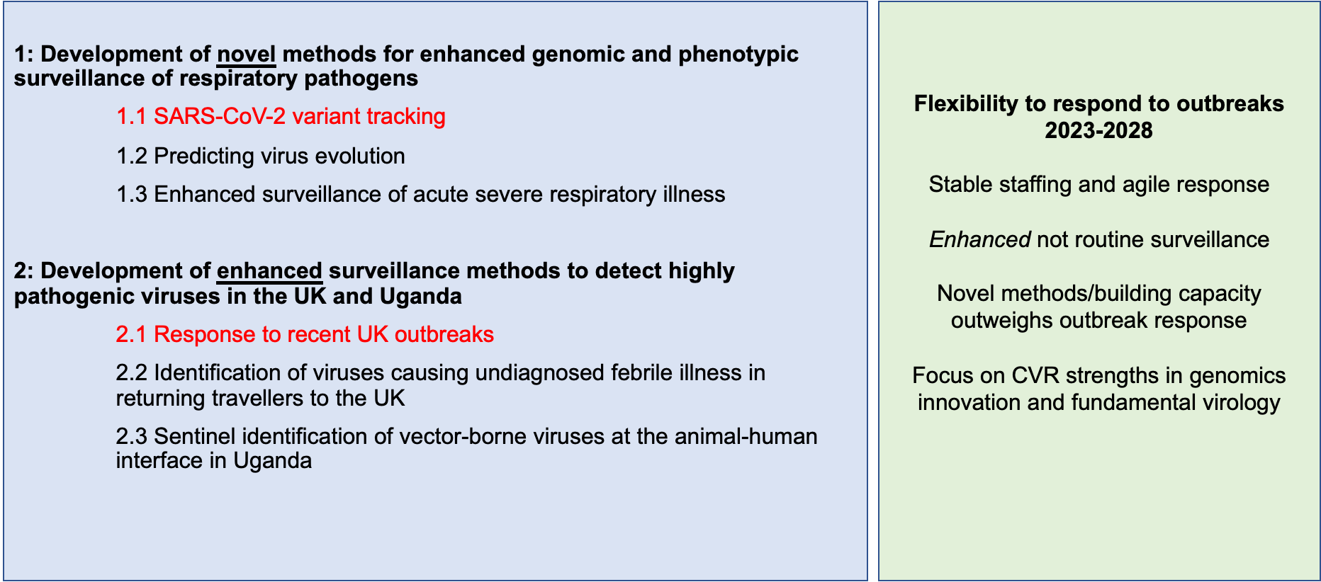
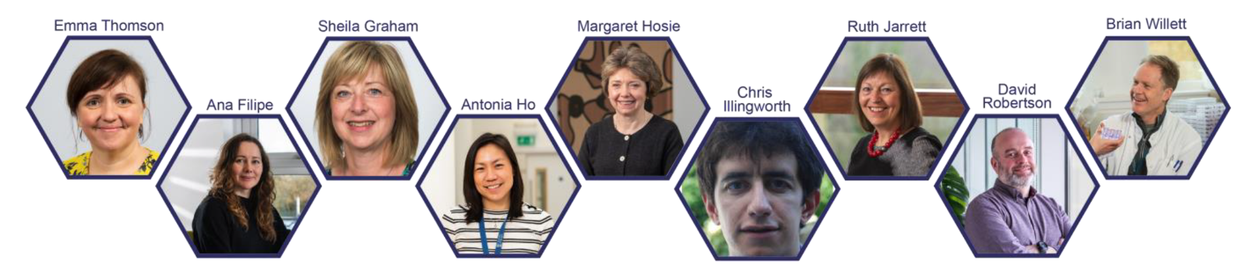
Preparedness
Notes:
Developing and applying novel serological methods (enhanced surveillance)

Slide 7
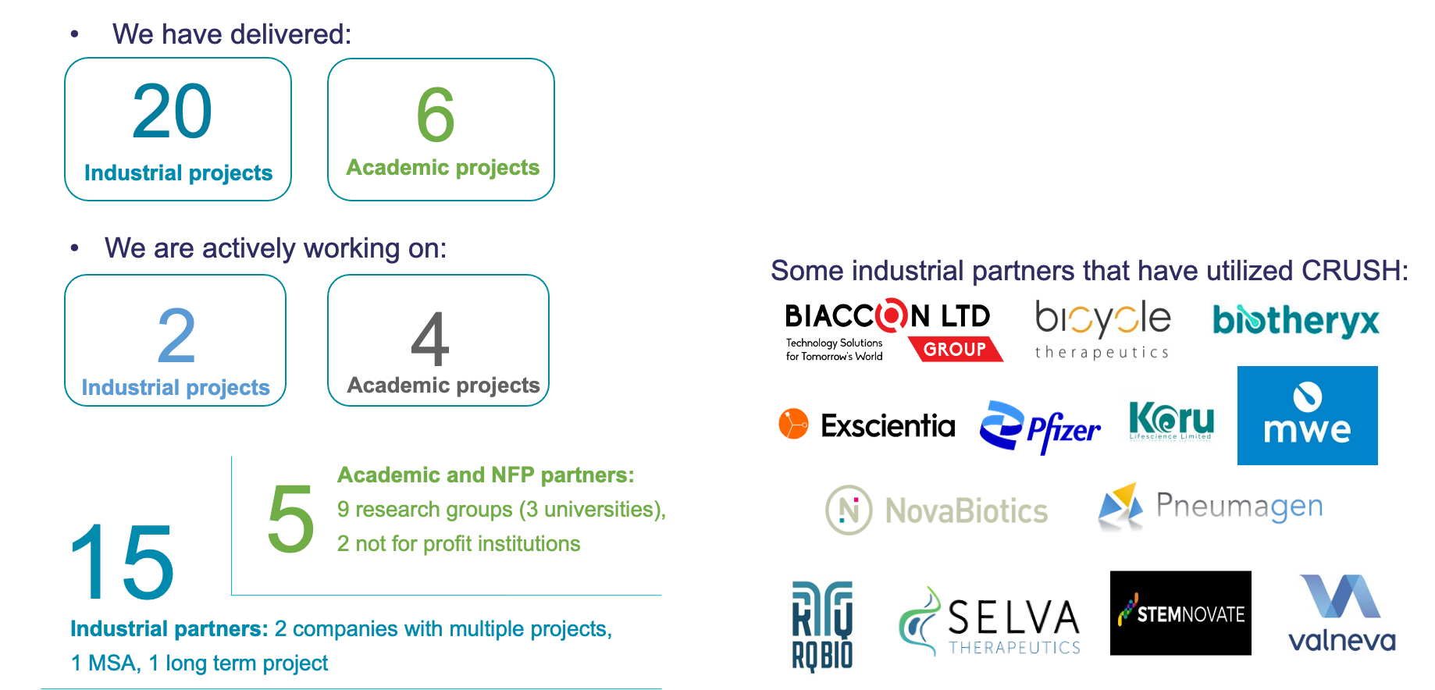
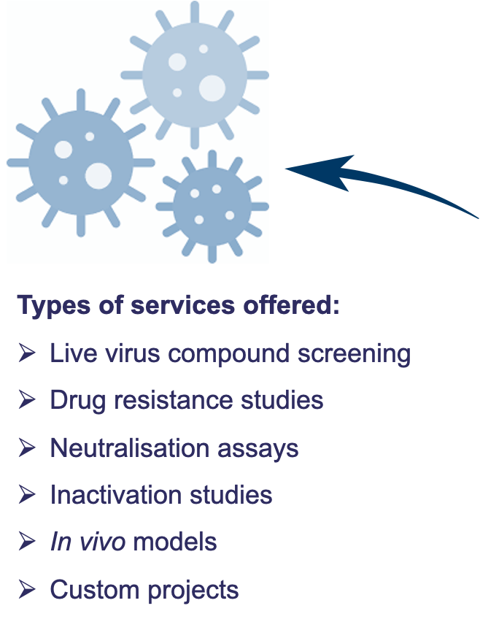


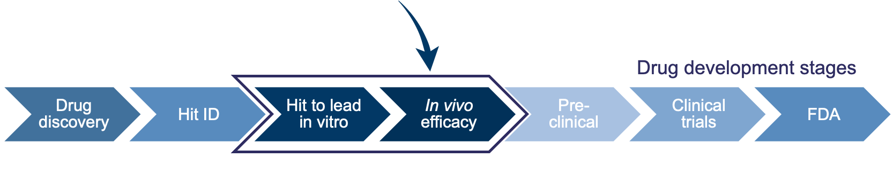
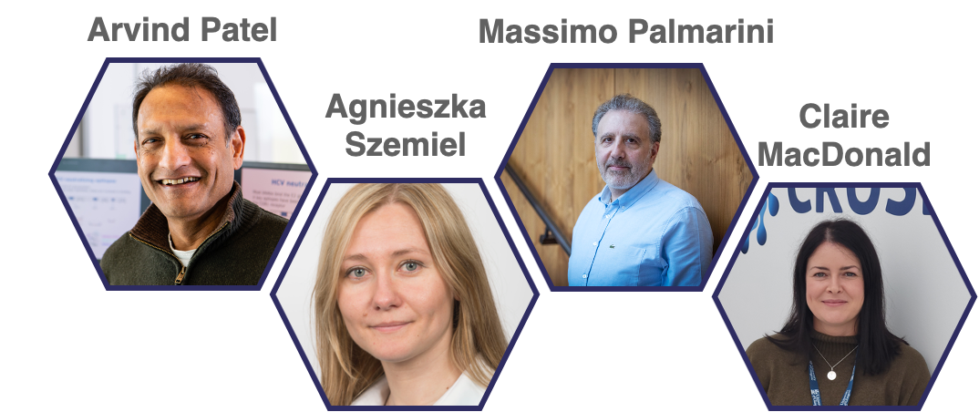


CRUSH - drug screening hub

Slide 8
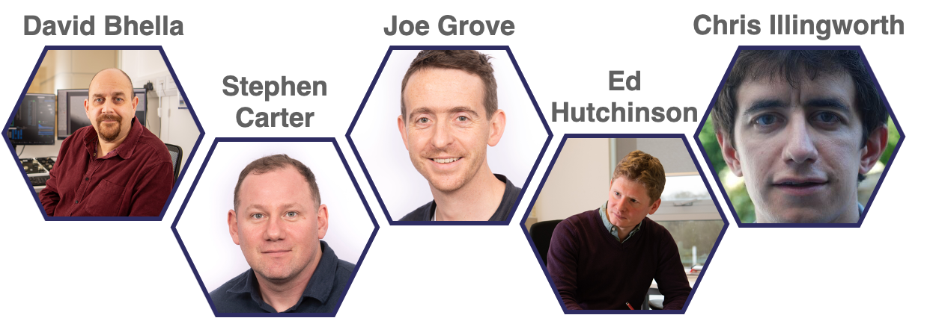
Structure and function of virions
Notes:
Brings together structural/molecular dynamics, molecular biological and mathematical modelling - to ask:
How do virus particles work (to deliver their genomes)
How does evolution change this?
Flu - SARS CoV2 and RSV

Slide 9
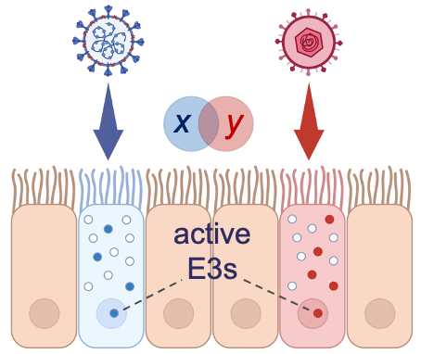
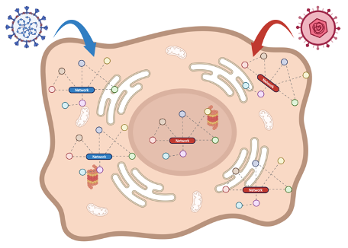
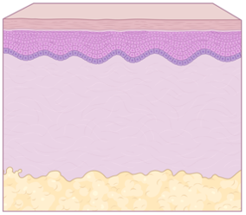
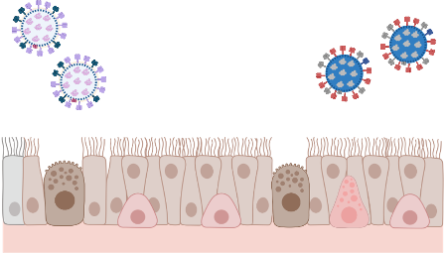

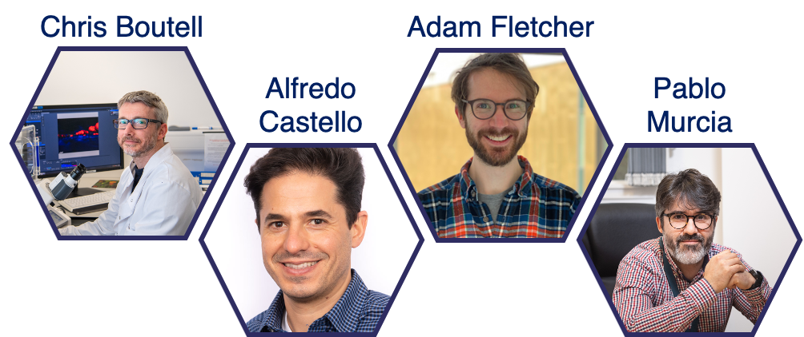
Host-cell responses to infection
Protein and RNA
Interactome mapping
Dissecting the role of
ubiquitin
Transgenic 3D
culture systems
Respiratory virus
coinfections
Notes:
What are the common networks involved in host responses to infection & co-infection by taxonomically unrelated viruses?
Flu, Herpesviruses, Arboviruses and RSV as well as co-infections.

Slide 10
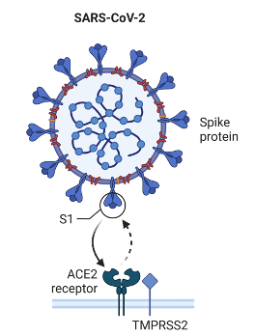
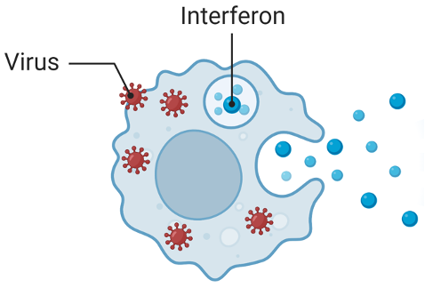

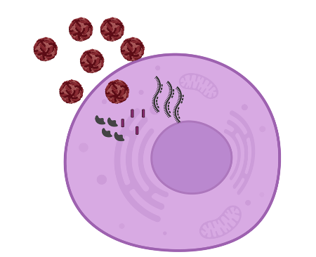

Virus cross-species transmission
Receptor tropism
Host factor requirements
Innate immunity
Adaptive immunity
Notes:
Identify host dependencies for virus replication
Examine virus determinants necessary to overcome these
Quantify the risk of zoonosis.
Working on Flu, Coronaviruses, HIV, RSV and Rabies virus

Slide 11

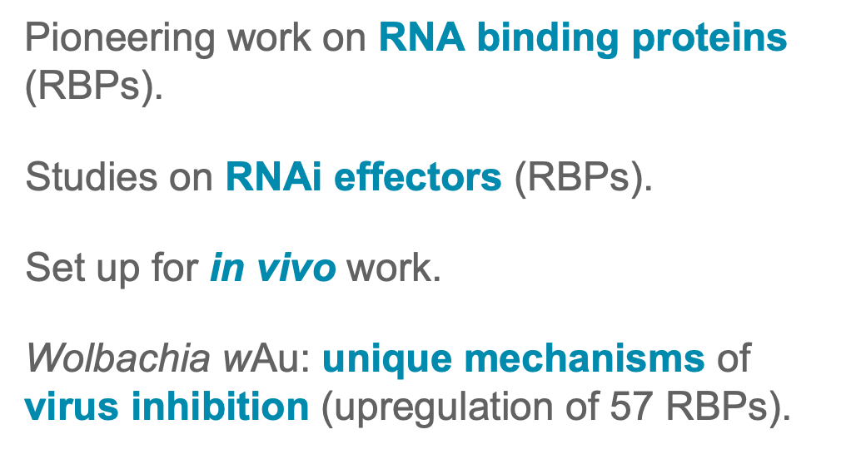
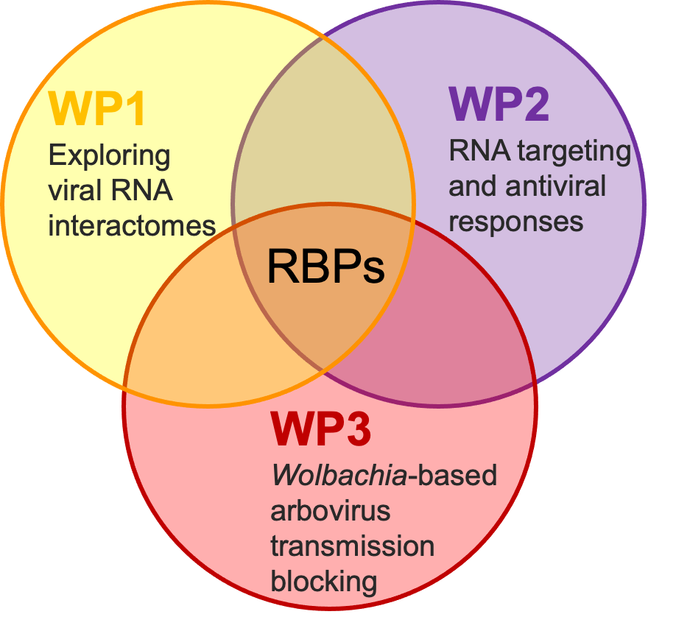
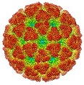
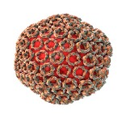
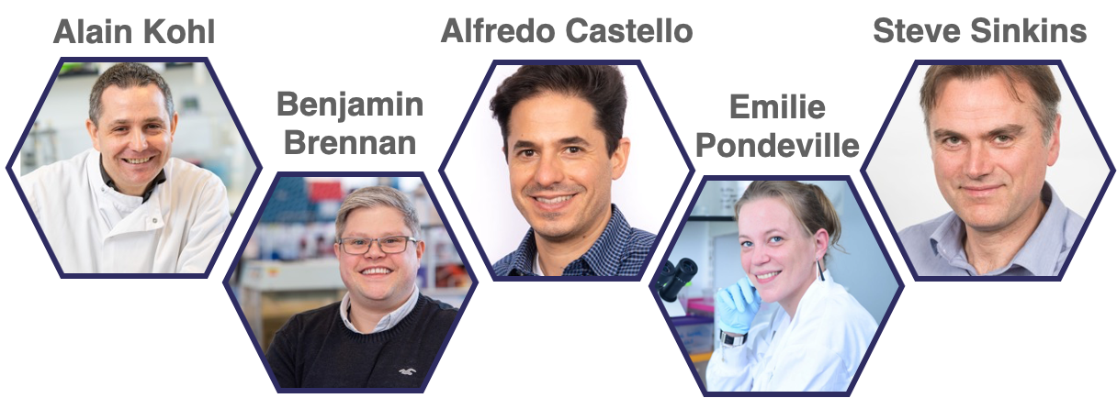
Arbovirus-vector interactions
Dengue virus
Chikungunya virus
Rift Valley fever virus
Notes:
RNA and RNA binding proteins in arbovirus vector interactions.

Slide 12
Recent highlights

Slide 13




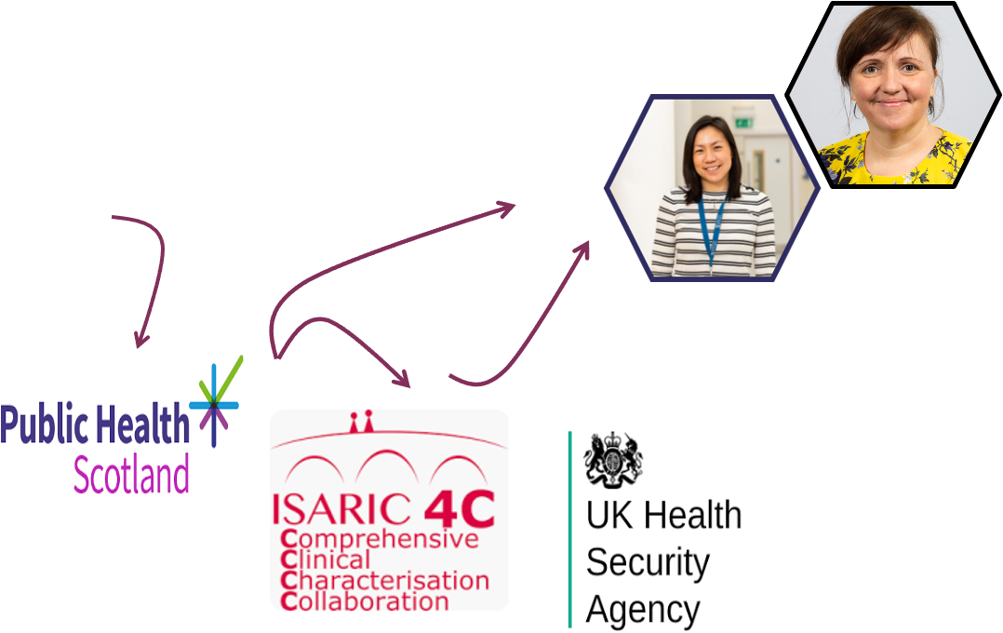
Paediatric hepatitis of unknown aetiology
MRC-University of Glasgow Centre for Virus Research
cvr.ac.uk

Slide 14
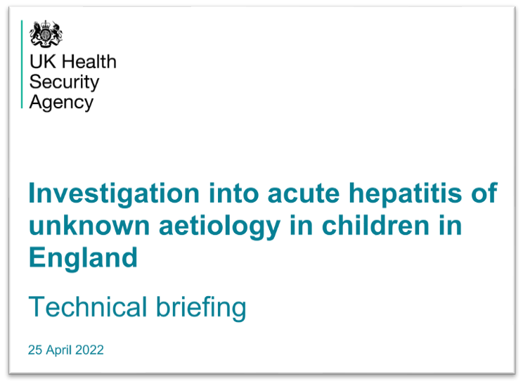
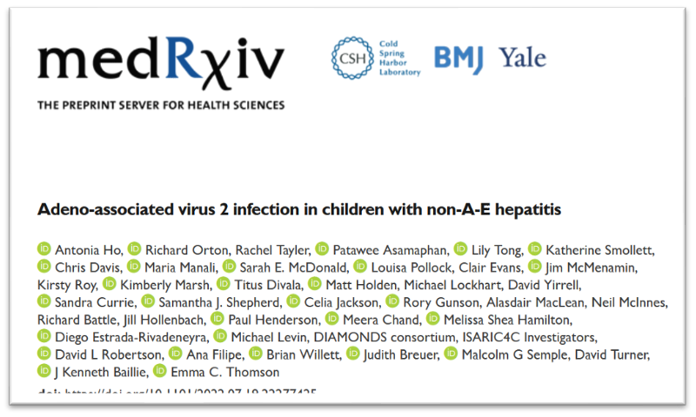

Identification of adeno-associated virus type 2
MRC-University of Glasgow Centre for Virus Research
cvr.ac.uk

Slide 15

Respiratory co-infections
MRC-University of Glasgow Centre for Virus Research
cvr.ac.uk

Slide 16
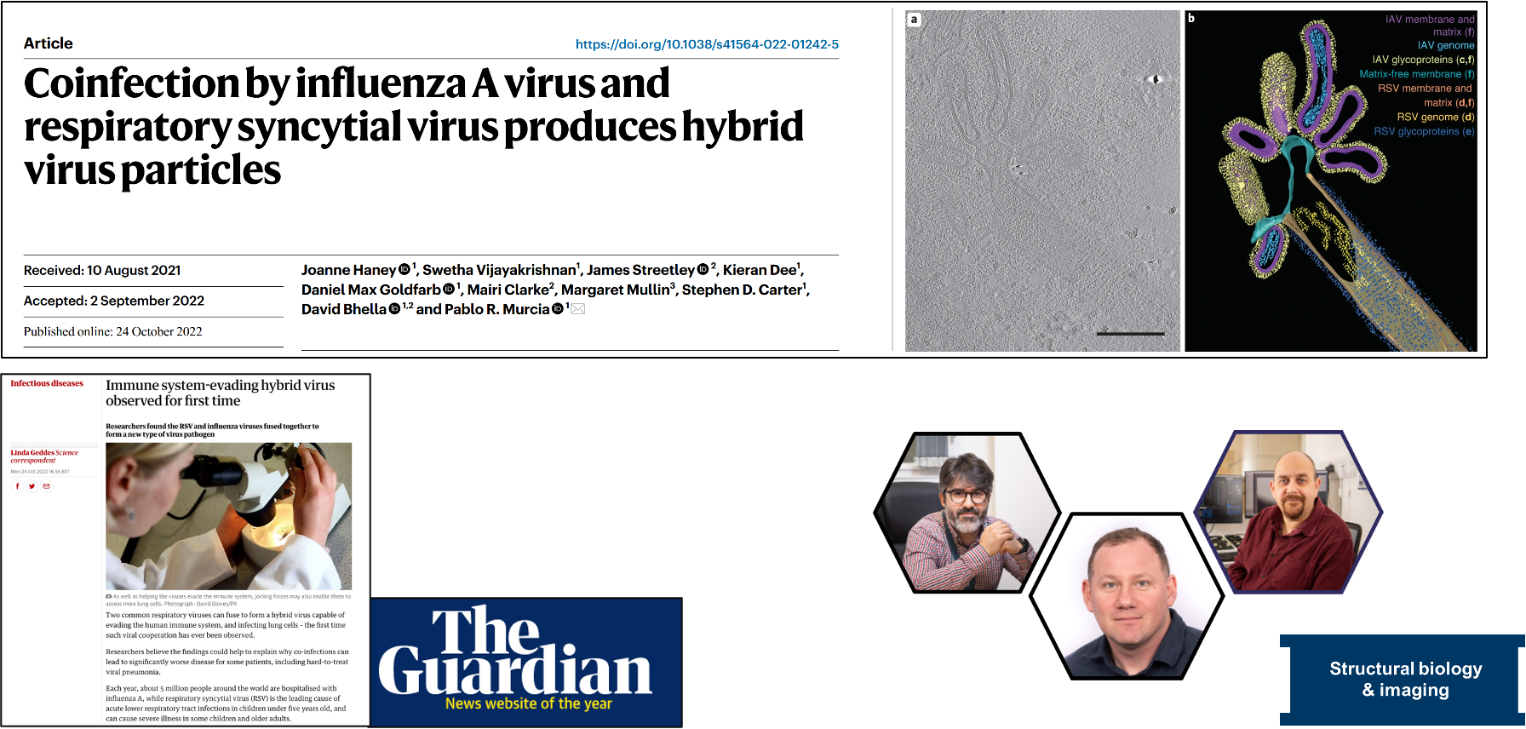
From populations to molecules
MRC-University of Glasgow Centre for Virus Research
cvr.ac.uk

Slide 17
Summary
The CVR is an MRC funded research institute
Research interests span structural/molecular through to clinical/epidemiological
Focus is on viruses that infect humans and viruses at the animal/human interface
We aim to become the UK’s national research institute for virus research
MRC-University of Glasgow Centre for Virus Research
cvr.ac.uk

