Slide 1
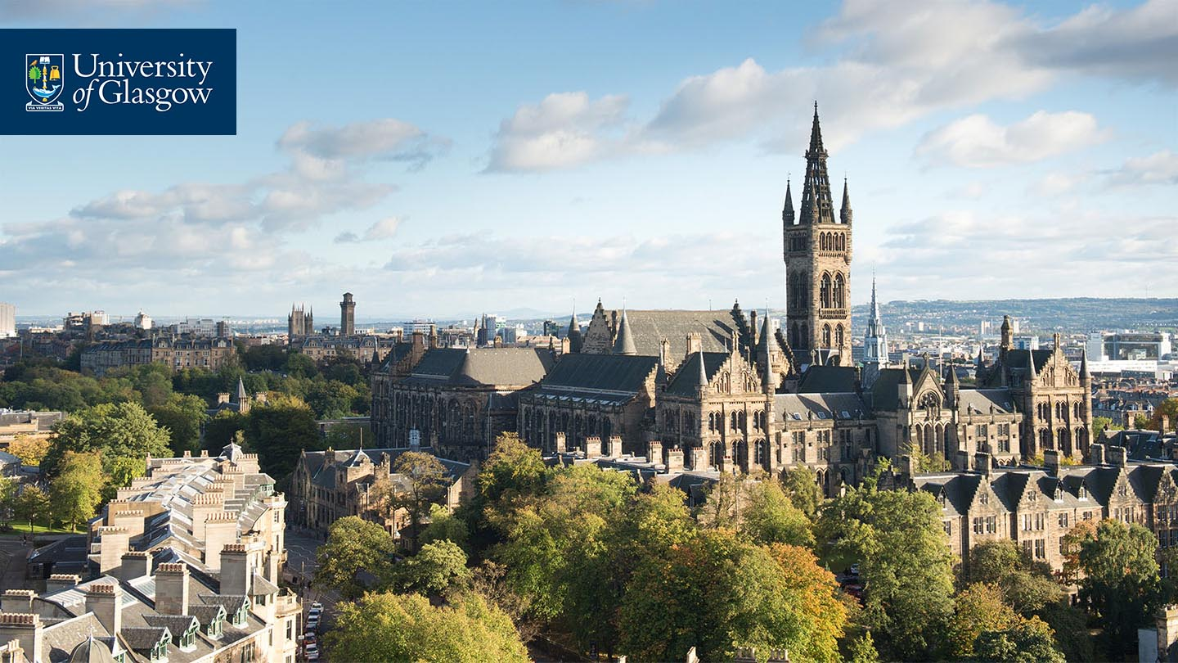

Parasitology

Slide 2

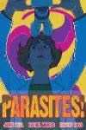





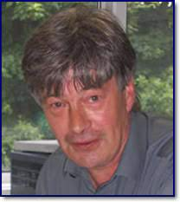
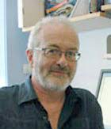
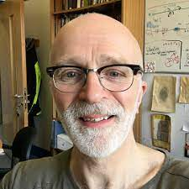
Glasgow has a long history in parasitology and remains a global hub
resources
networks
teaching
conferences
outreach
Mike Barrett
36 years of support for parasitology research in Glasgow
1987
1999
2019
Wellcome Unit for Molecular Parasitology
Wellcome Centre for Molecular Parasitology
?
Andy Tait
Dave Barry
Andy Waters

Slide 3
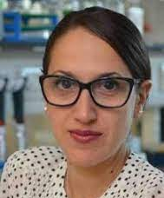
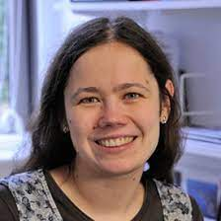
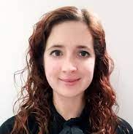
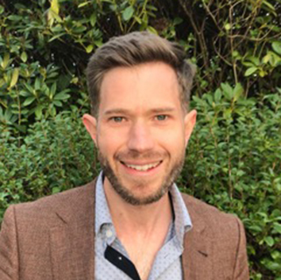
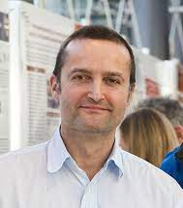
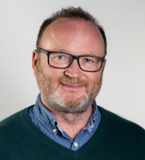
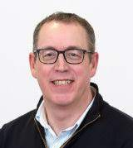
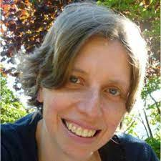
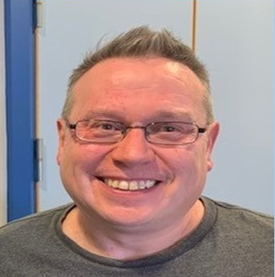
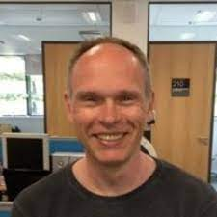
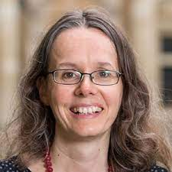
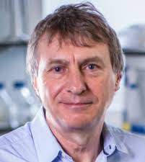
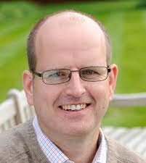
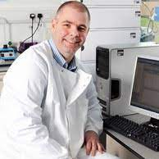
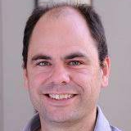
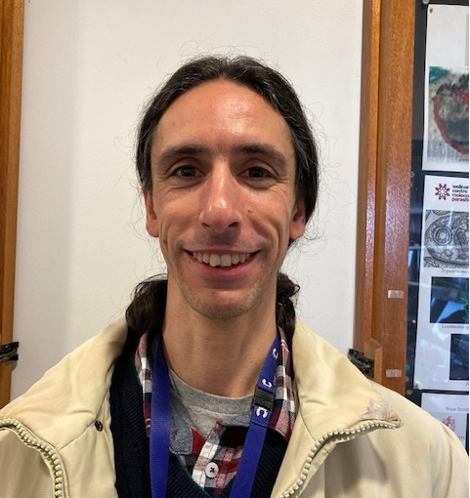
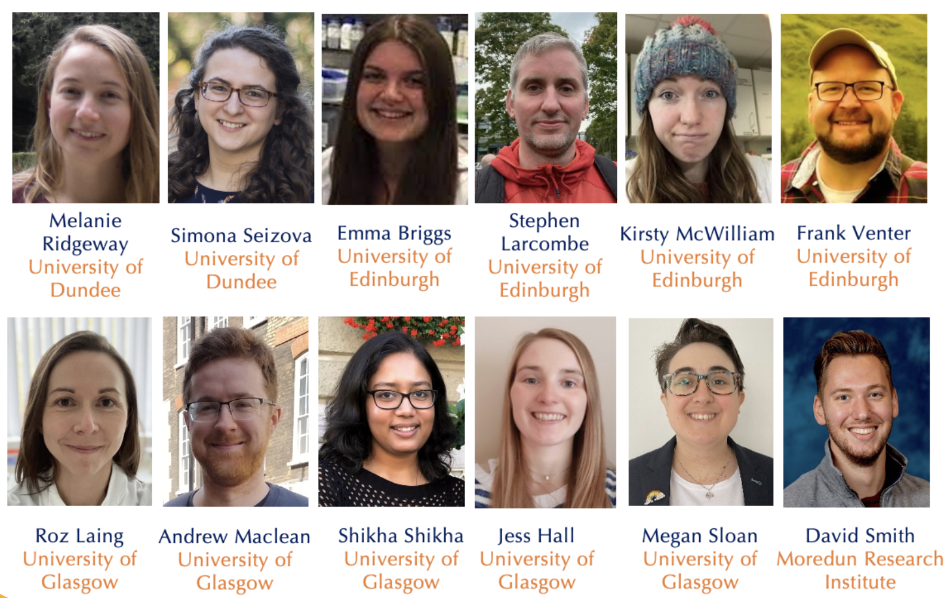
Parasitology research within
sII
sBOHVM
Apicomplexa
V
B
I
P
P
Kinetoplastida
WCIP
Helminths
sHW
sMB
Introducing some of the next generation….
early career fellows
Emma Briggs
Andrew MacLean
Megan Sloan

Slide 4
Emma Briggs

Slide 5
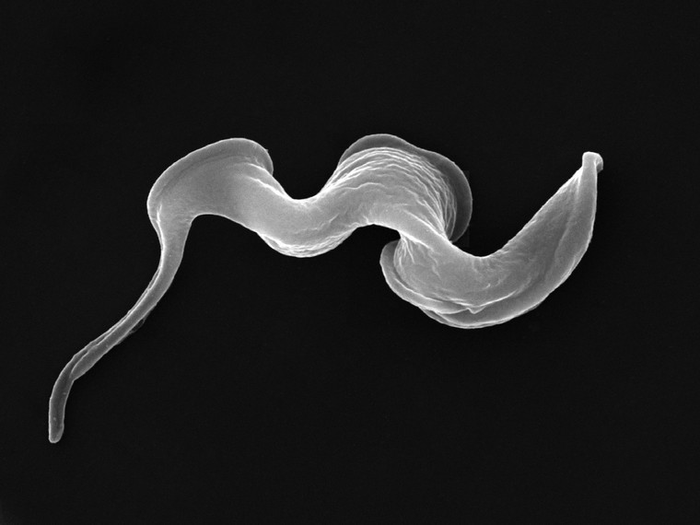
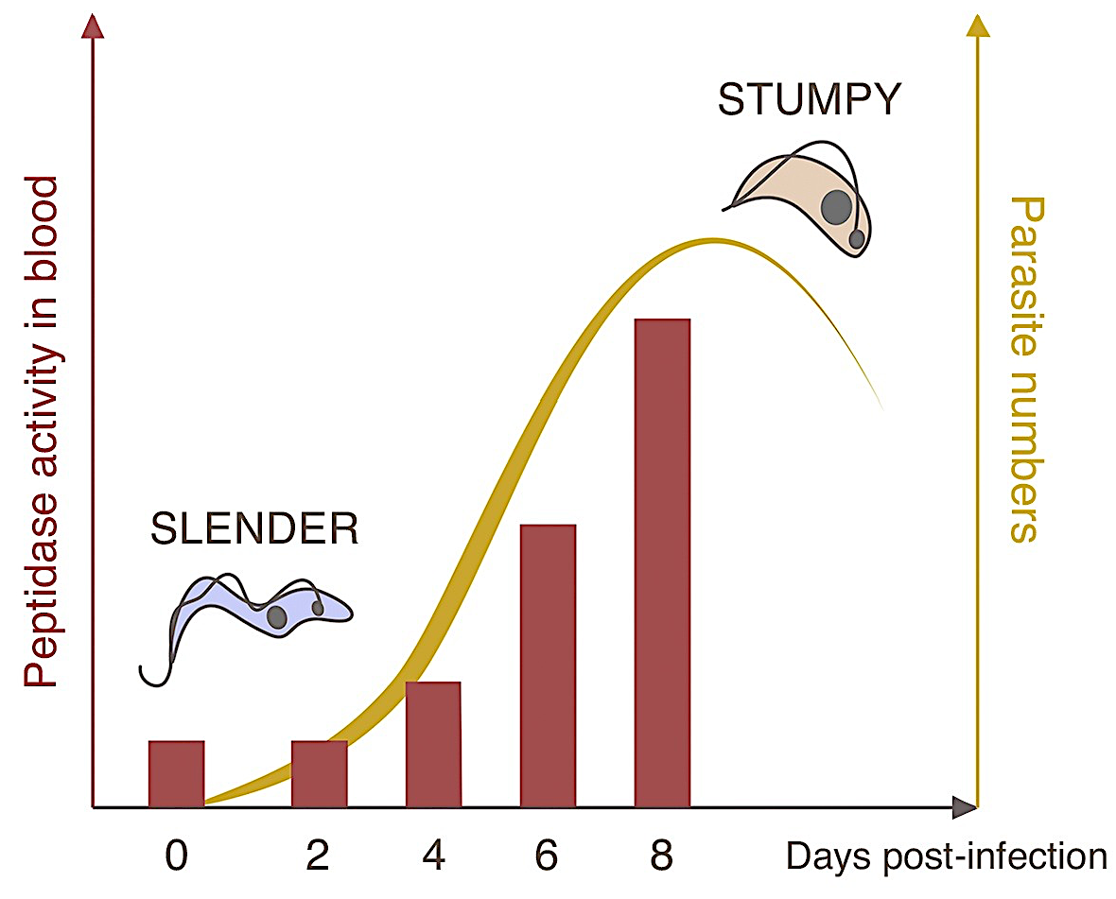
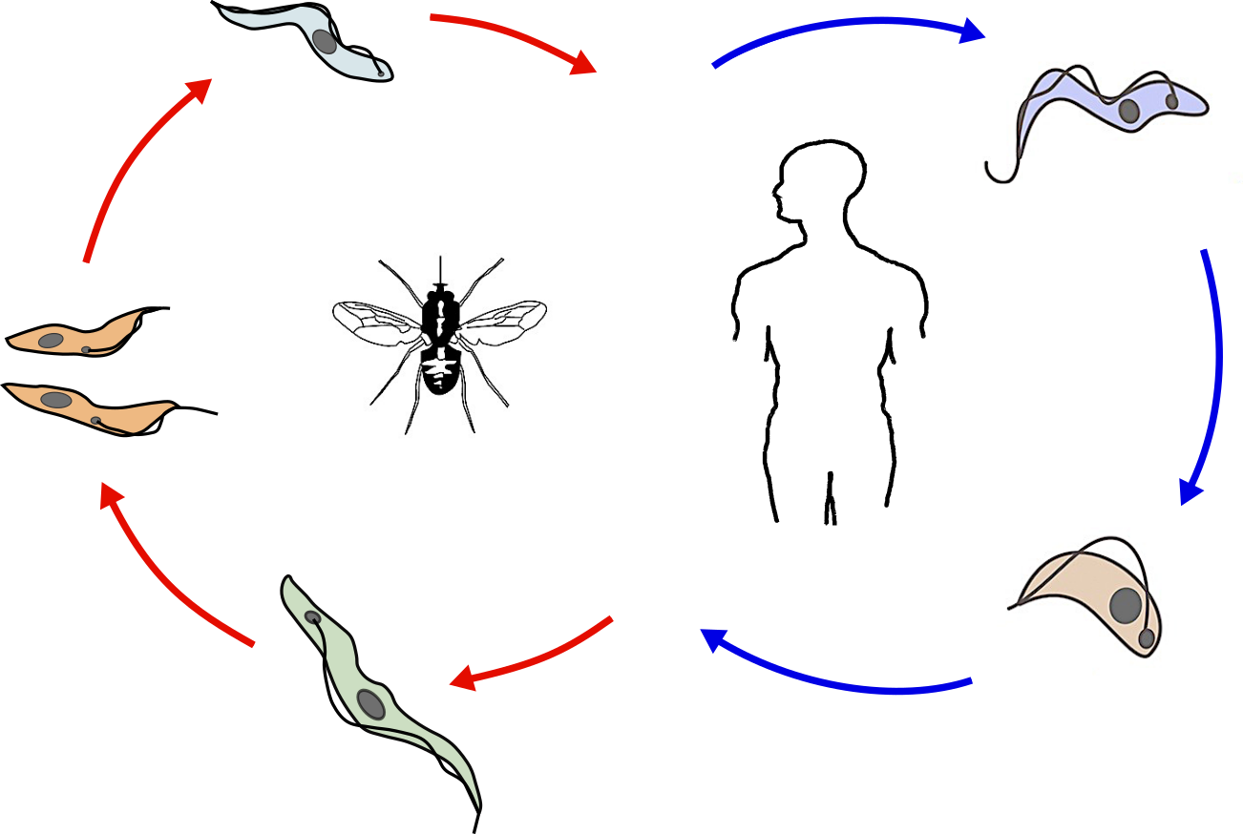
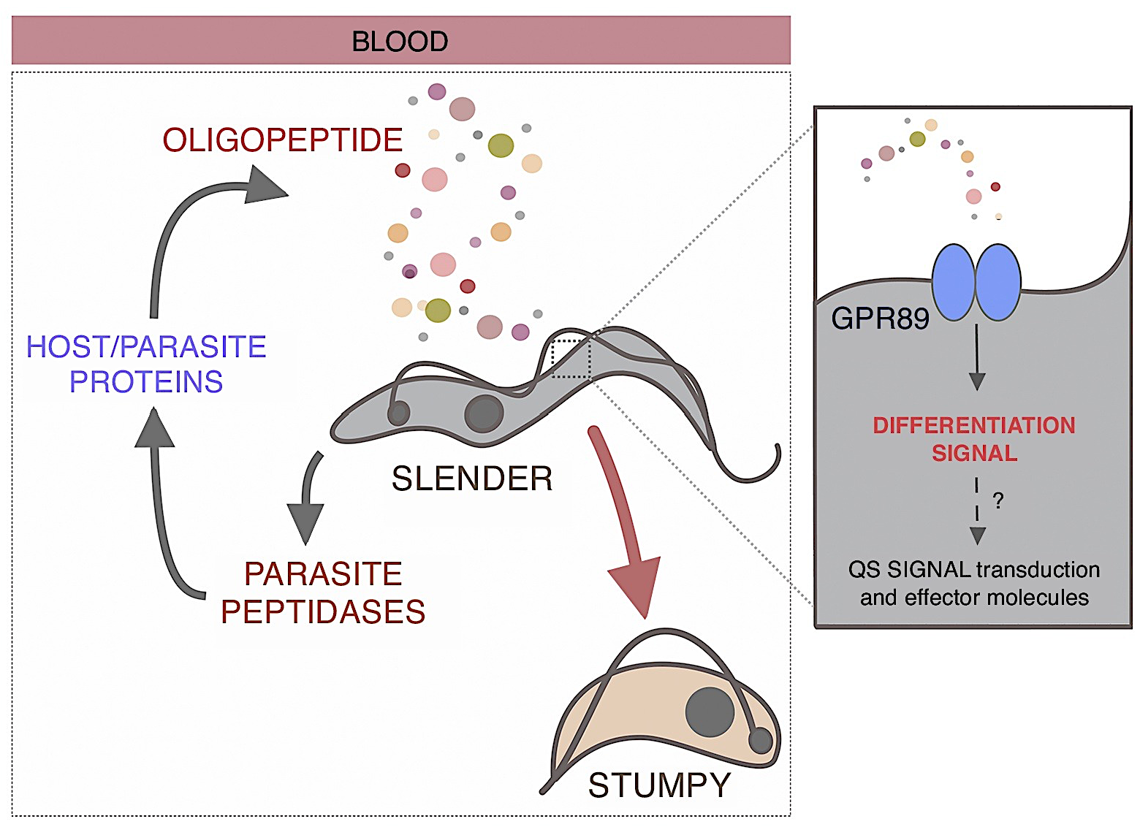
Deciphering developmental commitment in African trypanosomes
Quorum sensing
Slender
bloodstream
parasite peptidases
host/parasite proteins
oligopeptides
parasite numbers
oligopeptides
(Rojas et al. Cell 2019)
infection progression
Tsetse
?
gene expression changes
Stumpy
bloodstream
What are the signal transduction and effector molecules?
GPR89
-Irreversible cell cycle arrest
-Transmissible
Population-based methods are not applicable

Slide 6

Application of single-cell transcriptomics to resolve asynchronous differentiation
Matthews
Thomas Otto
Matthews
- Trypanosome differentiation expert
- Computational biologist
- Applying single-cell genomics across systems
- Deletion, RNAi, overexpression
?
Validate the roles of signal transduction and effector proteins
Differential expression
Asynchronously differentiating T. brucei
Single-cell RNA-sequencing
Clustering and trajectory inference
RBP
Gene network inference
Investigate RNA binding proteins
Expected outcomes
Future directions
- A trajectory of gene expression changes during differentiation
- Identification of the sequential roles of signal transduction and effector molecules
- Is this process conserved in other species?
- Is this process targetable for intervention?
- Expand approach to target more challenging differentiation events

Slide 7
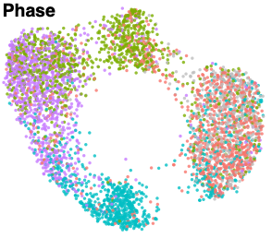
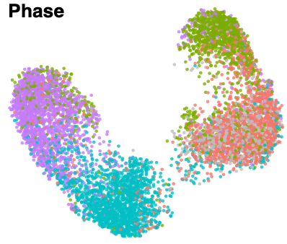
New direction.. how do African trypanosomes regulate cell cycle exit to G0
Briggs et al (2021) Nature Communications
How is cell cycle commitment regulated?
Does the African Trypanosome cell cycle have a “restriction point”?
Mining data sets for putative regulators
Developing a fluorescent cell cycle report system
cell cycle phase
early G1
UMAP 2
late G1
S
G2M
G0
UMAP 1
Resolving the cell cycles of slender and procyclic forms
Briggs et al (2023) BioRxiv
dot1a
orc1b

Slide 8
Andrew MacLean

Slide 9
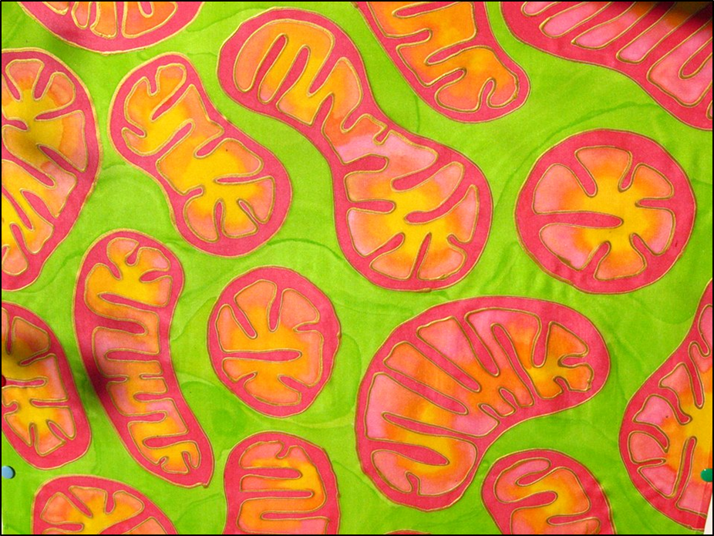
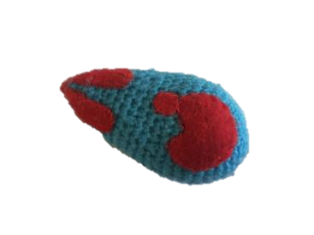


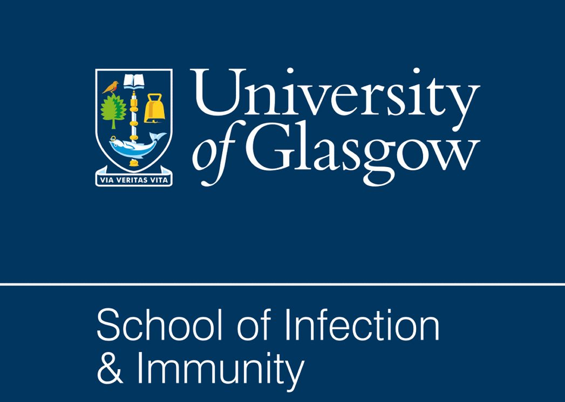

Exploring the divergent respiratory complexes in Toxoplasma parasites
Dr Andrew Maclean
Sir Henry Wellcome Postdoc Fellow, WCIP
SII away day
17th January 2023
Art by Odra Noel

Slide 10
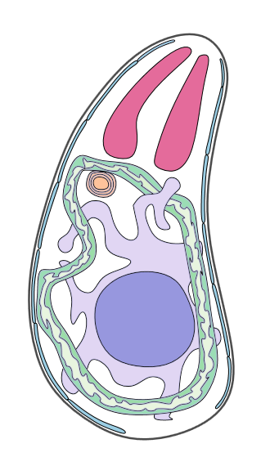
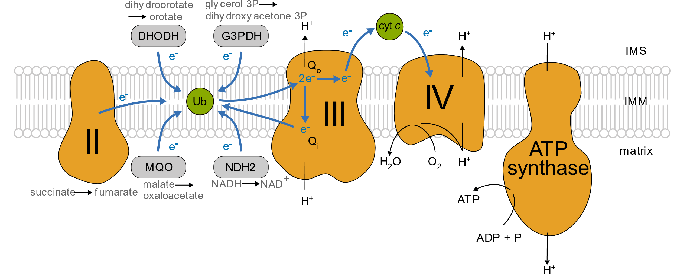
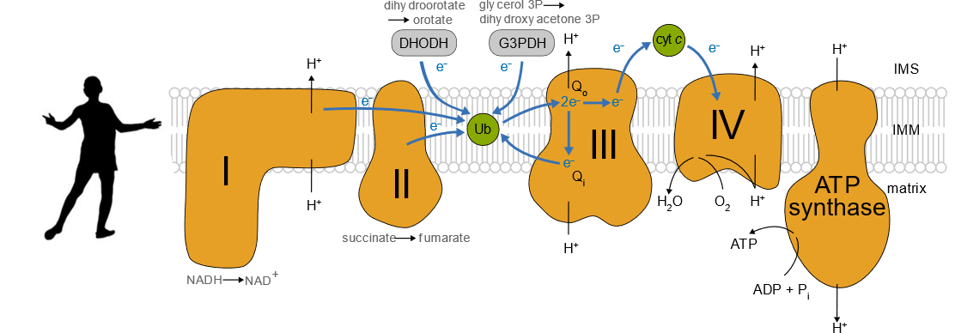
Apicomplexans have a divergent respiratory chain
Toxoplasma mitochondrial respiratory chain
Toxoplasma tachyzoite cell
What is the composition of the mETC?

Slide 11
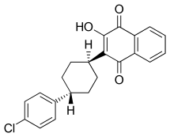
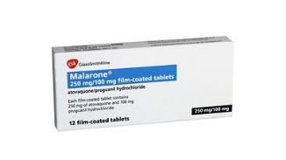
Apicomplexans have a divergent respiratory chain
Atovaquone
Buparvaquone
4-pyridines
Endochin-like quinones Decoquinate
Toxoplasma tachyzoite cell
Can we improve anti-apicomplexan drugs?

Slide 12
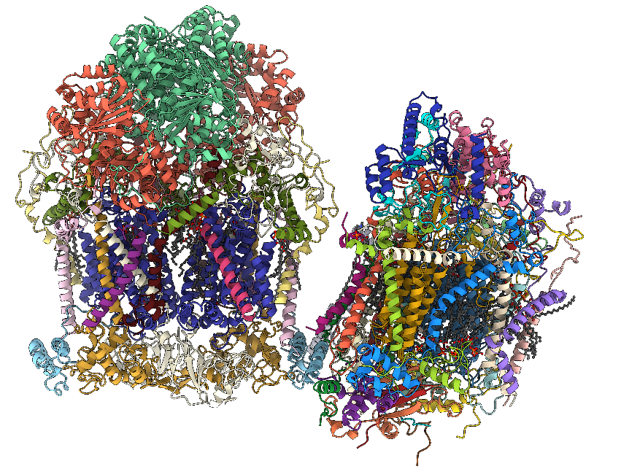
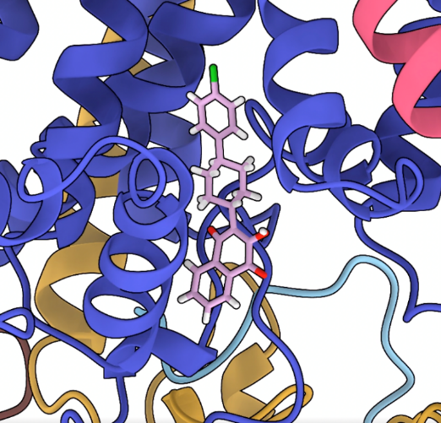
Cryo-EM structure of Toxoplasma respiratory complexes
Structure of respiratory
supercomplex
Inhibitor bound structure of complex III
Complex III₂
Complex IV
Atovaquone
Structural studies allow insight into parasite specific features and the mechanistic details of inhibitor binding.

Slide 13

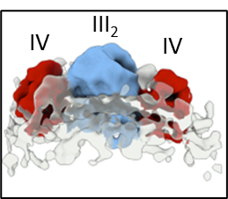

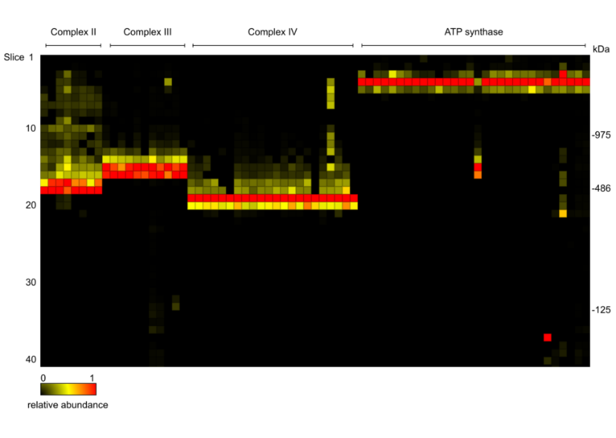
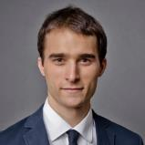
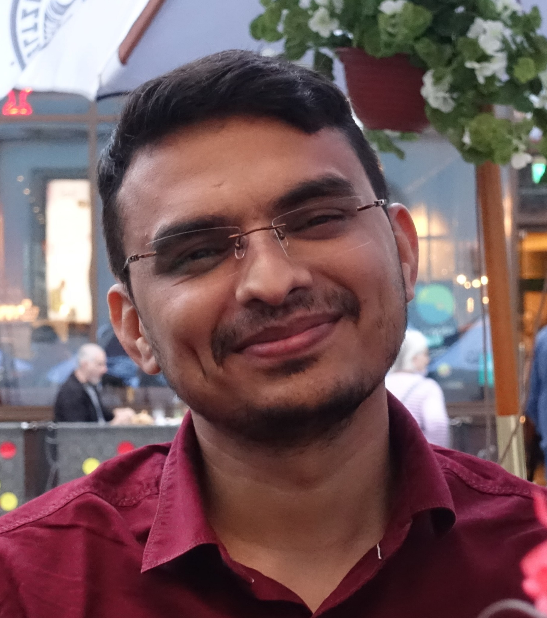
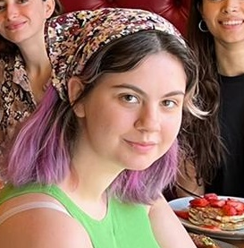
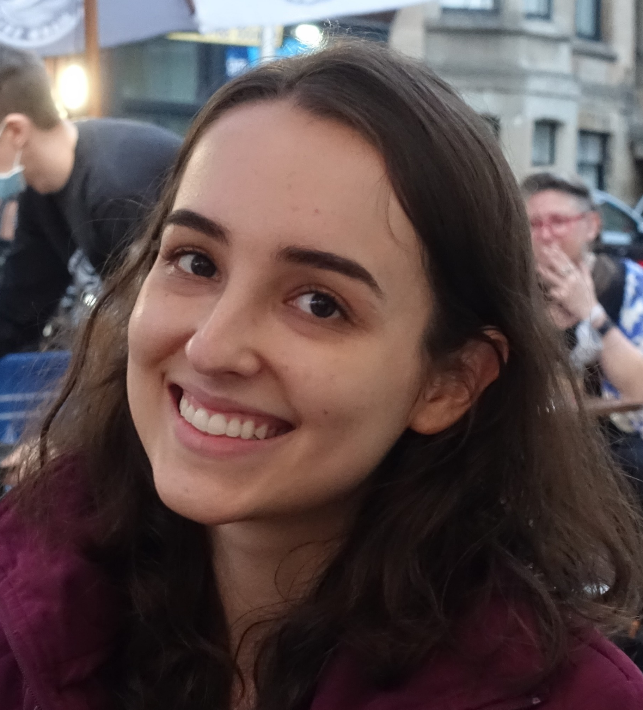

The story so far….
Understand the role of supercomplexes in different life stages
What is the subunit composition of the parasite respiratory chain?
Use structural insights to understand inhibitor binding
Structural studies of Toxoplasma respiratory complexes
Past
Present
Future
@AndrewEMaclean @SheinerLab
Structural studies of complex II
Studies in Plasmodium
Understanding the role of complex II
Alexander Műhleip,
WCIP fellow
Identified 71 subunits using complexome profiling
Dr Pradeep
Sheokand
Kiera Douglas, Wellcome PhD student
Dr Mariana Ferreira Silva

Slide 14




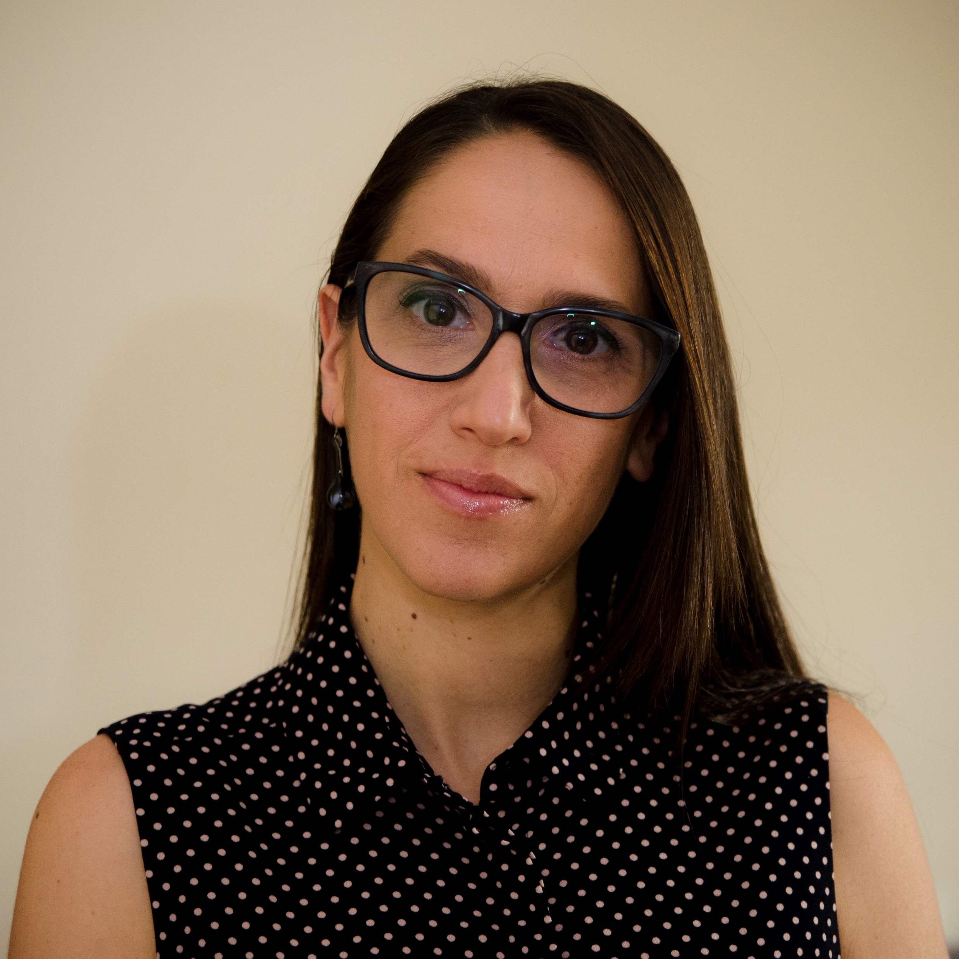

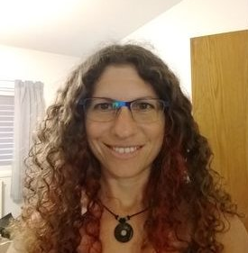
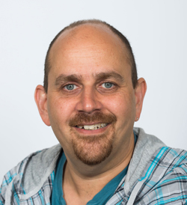

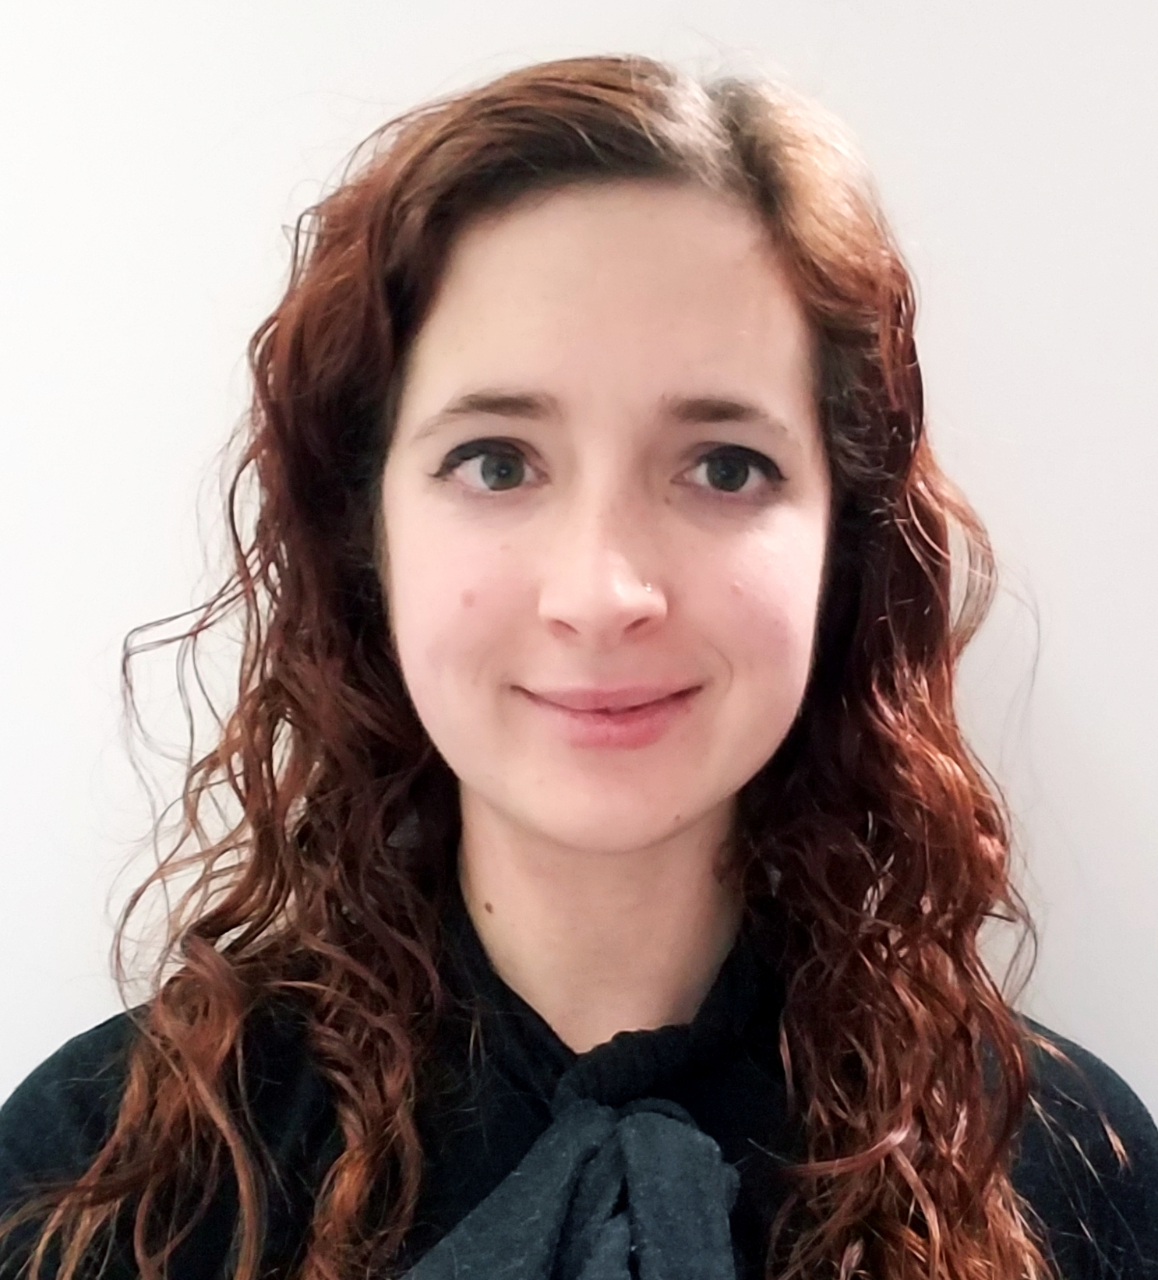
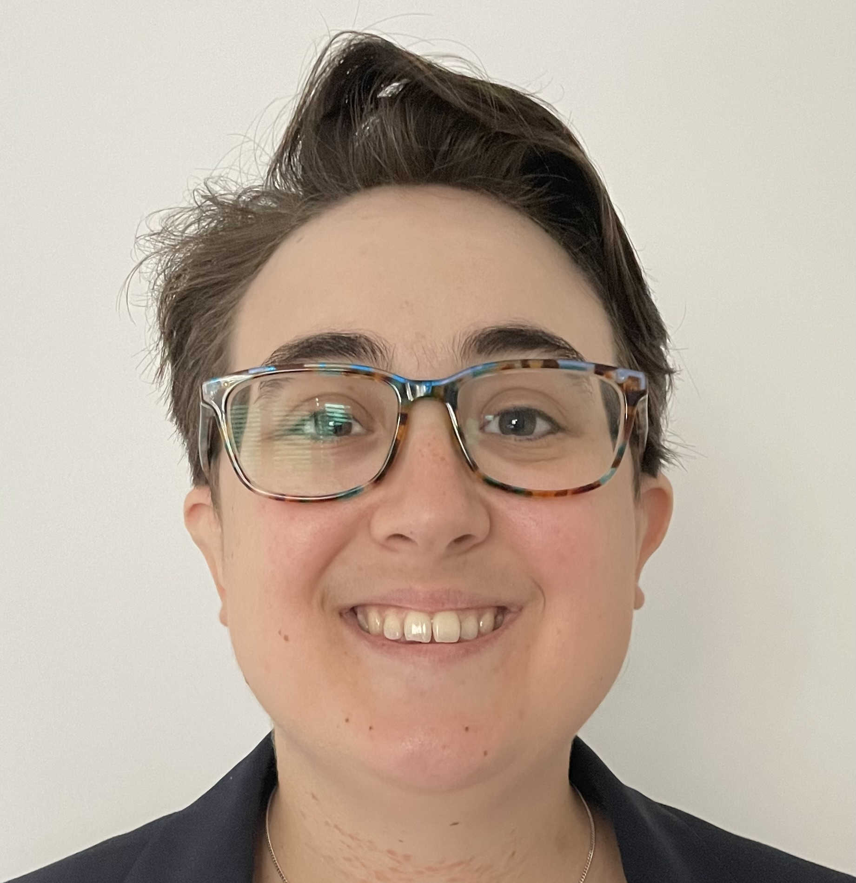
A great research environment at the SII and WCIP
Critical mass of parasitology researchers
Research support and access to cutting-edge facilities
Dr Alexander Műhleip,
WCIP fellow
Dr Amit Meir, CVR
Prof. David Bhella, CVR & SCMI
Funding support
Dr Megan Sloan,
Wellcome ECA fellow
Dr Mariana Ferreira Silva, Dr Pradeep Sheokand, Keira Douglas

