Slide 1
Overview: Clinical Strategy
Tom Evans

Slide 2
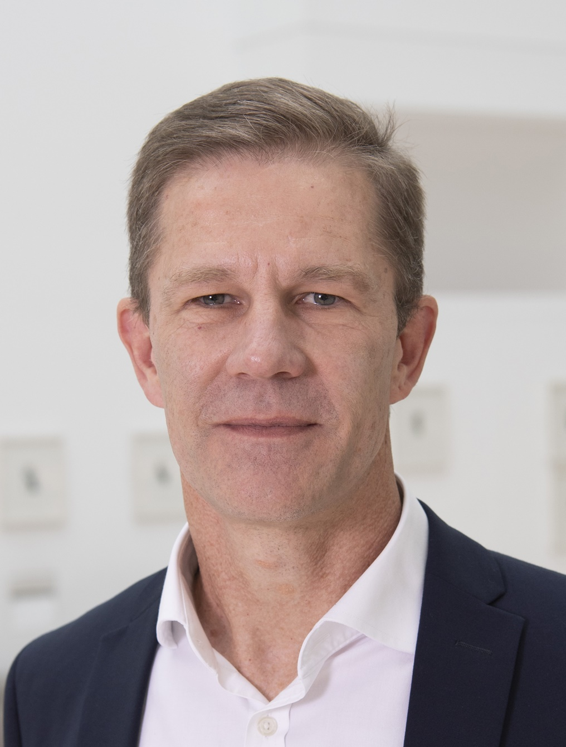
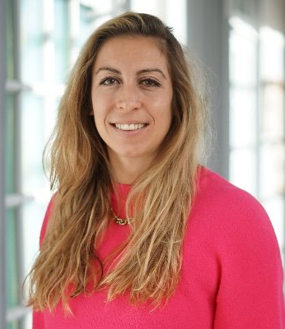
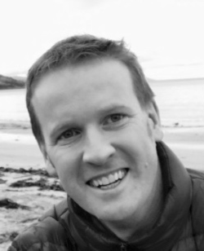
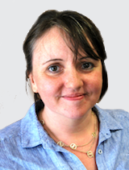
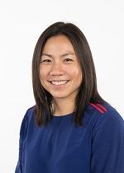
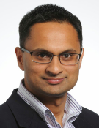
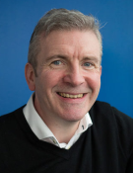
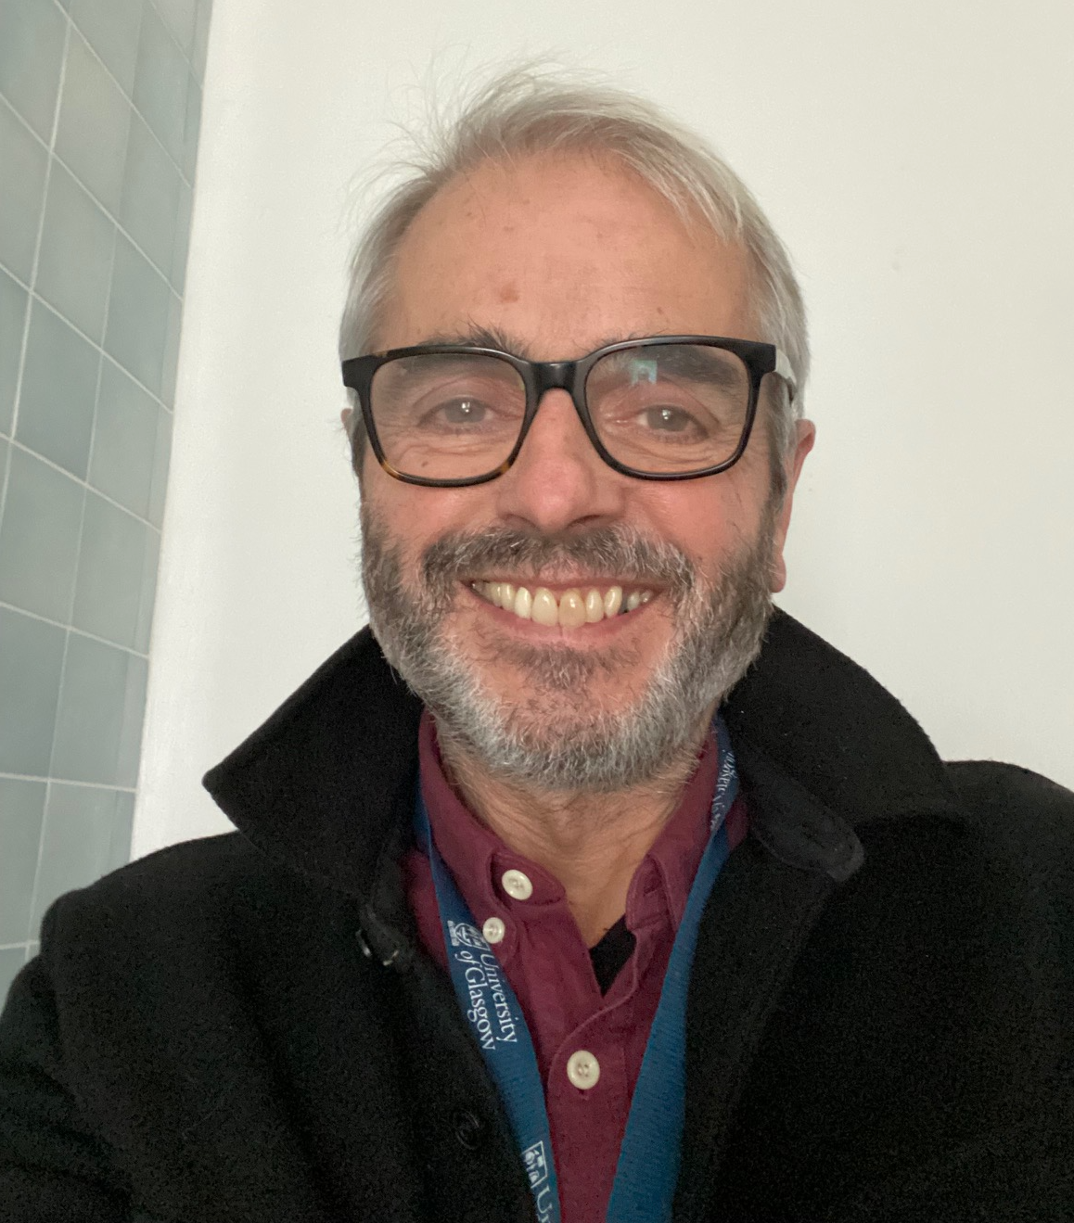
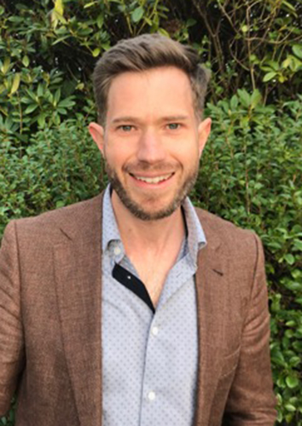
Who are we?
Stefan Siebert
Aurelie Najm
Neil Millar
Emma Thomson
Toni Ho
Neil Basu
Jonathan Cavanagh
Tom Evans
Chris Moxon

Slide 3
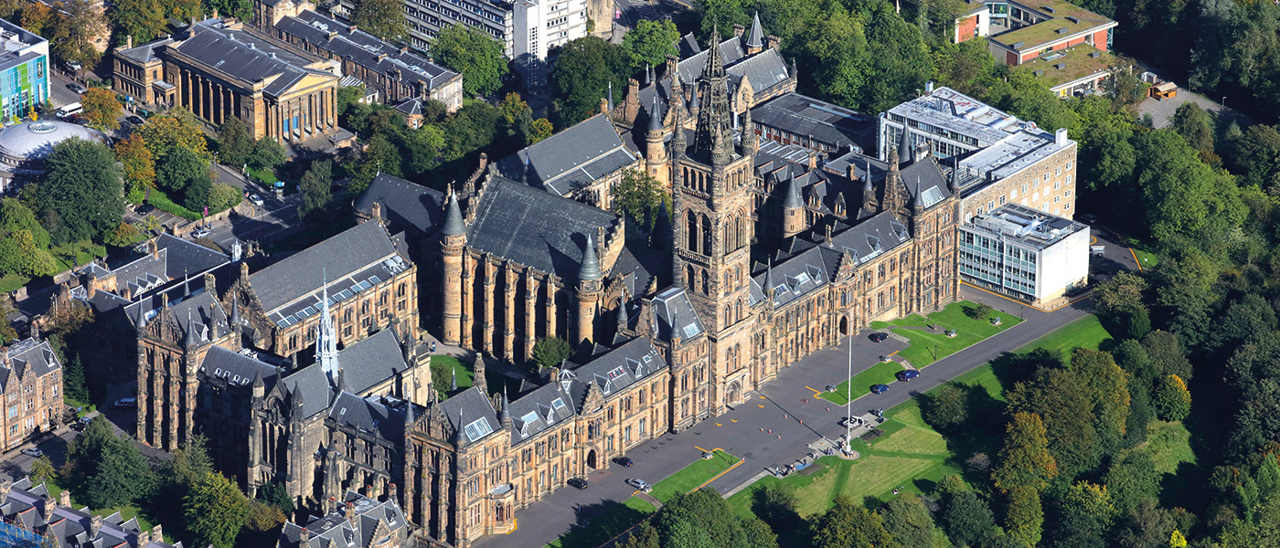
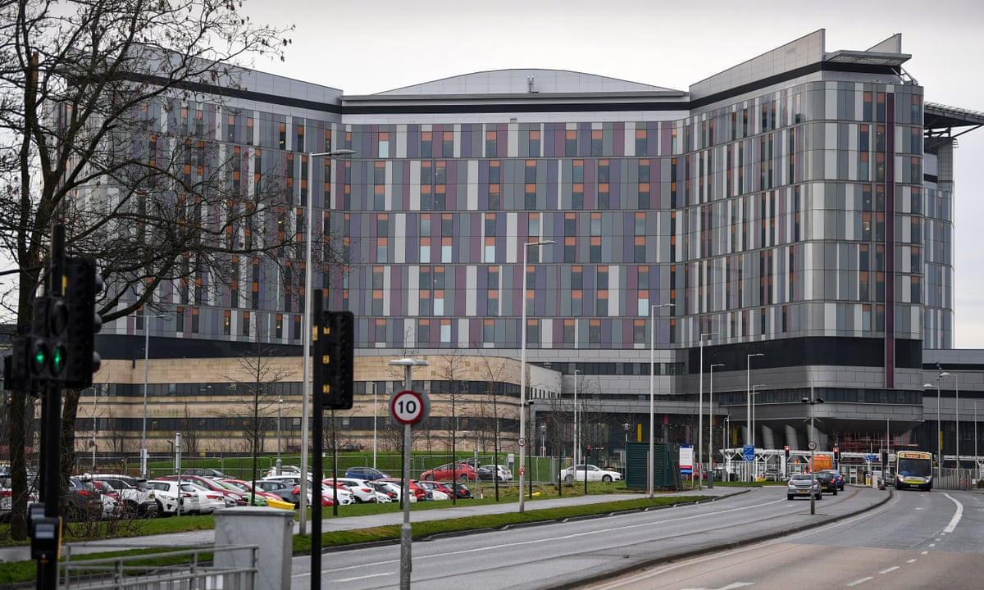
What do we do ?
University
National Health Service
Joint activities
Academics within the School
Clinical Responsibilities within the NHS, including out of hours work

Slide 4

What is our Vision?
To promote clinically based research within the School and elsewhere in MVLS
To provide clinical expertise to teaching within the School as well as other Schools within MVLS
To promote broader research interaction with clinicians more generally within Greater Glasgow and Clyde Health Board
To be powerful advocates for academic clinical medicine

Slide 5
What are the Opportunities?
Opportunities to obtain funding for clinically relevant projects (laboratory or informatic based) and other translational funding initiatives
Support clinical lecturers who can be funded to spend 1 day a week in a research group
Possibility of clinical PhD training (support funder dependent but local opportunities also e.g. TRAM Scheme for musculoskeletal research)
UK Biobank
Range of clinical and diagnostic material

Slide 6
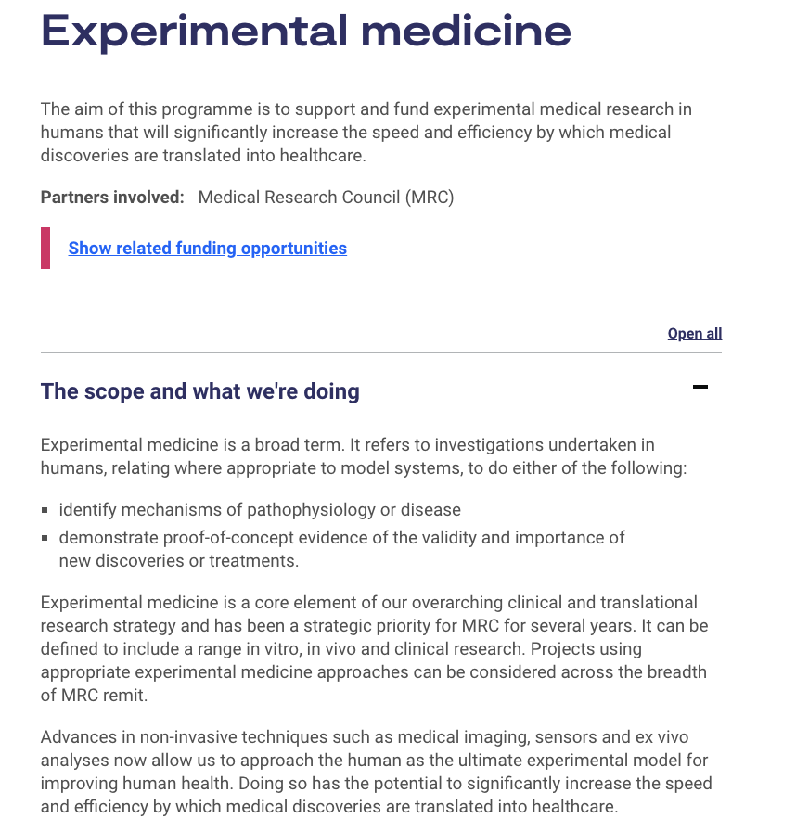
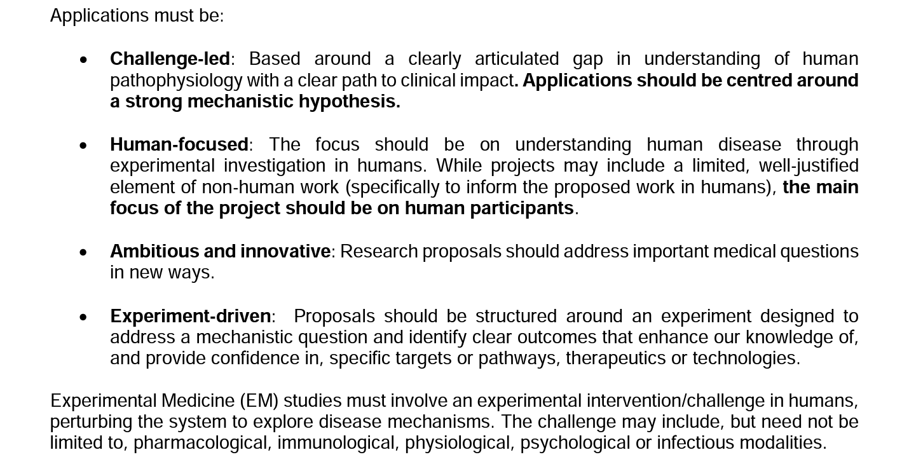
Example: UKRI/MRC Grants for Experimental Medicine
Jonathan Cavanagh

Slide 7
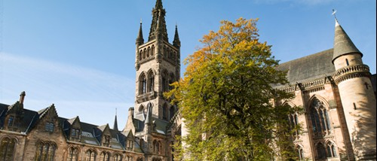
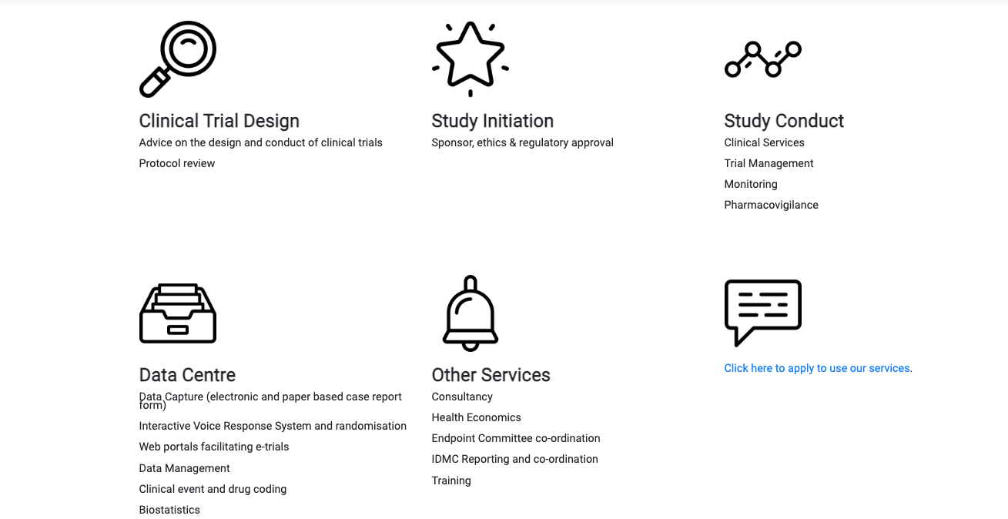
Example: Glasgow Clinical Trials Unit
Stefan Siebert
https://www.glasgowctu.org/Home/about-us/

Slide 8

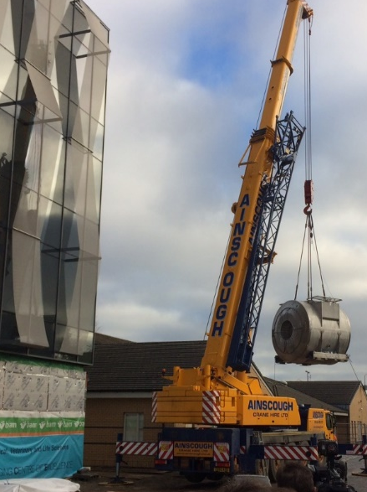
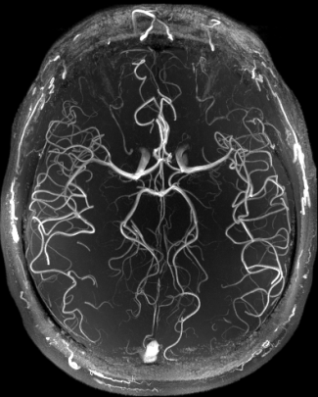
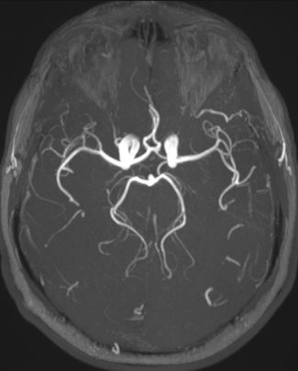
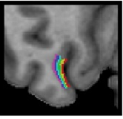

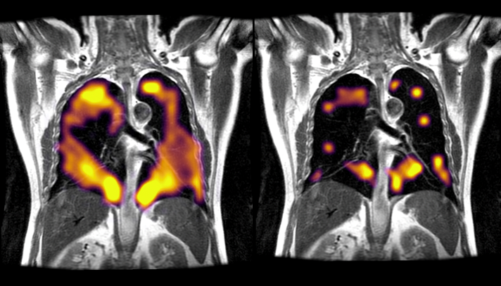
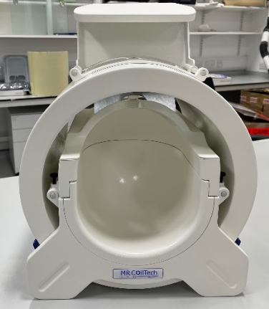
Example: 7T scanner at QEUH –
Basic Science & Innovation & Clinical mechanism – Scientific, societal and economic benefits
Siemens Terra delivered Nov 2016
7 Tesla
3 Tesla
Clinical research: Delivering enhanced diagnostics and transformational prognostic precision medicine
Fundamental research: Layer-specific fMRI to elucidate brain mechanisms
(UoG hosted 2022 Human Brain Mapping conference,
2,700 international delegates)
State-of-the-art technologies. Specialised RF coil developments improve image quality and extend 7T to image body regions not covered by commercial options
Building coils for all three of the world’s high-field 11.5T MRI systems (Boston, Paris, Nottingham)
Metabolic Imaging
Neil Basu
Notes:
Doesn’t only offer superior structural characterisation to enable classical diagnosis, but brings opportunities for metabolic imaging for mechanistic questions

Slide 9
End Note
Please contact any of us to discuss your ideas/ possibilities for research funding with a clinical emphasis
Plenty of opportunities for using human studies to explore fundamental biological mechanisms
High impact of studies of direct relevance to human disease

