Slide 1

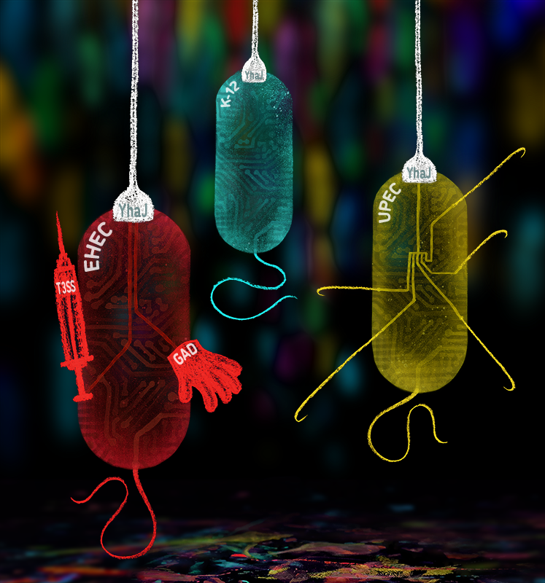
Bacteriology: past, present and future
Dr Dónal Wall
Professor Andrew J Roe

Slide 2
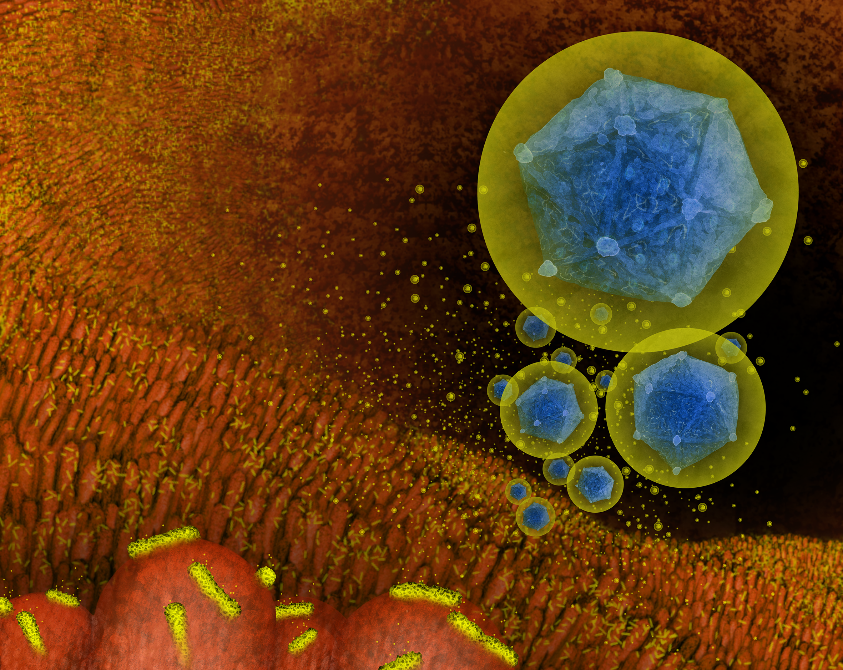
Bacteriology: past, present and future
Update on Bacteriology Dept. at present
Challenges and opportunities
Initiatives up and running
Securing the future of Bacteriology
Dr Dónal Wall

Slide 3
Bacteriology: past and present - Transition
Staff levels
Research active staff
Staff from the School
Period of transition for the Dept.
Need to re-establish solid research base
Recruitment of new PIs is crucial
Notes:
Knock on effects – no seminars, no external speakers as numbers are too low, negative effects on PhD training etc.

Slide 4
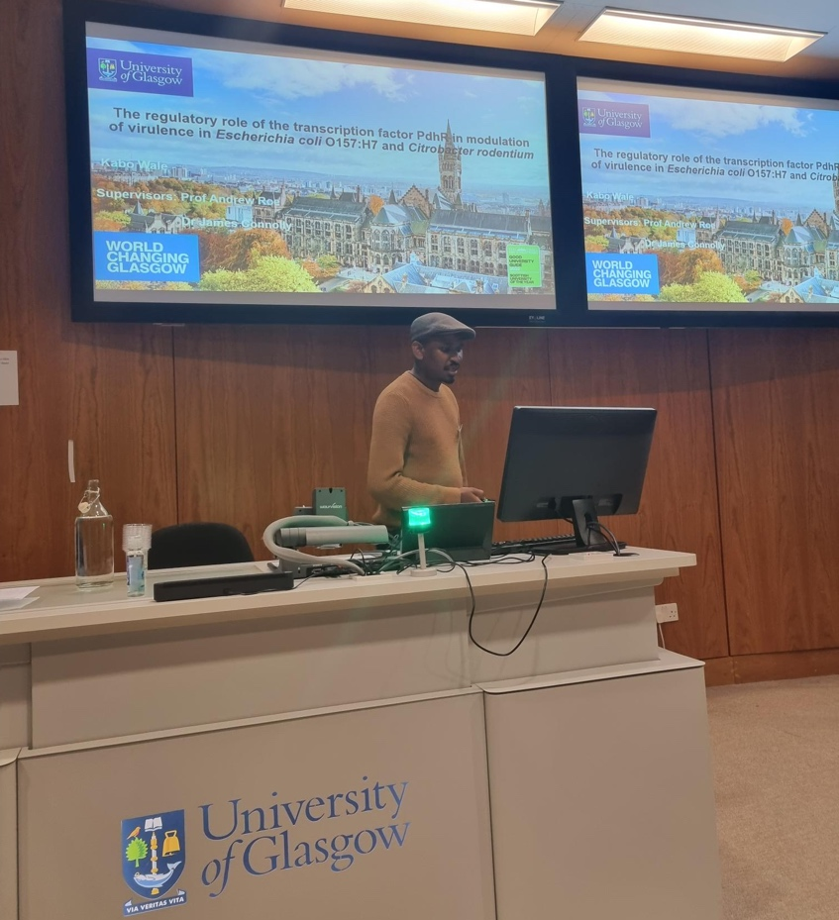
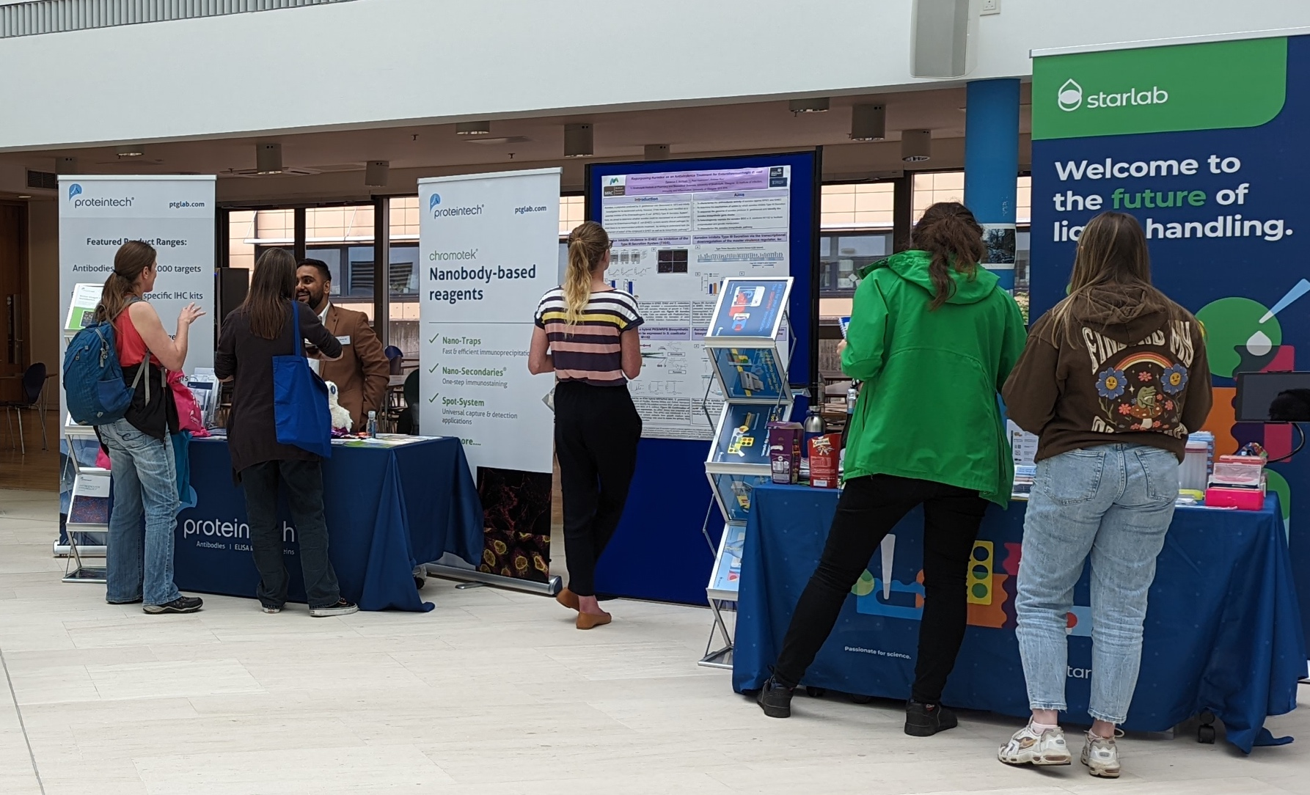
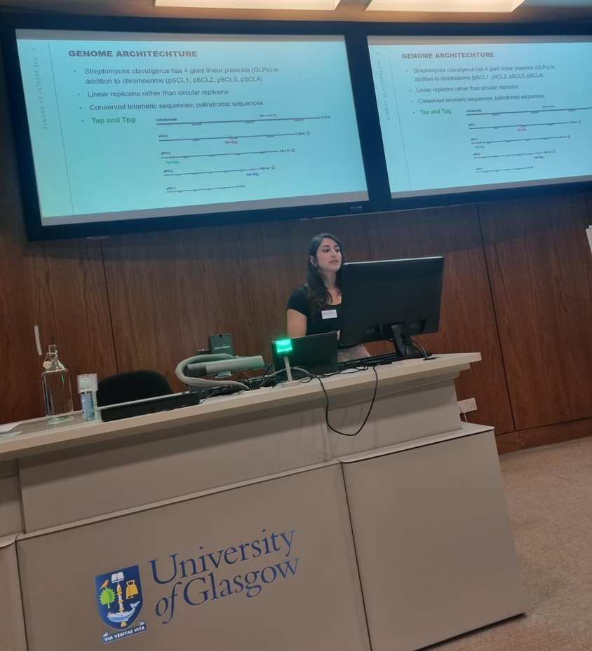
Bacteriology: present – GMC 2022
Glasgow Microbiology Collective
organised by research fellow Hua Wang
with SIPBS at Strathclyde University
source of collaborations, funding and training
Notes:
Brings in external speakers
Training opportunities for PhDs to give seminars

Slide 5

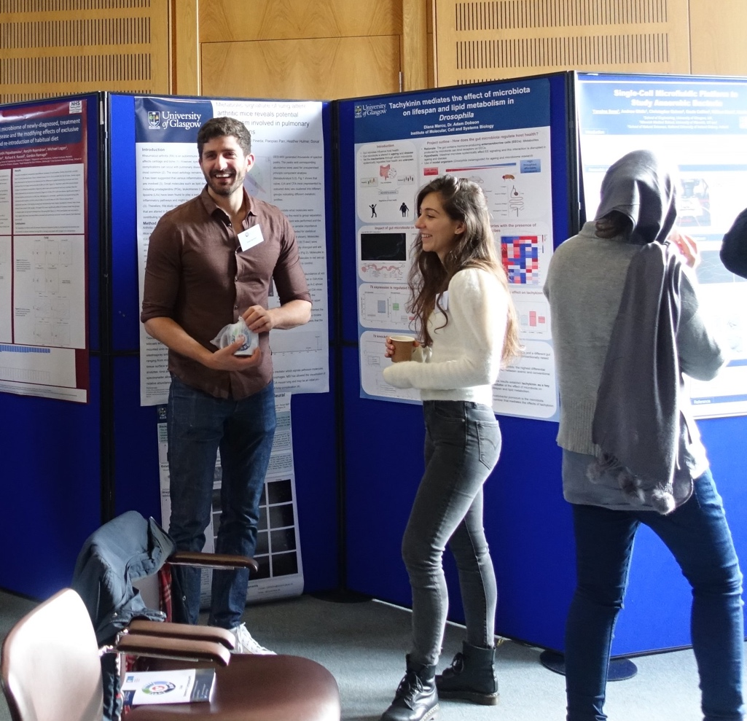
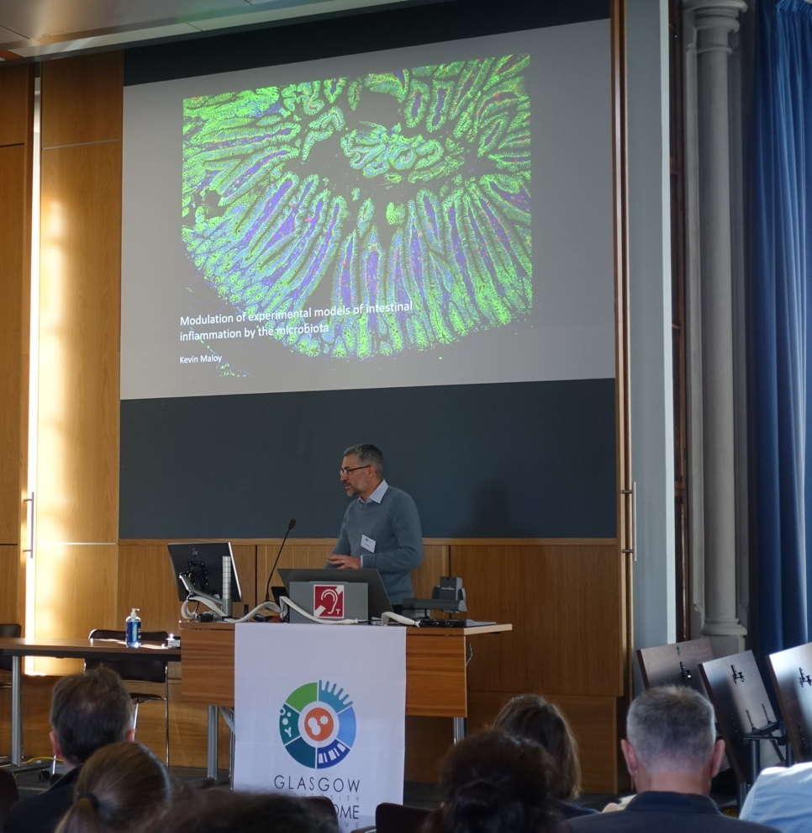
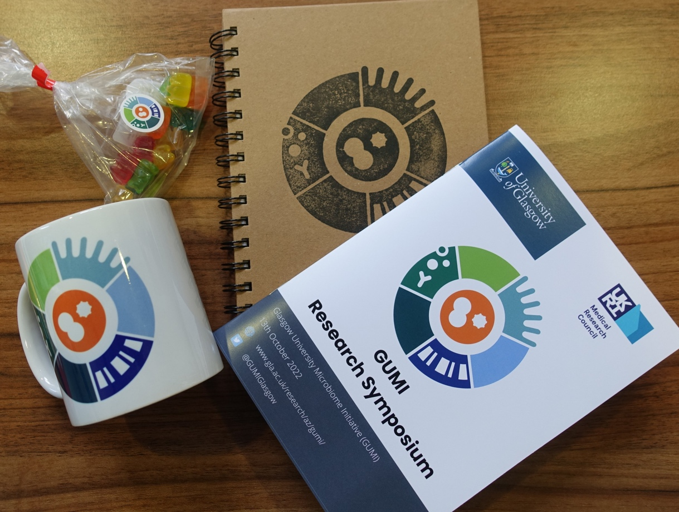
Bacteriology: present - GUMI
Glasgow University Microbiome Initiative
40 research groups across academia, NHS and industry
  including microbiology, cancer, infection, AMR, biochemistry, nutrition, epigenetics
Response to UKRI Microbiome Capacity report
First MRC CiC funded Symposium in October

Slide 6



Bacteriology: present - GUMI
Training opportunities
  Microbiome Data Analysis Workshop
  Introduction to R
Seminar series
Improve and retain links to industry
Expand spatial biology/microbiome studies
Current models DSS, CIA, GF and infection-based
Notes:
Microbiome industry link up will happen in Glasgow in March

Slide 7
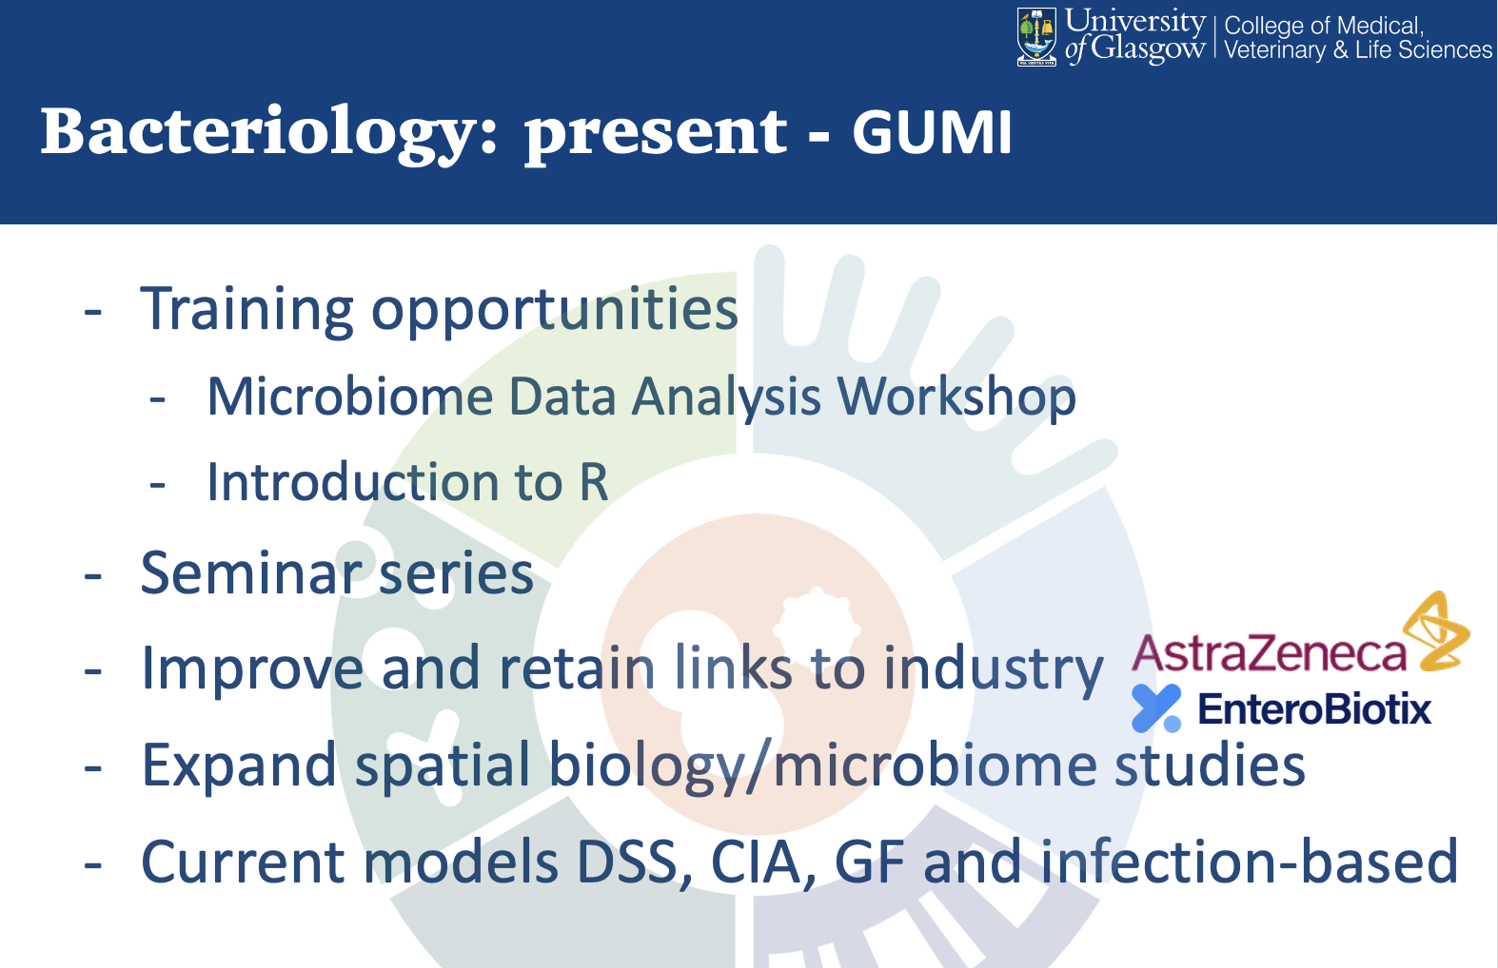
Prof Andrew Roe
- Research developments and areas of investment-

Slide 8


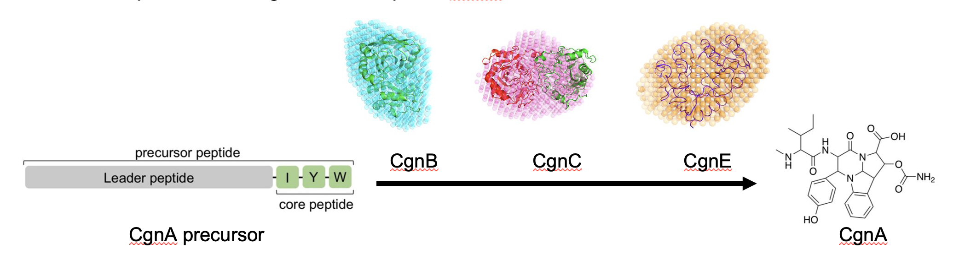
Strong collaborations with chemistry
BBSRC grant (Koehnke/Byron/UoLeeds)
MRC grant (Roe/Douce/France)
Development of novel for
hard to treat bacterial infections
Purification and modification of polyketide
antibiotics to block virulence
Ribosomally synthesised & post-translationally modified peptides (RiPPs) – antiviral / antibiotic​
Synthesised by RiPP complexes (RBCs)​
Better understanding of dynamics & structures of RBCs
To advance enzyme engineering efforts for production of high-value therapeutic RiPPs
Image by Eliza Wolfson

Slide 9

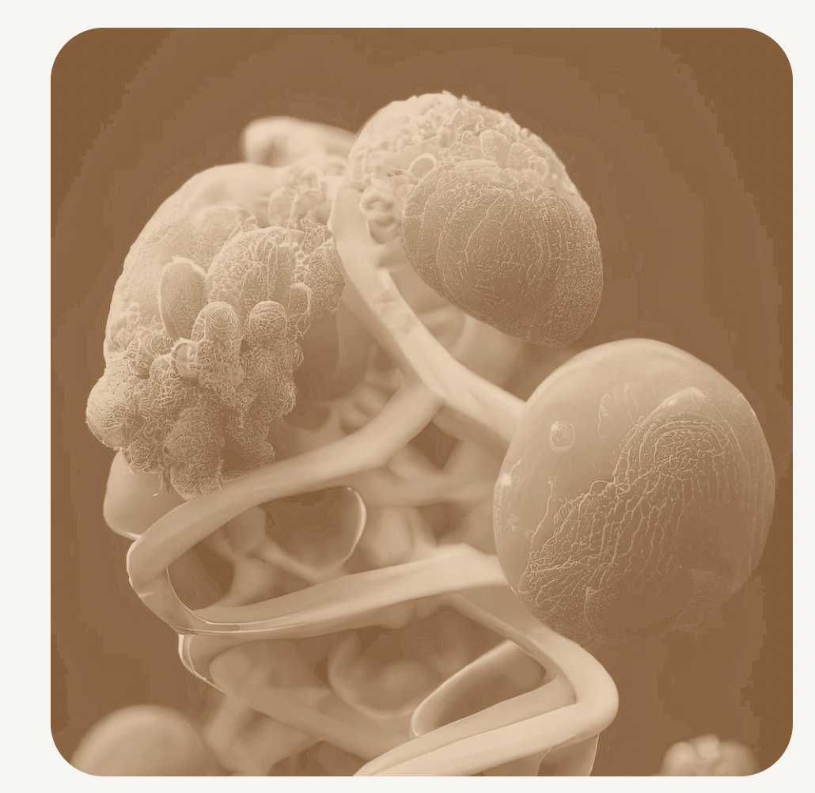
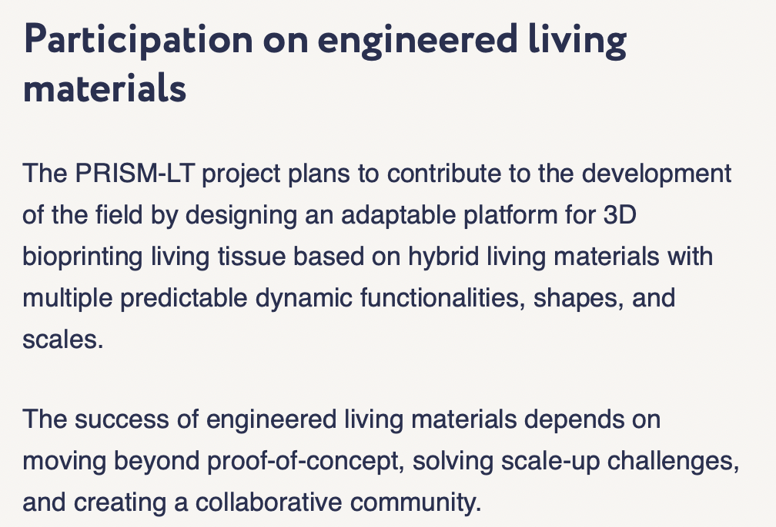





New links to Cell Engineering
https://prism-livingtissues.eu/about/

Slide 10


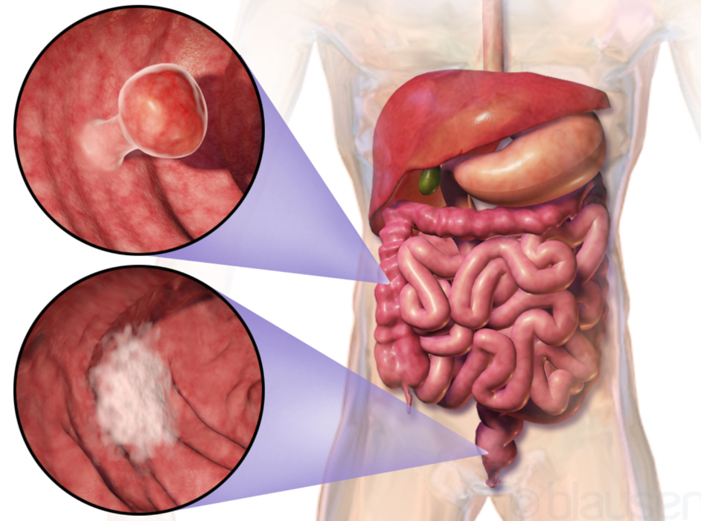
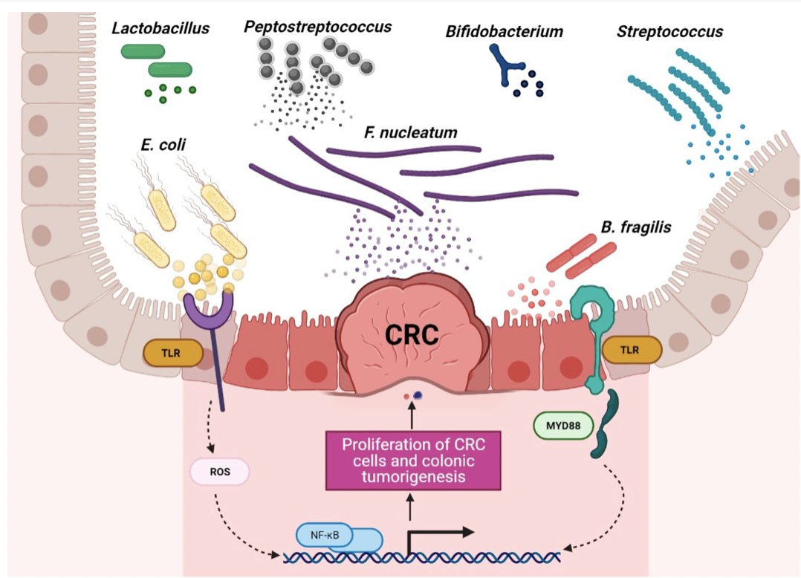
Strengthened links to cancer biology
New BBSRC grant (Roe/Douce; 2023-26)
supported by Owen Sansom (Beatson)
Role of E. coli toxins in development of
CRC
Testing intervention/dietary
strategies to modulate toxin production
in vivo
Microbiota in health and disease
Image by Eliza Wolfson

Slide 11
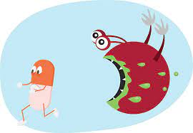
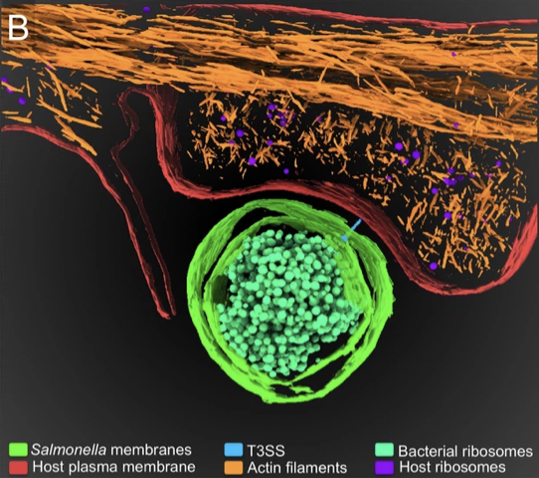
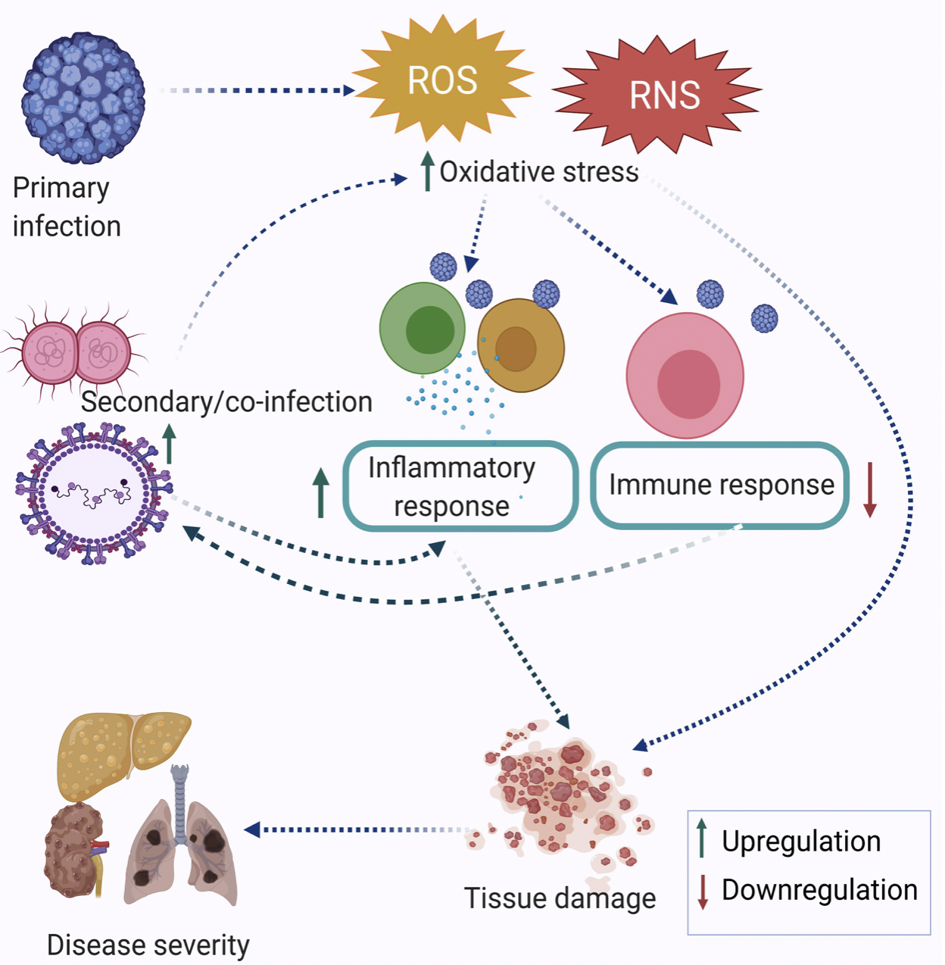
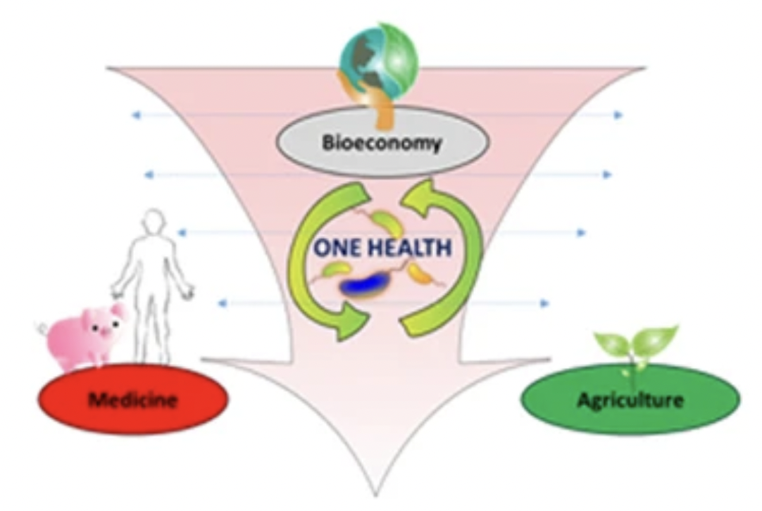
Future directions: key areas for investment

Slide 12
Future directions: key areas for investment 1
AMR: new targets, new strategies,
links with chemistry
GRAM study (https://t.co/Nqx8Xh453U )
4.95 million people died in 2019 with an antimicrobial resistant infection

Slide 13
Future directions: key areas for investment 2
Imaging: new technologies, Cryo-ET, links with CVR/enhanced core
facilities
New BBSRC application for
Zeiss Lattice lightsheet &
Mass spec imager for metabolites

Slide 14
Future directions: key areas for investment 3
Co-infections: bacterial/viral/
parasitic/fungal
Also blends AMR remit
Access to unique samples via
NHS colleagues

Slide 15
Future directions: key areas for investment 4
Microbiota: core link between
microbiology & immunology
Host nutrient metabolism, drug metabolism, integrity of the gut mucosal barrier, immunomodulation, and protection against pathogens.

Slide 16



Acknowledgements
All the bacteriology staff
The technical support
Postdocs and PhD students who make the work happen.
Andy Waters and the School management group
for their vision and support

