Slide 1
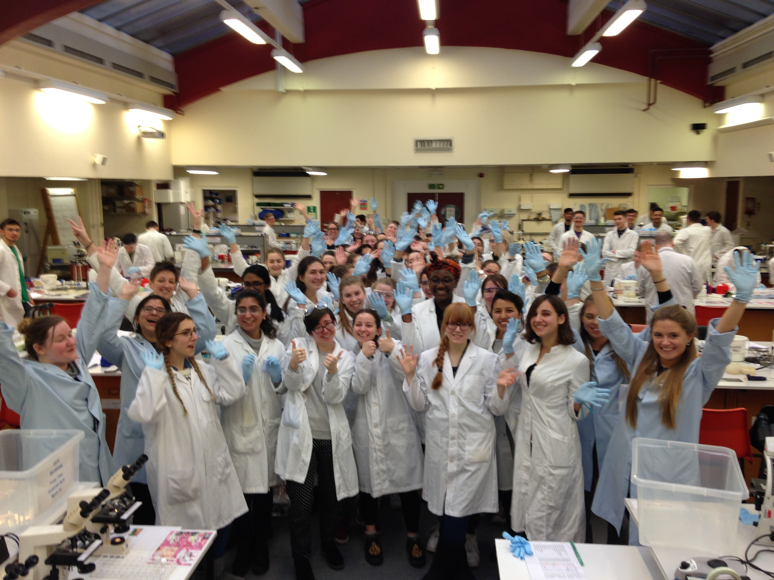
Sii Education Programmes
Jim Brewer • Olwyn Byron • Kathryn Crouch • Claire Donald • Gill Douce • Julia Edgar • Margaret Hosie •
Laura McCaughey • Georgia Perona-Wright • Nicola Veitch

Slide 2

Aim of this presentation
Familiarise you with
  colleagues who lead Sii UG & PGT programmes
  the programmes we, as a School, are responsible for
  opportunities for you to get involved

Slide 3
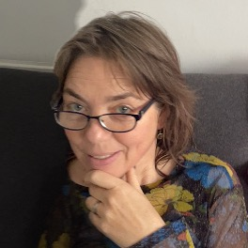
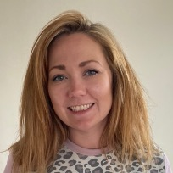
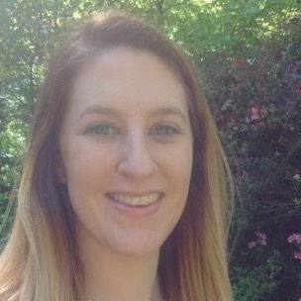

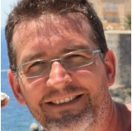


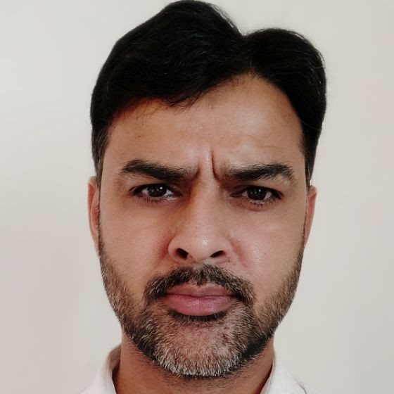


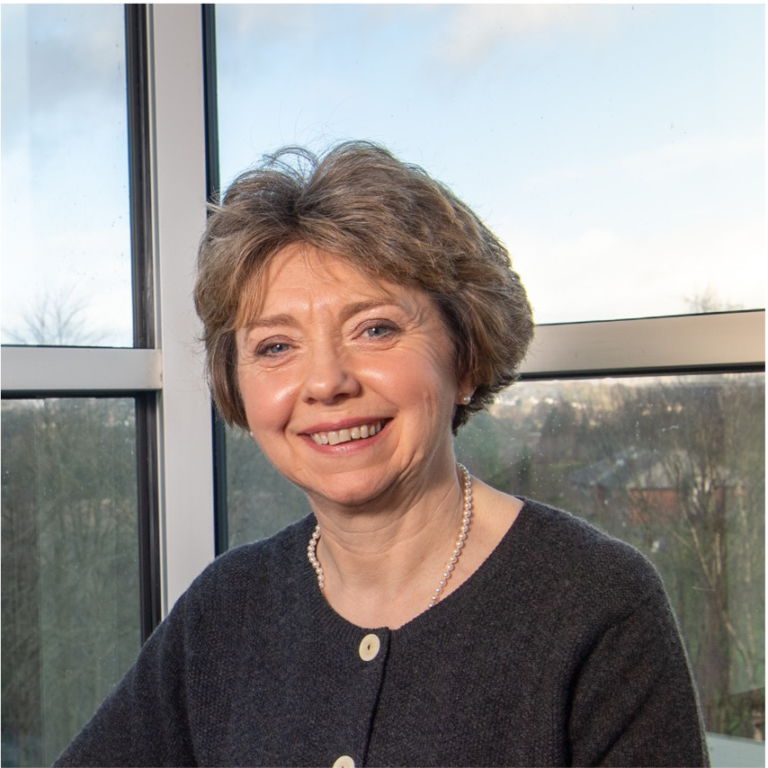

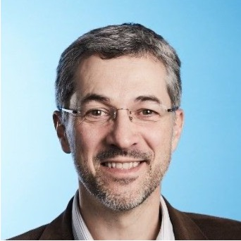

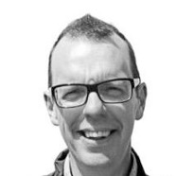
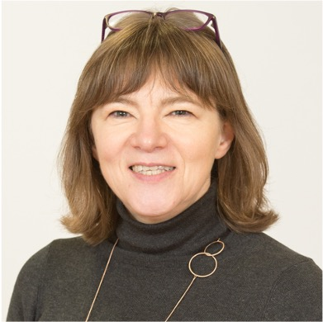
Olwyn Byron - Introduction to Education portfolio
Laura McCaughey - Level 1
Claire Donald - Level 2
(Leighann Sherry / Mahmood Alam)
Gill Douce - Level 3 Microbiology
(Rob Nibbs)
Georgia-Perona-Wright - Level 3 Immunology
(Rob Nibbs)
Olwyn Byron - MSci Work Placement
Nicola Veitch - Level 4/5 Microbiology
(Simon Milling)
Georgia-Perona-Wright - Level 4/5 Immunology
Margaret Hosie - Opportunities for engagement with UG
(Kevin Maloy)
Jim Brewer - MSc Immunology and Inflammatory Disease
(Robert Davies)
Julia Edgar - MSc Infection Biology
Kathryn Crouch - MSc Bioinformatics
Julia Edgar - Opportunities for engagement with PGT

Slide 4
Level 1
Biology 1A & Biology 1B - compulsory for all Life Sciences students
743 students, 45 lectures each semester covering all aspects of biology
Biology 1A
3x Diagnosis of Infectious disease labs
    ELISA
    Plating out
    Staining
    Microscopy
    Antibiotic susceptibility testing
  11 microbiology/immunology lectures
  The 'Adaptive' Immune Response: Antibodies,
  Lymphocytes & the MHC (PG)
  The Immune System: Hero and Villain (IM)
  Vaccination and Protection from Infection (JB)
  Prokaryotic Life (OB)
  Are Viruses Alive? (OB)
  How Bacteria & Viruses Make us Sick (OB)
  Beer, Drugs & Dairylea Slices (OB)
  A History of Human Epidemic Disease I (bacterial and viral) (CD)
  A History of Human Epidemic Disease II (bacterial and viral) (CD)
  People, Parasites & Pets (RM)
  Parasites of the Tropics (RM)

Slide 5
Level 2
Microbiology and Immunology - 2D
Second Semester course - running now!
273 students, 40 teaching & support staff, 18 GTAs
6 Teaching blocks
  Global Influences of Microbes
  Fundamentals in Microbiology
  Fundamentals in Immunology
  Infection Biology
  Immunology in action
  Careers and Employability

Slide 6
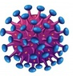
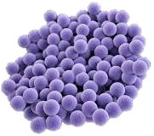
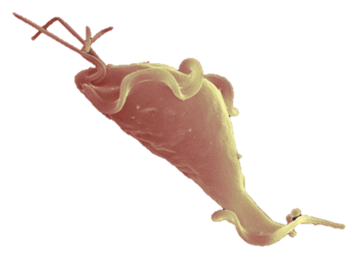
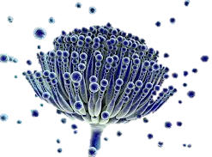
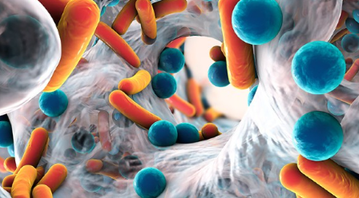
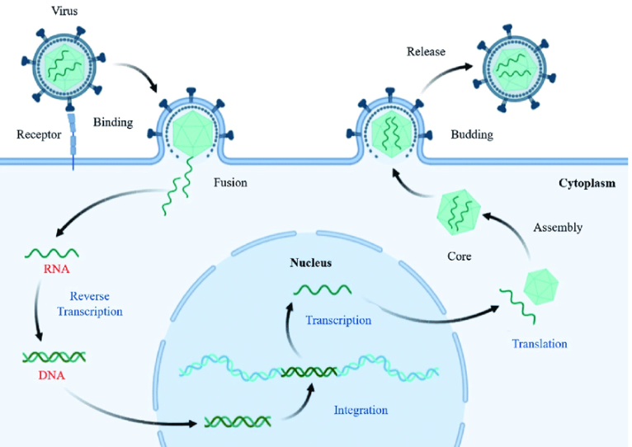
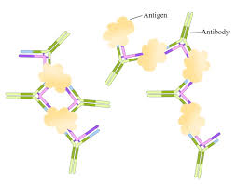
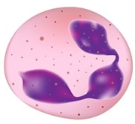
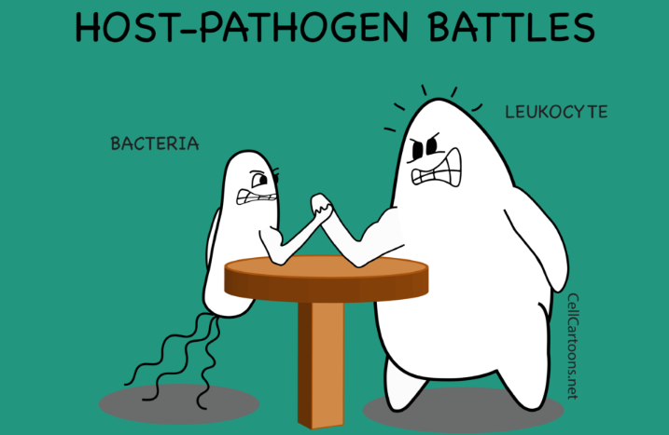
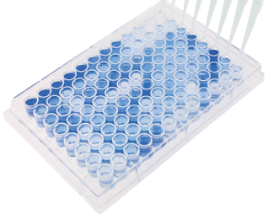

Level 3 Medical Microbiology
Study the process of infection from first contact with a pathogen to final outcome
30-60 students, 47 staff, 3 GTA’s per lab
Knowledge of pathogens
Key Players
Host Pathogen Interactions
Structure and Function
Host
Immune Response
Evasion of Immunity
Diagnostics/ Therapeutics

Slide 7
Level 3 Immunology
- Builds a strong foundation in fundamental immunology, immunology of infection, and immunopathology
- Develops scientific and transferable skills.
- 30-40 students each year; Away Day at SCENE in October.
COURSES
CONTENT
DELIVERY
SKILLS
Fundamental Immunology
Immunology 3A
60 credits; first semester
Cells & Molecules
Knowledge & Understanding
Lectures & Tutorials
~90 hours/semester
Tissues & Organs
Lab Skills & Report Writing
Processes & Mechanisms
Labs & Bioinformatics
Research & Experimental Design
Virtual Investigative Project
Host/pathogen
Interactions & infectious disease
Computational Skills
Immunology of Infection & Immunopathology
Immunology 3B
60 credits; second semester
Journal Clubs (x5)
Statistics, Data Analysis & Presentation
Prevention, Treatment & Immunotherapy
Oral Presentations (x5)
Critical thinking
Autoimmunity, inflammatory disease, CVD, cancer etc
Essays (x3)
Public Speaking
Scientific Writing

Slide 8








MSci Work Placement
5-year cross-College Programme
  50 students each year, 10-15 from Microbiology / Immunology
Includes 10-12 months research on topic relevant to degree at approved host institution / company
  Industry, Research Institute, Hospital or University
  Glasgow, Rest of UK, EU or beyond...
Done between Year 3 and final year by students with grades equivalent to 2:1 or above in Years 1 & 2
Masters-level assessment of lab report and dissertation (30% of degree grade)
Excellent preparation for postgraduate research

Slide 9
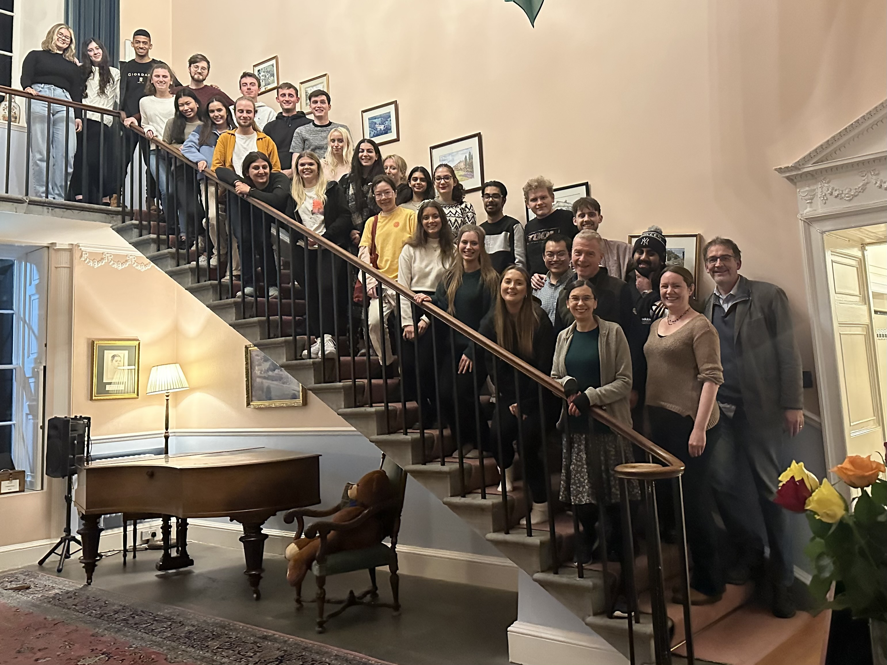
Level 4/5 Immunology
Explore more detailed topics in immunology, with 30-40 students,
Fundamental Topics
Immunology of Infection
Fundamental Molecular Topics
Immunology of Inflammation
Cancer Immunopharmacology or Cancer
NSS: 100% SATISFIED!

Slide 10
Level 4/5 Microbiology
29 students taking Microbiology 2022-23
Core Skills course and options:
Industrial and Environmental Microbiology 4Y
Molecular and Cellular Microbiology 4Y
Business in Bioscience 4Y/Statistics for LS
Emerging Viruses 4A
Chemotherapy, Resistance and Parasite Control 4B
Medical Virology 4C
Grand Challenges in Medical Microbiology 4D
Final Year Project-Lab/Dissertation/Outreach/Internship
In course assessment and final exams
Students can graduate with specialisation in Bacteriology/Parasitology/Virology
Semester 1
Semester 2

Slide 11
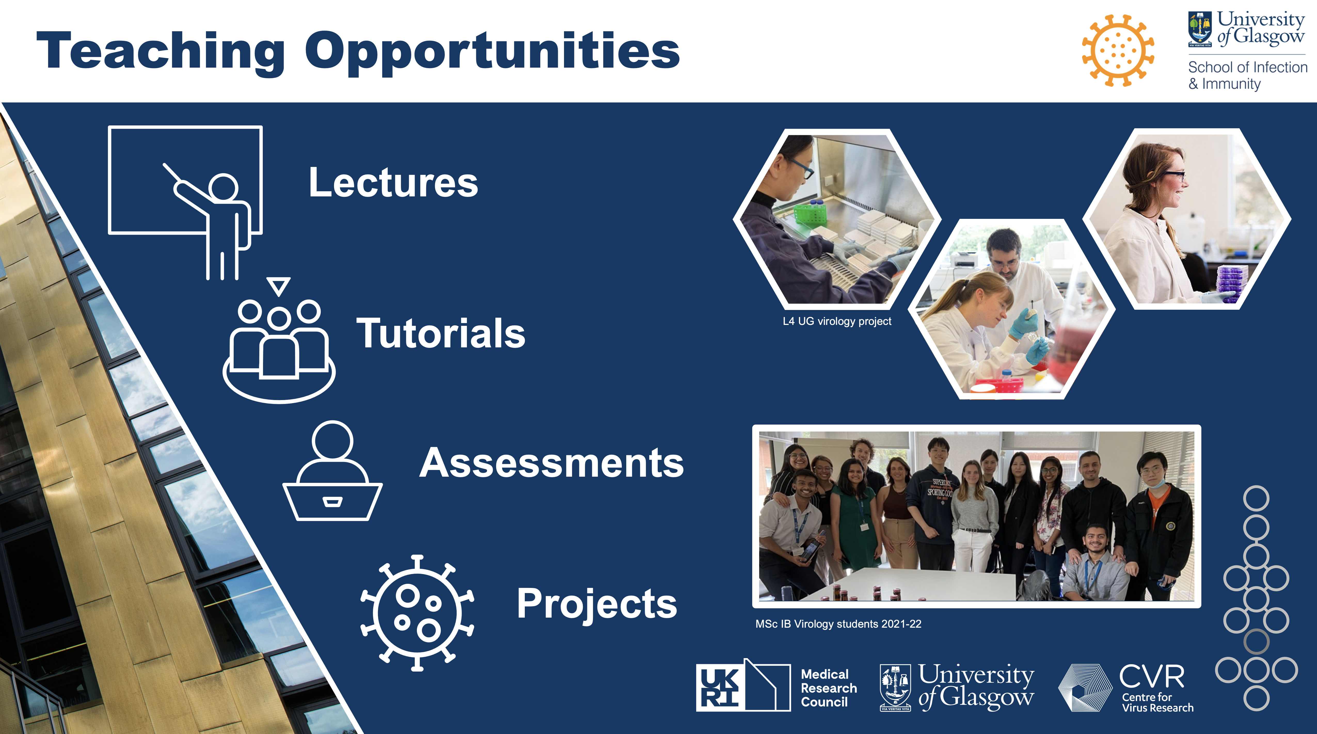
Opportunities for engagement with UG

Slide 12
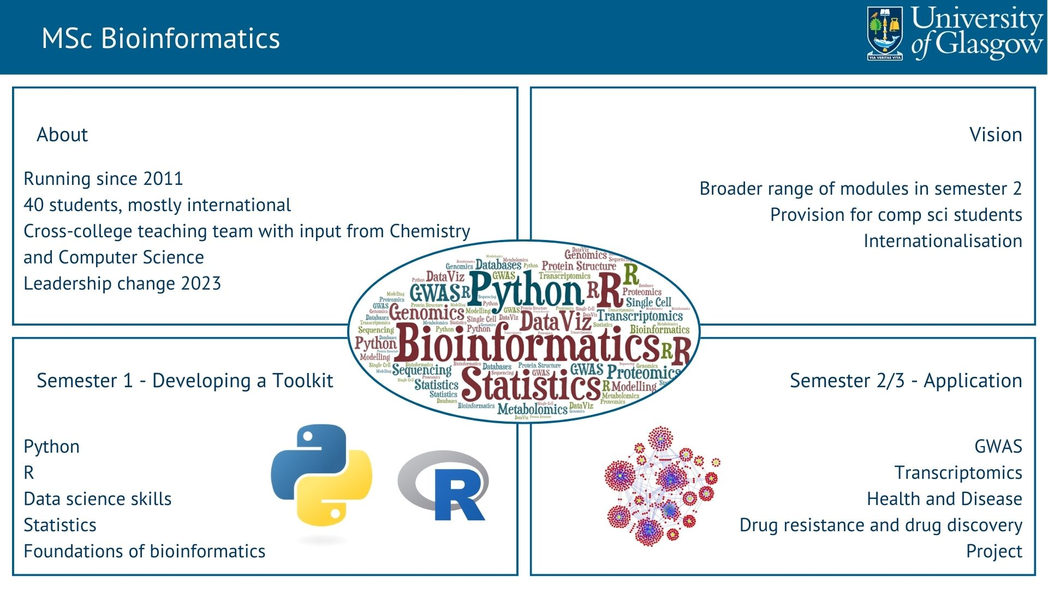
MSc Bioinformatics

Slide 13
MSc Immunology and Inflammatory Disease
35 students in 2022-23 – mainly international.
Provides a deep understanding of the immune system and inflammatory diseases.
Transferrable research skills with clinical and translational emphasis.
FT – 180 credits over 1Yr
Immunology and inflammatory disease (40CR)
Research Skills (20CR)
Animal Models or Diagnostics or Bioinformatics (10CR)
Current Challenges or Tech transfer or Emerging Viruses or Neuroinflammation (10CR)
Omics or Bioimaging or Immunotherapy or NGS (20CR)
Designing a research project (20CR)
Research Project (60CR)
Semester 1 (Compulsory; Sep-Dec)
Semester 2
(Options; Jan-May)
Summer Project (Compulsory; Jun-Aug)

Slide 14
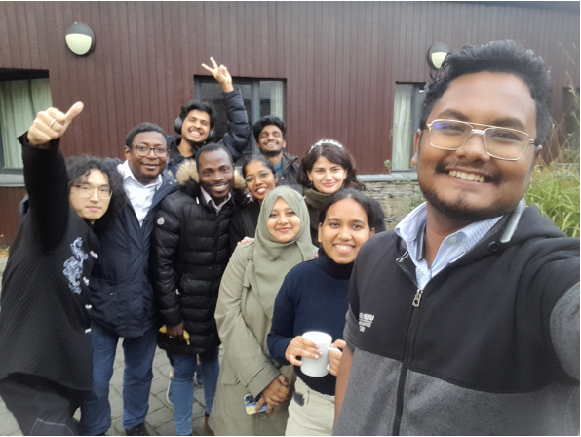
MSc Infection Biology
35 students in 2022-23 (28 international, 7 home) generating an income of ~£800,000
Programme aim is to provide knowledge and understanding of molecular mechanisms of infection in humans and domesticated animals as well as a world-class laboratory-based research (project) experience
Students can specialise in Bacteriology, Parasitology or Virology
Accredited by the Royal Society of Biology
Programme Structure
Semester 1
Fundamental compulsory courses:
Host-Pathogen Interactions; Research Skills in Immunology & Infection
Semester 2
Various optional courses including:
Animal Models of Disease; Diagnostic Technologies and Devices; Technology Transfer and Commercialisation; Emerging Viruses; Omic Technologies for Biomedical Sciences; Bioimaging; NGS
Summer
Research Project
Happy Students at SCENE

Slide 15

Opportunities for engagement with PGT
Join the Infection Biology students at SCENE on the shores of Loch Lomond to assess their oral presentations and enjoy some social time
Join the Immunology and Inflammatory Disease students at the BSI conference
Design and develop a course
Run a journal club
Offer a tutorial on calculations
Make an instructive video of an important research method
Contribute a laboratory practical
Contribute to teaching on a range of 10, 20, 40 or 60 credit courses
Supervise a project for students from one or all of our programmes

Slide 16

Q&A

