Slide 1

Sii AWAY DAY
January 17th, 2023 Glasgow
Overview International Strategy
Pasquale Maffia
Pasquale.Maffia@glasgow.ac.uk
Professor of Cardiovascular Immunology
School of Infection & Immunity International Lead

Slide 2
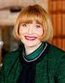
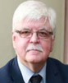
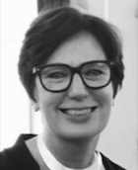
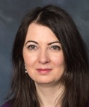
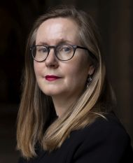
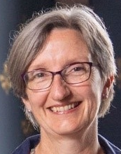
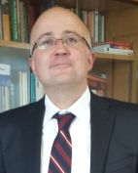
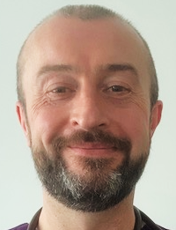
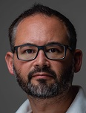
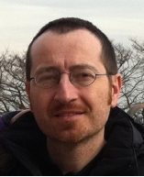
EXTERNAL RELATIONS
Rachel Sandison
Deputy Vice Chancellor External Engagement & Vice Principal
Bill Cushley
Assistant Vice Principal International
Professor Moyra Boland
Dean for Global Engagement
Clare McManus
Dean for GE
Lorna Hughes
Dean GE Europe
Penelope Morris
Dean GE Americas
Konstantinos Kontis
Dean GE China/East Asia
TBA
Dean of GE MENA
TBA
Dean of GE SSA
MVLS
Matthew Walters
MVLS College International Dean
Christopher Loughrey
MVLS College International Dean
Sii
Pasquale Maffia
Sii International Lead

Slide 10
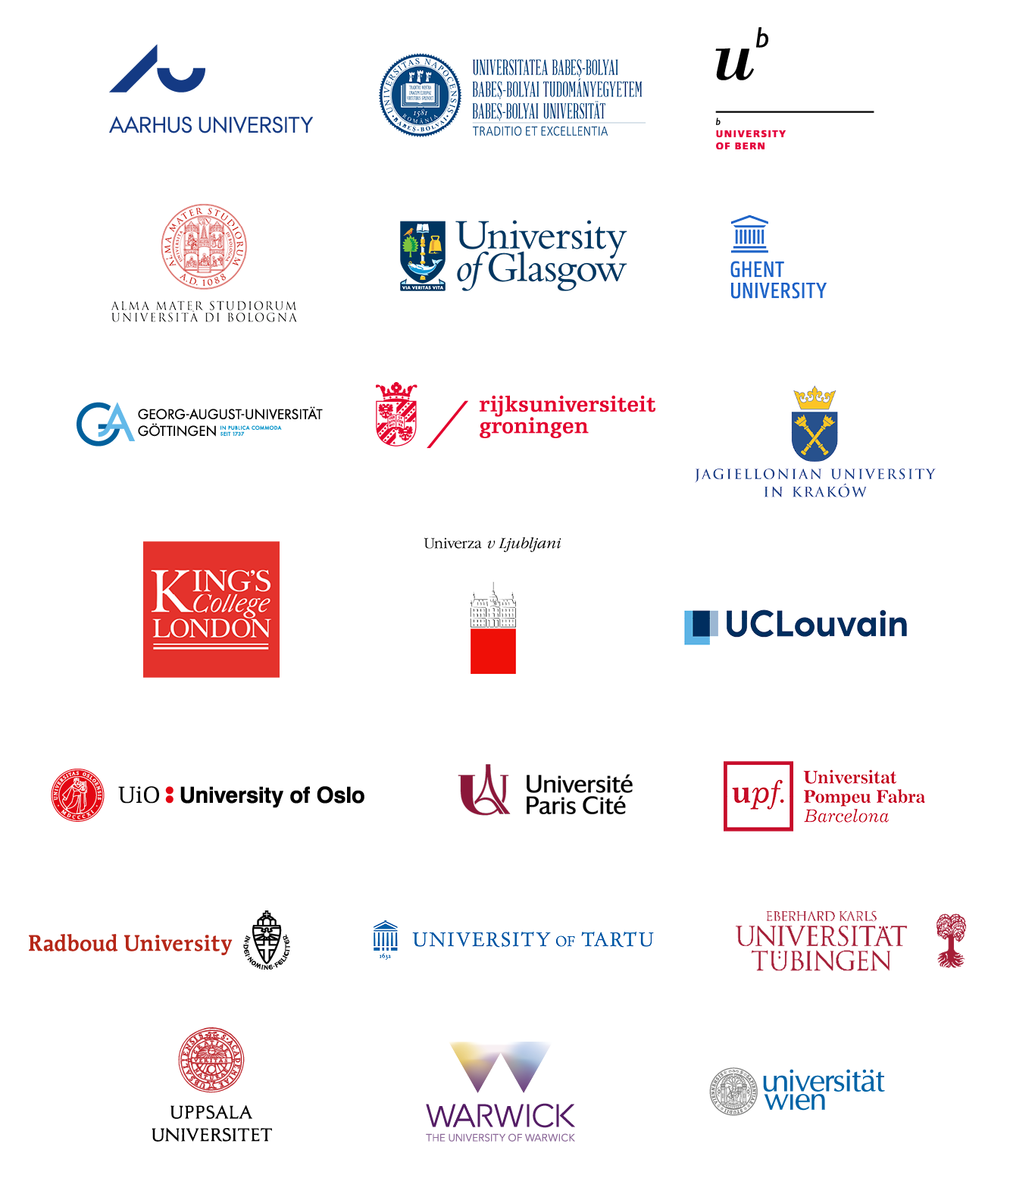


Slide 11
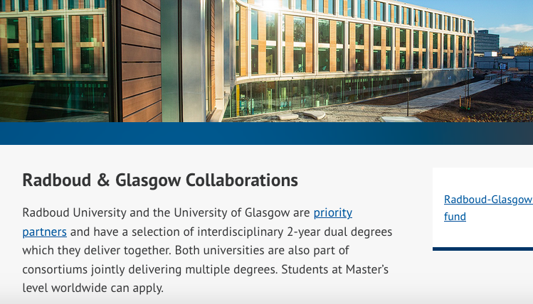



Slide 13
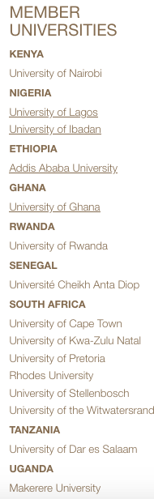

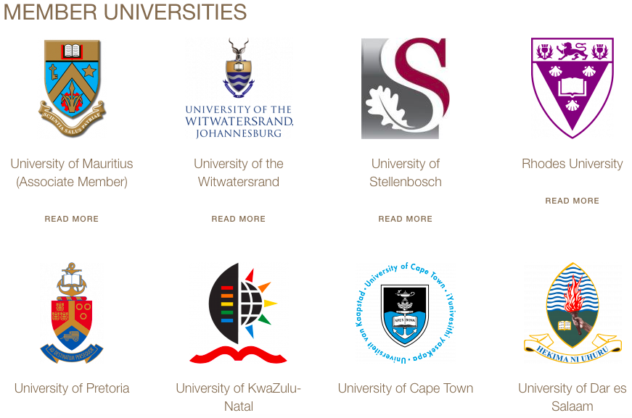

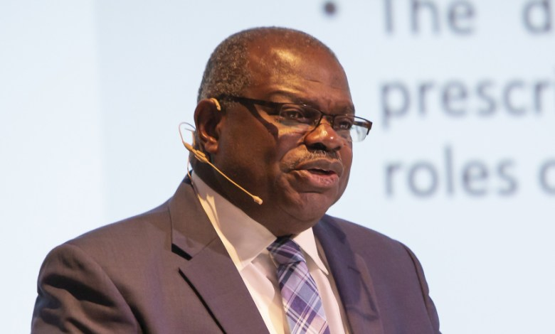
The Secretary-General of ARUA
Professor Ernest Aryeetey

Slide 14









Slide 15
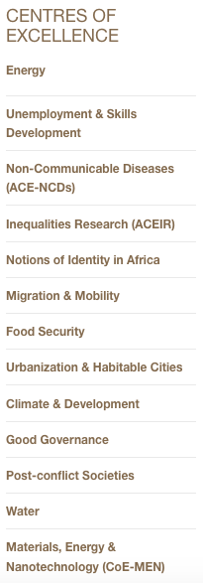

Slide 16
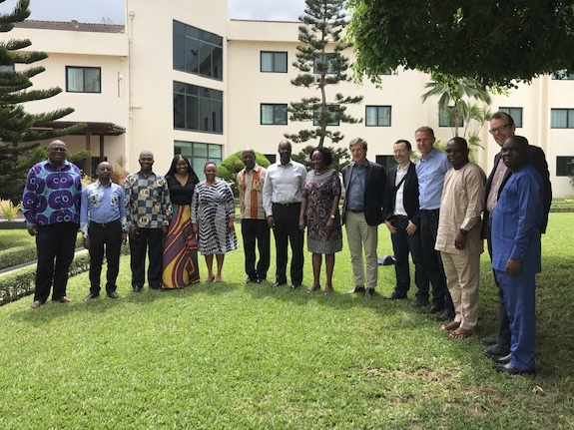



Slide 17
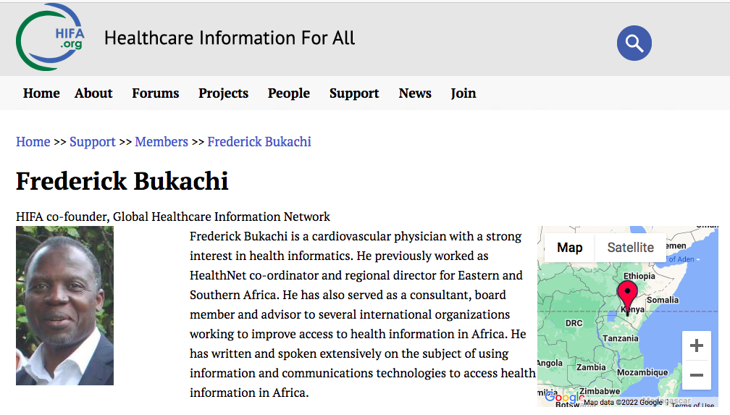

Slide 18
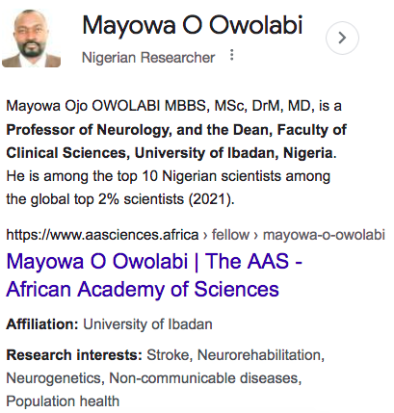
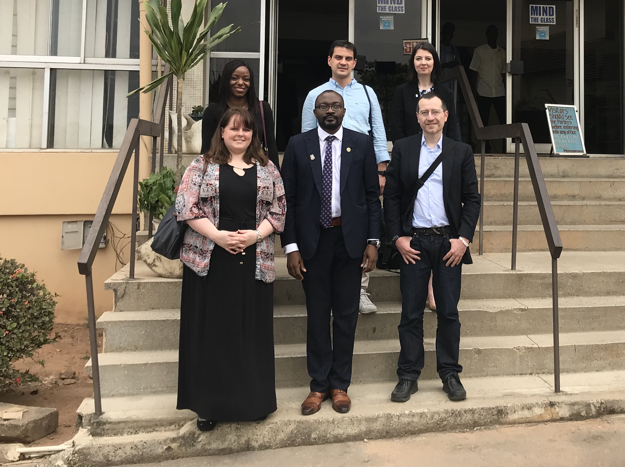

Slide 19

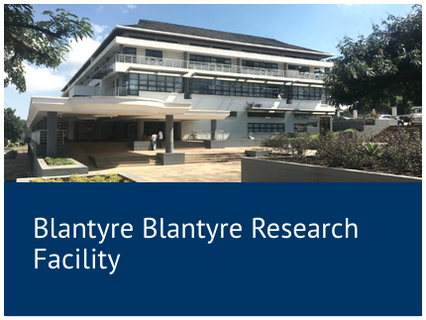
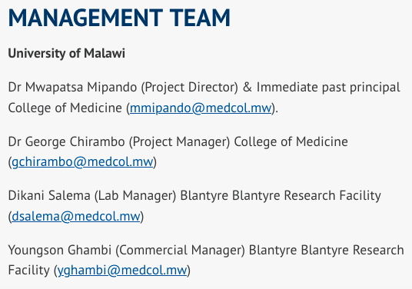

Slide 20

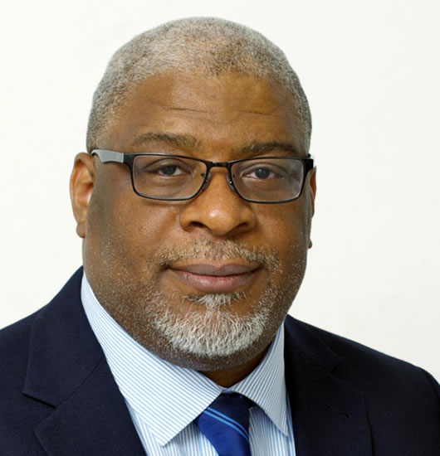
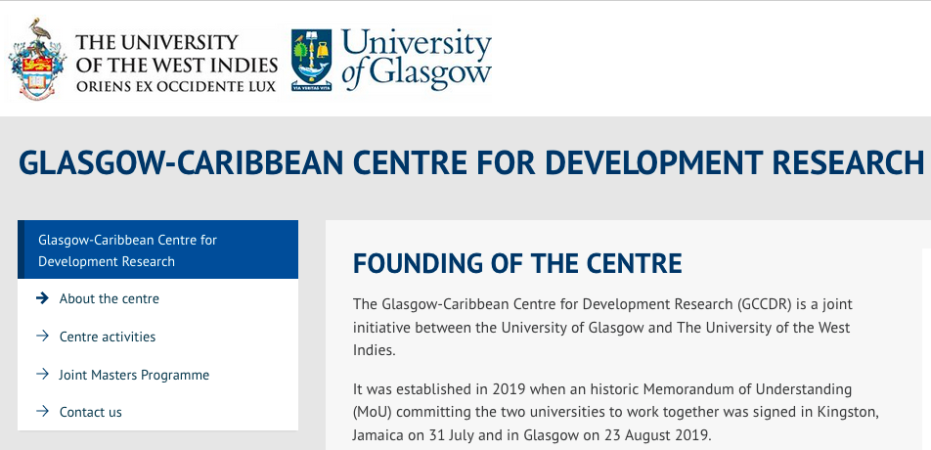
Professor Simon Anderson

Slide 21

Next ARUA CoE in NCD meeting in Glasgow
27th - 29th March 2023
Advanced Research Centre, University of Glasgow
Notes:
We are divided up into 3 schools and 7 research institutes.

Slide 23


Slide 24
What we need
Map Sii international activities (MoU/MoA, Parnerships, Industry, Committees, PE, etc.)
Discussion Points
Sii areas of prioritization
Get the right balance between teaching vs. research vs. innovation
Staff / Money
Perform a SWOT analysis
To develop a Sii international strategy

