Slide 1
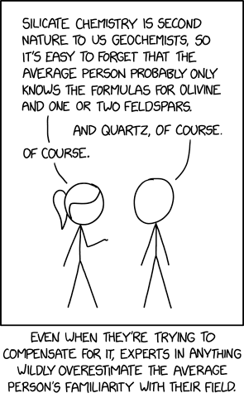
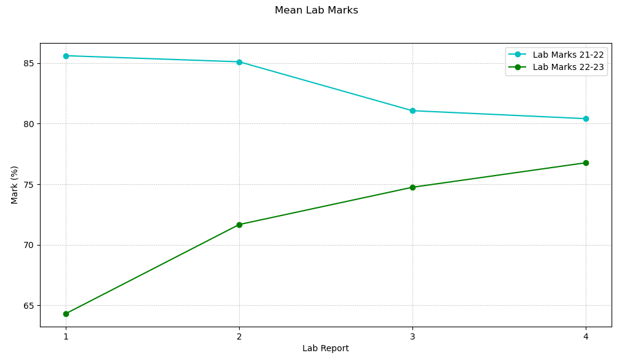
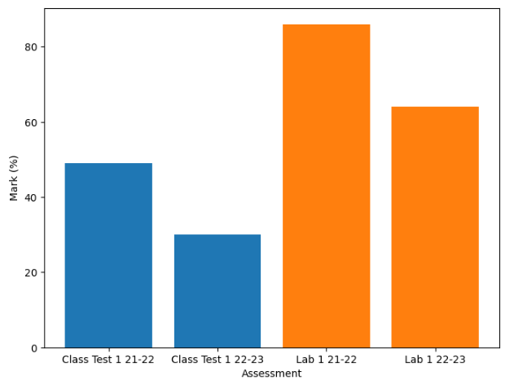
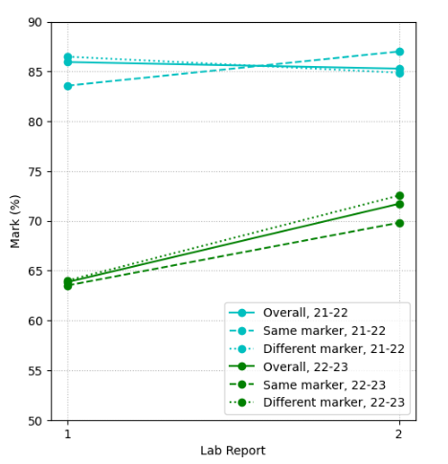
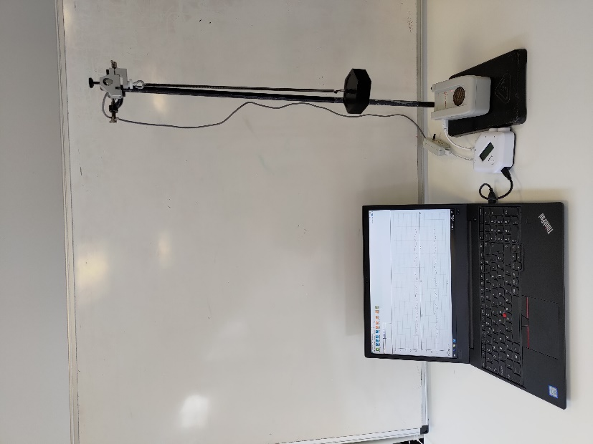
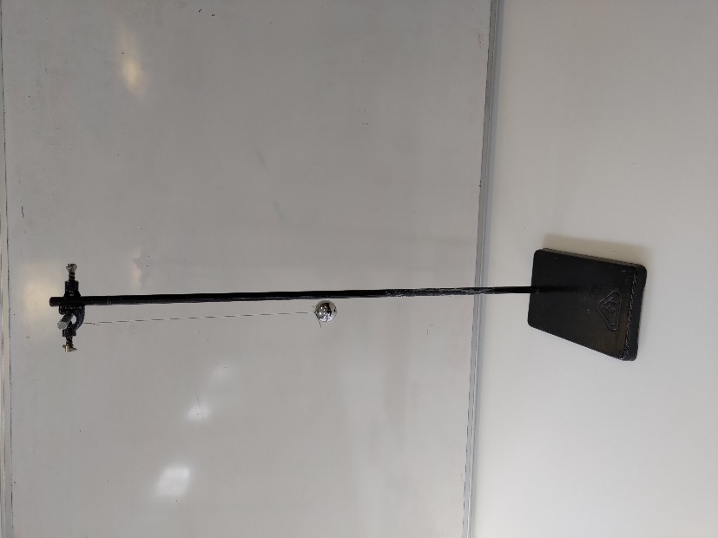
Physics Theory in Simple English
Theory Guides for Lab Marking in Physics 1
Claire Neilan, Pedro Parreira, Luke Marshall
This poster concerns a project carried out in the School of Physics and Astronomy to write a series of simple English guides to each of the experiments carried out in the non-Honours undergraduate Physics labs. These guides include an overview of the theoretical underpinnings of each experiment, and of the analysis involved and common sources of errors, written with minimal assumption of prior Physics knowledge. They were made available to the demonstrators for the beginning of the 22-23 session.
The aim of this project was to improve the quality and consistency of marking by ensuring that postgraduate demonstrators shared a common understanding of the experiments, and of what should be expected of student lab reports. A secondary aim was to better equip the demonstrators to use simple, colloquial language when discussing the experiments with undergraduate students lacking a strong prior understanding of Physics. In addition to improving the student experience of marking and feedback, this allows the demonstrators to develop their teaching skills.
Abstract
“The curse of knowledge occurs when, in predicting others’ knowledge […] individuals are unable to ignore knowledge they have that others do not have”^{[1]}
Undergraduate Physics labs are demonstrated and marked by postgraduate researchers. Postgraduate researchers are required to have a strong background in Physics and a level of expertise in their chosen sub-field, but will not necessarily have any prior experience in teaching and tutoring. Studies have shown that even experienced teachers are likely to misjudge the level of knowledge their students have^{[2]}.
Students in the cohort come from a wide variety of backgrounds and include students who are not on a Physics degree program. Accordingly, the level of pre-existing physics knowledge students possess can vary significantly.
Taking these facts into account, the project proceeded on the following assumptions:
That postgraduate demonstrators are likely to have minimal prior teaching experience, and as such will lack experience in:
  judging the level of physics knowledge other have and tailoring their explanations accordingly.
  assessing others’ work.
That a Physics 1 cohort is likely to contain students with minimal pre-existing physics knowledge.
Background
The aim of the Simple English Theory Guides is to address these issues by equipping demonstrators with examples of how to explain the underlying theory in simple language to someone with minimal prior knowledge, and by providing them with guidance on what level of analysis and discussion is expected from first year undergraduates.
[3]
When working on the project the main consideration was the target audiences – especially since the two sections were aimed at different groups. The introduction to the theory was to be written in plain language for someone with no physics background and the description of the analysis and errors was intended for markers.
“When writing the theory introductions, it was helpful to refer consider people I know who fit into that target demographic and consider explaining the concepts to them.”
An effort was made to avoid equations and mathematics, choosing instead to rely on analogies to everyday examples. When applicable, explanations regarding why a certain piece of equipment or a given technique would be used were included. Similarly, the context of the experiments was highlighted in reference to the course: for example, the importance of studying waves and their prevalence in physics.
When writing about the analysis required by an experiment, the main goal was to highlight the key points that would be expected in a student’s lab report. Common sources of error that would be expected for a student to discuss were included, based on tests of each of the experiments and the previous copies of the lab guides. Ensuring these sections were written for the different target audience was mainly a task of reading through the existing lab guides for demonstrators and considering what would be required information for someone who had not been in the lab.
Engagement with Conference Themes
Excellence in Learning & Teaching | Continuing Professional Skills Development
Ensures that all markers are working from a common understanding of how the analysis should be approached, improving consistency. Improves turnaround time on marking & feedback by not requiring markers to individually reinvent the wheel. | Encourages demonstrators to consider their language when explaining experiments, improving their science communication skills. Provides a foundation for demonstrators who have specialised in areas of physics to improve their understanding of the basics of other specialisms.
Working collaboratively/diversity of contributions | Inclusivity, Diversity, & Wellbeing
Allows technical teaching staff & apprentices who don’t have a background in physics to engage with the theoretical side of the experiments & more effectively implement technical & process improvements. | Equipping demonstrators with simple, colloquial ways of explaining the theoretical underpinnings of the experiments helps them more effectively engage with students who don’t have strong physics backgrounds.
Approach
Mean Lab Marks
Figure 2 shows the mean marks for each submission divided into two populations based on whether students were marked by the same marker for both submissions, or by a different marker for each.
Considering each of the populations separately shows that in 21-22 the expected improvement occurred only where the second submission was marked by the same marker. This suggests inconsistency in marker approaches, as changes a student made based on one marker’s feedback may not have been perceived as correct by another.
In 22-23, after the introduction of the theory guides, this same disparity is not observed, and submissions in both populations show a significant improvement in the marks awarded to the second submission. This suggests that students are better able to engage with the marking criteria, the physics theory, or both; and also that the improvement in their marks is less impacted by which marker their submission is allocated to.
Analysis of Results
Fig.1 Mean marks for each semester 1 submission in the 21-22 and 22-23 sessions
The first semester labs in Physics 1 focus on basic dynamics. For their first lab, students carry out an experiment on either projectile motion or simple harmonic motion; for their second lab, they carry out an experiment investigating the same theory, but using a different methodology.
Fig.4 Comparison of lab and class test marks between the two sessions
The mean lab marks are significantly lower in the 22-23 session than they were in the 21-22 session. However, this difference was also observed in the semester 1 Physics 1 Class Test. As can be seen, the percentage decrease is comparable in magnitude.
The class test questions remain in the same format as the previous year and are marked solely by academic staff. As such they can be considered a strong indicator of overall cohort performance as compared to the previous year.
Figure 1 shows a comparison of the change in mean marks between the first and second report submission in the 21-22 session (before the introduction of the theory guides), and the 22-23 session (after the introduction of the theory guides). Given this format, it would be expected that student marks for the second submission should improve, as they are now more familiar with the theory underlying the experiment, with the lab environment, and with the required format of the lab report. However, in 21-22, the mean grade for the entire cohort was in fact slightly lower for the second submission, suggesting that students had not grasped either the marking criteria, the physics theory, or both.
Conclusion
Fig.2 Effect of changing marker
Fig.3 Two methods investigating simple harmonic motion: a mass on a spring (a), and a pendulum (b)
Overall, the general trend in the 22-23 session shows improvement over the course of the semester, something which was not observed in 21-22. Whether a student’s lab mark improved between the first and second submission was also observed to be less strongly influenced by their marker in 22-23 than was the case in 21-22.
[1] Kennedy, J. (1995) ‘Debiasing the Curse of Knowledge in Audit Judgment’, The Accounting Review, Vol. 70, No. 2 (Apr., 1995), pp. 249-273
[2] Güzel, M.A. & Başokçu, T.O. (2023) ‘Knowledge about others’ knowledge: how accurately do teachers estimate their students’ test scores?’, Metacognition and Learning, 18, pp. 295–312.
[3] Munroe, R (2023) https://xkcd.com/2501/

