Slide 1


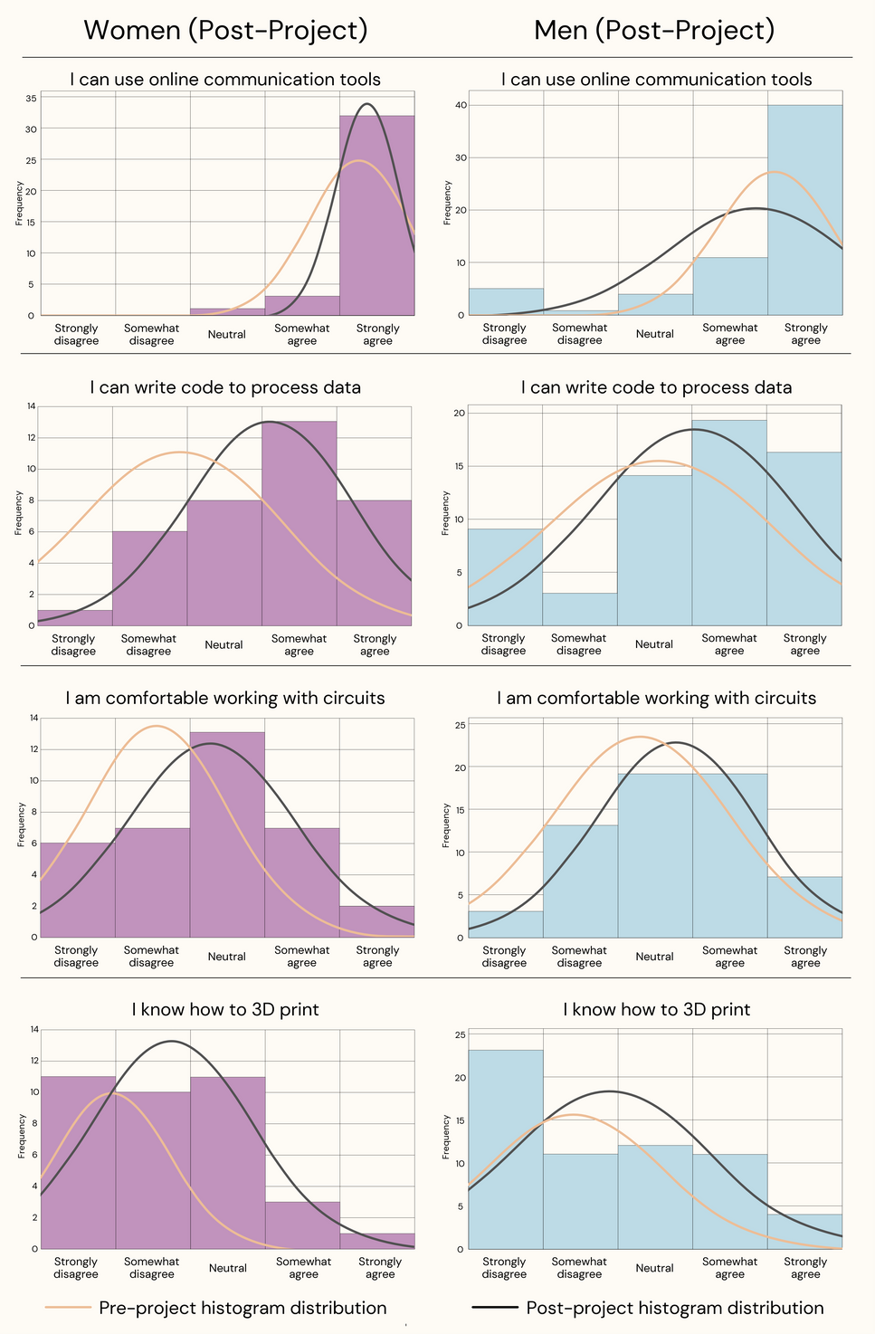
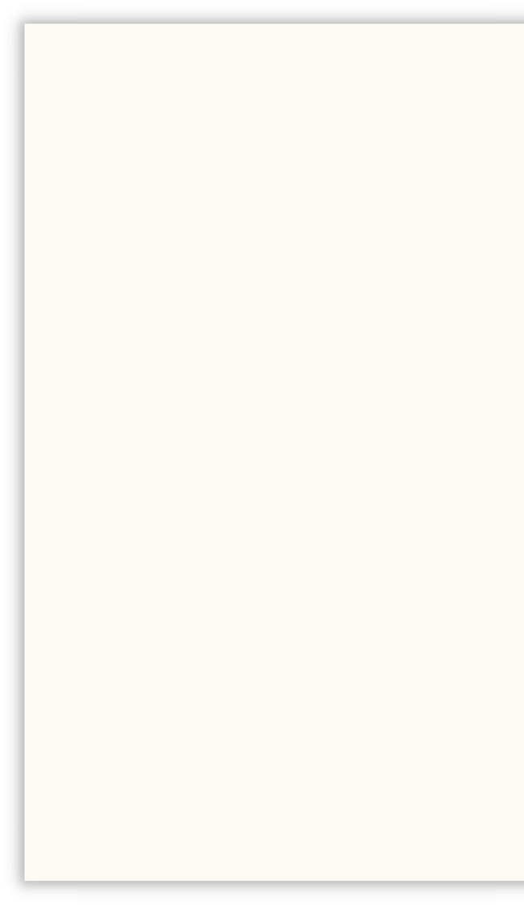
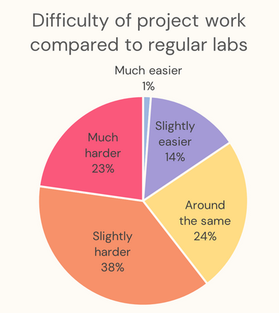

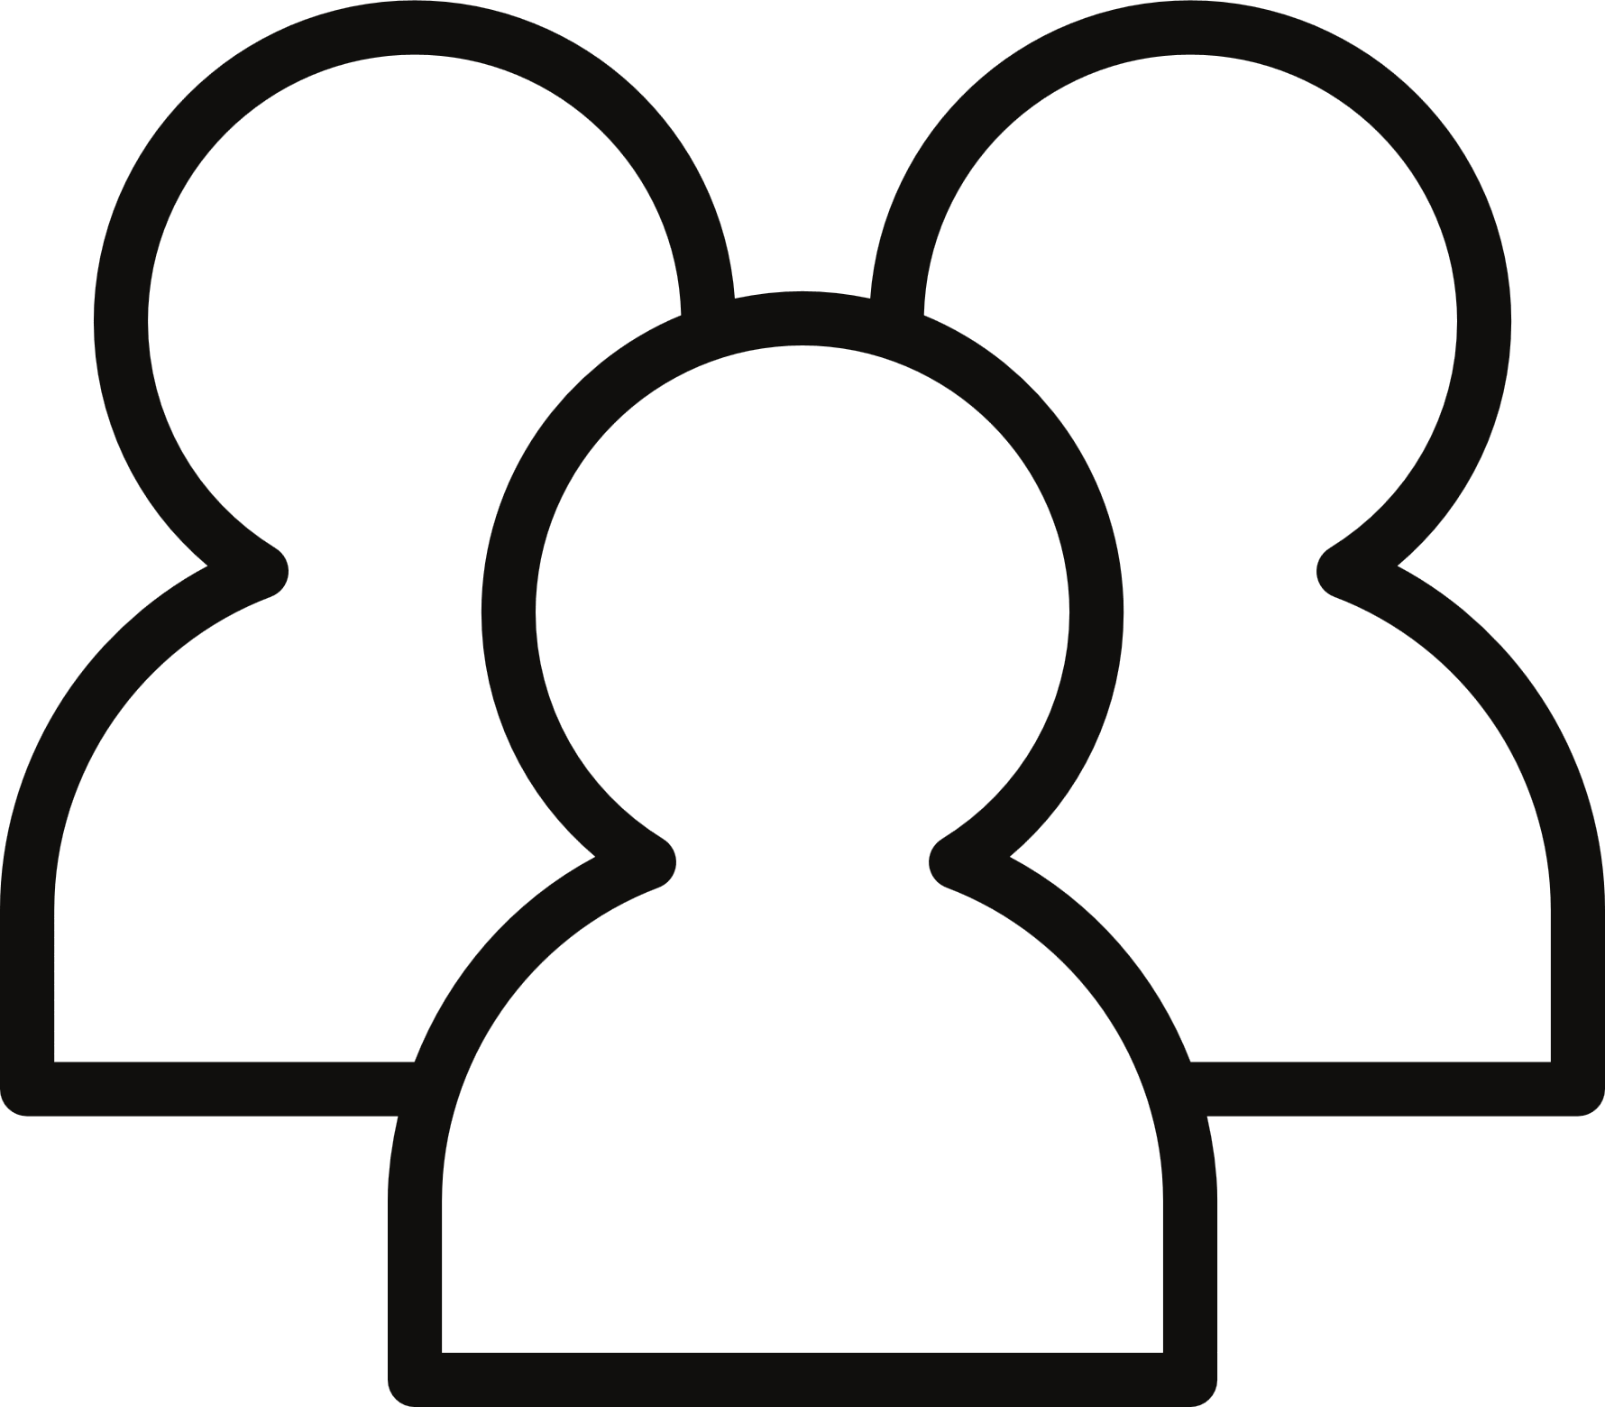

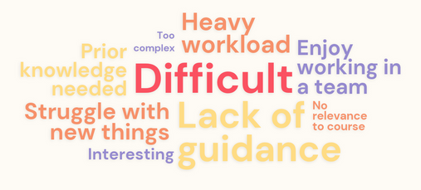
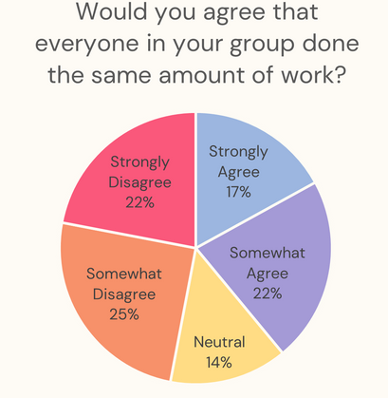

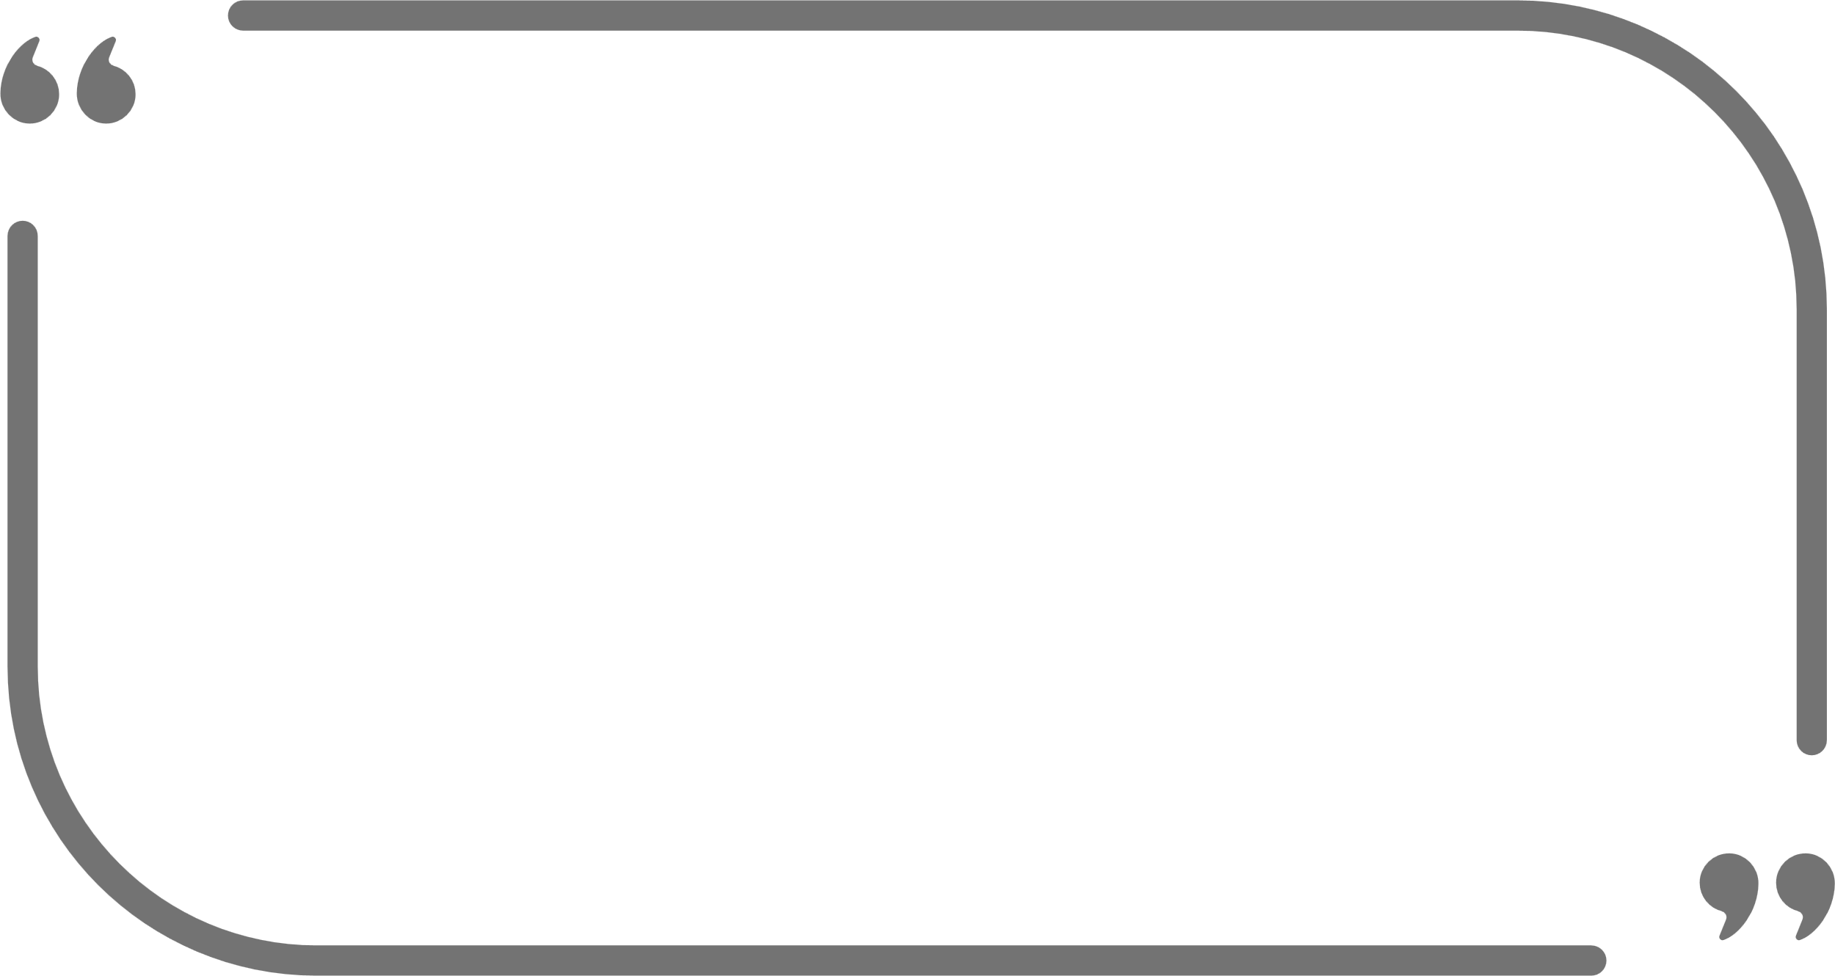
Divide and Conquer?
Analysis and Interpretation
The distribution curve of the pre-project data, displayed in yellow, was overlayed on the post-project histogram with the post-project distribution shown in black. This was done to clearly see how skills had progressed.
Exploring the Limits of Teamwork through Task Splitting
Alix Weir
Motivation
Methodology
The IOP and the University of Glasgow want students to develop a range of transferrable skills during their education. I aimed to investigate the transferable skills of Physics 1 students to explore the different barriers that students experience when learning these skills. In addition, I sought to answer whether there are differences in self-assessed transferrable skills based on: Coding experience, gender identity and degree subject.
Students were asked to self-assess their abilities in different skills on a Likert scale before starting a group project. Students were also asked how difficult they perceived project work to be compared to regular labs and were given an open response box to share their thoughts. This survey was also given at the end of the project in order to compare how the project improved these skills. The project received 168 pre-project responses and 100 post-project responses. Common sentiments expressed in the open response box are shown in the word cloud below.
Hypothesis
Coding Experience
Gender Identiy
Degree Subject
Students who had previously studied coding would rate their skills higher.
Men would rate themselves higher in skill categories compared to women.
Students doing a coding-heavy degree would rate their skills higher.
Focus Groups
Outlook
I conducted focus groups after the initial survey to try and determine the reasons behind the results. I discovered that students filled in each other's knowledge gaps and chose to work to their strengths, resulting in students splitting the work up into different categories and tackling the tasks that were easiest for them. This meant not all students got the opportunity to experience working with these new skills meaning their skills didn't improve as much as they could have.
In the focus groups, many complaints about teamwork arose. Because of this, in the post-project survey, I asked students if they felt like all the team members in their group had done an equal amount of work. The results varied widely when comparing gender, degree subject and previous computing knowledge.
This feedback stresses the importance of how teamwork is constructed. Students tended to split tasks up instead of working collaboratively, this meant students missed out on the opportunity to develop their weaker skills.
It encourages teamwork and a group approach to difficulties you face. Also gives everyone the opportunity to work on a specific section in which they have strengths.
Conclusion
While this project provided valuable insights into the factors affecting undergraduate physics students' skill development, it also highlighted the importance of ensuring group projects are truly collaborative. By doing so, we can ensure that students develop a more diverse range of skills and are better prepared for their future physics education.
The paper "Share It, Don’t Split It:
Can Equitable Group Work Improve Student
Outcomes?" by Danny Doucette and Chandralekha Singh provided valuable ideas that this project expanded on.

