Slide 1
Decolonising Physics
Scattered thoughts on a very large topic…
Sam Skipsey
(he/they)
University of Glasgow

Slide 2
Foreward to the downloadable version
This slideset heavily uses animation, including in places where this means text is obscured without it.
Please view these slides in “slide show” or “reading view” mode if using PowerPoint.

Slide 3
Some topics
"Colonisation" & Decolonisation
STEM and the problem of objectivity
Epistemic issues & Empathy
“Colonial Physics”
“Decoloniality" in teaching practice

Slide 4
What is... colonisation
“control by one power over a dependant area or people [implicitly, with the colonisers considering their own culture and needs superordinate to those of the colonised peoples’]”
Overlaps significantly with
  Imperialism (which uses colonization to make new subjects for the metropole)
Multifarious (“settler colonialism” [Europe in the Americas, Australia etc], “exploitation colonialism” [Europe in Africa, Asia], “trade colonialism” [Europe in China, Japan in C19th])
Not just Europeans in Africa, Americas, Asia
  For example, Britain in Ireland until the early C20th
  China…
  Neocolonialism…
Notes:
“Englishman, Scotsman, Irishman” jokes are a thing because of the British colonial attitude to the Irish, which still survive today.

Slide 5
What is... neocolonialism
“colonialism without the (explicit) colony: control via economics, cultural imperialism, other soft power”
A lot of “postcolonial” states have been argued to have become “neocolonised” – often by debts they were made to accept during the process of becoming “independent”.
The USA, itself a colonised nation, is often argued to extend power via neocolonial methods in the modern era. (This even, arguably, happens to Western European powers – our lenses for issues, including decolonisation, are tinged with US perspectives.)

Slide 6
What is decolonisation?
"The effort to interrogate and transform the institutional, structural and epistemological legacies of colonialism"
  [The Decolonising SOAS Working Group]
In colonised nations, this can be very concrete:
first, remove the colonisers!
(longer term, address the cultural and institutional changes they made in their occupation
and the social hysteresis that prevents a return to a purely “precolonised” state [which is why people also talk about “postcolonialism”] )
Notes:
And not all people in the postcolonial state want to give up some things the colonial period gave them – there’s always *some* people who did better, even in the worst of situations, and they tend to want to keep those things. (Plus, of course, coloniality is also about persuading the colonised that this is all in their own interest…)

Slide 7
What is decolonisation in a colonising state?
"The effort to interrogate and transform the institutional, structural and epistemological legacies of colonialism"
  [The Decolonising SOAS Working Group]
In colonising / imperial states [such as Western European states], this is less concrete.
Recognition and ownership of the colonial actions and consequences.
Attention is drawn to dismantling the above legacies as they reflect their effects on the constructed nature of the society that was informed by them, and applying ethical choices.
(Some people extend “decolonisation” to cover other adjacent social justice applications that aren’t directly due to colonial mindsets.)
Notes:
This latter point still causes some discussion in decolonising the curriculum circles – some people interpret “decolonising” widely enough to mean “social justice in general”, and others try to stay closer to the original meaning (there’s a famous paper called “Decolonisation is not a metaphor” by Eve Tuck and K Yang which gets cited a lot here, although it really is talking about settler colonialism in particular – the case of the USA, Australia, etc).
I’m going to try to take a sort of middle-ground here – talking about both explicitly “colonial” approaches, but also the more EDI-tinged aspects.

Slide 8
Legacies of colonialist framings
Modern racism
Epistemic distortions
  "The West invented Science [via our cultural antecedents, the Greeks]“
  Naming things
  The Great Man theory
Physics abetted by Colonialism
  Astronomy!
Physics abetting Colonialism
  Navigation, artillery tables and ballistics, the telegraph! (etc etc)
The personal: Physicists and Colonialism
  Lord Kelvin and the "Irish Question“
  The Royal Society and the East India Company
Notes:
Kelvin, being Ulster-Scots, was very much opposed to Irish Home Rule (and would have been even more upset by the idea of actual Irish Independence).
Being wealthy individuals – as was necessary to do recognised Science in those days - most members of the 17th C Royal Society had shares in the EIC and the South Seas Company (in fact, Newton lost money in some unwise trades of his SSC shares). Halley also made use of EIC holdings on St Helena to perform his observations of the southern sky, which made his name.

Slide 9
The colonising national myth
Colonising nations justify their “right” to colonise by constructing a national myth which asserts their “superiority” over other cultures and peoples.
This myth creates structures in society that support it, and survive after the end of the “colonial” period.
Modern (Western) racism is largely a colonial construct, for example. (As such, decolonisation overlaps with EDI, in some ways)
The modern image of “Western Science” is also such a construct.
Notes:
Although it’s also because “Western Science” starts and is co-mingled with the advancement of the printing press – so everyone “speaks louder” via replication.

Slide 10
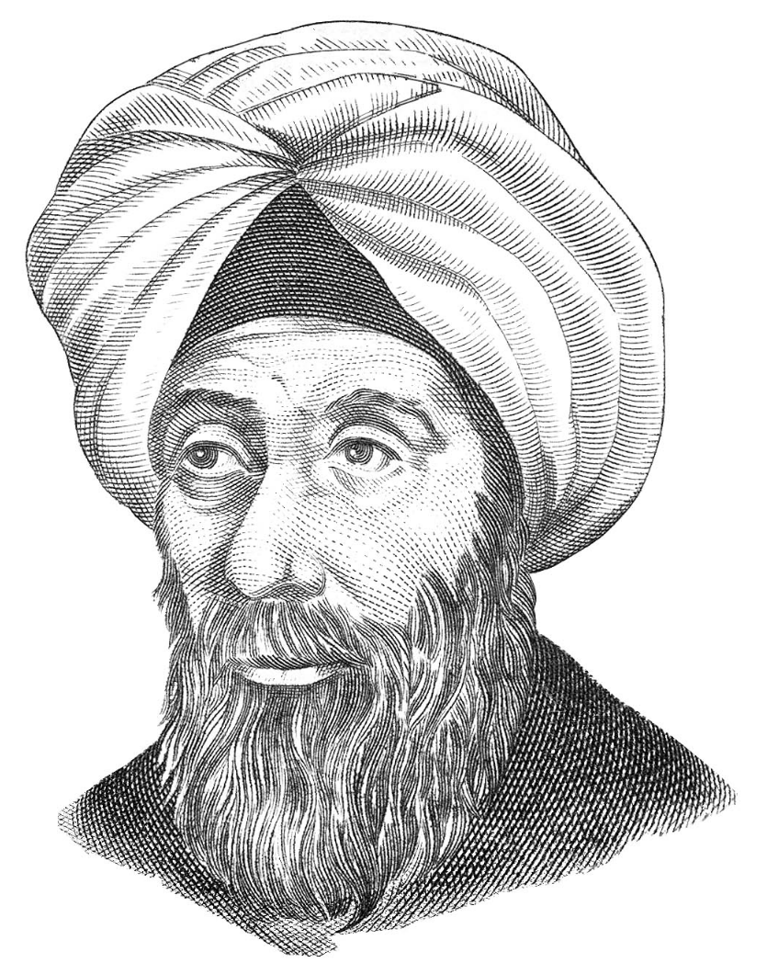
For example, “the Scientific Method”
Science is defined by the Method, arguably.
Empiricism was first strongly advocated by:
al-Haytham (C11th), “Therefore, the seeker after the truth is not one who studies the writings of the ancients and, following his natural disposition, puts his trust in them, but rather the one who suspects his faith in them and questions what he gathers from them, the one who submits to argument and demonstration, and not to the sayings of a human being whose nature is fraught with all kinds of imperfection and deficiency”
Roger Bacon (C13th) – before the Francis Bacon we often credit with The Method – cited a number of scholars in Arabic, including al-Haytham [as “Alhacen”] as his influences, among others.
Notes:
It’s worth noting that Arab thinkers in general were much keener on criticising ancient Greek “classics” like Ptolemy, Plato and Aristotle than Western natural philosophers were [at least after the Church decided that Aristotle was compatible with Christianity] – which is possibly why it took until C17th and Francis Bacon for empiricism to “stick” in the West. There’s quite a lot of even early Arab golden age stuff with titles like “Problems with Ptolemy”…

Slide 11
For example, “Calculus”
Calculus has a prestigious founding-myth role in the self-image of Western Science.
However, much of the meat of calculus was being done hundreds of years earlier in India, mostly in astronomy contexts, e.g.
Bhaskara uses the fact that the rate of change of a variable is zero when its value is extremal in C12th, along with the differential relationship between sin and cos
Madhava (C14th) derived (infinite) power series (complete with error terms) for trigonometric relations using differential relationships
There’s weak evidence that some of these ideas filtered into Europe from India (but even if they didn’t, this counters the “linear” model of Scientific Progress) – and “became” integral-differential calculus over 100 years of work, which Newton and Leibniz were only responsible for the final bits of.
Notes:
al-Haytham, from the previous slide, had derived the “Riemann sum” for an integral power several centuries earlier – and in general various proto-integration methods of various sophistication turn up worldwide throughout history.
[This wasn’t a problem to Indian mathematicians because they didn’t work on an implicitly Platonic model of mathematics in the first place. In fact, Western mathematicians seem to have been uniquely resistant to “non-physical“ numbers and mathematics – even up to the 17th C, there were otherwise respectable mathematicians in Europe decrying the nonsensical idea of “negative numbers”, for example] It’s also worth noting that Leibniz, at least, was a keen Sinophile and collected texts from across the world if he heard of them… so if anyone could have had access to ideas from outside Western Europe, it would have been him.

Slide 12
"But Science is objective"
"I don't even see colour"
Science, as a cultural construct, tends to claim the objectivity of its results as also a trapping of its own narratives.
As a result, we also tend to not like talking about scientists as human beings, in human societies.
We also don’t talk about how science (esp. physics) is used.
This blinds us to the biases we do have in the way we present science.
If you never talk about something in the text, all you do is give people no way to interpret the subtext.
Notes:
Not talking about Scientists as people also tends to make it harder for students to think of themselves as potential scientists – because they’re imperfect human beings. Treating science as a product of real, imperfect people – who even did things that we disapprove of today, or who had viewpoints different to ours – is important!
When I was an undergraduate, I managed to see Joseph Rotblatt speaking on the ethics of physics research (and the need for a Hippocratic Oath for non-medical scientists). I still think this is important – especially considering the technological arc of the 21st C…

Slide 13
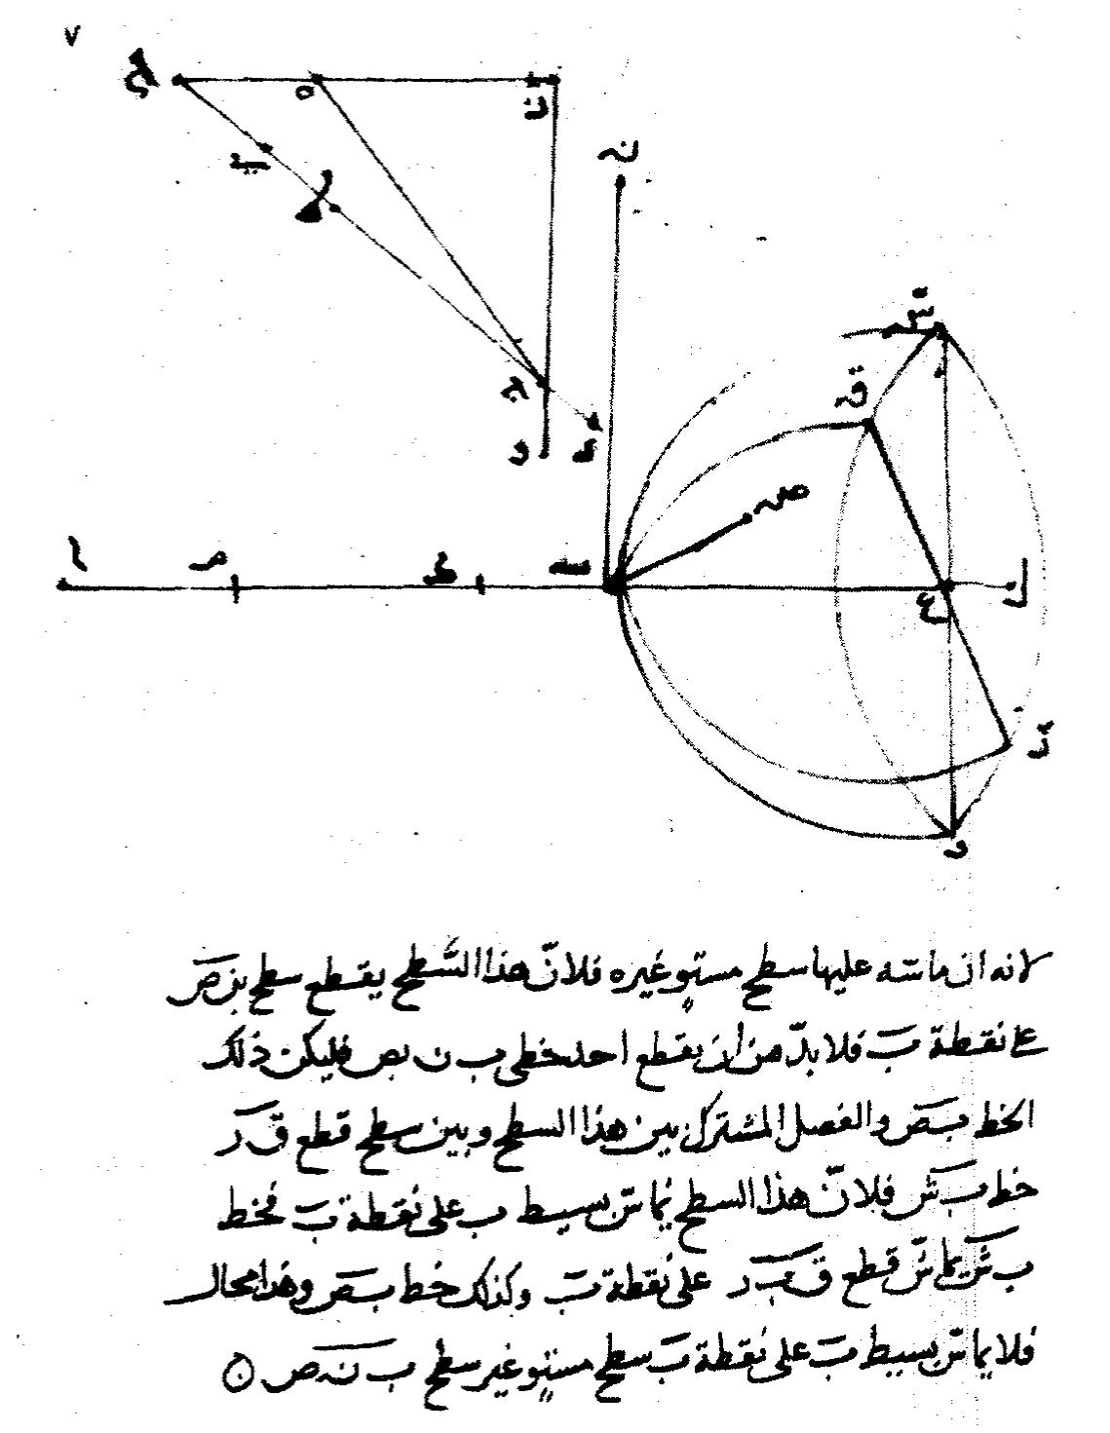
An example of subtext: naming things
We like to name things after scientists. Often, these scientists didn’t actually invent or discover the thing, or co-discovered it.
“Gaussian elimination” – Carl Friedrich Gauss never even claimed to have invented this, he just presented it well.
Actually ancient – known to Chinese mathematicians by 179AD at the latest.
“Snell’s Law” – first discovered by Abu Sa’d al-Ala ibn Sahl in 984! (Even in the West, first discovered by Thomas Harriot!)
“Fermat’s Principle” – this is a strengthening of al-Haytham’s (C11th) empirical observation that “light takes the easiest path” with a mathematical pre-calculus justification. (Fermat was aware of “Alhacen” and cited him)
Notes:
This may seem trivial, but it affects how students see science as working. (and we should also *talk* about issues of how credit is given for research and discovery, versus how research is actually done)

Slide 14
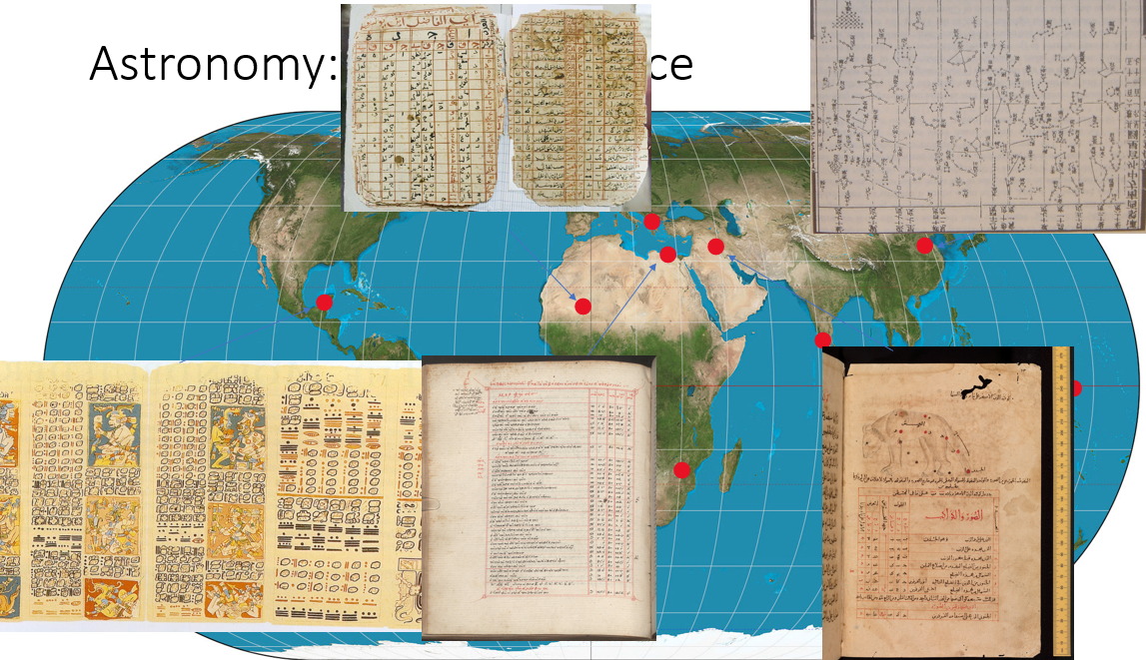
Names imply history…
By not talking about this, we give the impression that Science was created entirely by Western thinkers, either:
Ancient Greeks (some who lived in Egypt…)
Western Europeans c1500 or later
(We also tend to use only “last name”, which elides gender signifiers etc)
In actual fact, “Science” developed across the world (outside of the Americas¹, via interchange between Europe, the near East, India, China and north Africa) from 4000BC to the present day – the focus just changed over time (and sometimes things were lost and rediscovered)
¹It’s hard to say how sciences developed in the Americas because a lot of records were destroyed by Spanish colonialists…
Notes:
As an example, this is a slide from a talk I gave to PhysSoc last year, showing places where astronomy was developed across the world, with samples of the written records where they exist.
Ptolemy's Syntaxis Mathematica ("Almagest")
Kitab Suwar al-Kawakib by al-Rahman ibn Umar
Star Atlas by Su Song
Astronomical tables from the Dresden Codex
Star tables from the Timbuktu Manuscripts project (Mali Empire era)

Slide 15
An example of subtext: academic writing!
Formal academic writing is constructed on the basis of Western (scientific) rhetoric (which we generally don’t teach explicitly anymore)
Other cultures have their own rhetorical structures and modes of argumentation, which students from those background will be implicitly skilled in. (And may be marked down for using over Western methods)
Physics doesn’t do a lot of essay-writing marking as a fraction of its assessments, but… we do have a lot of lab reports.
Notes:
For example, although I’m not sure if it’s taught any more, the traditional Chinese model of rhetoric 起承转合, known in English as “Kishōtenketsu” from the Japanese name for it, (“start”, “develop”, “twist”, “conclude”) builds up from an introduction describing the problem, but includes the “twist” (sometimes one or more analogical or metaphorically related scenarios, used to contrast/enhance the main topic) before the conclusion.
There’s a trade-off here – is part of the “value” of a science degree being taught to argue in the “right way” to fit into the “culture of Science”?

Slide 16
Is decolonising the curriculum enough?
Previous examples are about how we present science to students.
But does Science (and Physics) behave in a colonialist way in itself?
That is: does Science act in a place to prioritise Science (and explicitly the Science of people elsewhere) over the (indigenous) peoples of a location?
Arguably… yes.

Slide 17
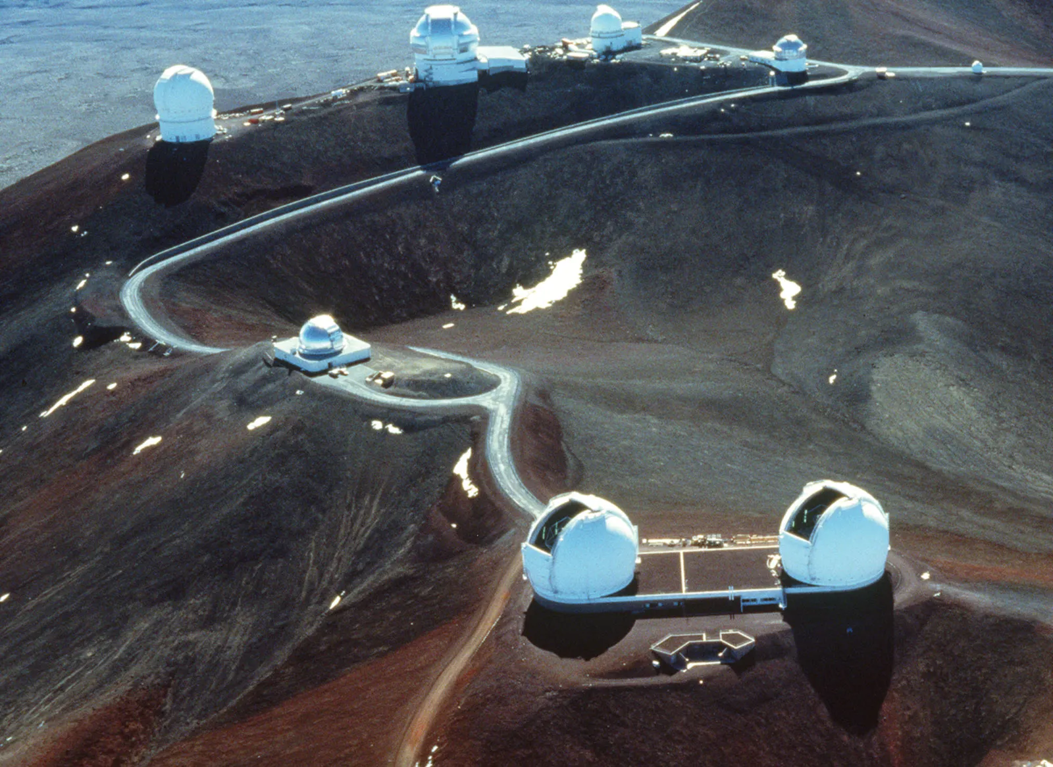
Astronomical colonialism (an example)
Predominantly North American and European astronomers...
… build telescopes historically outside of Europe or mainland USA (Mauna Kea, Hawai'i ; Chile ; Peru )
“Colonial” on two levels:
(explicit) indigenous Hawaiians ignored (until
recently) in favour of science goals
(implicit) How many Hawaiians (indigenous or
otherwise) are authors on papers from the
1970s from the Mauna Kea observatories?
Notes:
It should be noted that, at least as far as “building stuff in the USA on indigenous land”, there are similar historic issues with other Big Science projects.
And this is not to say that “all Astronomers are evil if they use data from these telescopes / are in these consortia”! The point is that we should at least *think* about aspects other than “the science” when we decide on a course of action.

Slide 18
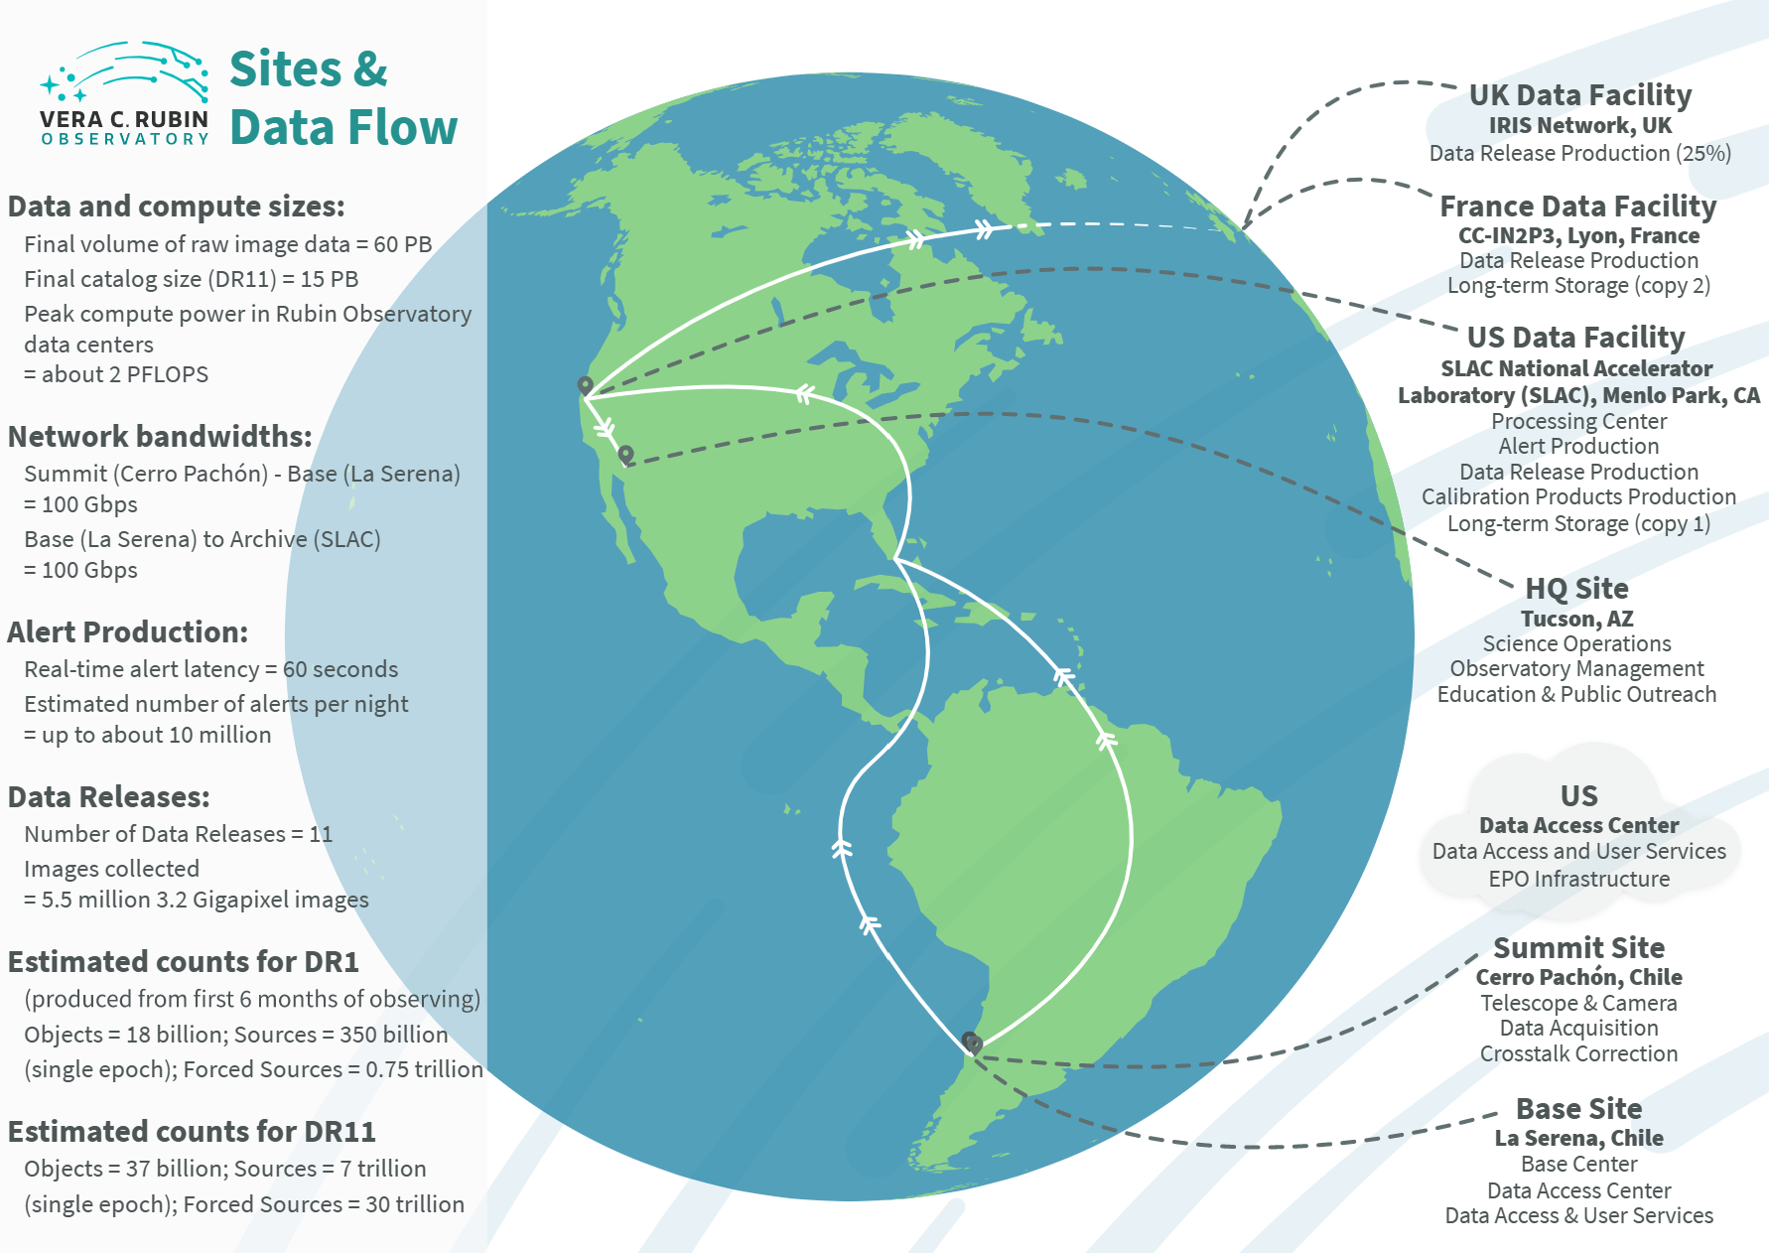
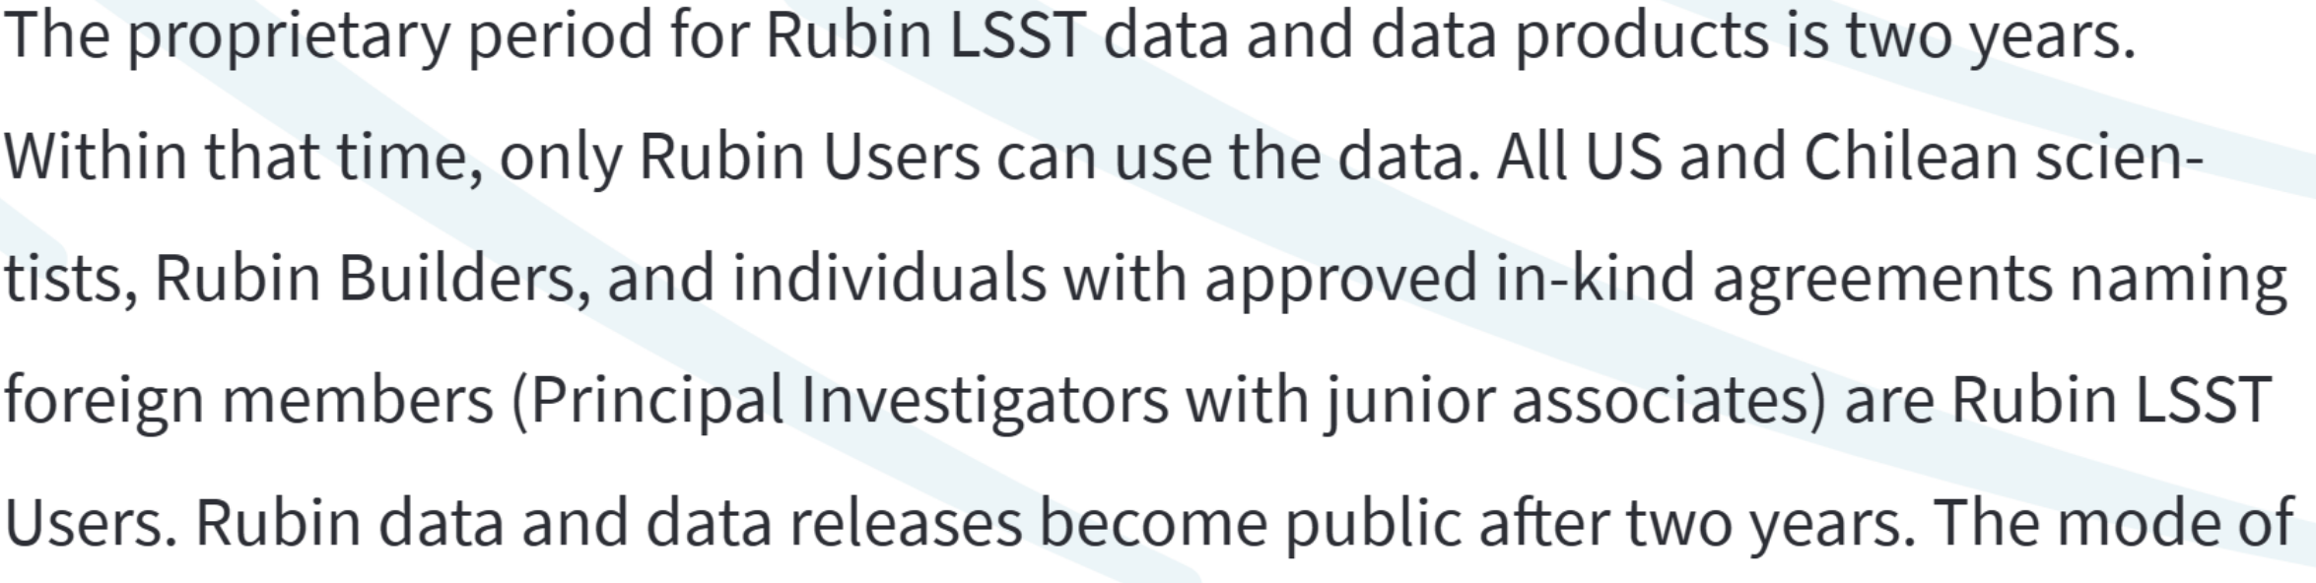
Astronomical colonialism (2)
There is (some) awareness of this in the modern era:
Control of the Mauna Kea Observatory site is now migrating to a joint authority with indigenous Hawaiian representation.
The Vera C. Rubin Observatory does explicitly provide access to its data to Chilean researchers as part of the agreement on hosting the site (although the data products and most of the research science infrastructure is in the USA).
Can (should?) we do even better?
Do we talk about any of this in Astronomy curriculum?
Notes:
We can talk a bit about how much the “land declarations” help – at least they recognise that there are indigenous peoples, although you can easily make a land declaration without actually changing your behaviour at all.

Slide 19
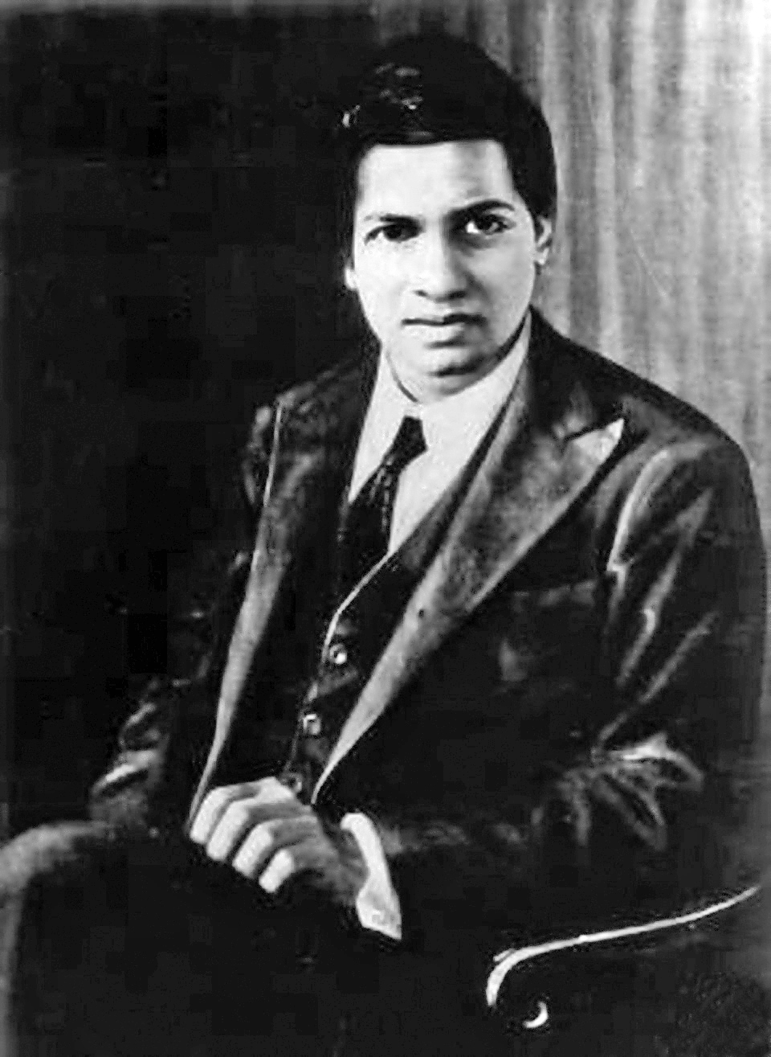
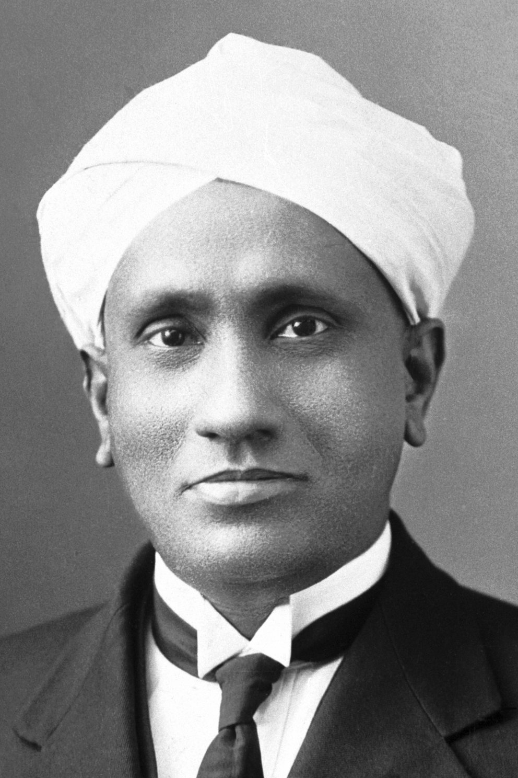
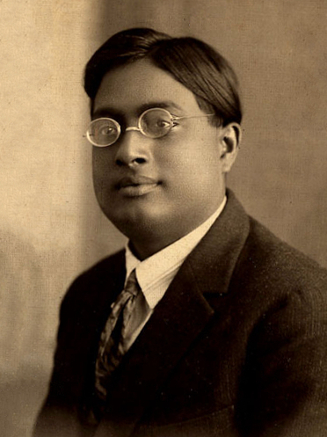
Academic colonialism
People like to cite a number of Indian mathematicians and physicists as counter-examples to colonial attitudes.
(for ex, Srinivasa Ramanujan, C.V. Raman, Satyendara Bose )
However…
They were regarded as “exceptional”
Often, the first thing Western scientists did when they saw their work (often via a letter addressed to them) was to try to get them to move to Europe.
(This worked, eventually, on Ramanujan, but not on Raman)
Notes:
There’s that phrase “a credit to their race”, which goes along with “a credit to her sex”. Also, the racial/colonial construct for India was always “clever people whose civilisation just needs a guiding hand from the British culture”, rather than the position in colonised Africa or the Americas.
In fact, Raman seems to have been generally a proponent of Indian independence – and spent a lot of effort trying to improve research in India (and disliking the Royal Society for inviting him as a “British subject”)

Slide 20
Academic colonialism (2)
This, in itself, is a kind of “colonial” relation with India – it produced local brilliant mathematicians, and the first thought on encountering them was to remove them to the metropole.
(The European scientists in question almost certainly thought of this as helping to recognise the genius they’d encountered, but framing is important)
It’s also worth noting that, for example, Bose never got any share of the Nobel Prize related to his work… although Raman did for his)

Slide 21
So, what can we do about it?
Self-education & reflection
  Much of the subtext we teach is unexamined in the first place – we don’t know what we don’t know, and none of us really interrogate the axioms of our knowledge as much as we should.
  There’s some links at the end of this presentation…
Encourage & support students to critically examine material
  Science is not about rote repetition of facts!
  Also: listen to the students when they do critique things!
Ethical considerations
  Do we need an “ethics in physics” course? (Or at least a “philosophy of physics” course”!)
Notes:
There’s this tension in that we still teach students to “pass exams” + require them to recall knowledge, but actual science advances by critiquing “facts”…

Slide 22
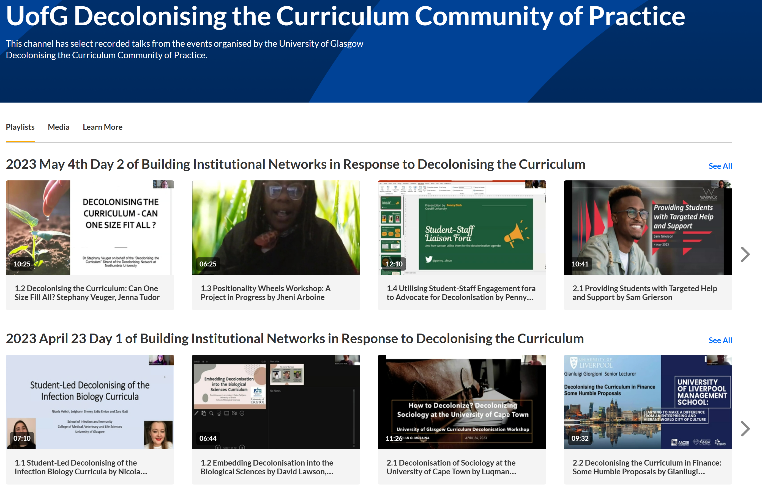
The “Decolonising the Curriculum” Community of Practice
Launched in August 2022 (University of Glasgow - MyGlasgow - MyGlasgow News - News Archive - 2022 - 16 August 2022 - Launch of Decolonising the Curriculum Community of Practice )
Collectively sourced reading list on decolonisation (link at end of presentation)
Organised / hosted a two-part International Workshop “Building Institutional Networks in Response to Decolonising the Curriculum” earlier this year
Videos of the presentations are available here: The University of Glasgow - UofG Decolonising the Curriculum Community of Practice
Other activities planned – a Podcast series (that I think we were hoping to have started by now…)
There’s an open Teams group invite on the top link here if you want to join.

Slide 23
"But there's not enough room in the curriculum"
This begs the question!
The things we put in the course are the things we value most.
If we don't put effort into “decolonising the course”, then it just says that we don't value this highly
  [and the same goes for anything else we don't put into the course that we reject for the same reasons]
Accreditation is, of course, important…
but the requirements for accreditation themselves can be changed over time
Notes:
And they are changed by mostly subject experts deciding what they value most for new experts in their field to know. (As Max Planck once noted “A great scientific truth does not triumph by convincing its opponents and making them see the light, but rather because its opponents eventually die, and a new generation grows up that is familiar with it”, but this is true of other beliefs and practices as well.)

Slide 24
Things happening in P&A and related schools
Colette Mair is developing work to decolonise Statistics [and hopefully is in the room…]
Caroline Muellenbroich & Sarah Croke have been leading Decolonising the Curriculum work in P&A.
  This has produced several literature reviews and surveys taking a critical examination of the history of science with a decolonial bent.
I know several lecturers in P&A (inc Caroline) use padlets (etc) to allow parallel discussion of the context of science in their courses, including about the “human” side of the process of science.
There’s the “mini-biogs” of inspirational Physicists in the lobby area.

Slide 25
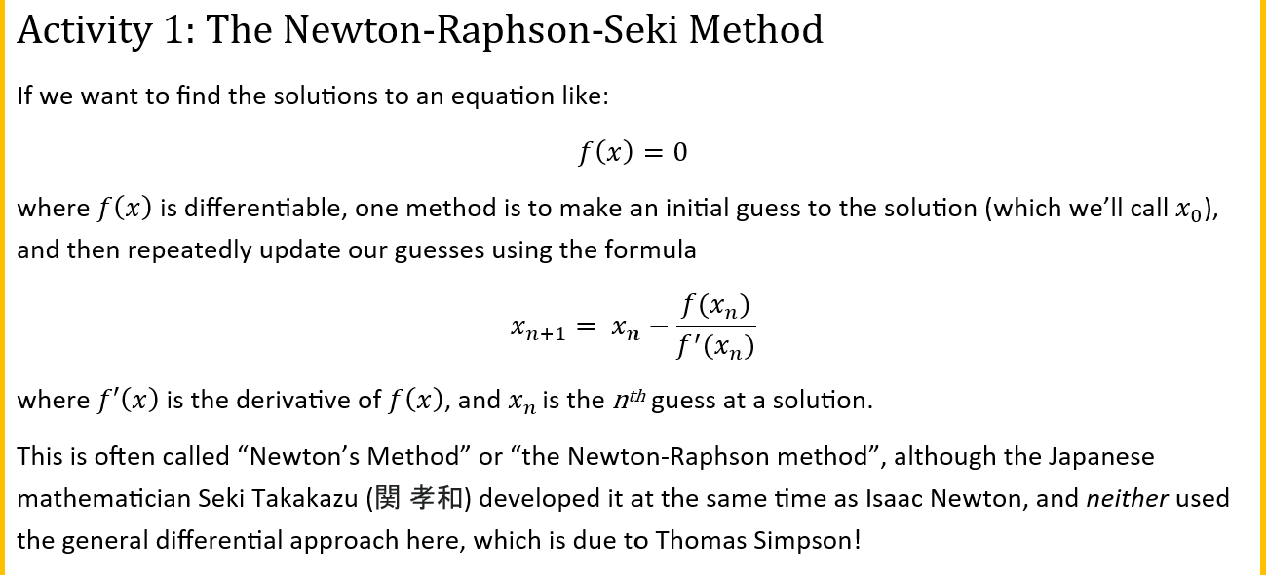
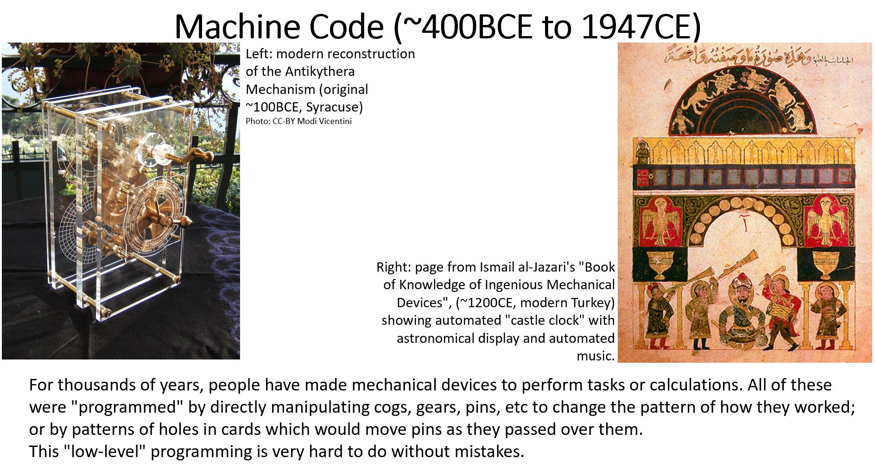
Small things I have done…
I only have control over the content of P2T Labs (which are about introducing computing & programming to students), and some influence over the lecture slides presented.
Justify the material: why is it important to learn this? (Not just “because it’s important”)
Epistemological “corrections”: I explicitly give context to numerical methods and concepts introduced in each lab.
Epistemological “corrections” and context: I put aside ~10 to 15 minutes on the history of computing and physics, with an explicitly decolonial slant in lecture 6.
Trying to encourage people to ask questions freely in labs (this is harder than you think, because people are trained not to do this by their history)
(End of year Q&A “lecture” does work – but needs time for the students to “warm up” – should we move this earlier in the course?)
Notes:
Whilst “getting students to talk more in labs” hasn’t been universally successful, “making time for students to talk through problems” is absolutely helpful to those students who choose to engage in the process.
I’ve also given an invited talk to the student PhysSoc on “Computing and Physics”, which spent some time on the “history of computing and mathematics” with an international slant. (and covered some context for *why* a lot of this stuff was funded in the first place… Artillery, Naval power, “The Atomic Bomb” and so on.

Slide 26
Things I would like to do more of:
Extend the “naming things” bit into more context and discussion about “how” the thing arose (and how it got here from there)
esp. relevant to computing-in-physics as, say, finite-difference methods are much older than “integral calculus” and are how we basically solve most differential equations nowadays…
More on discussion in labs: this is hard because of multiple factors (some students are acculturated to not be active speakers in learning environments, for example).
Think about how to assess students more inclusively and fairly. (This is a balancing act, especially in a programming skills course!)
Notes:
In fact, quite a lot of “numerical methods” has its roots in techniques that are old enough that we’re not sure exactly who invented them (or how many times they were reinvented).

Slide 27
Things that would be nice to do…
Joined up policy on “naming things” across the rest of the curriculum. (If everyone else is still calling “Newton-(Raphson)-Seki” “Newton”, then…)
More time talking about the context of science in general – who and how and why (for who?) was the science you teach done?
Think about the nature of the example problems and contexts you use (where this is applicable). Where do your datasets come from?
Outside the curriculum: think about the wider effects of science you do (and act, as much as you can).
Notes:
The first point here is mostly one of consistency – but consistency is not itself unimportant, students do notice these things…

Slide 28
Introductory Reading List
The Decolonising the Curriculum CoP Reading List https://rl.talis.com/3/glasgow/lists/D36B0836-D7DB-015E-4CE6-4F5507667BDB.html
On what Decolonisation means [in a colonised country]: “Decolonisation is not a Metaphor” Tuck, Eve and Yang, K Decolonization: Indigeneity, Education & Society 1 (2012)
On Mauna Kea and Astronomy: Mountains of Controversy: Narrative and the Making of Contested Landscapes in Postwar American Astronomy; Leandra Swanner (harvard.edu) 2013
On “Indian Calculus” (but note that this is the extreme view against the Western canon): C.K. Raju . Cultural Foundations of Mathematics […]. History of Science, Philosophy and Culture in Indian Civilization Vol. X, Pt 4. New Delhi, Centre for Studies in Civilizations/Delhi (Pearson Education) 2007 ISBN 81-317-0871-3.
On the Islamic Golden Age & Science: al-Khalili, Jim. Pathfinders: The Golden Age of Arabic Science (Penguin) 2012 ISBN 978-0141038360

Slide 29
Online version addendum: Questions Raised
Questions raised in discussion after this talk included:
Should we name theorems/”laws” etc after people at all?
  Issues of social power and “charisma”/self-promotion in the sciences [and it works!]
Ethical ways to do science (or teach science), when even a lot of our equipment is constructed from materials extracted in a colonial way (coltan etc). Should we pay more to be more ethical?
Possibilities of working items in this talk into “science skills” course projects
The inevitable fact that basically all of science goes back to issues of “who’s paying for it [and what do they want to use it for]” (and do we have to approve of that).

